Slide 1
NEST tool, what’s new ?
Nicolas Fuller, LIRA, Observatoire de Paris, Université PSL, Sorbonne Université, Université Paris Cité, CY Cergy Paris Université, CNRS, France
These slides summarize the live demo presented at the NMDB meeting 2025. It was devoted more specifically to recent developments on an interactive interface complementary to the original Nest.
www.nmdb.eu/nest

Slide 2
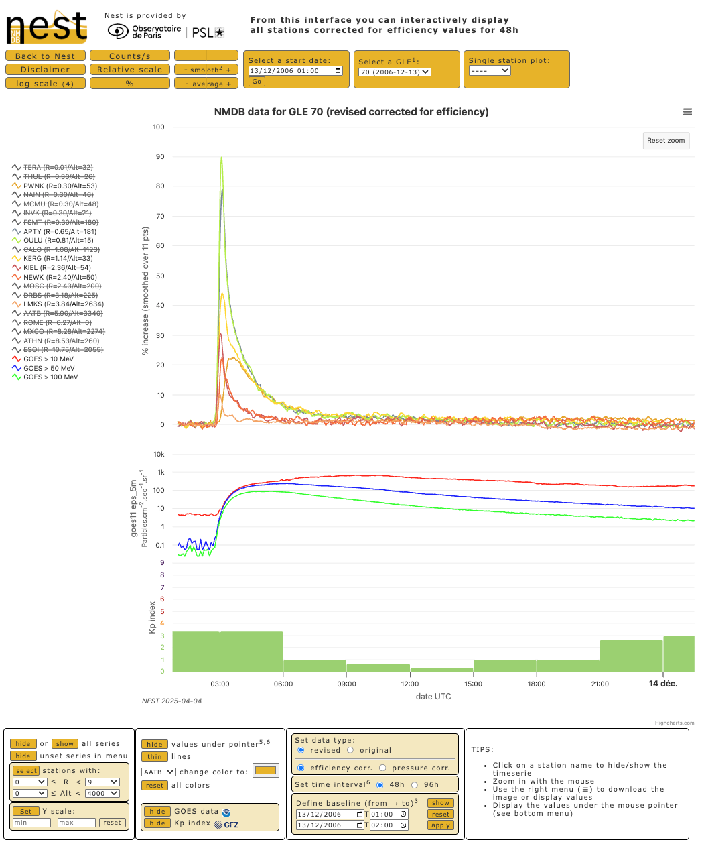
The original Nest works with a form that the user fills in and submits to obtain a graphical representation of the selected data, or in ascii format. A PHP engine is used on the server side.
This new interface is based on Javascript code and the Highcharts library. This means that user actions are managed by their browser (client). The retrieval of NMDB data, however, remains managed by the server, while ancillary data (Kp, Goes) are loaded directly by the client.
The main advantage of this design is that it allows the user to play with the different time series, without having to re-submit a form for each modification. This also means that the fluidity of navigation depends on the performance of the client machine. As all data is loaded when the page is opened, its weight must be limited. This is why the interface currently offers a 48-hour limit, which can be extended to 96 hours via the interface.

Slide 3
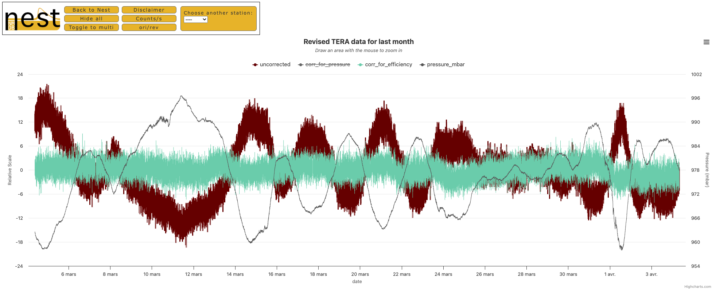
Another page (which doesn't yet have as many options) offers the possibility of displaying data from a single monitor over a longer period (1 month). It allows you to play with pressure data and counts, corrected or uncorrected, revised or original.
A 3rd page, yet to be developed, will represent 1-hour data over the long term.
These pages are not intended to replace the current Nest site, which offers a wide range of possibilities despite its reduced interactivity.
Feedback ! Please let me know about your experiences with the website, any bugs or improvements you think might be useful.

