Slide 1
Neutron Monitor based Approaches of the Incoming Flux Correction for Cosmic-Ray Neutron Sensing of Soil Moisture
Lasse Hertle¹,Steffen Zacharias1, Nicholas Larsen²,
Daniel Rasche³, Martin Schrön¹
¹Helmholtz Centre for Environmental Research - UFZ
²Sodankylä Geophysical Observatory, University of Oulu
³GFZ Helmholtz Centre for Geosciences

Slide 2
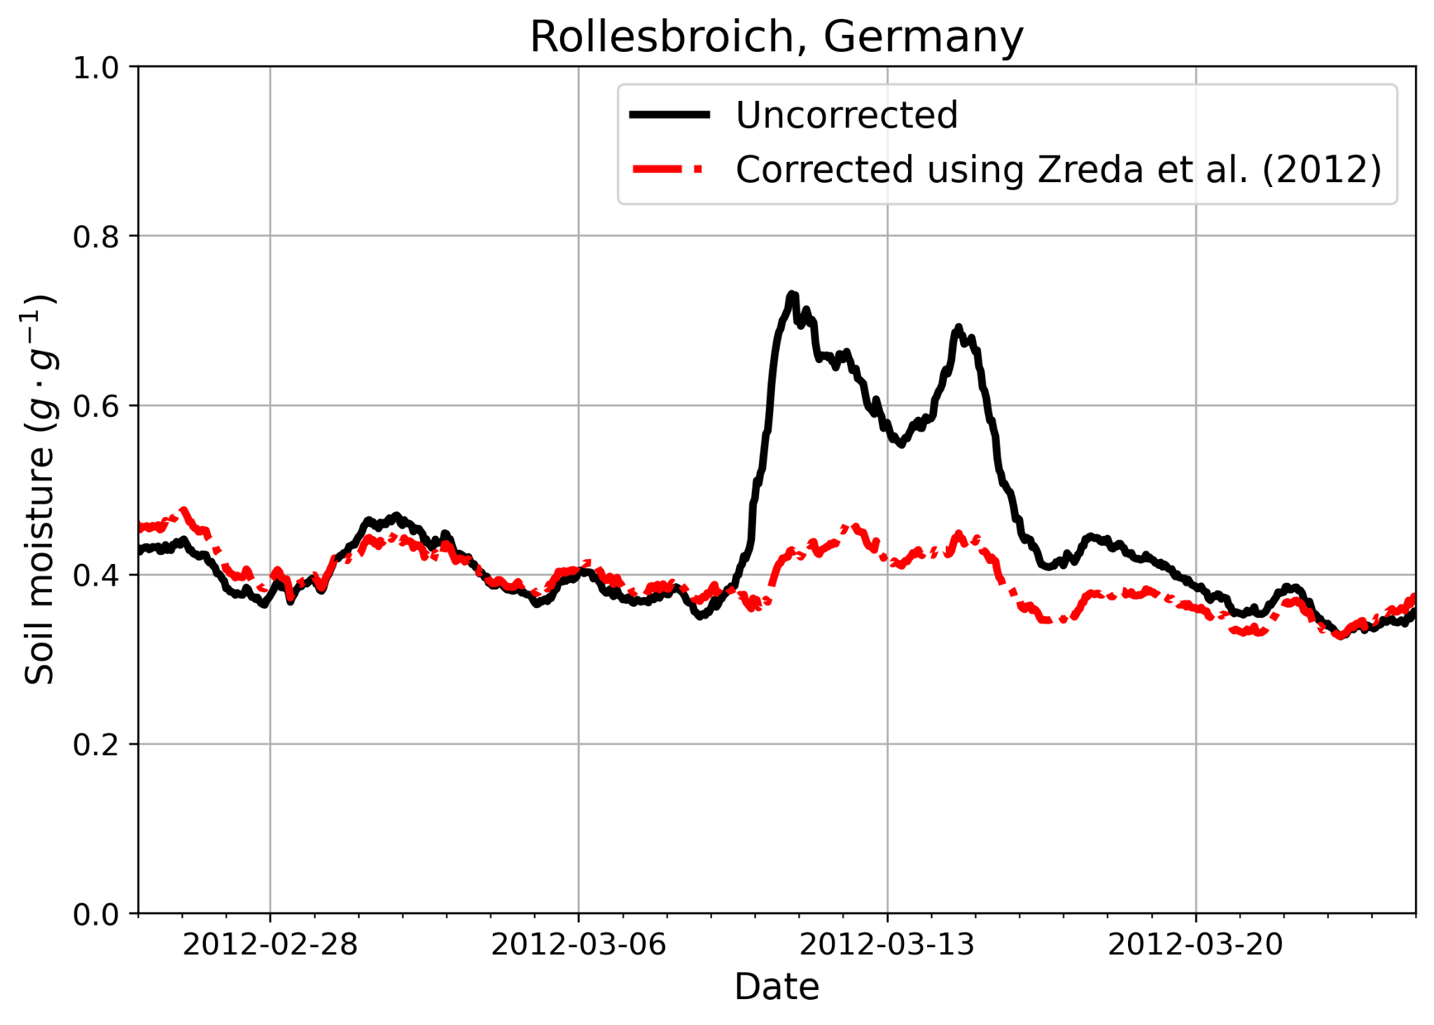
Introduction
CRNS is a technique to measure water content in soil or
snow (SWC) through the measurement of epithermal
neutrons. These epithermal neutrons stem from cosmic-
rays impinging on the atmosphere
CRNS is a technique to measure water content in soil or snow (SWC) through the measurement of epithermal neutrons.
These epithermal neutrons stem from cosmic rays impinging on the atmosphere. Thus, the SWC measurement is sensitive to changes in the ﬂux of cosmic rays.
If the solar cycle is not accounted for, then the monitored SWC will increase during solar maxima and decrease during solar minima
A Forbush decrease can also cause a drastic change in the observed soil moisture if left uncorrected, as shown on the right.

Slide 3
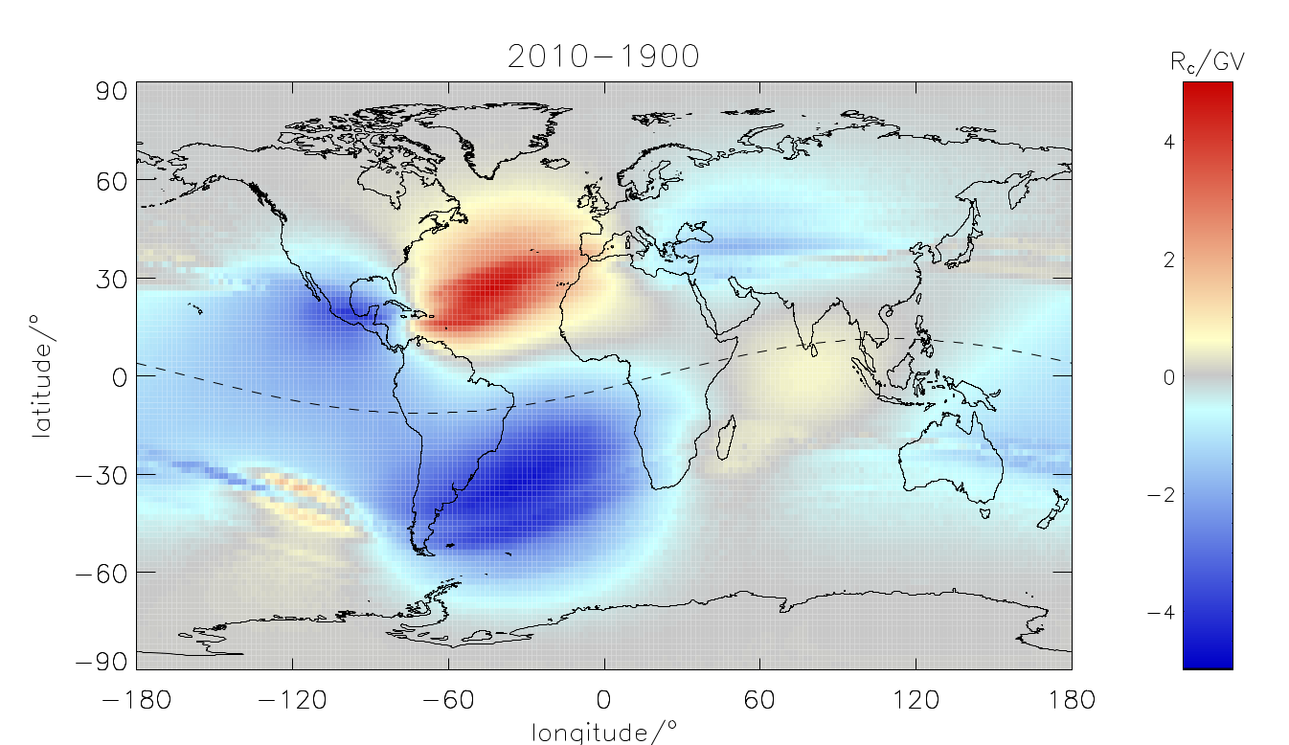
Correction Methods
The correction is most commonly done using neutron monitor data M and a scaling factor τ.
Three distinct methods for calculating τ have been proposed:
τ = 1 by Zreda et. (2012)
linear dependence of τ on cut-off rigidities by Hawdon et al. (2014)
τ as a Dorman function of rigidities and linear in atmospheric depth by McJannet and Desilets (2023)
All these methods assume τ to be constant in time yet the geomagnetic field changes over time.
An example, taken from Herbst et al. (2013), shows the strong dynamics of cut-off rigidity in different regions.

Slide 4
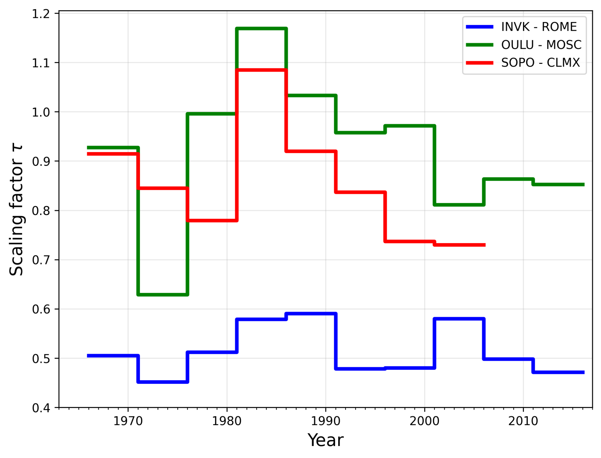
Alternative Correction Methods
Inclusion of Temporal Changes in Rigidity
To include this dynamic in the scaling factor, data from 25 neutron monitors was used to fit for τ between them in five year intervals. Three such combinations are shown as an example. This data set was then used in conjunction with rigidity and atmospheric depth for each station to derive a novel formula for the scaling factor τ_{TMP}.
Model Based Correction - PARMA
PHITS-based Analytical Radiation Model in the Atmosphere (PARMA)is an analytical approximation of extensive air shower simulations developed by Sato (2015). Its input is based on a solar modulation proxy referred to as the W -index. As such PARMA is less dependent on local environmental factors. As an example a day of snow fall at JUNG is shown. On the day of recorded snow fall the signal decreases significantly and rebounds as the snow is cleaned, which is not observed in PARMA

Slide 5
A Correction Complication - Diurnal Variation
Diurnal variations in cosmic-ray measurements are a consequence of the asymptotic cone sweeping through the anisotropic cosmic ray flux. Diurnal variations observed by neutron monitors are shown in a and by three german CRNS sites in b.
If a CRNS site is corrected using a neutron monitor on a different longitude then the diurnal variation observed by the neutron monitor could be corrected into the CRNS signal. To avoid this a simple, sinusoid based correction is introduced, that either removes the diurnal variation or shifts it to the longitude of the CRNS

Slide 6
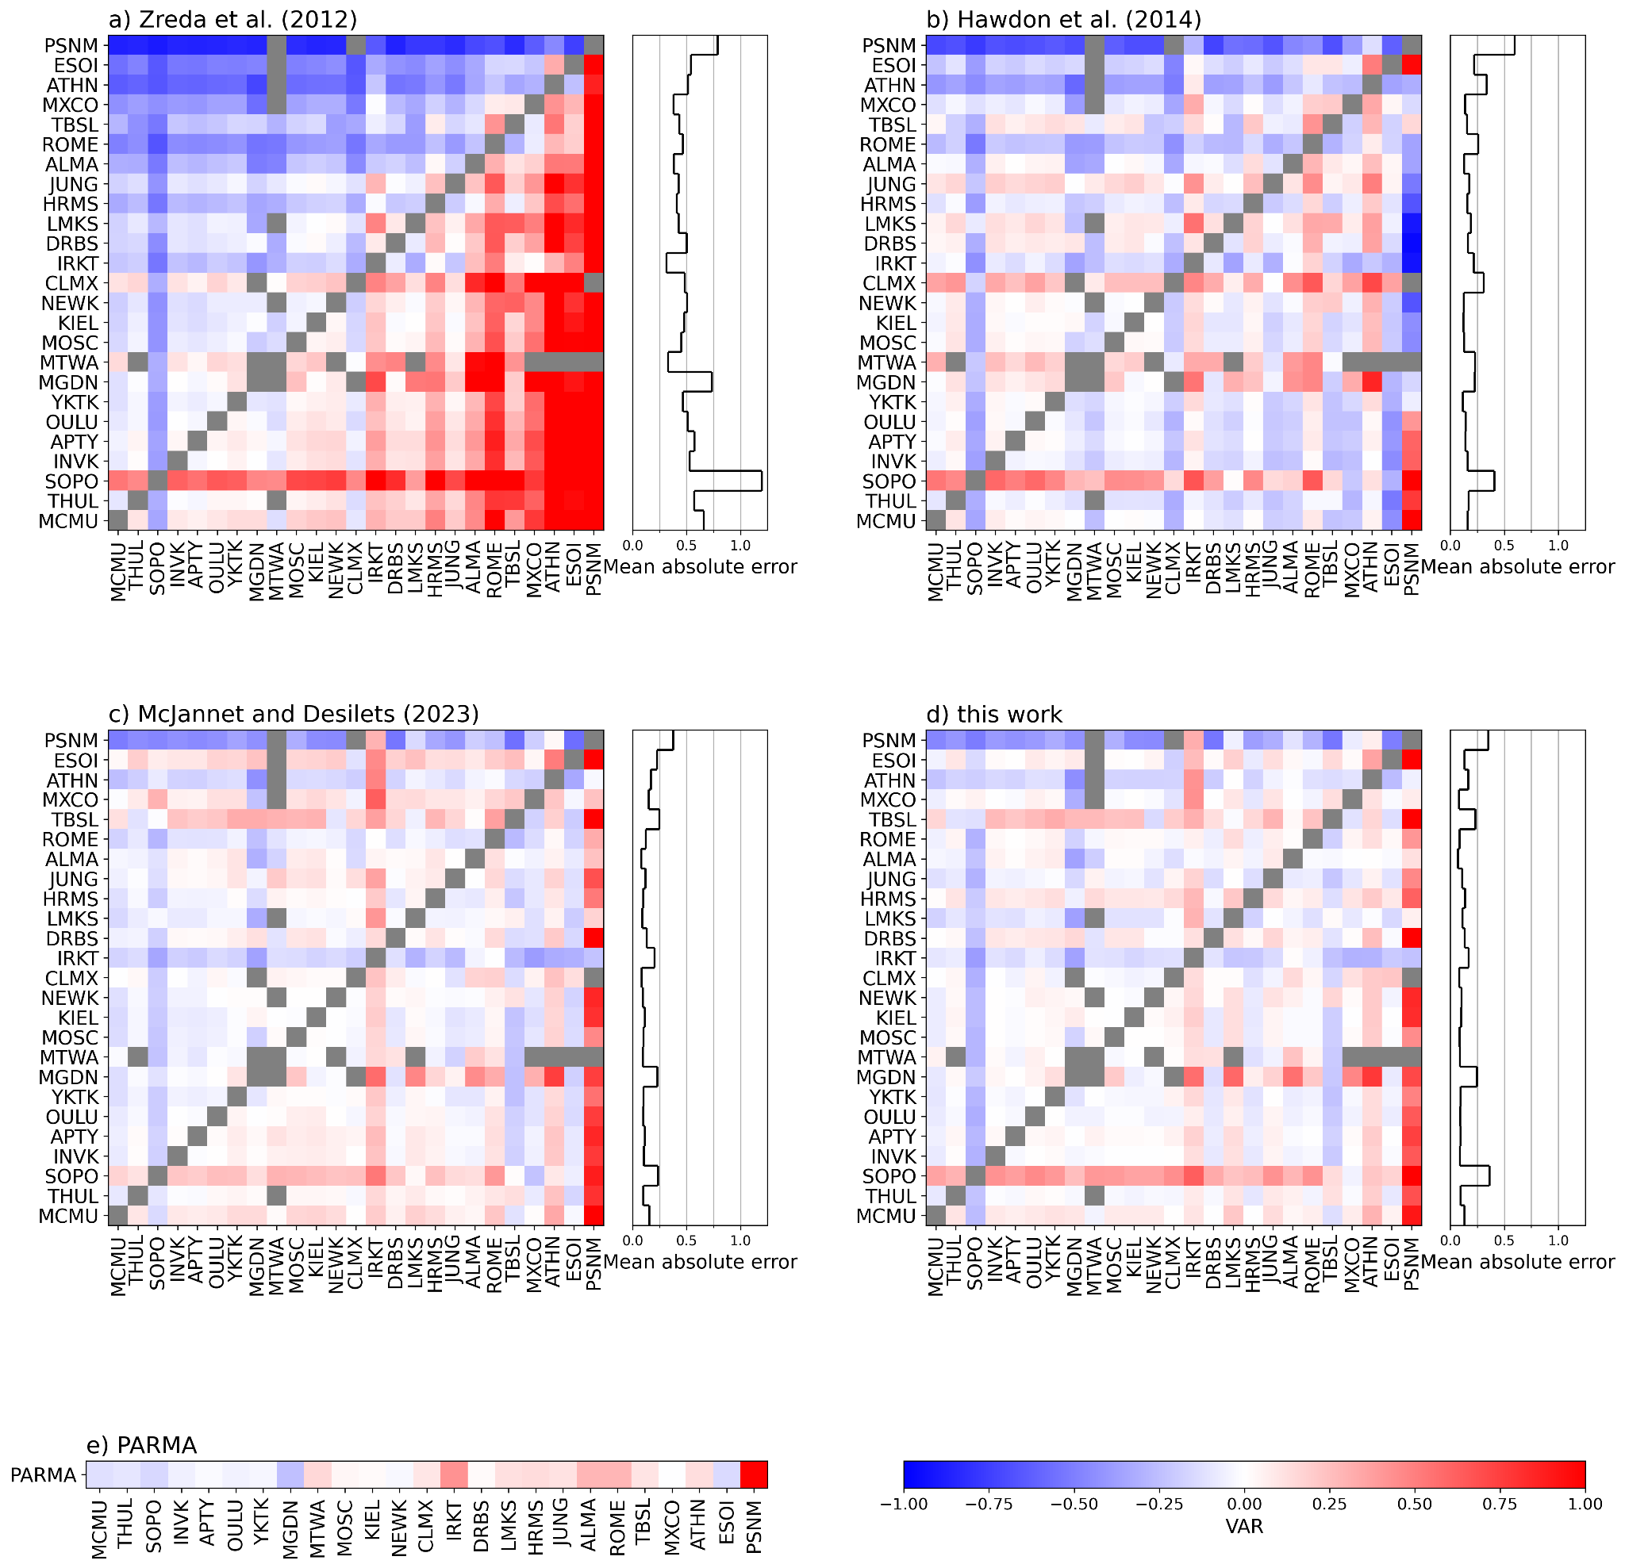
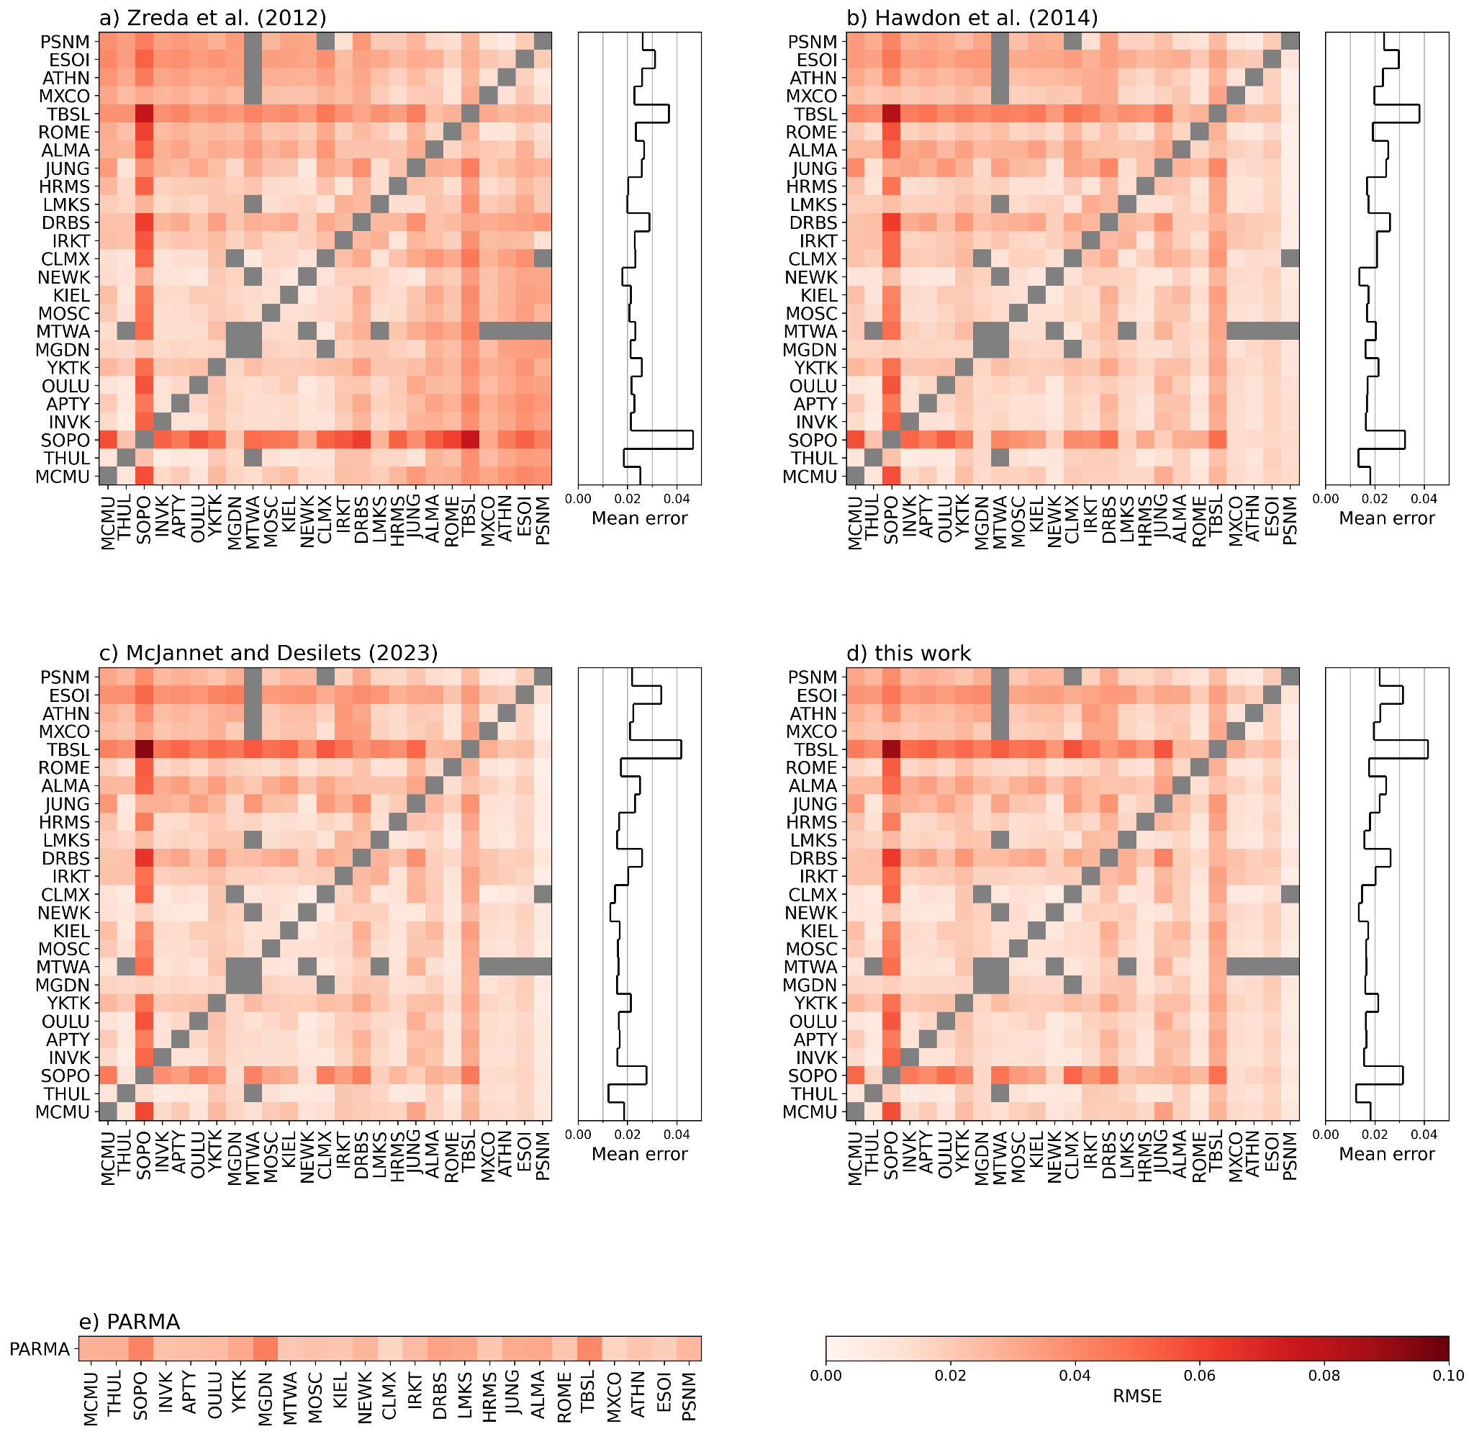
Comparison of Correction Methods - Neutron Counts
The five correction methods are compared in their ability to predict the normalised count-rate of another neutron monitor. To evaluate the prediction RMSE and a measure of variability, VAR are used:
The figures show the result when predicting a station on the x-axis with a station on the y-axis for each correction method. The stations are ordered by increasing rigidity.

Slide 7
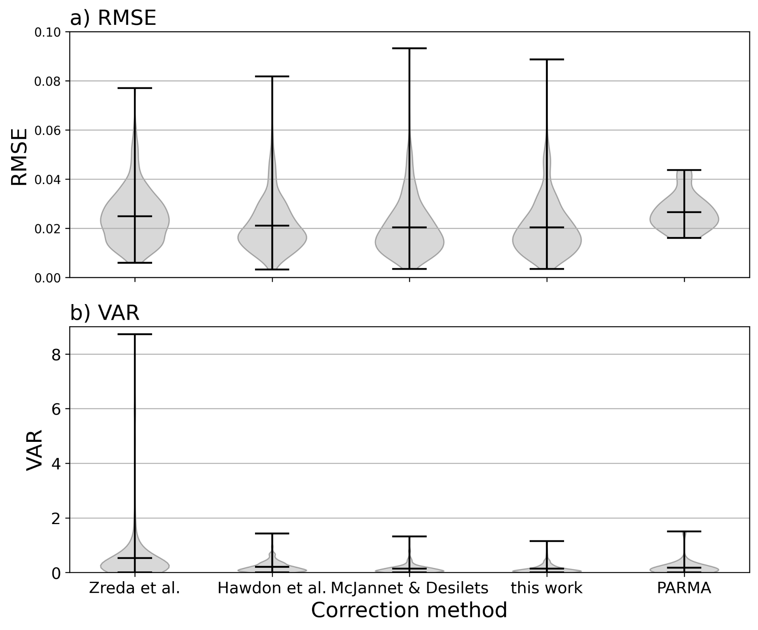
Conclusion
The dependence of CRNS on the incoming radiation is complex. Great care has to be taken when applying corrections.
The lowest error is achieved by using a neutron monitor with a lower cut-off rigidity than the corrected site.
The McJannet and Desilets (2023) and correction method and this work reliably outperform the Zreda et al. (2012) and Hawdon et al. (2014) methods.
PARMA shows robust performance in most cases but performs slightly worse in the mean for RMSE

Slide 8
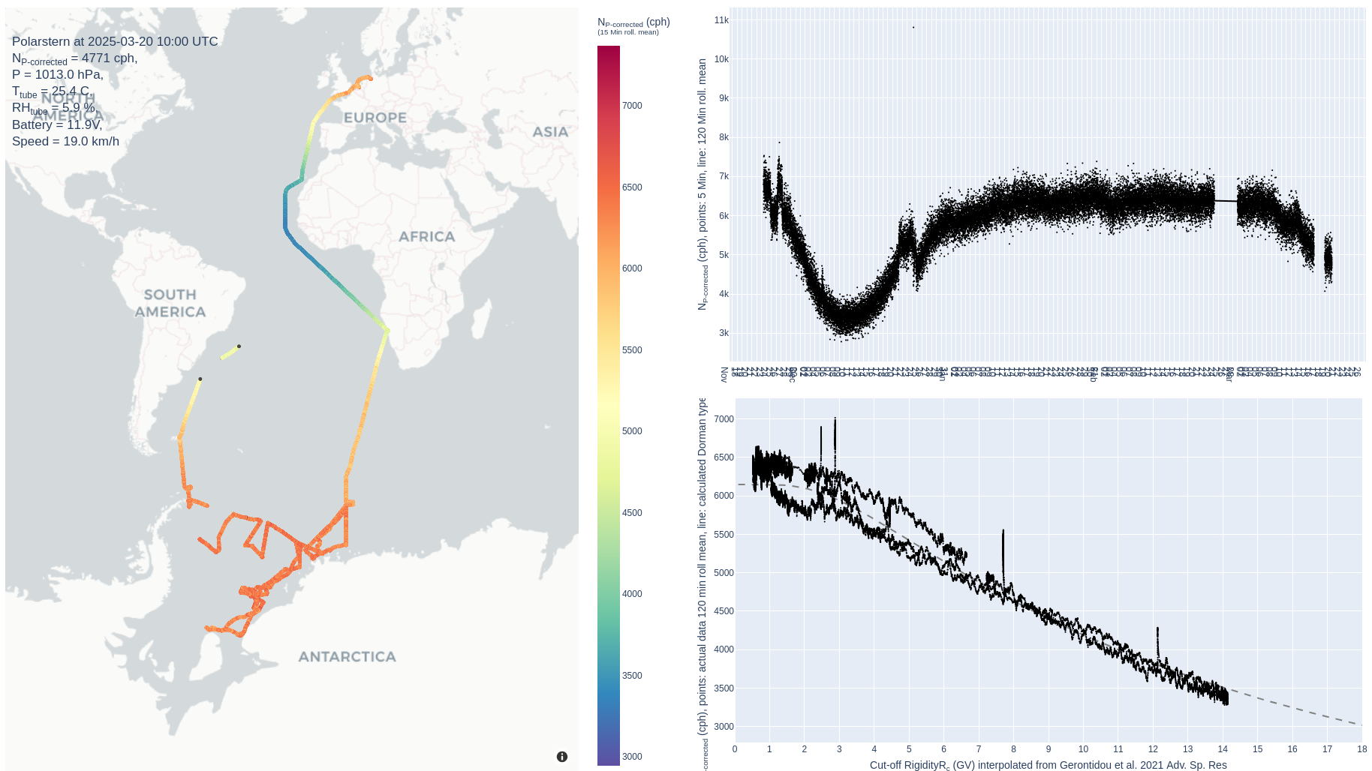
Open Questions
Do we need to account for the spectral difference of neutron monitors and CRNS?
How do we determine whether a CRNS station observed a FD? Which neutron monitor do we use to correct?

Slide 9
8. References and Acknowledgement
Hawdon, A., McJannet, D., & Wallace, J. (2014). Calibration and correction procedures for cosmic-ray neutron soil moisture probes located across australia. Water Resources Research, 50 (6), 5029–5043.
Herbst, K., Kopp, A., & Heber, B. (2013). Influence of the terrestrial magnetic field geometry on the cutoff rigidity of cosmic ray particles. , 31 (10), 1637–1643
McJannet, D., & Desilets, D. (2023). Incoming neutron flux corrections for cosmic-ray soil and snow sensors using the global neutron monitor network. Water Resources Research, 59 (4)
Sato, T. (2015). Analytical model for estimating terrestrial cosmic ray fluxes nearly anytime and anywhere in the world: Extension of parma/expacs. PloS one, 10 (12)
Zreda, M., Shuttleworth, W., Zeng, X., Zweck, C., Desilets, D., Franz, T., & Rosolem, R. (2012). Cosmos: The cosmic-ray soil moisture observing system. Hydrology and Earth System Sciences, 16 (11), 4079–4099
All neutron monitor data has been accessed through the NMDB database (www.nmdb.eu) and (cr0.izmiran.ru) kindly provided by:
ALMA: Al Farabi KazNU, Kazakhstan
APTY: Polar Geophysical Institute, Apatity, Russia
ATHN: Physics Department of the National and Kapodistrian University of Athens, Greece
CLMX and MTWA: University of New Hampshire, USA
DOMC and OULU: Sodankyla Geophysical Observatory, Finland and French-ItalianConcordia Station
ESOI: Tel Aviv University, Israel
DRBS: Royal Meteorological Institute of Belgium
HRMS: Centre for Space Research, North-West University,Potchefstroom, South Africa
INVK, MCMU, NEWK and THUL; University of Delaware, Department of Physics and Astronomy and the Bartol Research Institute, USA
IRKT: Institute of Solar-Terrestrial Physics, Irkutsk, Russia
UNG; Physikalisches Institut, University of Bern, Switzerland
KIEL: Institut f¨ur Experimentelle und Angewandte Physik,Christian-Albrechts-Universität zu Kiel, Germany
LMKS: Department of Space Physics, Institute of Experimental Physics, Koˇsice,Slovakia
MGDN: Institute of Cosmophysical Research, Magadan, Russia
MOSC: Pushkov Institute of Terrestrial Magnetism, Ionosphere and radio wave propagation, Moscow, Russia
MXCO: Cosmic Ray Group, Geophysical Institute, National Autonomous University of Mexico (UNAM), Mexico
PSNM: Princess Sirindhorn Neutron Monitor Program, Thailand
ROME: IAPS/INAF, Rome, Italy
SOPO: University of Wisconsin, River Falls, USA
TBSL: Laboratory of Cosmic Ray, Tiblisi, Georgia
TERA: Observatoire de Paris and the French polar institute (IPEV), France
YKTK: Institute of Cosmophysical Research and Aeronimy, Yakutsk, Russia

