Slide 1
Institute of
Ionosphere
On solar sources of interplanetary disturbances leading to high-energy magnetospheric electron enhancements
in geostationary orbit
Kryakunova¹, B.B. Seifullina¹, I.L. Tsepakina¹, N.S. Shlyk³, A.A. Abunin³,
M.A. Abunina³, A.V. Belov³, N.F. Nikolayevskiy¹
¹Institute of the Ionosphere, Almaty, Kazakhstan
² ³Pushkov Institute of Terrestrial Magnetism, Ionosphere and Radio Wave Propagation (IZMIRAN), Russian Academy of Sciences, Troitsk, Moscow, Russia

Slide 2
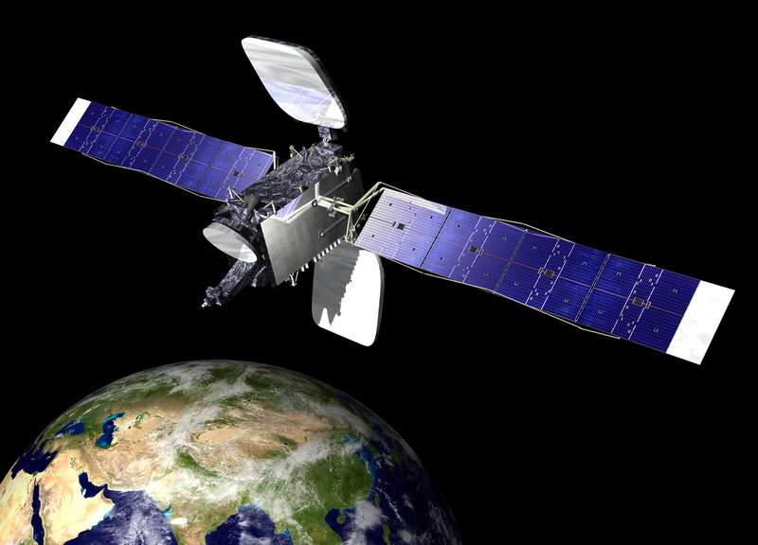
Introduction
The study of relativistic magnetospheric electrons with energies >2 MeV is one of the most important tasks of magnetospheric physics and space weather.
The dynamics of the electron flux behavior is very complex; it can change by some orders of magnitude over several days, depending on the state of the interplanetary and near-Earth environment. Sharp increases and decreases in the electron flux can be attributed to extreme space weather events.
The day-to-day variability of the high-energy electron flux is related to conditions in interplanetary and near-Earth space. Increases in high-energy magnetospheric electron fluxes occur after the arrival of interplanetary disturbances to the Earth with a delay of 1-2 days.

Slide 3
Materials & Methods
To study the behavior of the high-energy electron flux and interplanetary disturbances that caused its changes, various characteristics of the interplanetary and near-Earth environment were used for the period 1995-2023. For this work, it is assumed that the enhancement begins when the daily electron fluence exceeds 10⁸ particles∙cm⁻²∙sr⁻¹∙day⁻¹. For the period 1995-2023, 478 such events were identified.
For all events, we carefully analyzed the state of the interplanetary and near-Earth space several days before and during high-energy electron flux enhancements, as well as solar sources of interplanetary disturbances that led to electron flux increases. It should be noted that determining solar sources of interplanetary disturbances is a rather complex task.
Data used
https://services.swpc.noaa.gov/json/goes/ (the fluxes of high-energy magnetospheric electrons
with energies >2 MeV, measured on the GOES)
https://omniweb.gsfc.nasa.gov/ (SW and IMF), ftp://ftp.gfz-potsdam.de/pub/home/obs/kp-ap/wdc
(Kp, Ap indices), FEID (Forbush Effects and Interplanetary Disturbances, https://tools.izmiran.ru/feid),
https://soho.nascom.nasa.gov/, https://cdaw.gsfc.nasa.gov/CME_list/,
https://ssa.esac.esa.int/ssa/#/pages/home, https://sdo.gsfc.nasa.gov/assets/img/dailymov/,
https://solen.info/solar/index.html, https://solen.info/solar/coronal_holes.html),
https://www.sidc.be/SILSO/datafiles

Slide 4
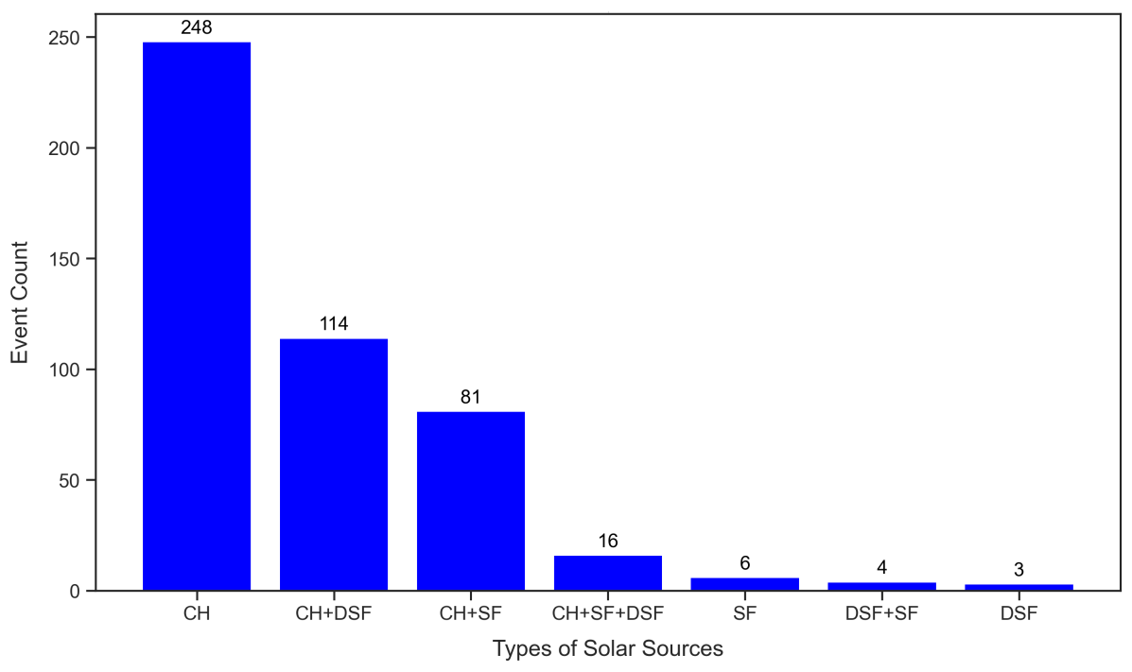
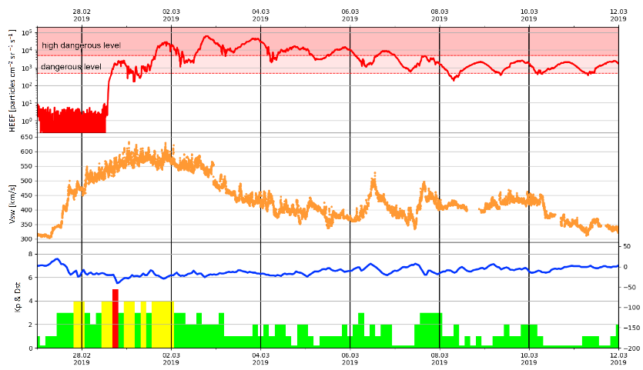
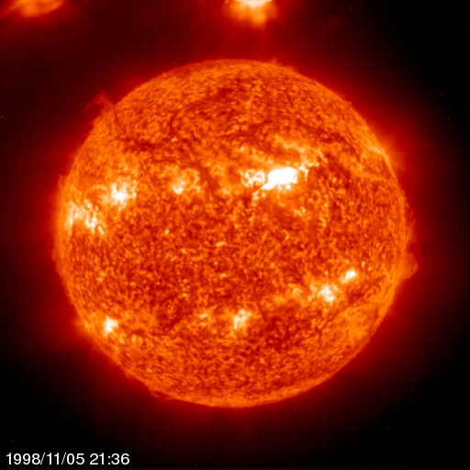
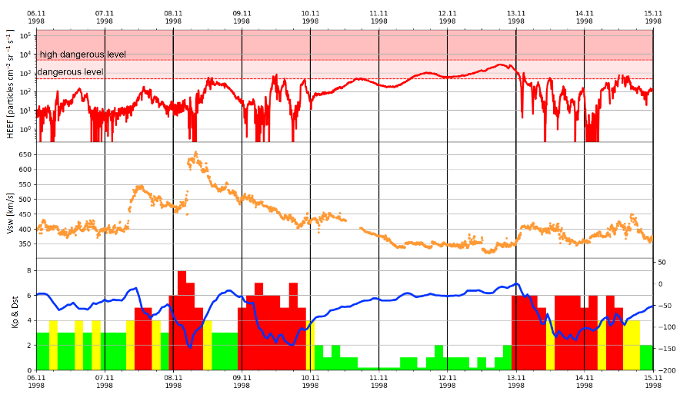
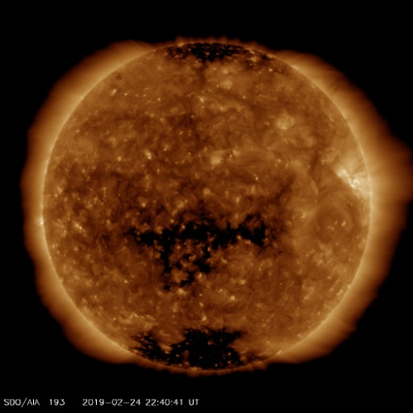
Results
Distribution of the number of electron flux enhancement events depending on the types of their solar sources
It is evident from the presented distribution that more than half of the high-energy electron flux enhancements (52.5%) are associated with the arrival of HSSs from CHs to the Earth. In addition, in another 44.7% of cases, electron enhancements were preceded by disturbances caused by the combined effect of an HSS from CH and a CME.
Solar disc image (SDO/AIA 193 data)
on 2019 February 24
b) High-energy electron flux (upper panel), SW velocity (middle panel), and geomagnetic indices Kp and Dst (lower panel) on 2019 February 27 – March 11
Solar disc image (SOHO/EIT 304 data)
on 1998 November 5
b) High-energy electron flux (upper panel), SW velocity (middle panel), and geomagnetic indices Kp and Dst (lower panel) on 1998 November 6 – 14.
A typical example of an event of the high-energy electron flux enhancement after the arrival of an HSS from CH
A typical example of an event of the high-energy electron flux enhancement after the arrival of a CME after SF.

Slide 5
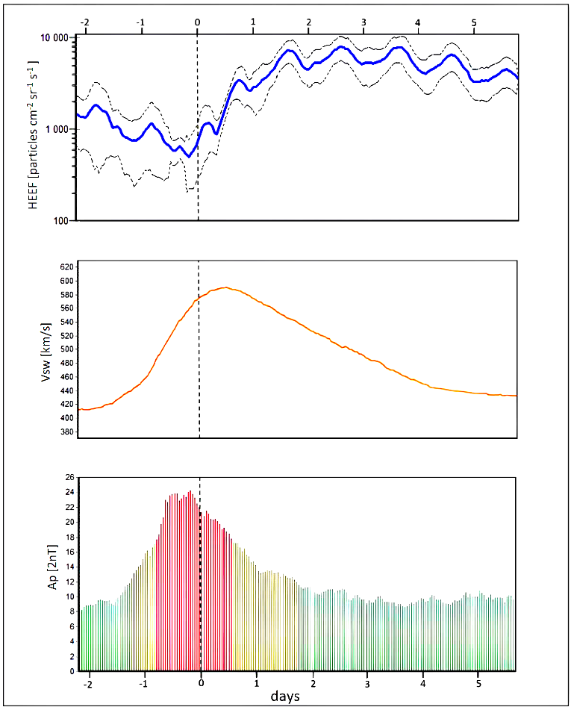
Results
Behavior of the hourly averaged high-energy electron flux, SW velocity and the Ap-index of geomagnetic activity, obtained by epoch superposition method for the high-energy electron flux enhancements after arrival of HSSs from CHs in 1995-2023
Behavior of the hourly averaged cosmic ray density A0, Bz, SW velocity and the Ap-index of geomagnetic activity, obtained by epoch superposition method for the high-energy electron flux enhancements after arrival of HSSs from CHs in 1995-2023

Slide 6
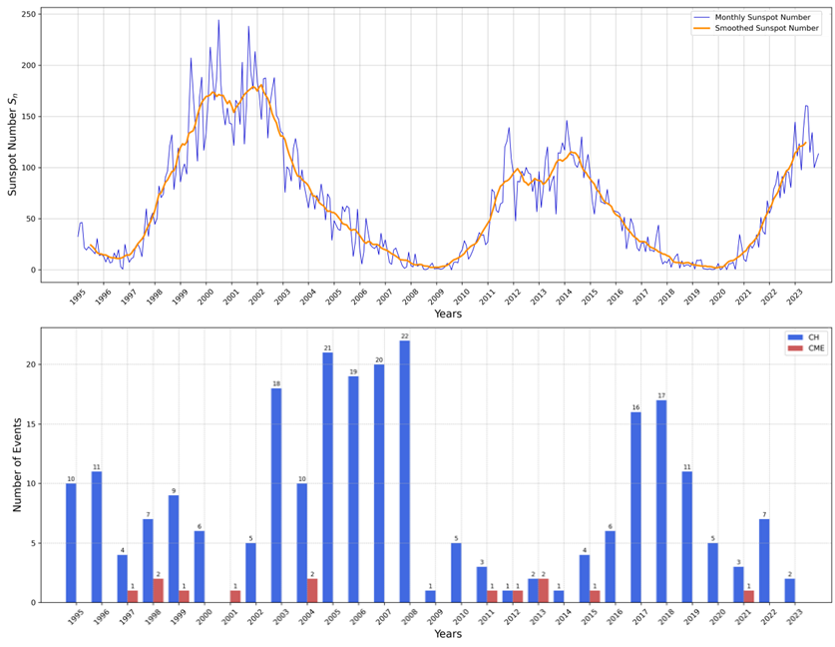
Results
Monthly sunspot numbers with their smoothed values (upper panel) and distribution of high-energy electron flux increases in solar activity cycles depending on its solar sources (blue bars – CH group, red bars – CME group in the lower panel).

Slide 7
Conclusions
Solar sources of interplanetary disturbances, after which increases in fluxes of high-energy magnetospheric electrons with energies >2 MeV occur in geostationary orbit, can be both HSSs from CHs and CMEs after SFs and DSFs.
Of the 478 events of high-energy electron flux enhancements, in 248 events the source of corresponding interplanetary disturbances were only HSSs from CHs, which is 52.5%. In 44.7% of the events the sources were mixed solar events associated with the impact of HSSs from CHs and CMEs after SFs and DSFs.
On average (epoch superposition method data) enhancements of high-energy electrons in geostationary orbit above the dangerous level (>500 particles∙cm^{–2}∙s^{–1}∙sr^{–1}) due to interplanetary disturbances from HSSs from CHs occur when geomagnetic activity increases to the level of a minor magnetic storm and at a high SW speed (V_{sw}= 590 km/s).
The IMF strengthening and geomagnetic activity increase in the CME group significantly exceed the corresponding values for the CH group, however, the mean duration of high-energy electron flux increases after HSSs from CHs is 5 days, and due to CMEs influence – 3.5 days. On average, the electron fluence for the CH group reaches 5.4∙10⁸ particles∙cm⁻²∙sr⁻¹∙day⁻¹, and for CMEs – 3.3∙ 10⁸ particles∙cm⁻²∙sr⁻¹∙day⁻¹, however, such events occur very rarely, in 2.8% of cases of all discussed high-energy electron flux enhancements.
High-energy electron flux enhancements following interplanetary disturbances associated with HSSs from CHs occur mainly during the declining phase of the solar cycle and at solar activity minimum, and rare events following interplanetary disturbances associated with CMEs occur near solar activity maxima.

