Slide 1
Selection of solar-diurnal anisotropy of cosmic rays by local and global methods
NMDB Meeting 2025
Shlyk N., Belov A., Abunina M., Abunin A.,
Oleneva V. , Yanke V.

Slide 2
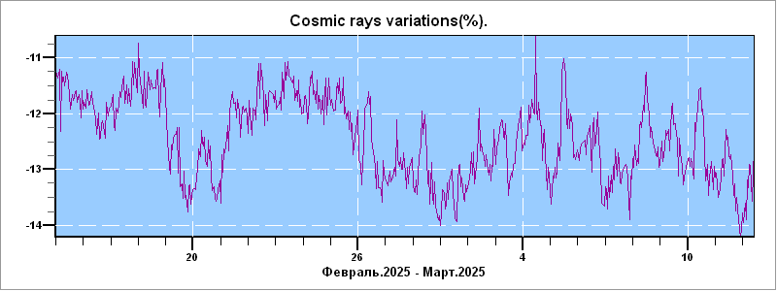
Solar-diurnal anisotropy of CRs
From Thompson (1939), Duperier (1946), Forbush (1969) to present
Manifestations of solar cyclicity (11- and 22-year, 27-day) and Forbush effects
Data from ground-based detectors, ionization chambers and balloons
February-March, 2025
NM Moscow, http://cr0.izmiran.ru/mosc/

Slide 3
Methods of CR solar-diurnal anisotropy selection
3
Local
Harmonic/Fourier analysis of the data from one or several detectors
Global
Modeling on the basis of data from the entire network of NMs
Krymsky et al., 1966; Nagashima, 1971; Belov et al., 1973
Patel et al., 1968; Forbush, 1973; Mathews et al., 1969 …

Slide 4
The purpose
4
To create and describe a method for selecting the solar-diurnal anisotropy of CR flux using the data of Moscow and/or Climax NMs for quiet days from 1953 to 2023
To compare the obtained characteristics with the results of the global survey method (GSM) for 10 GV particles

Slide 5
Main steps
Smoothing the NM count rate
Harmonic analysis
(2 harmonics)
Calculating dispersion between expected and observed variation
Excluding days with large dispersion
Excluding nonlinearity of the isotropic part

Slide 6
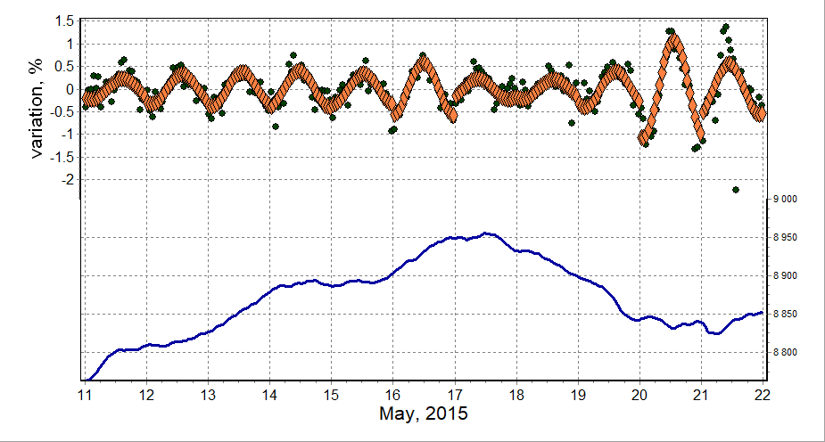
Count rate smoothing and Harmonic analysis
The Moscow NM count rate smoothed for running 24 h (lower curve), the result of harmonic analysis (diamonds) and average hourly deviations from it (count rate variations are black dots)

Slide 7
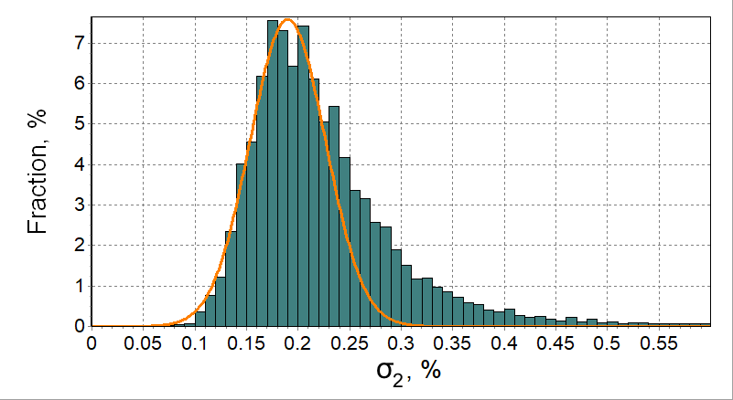
Calculating dispersion and Excluding some days
Exclude ≥0.25%
The distribution of σ₂ values for all days of 1965–2020 in which the hourly CR variation did not deviate from the smoothed average by more than 3%.

Slide 8
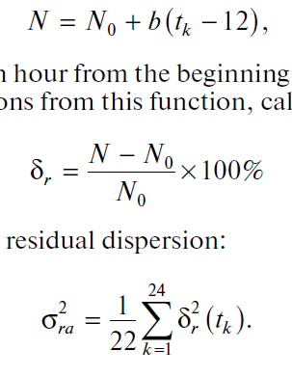
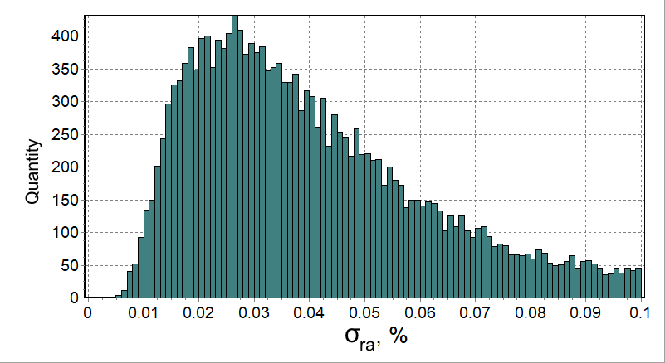
Excluding nonlinearity of the isotropic part
8
Exclude ≥ 0.06%
The distribution of the nonlinearity index σ_{ra}

Slide 9
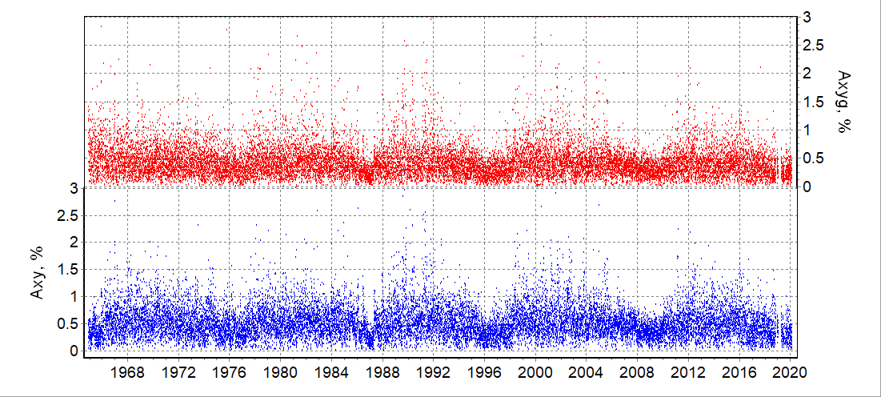
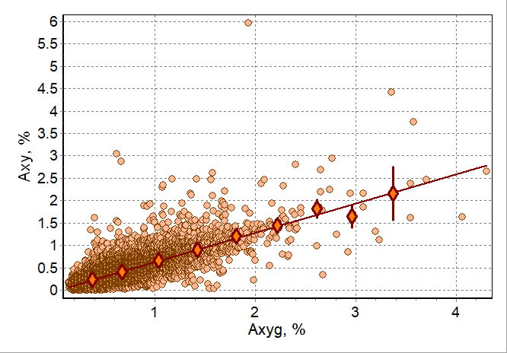
Comparison of the local (NM Moscow) and global (GSM) results: anisotropy AMPLITUDE
C11 = 0.661
(Yasue et al., 1982)
Slope = 0.652 ± 0.004

Slide 10
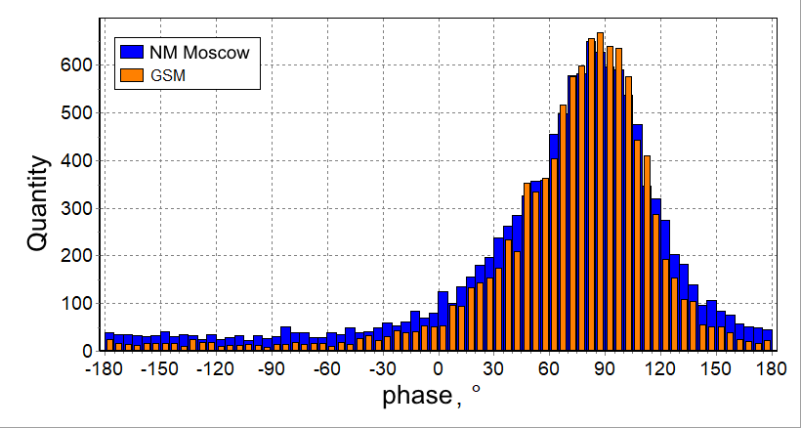
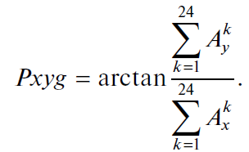
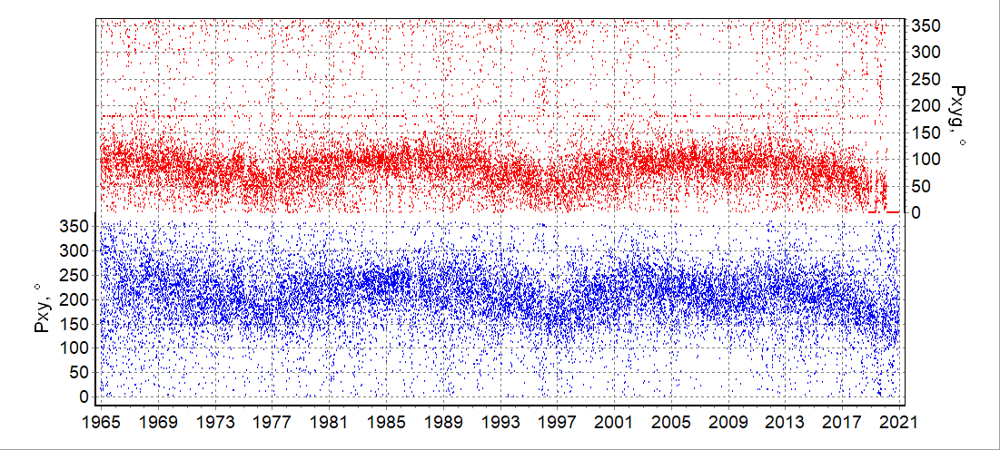
Comparison of the local (NM Moscow) and global (GSM) results: anisotropy PHASE
Shift = 48.1° ± 0.3°
P11 = 51.59°
(Yasue et al., 1982)

Slide 11
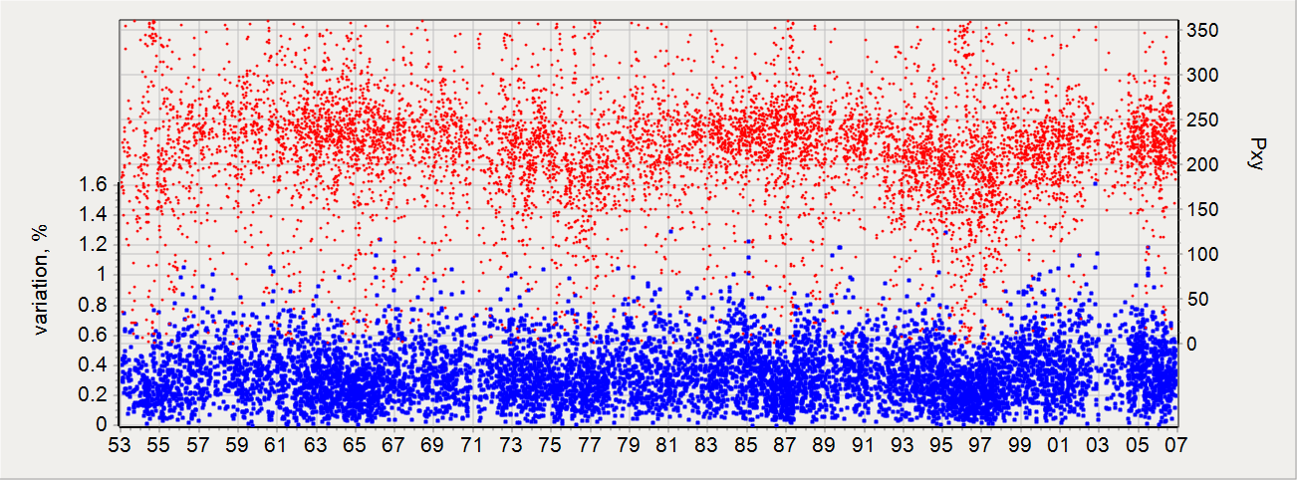
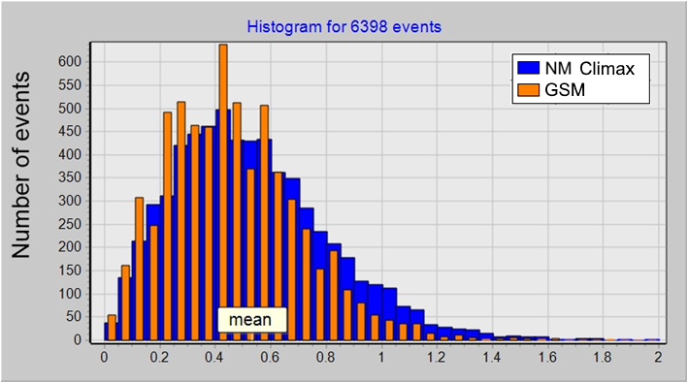
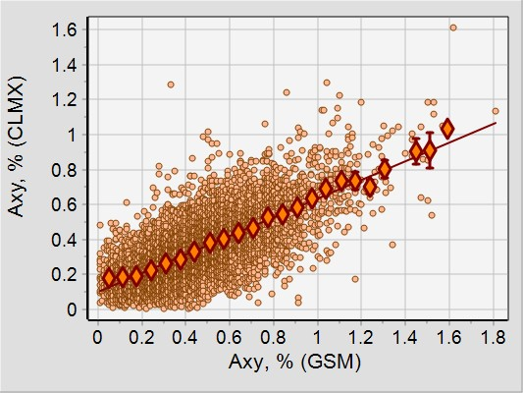
Comparison of the local (NM CLIMAX) and global (GSM) results
Amplitude (blue) and phase (red) of the 1st harmonic of CR anisotropy for NM Climax for quiet days of 1953-2006
NM Climax Axy data in comparison to GSM data

Slide 12
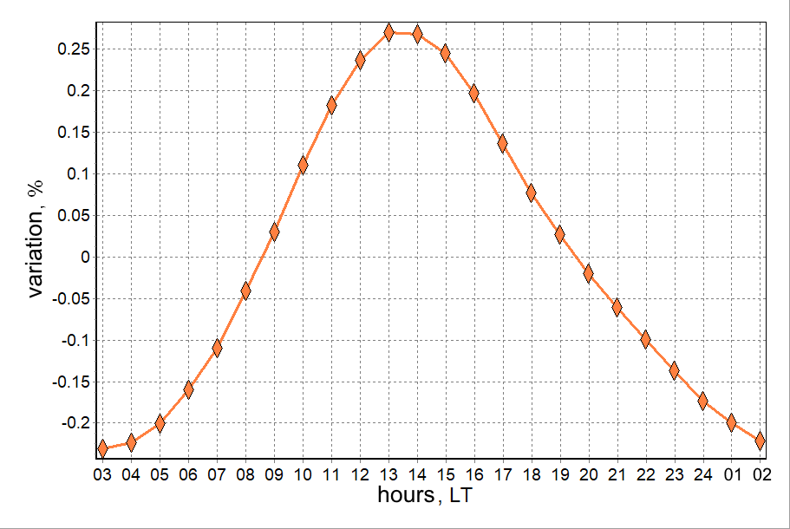
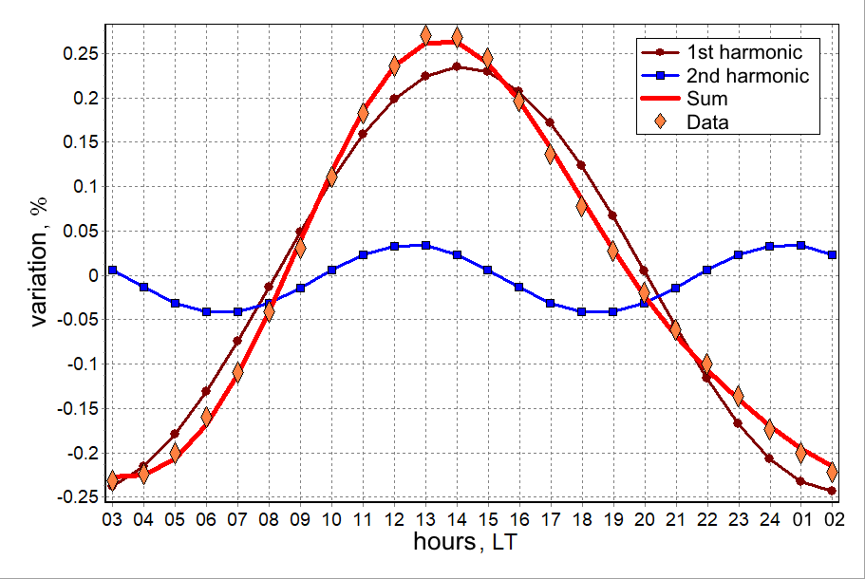
THE AVERAGE DAILY CR VARIATION
 | NM Moscow | GSM
Axy | 0.239 ± 0.002% | 0.362 ± 0.003%
Pxy | 31.9° ± 0.4° | 80.1° ± 0.3°
NM Moscow
NM Moscow
cc = 0.9995

Slide 13
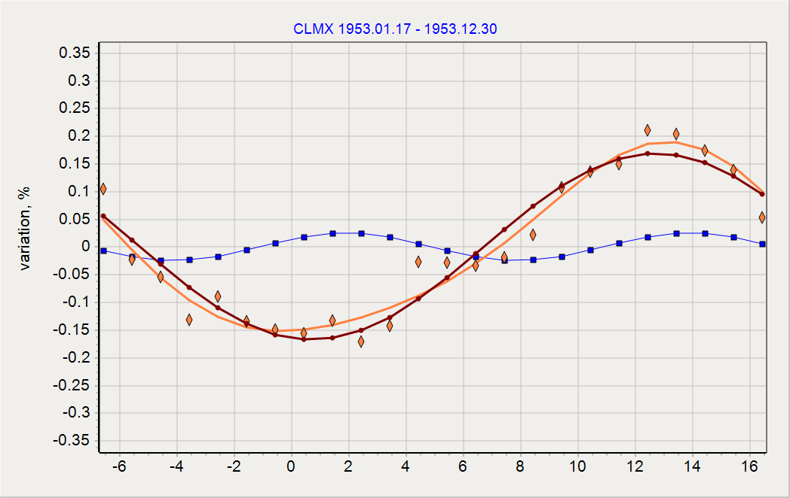
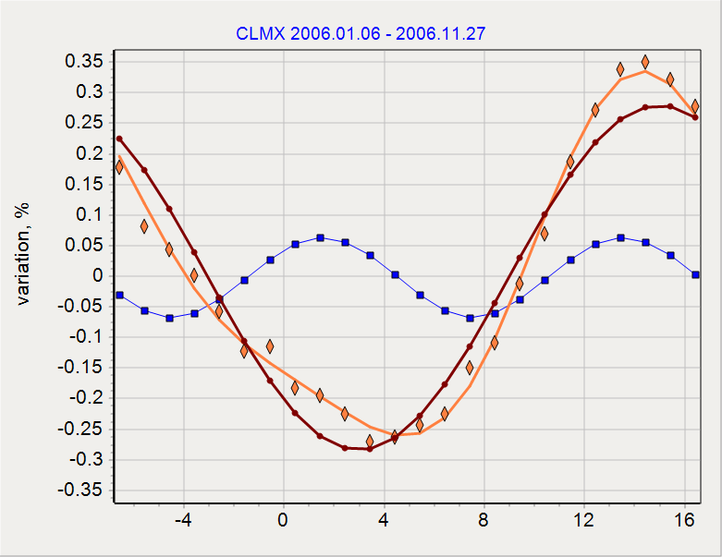
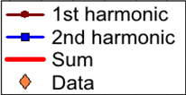
THE YEARLY AVERAGEd CR VARIATION
NM Climax, 1953
NM Climax, 2006
NM Climax yearly averaged Axy data (blue) in comparison to GSM data (red)

Slide 14
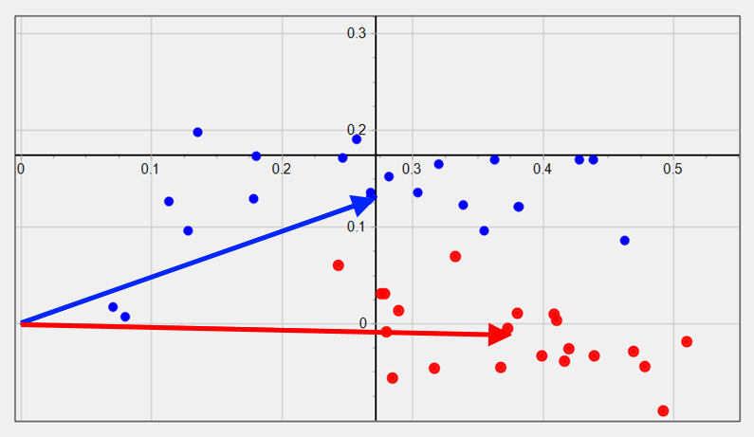
THE AVERAGE YEARLY CR VARIATION
“Coupled vectors” diagram of solar-diurnal CR anisotropy (NM Climax+GSM data)
NM Climax data
GSM data
Average annual values ​​of solar-diurnal CR anisotropy in vector form (dots) and averaged values for periods of the same Sun’s magnetic field polarity (arrows, blue=positive polarity)

Slide 15
CONCLUSIONS
1
The characteristics of the solar-diurnal variation of CRs observed at the NMs Moscow and Climax were obtained on quiet days for the 1953–2023.
3
6
4
5
2
A comparison with the GSM results showed a good agreement.
The average daily and yearly CR variations at the NMs Moscow and Climax are almost completely described by two harmonics of the solar-diurnal anisotropy.
A new experimental method for calculating the coupling coefficients of the first harmonic of anisotropy for individual detectors is proposed.
The global and local methods for selecting CR vector anisotropy are reliable and complement each other.
The main limitation of the local method: during Forbush effects, it does not give reliable results.

Slide 16
THANK YOU
nshlyk@izmiran.ru
A. V. Belov, N. S. Shlyk, M. A. Abunina, A. A. Abunin, V. A. Oleneva, V. G. Yanke, and A. A. Melkumyan Selection of the Solar-Diurnal Anisotropy of Cosmic Rays by Local and Global Methods // Geomagnetism and Aeronomy. – V. 63. – N. 3. – P. 268-282. – 2023

