Slide 1
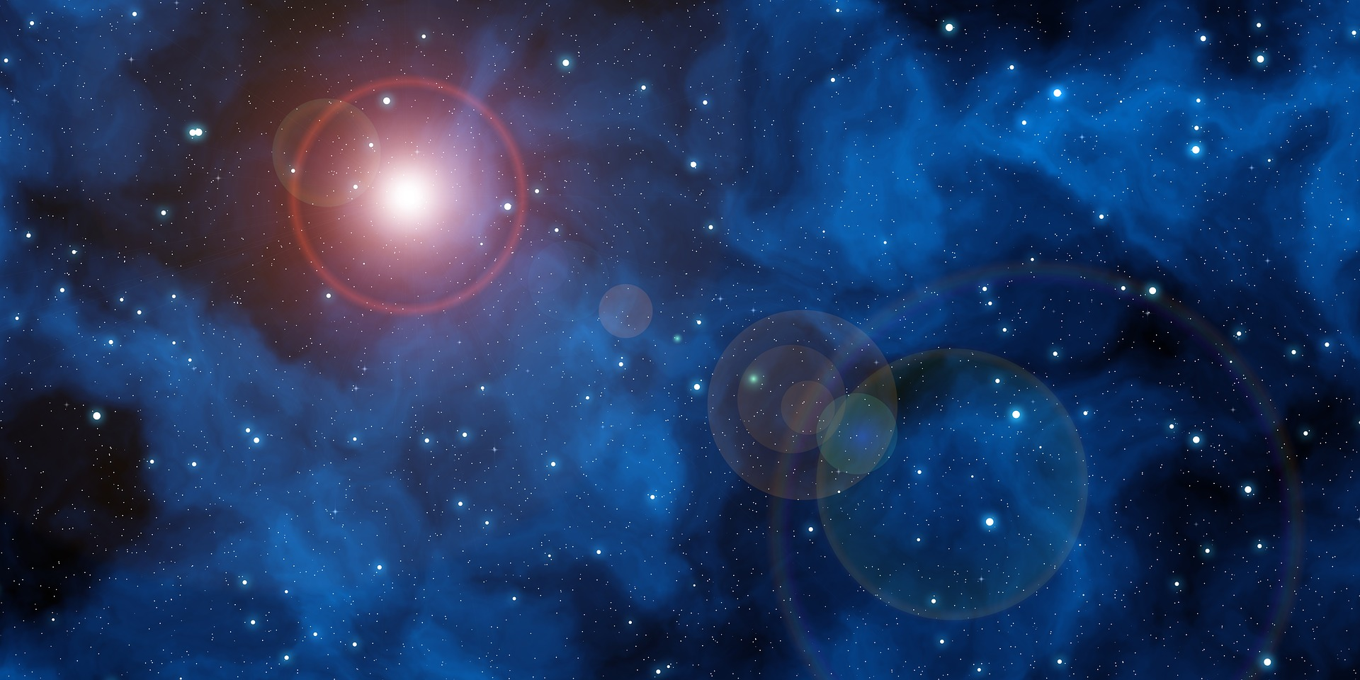
Forbush Effects and Interplanetary Disturbances
Maria Abunina and Anatoly Belov

Slide 2
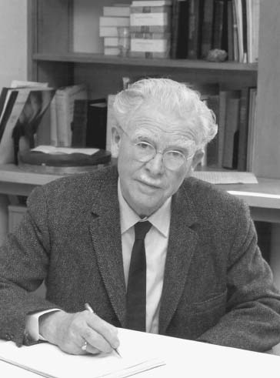
Scott E. Forbush
Forbush, S. E.: 1937,
'On the Effects in the Cosmic-Ray Intensity Observed During the Recent Magnetic Storm', Phys. Rev. 51, 1108–1109.
Forbush, S. E.: 1938,
'On the World-Wide Changes in Cosmic-Ray Intensity', Phys. Rev. 54, 975.
Lockwood J.A.
Cane H.V.
Dorman L.I.
Belov A.V.
…

Slide 3
What is a Forbush effect?
Forbush decrease — A Forbush decrease is a rapid decrease in the observed galactic cosmic ray intensity following a coronal mass ejection (CME). Wikipedia
Forbush decrease — the sudden decrease in the intensity of cosmic rays after an increase in solar activity. Universalium
Forbush effect — an occasional decrease in the intensity of cosmic rays as observed on Earth, attributed to magnetic effects produced by solar flares (solar flare), which are disturbances on the Sun. Universalium
Forbush decrease. An abrupt decrease, of at least 10%, of the background galactic cosmic ray intensity as observed by neutron monitors. It is associated with major plasma and magnetic field enhancements in the solar wind at or near the Earth. On-line glossary of solar-terrestrial terms (NOAA)

Slide 4
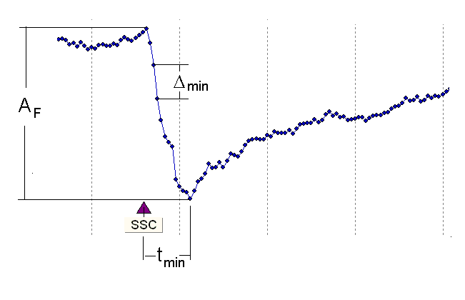
Definition
Forbush effect - CR flux variations, caused by interplanetary disturbances from coronal mass ejections (CMEs) and/or High Speed Stream from Coronal Holes (HSSs from CHs)

Slide 5
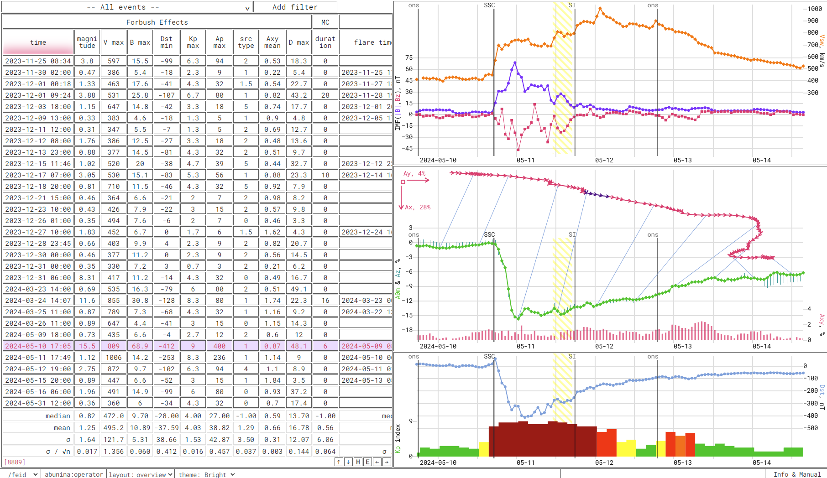
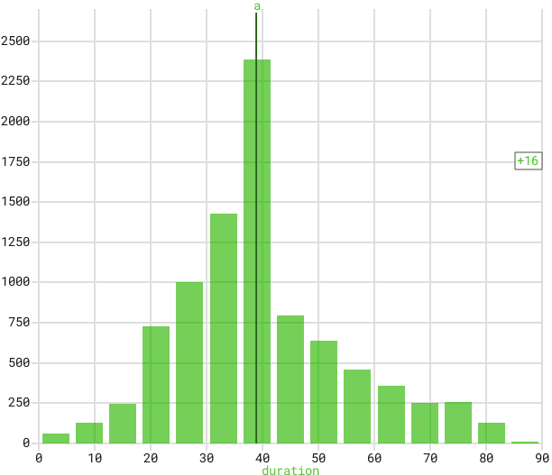
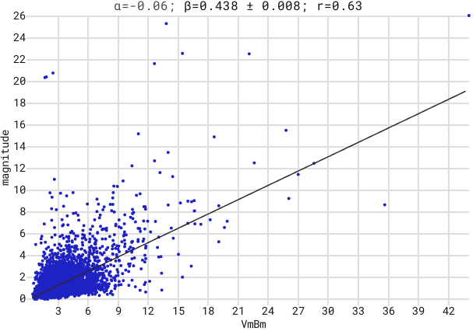
FEID - Database of Forbush Effects and Interplanetary Disturbances
https://tools.izmiran.ru/feid
>8800 events
1957 - 2024
10 GV rigidity
GSM

Slide 6
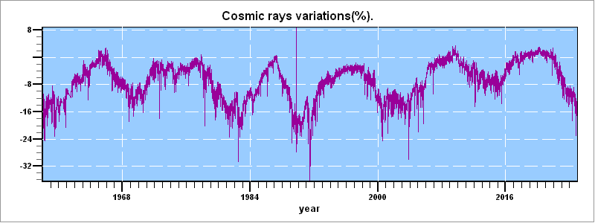
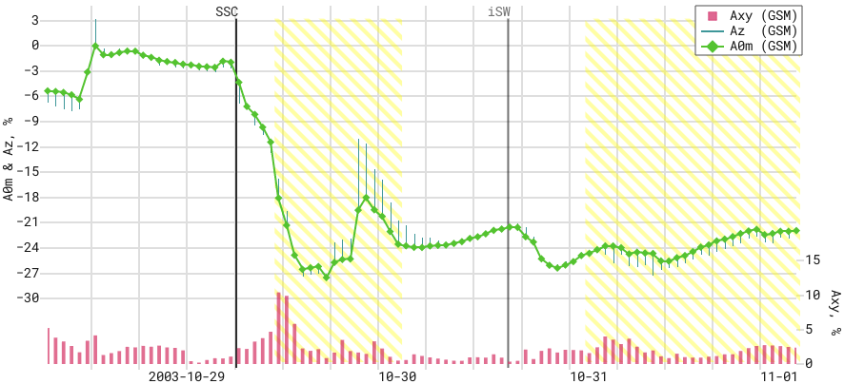
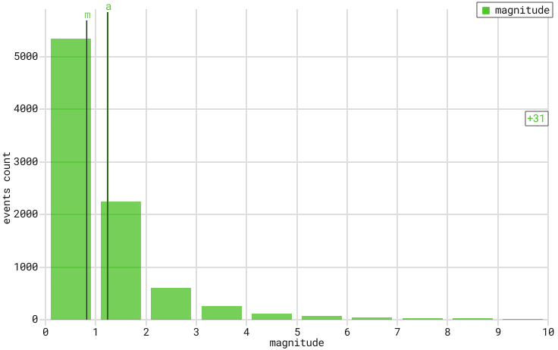
Forbush effect is the largest galactic CR variation

Slide 7
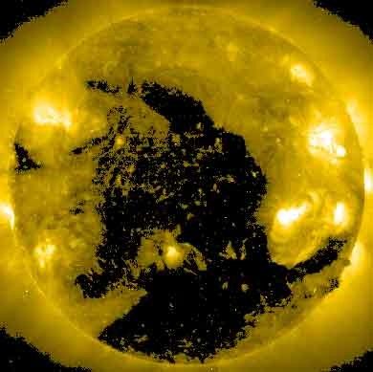
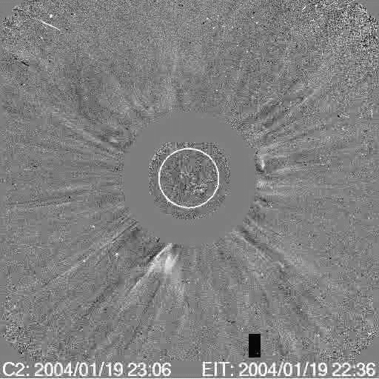
Forbush effects and Interplanetary disturbances
recurrent
sporadic
HSS from CH
CME

Slide 8
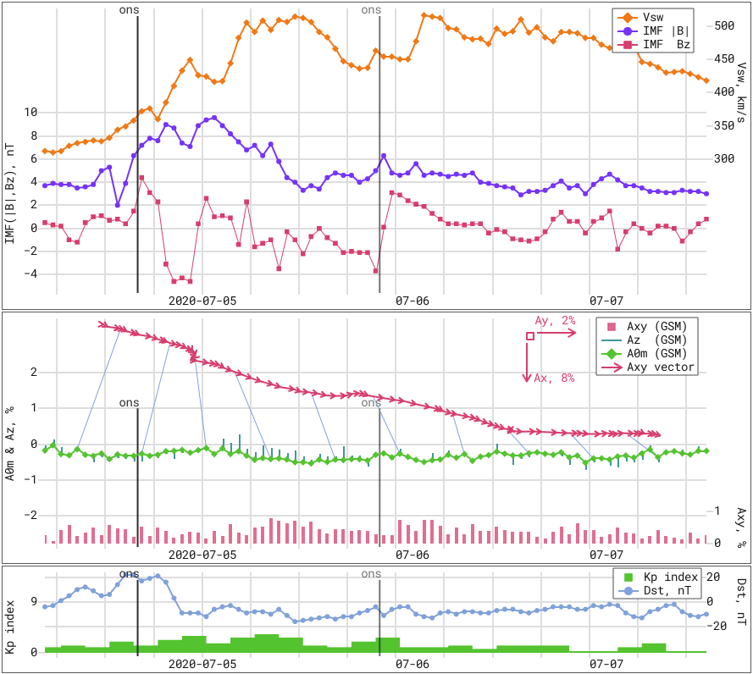
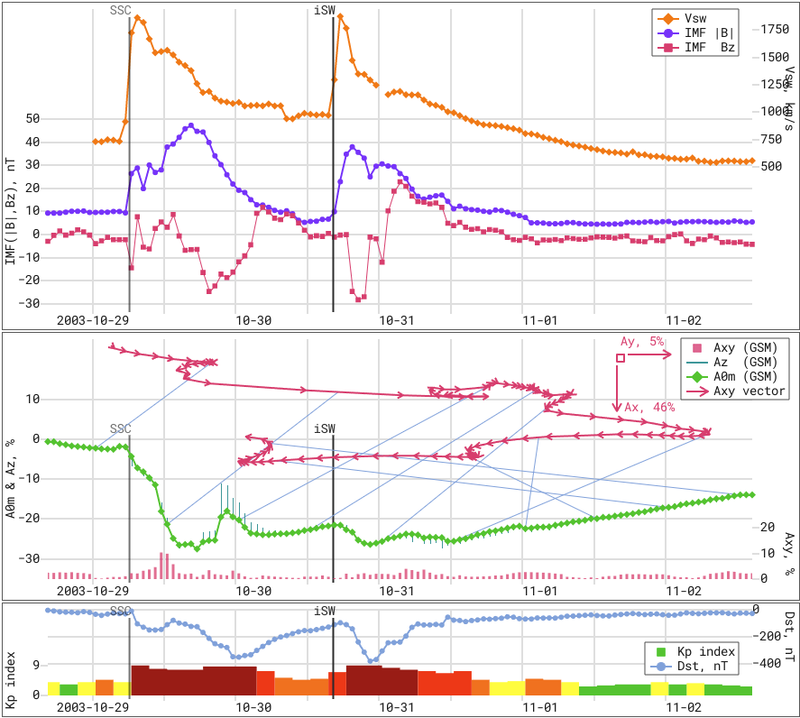
HSS from CH CME

Slide 9
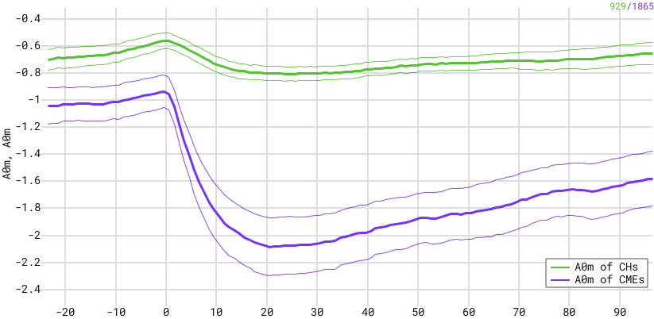
HSS from CH CME
Group | Mean FE magn. | Mean time to A0min
CH | 0.77 % | 26.9 h
CME | 1.8 % | 18.5 h

Slide 10
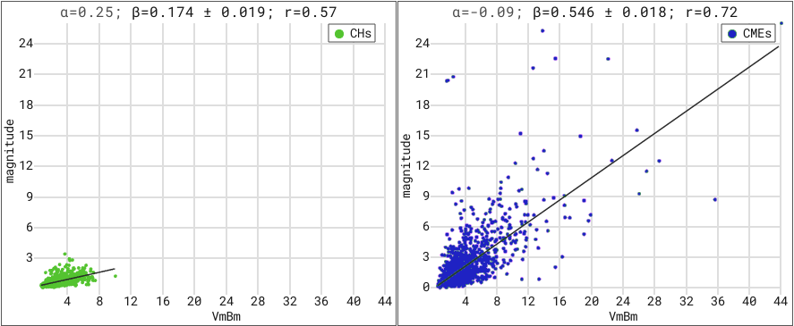
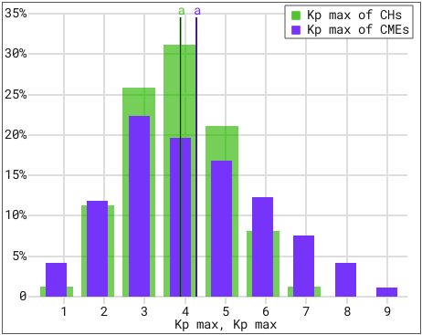
HSS from CH CME
V₀=400 km/s
B₀=5 nT

Slide 11
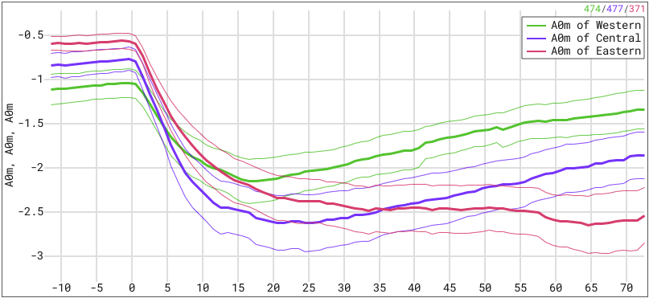
CME heliolongitudes and FEs
Group | Longitudes | Mean FE magn. | Mean time to A0min
Eastern | < -20 | 2.33 % | 21.4 h
Central | -20 … 20 | 2.58 % | 18.6 h
Western | > 20 | 1.85 % | 16.8 h

Slide 12
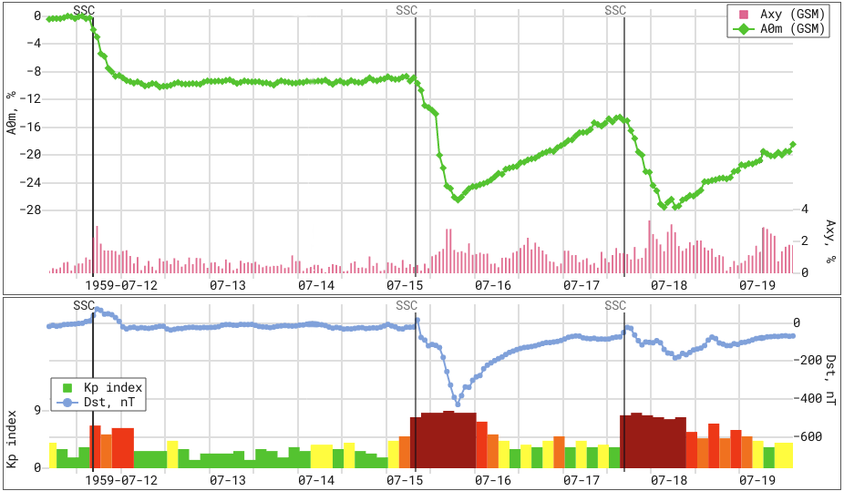
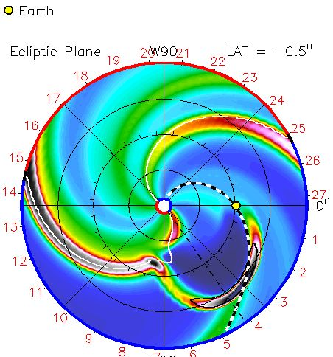
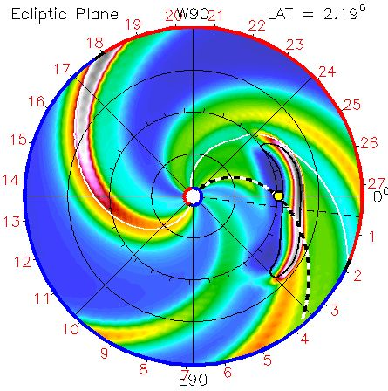
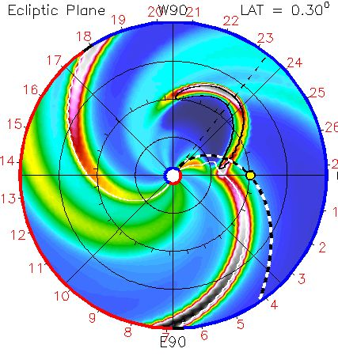
CME heliolongitudes and FEs
E63
E04
W30

Slide 13
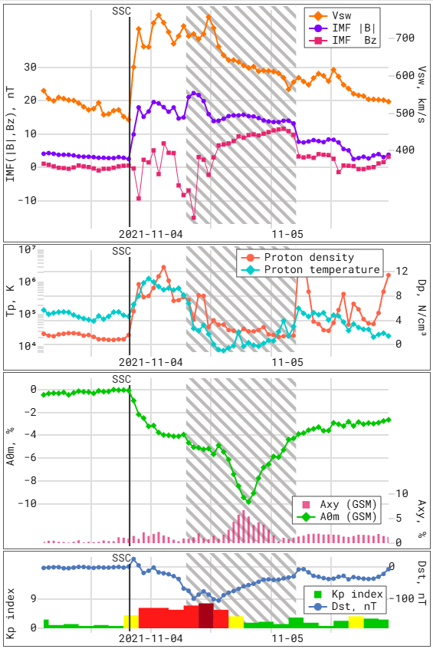
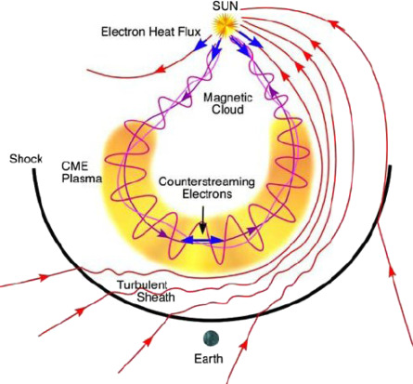
Magnetic clouds
Magnetic cloud (MC) is a part of CME with a specific characteristics:
Solar wind (SW) speed decreasing
High interplanetary magnetic field (IMF)
Smooth rotation of IMF’s components at large angles
Low SW temperature
…
Burlaga et al., 1981
Burlaga et al., 1982
Zurbuchen and Richardson, 2006

Slide 14
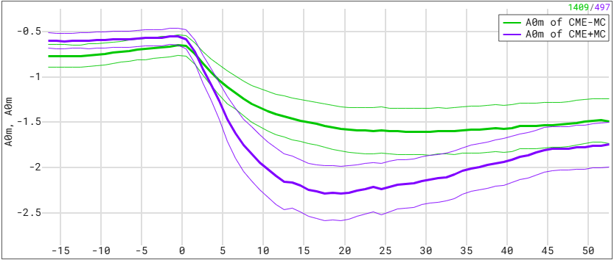
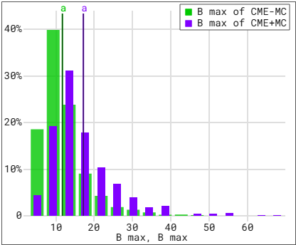
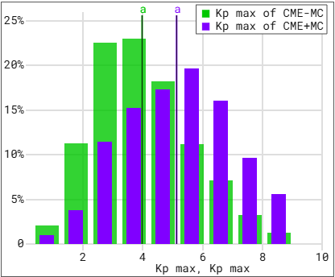
Magnetic clouds
Group | Mean FE magn. | Mean time to A0min
CME-MC | 2.33 % | 21.4 h
CME+MC | 2.58 % | 18.6 h
Belov et al., 2015
Abunina et al., 2021
Melkumyan et al., 2022
Abunina et al., 2024

Slide 15
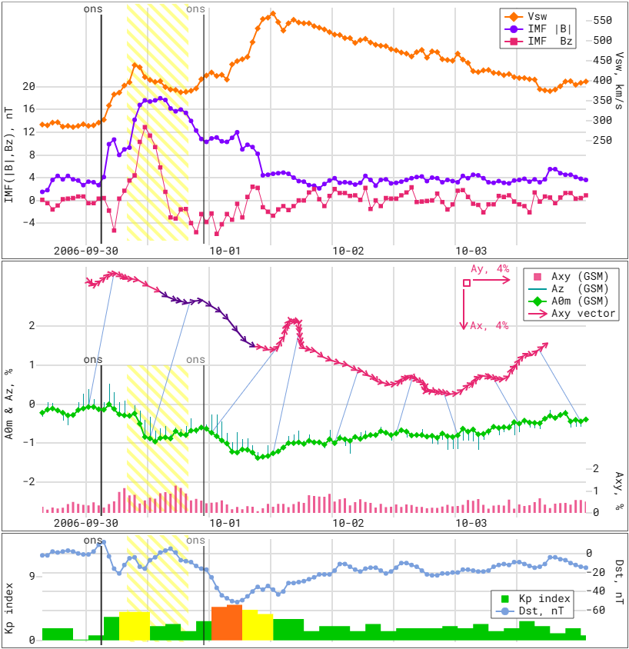
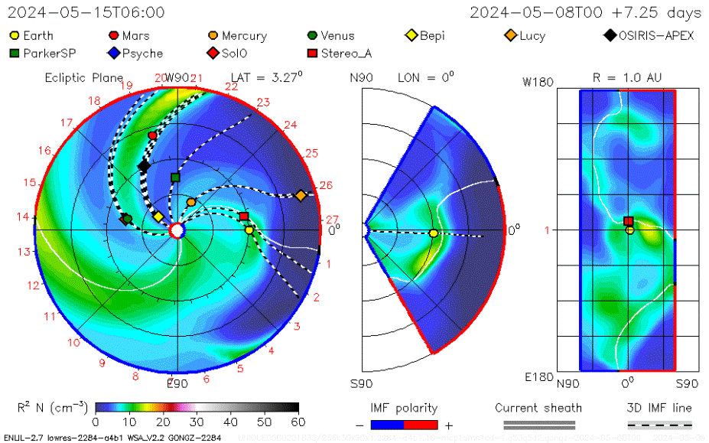
Interacting interplanetary disturbances
ICME HSS
ICME+ICME
HSS+HSS
ICME+HSS
…
Shlyk et al., 2021
Shlyk et al., 2022
Shlyk et al., 2024

Slide 16
Interacting interplanetary disturbances
For all interacting interplanetary disturbances, a change in the parameters under study is observed.
The first events from any interacting pair are "depleted", the second ones are "enriched".
The most effective in terms of modulating the cosmic ray flux and enhancing geomagnetic activity are the events of the MIX (CME) group.
Shlyk et al., 2024

Slide 17
Conclusions
Studies of FDs get more and more interesting
Studies of FDs are useful for solar physics
Studies of FDs are very important for space weather tasks

Slide 18
Thank you!
abunina@izmiran.ru

Slide 19
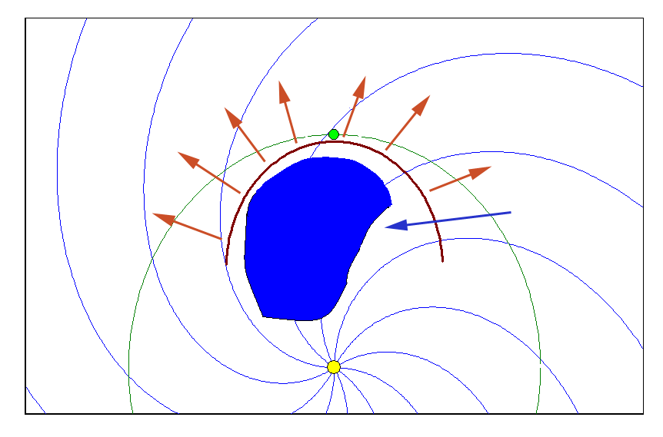
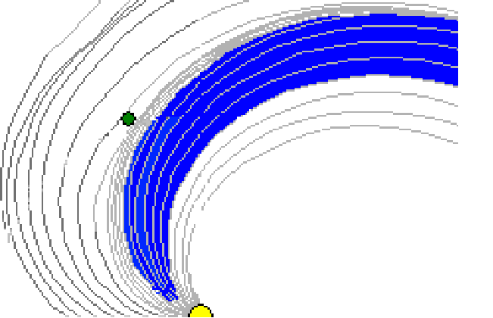
Forbush Decreases and Interplanetary disturbances
Cosmic ray decrease is created by expansion of disturbed region that partly screened from outside by strong and/or transverse magnetic fields

Slide 20
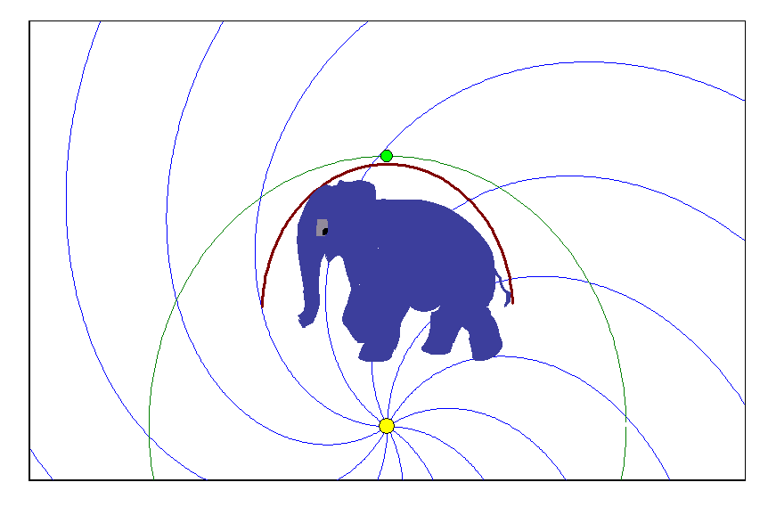
Forbush Decreases and Interplanetary disturbances
Wall
Column
Carpet
Tube
Rope

