Slide 1
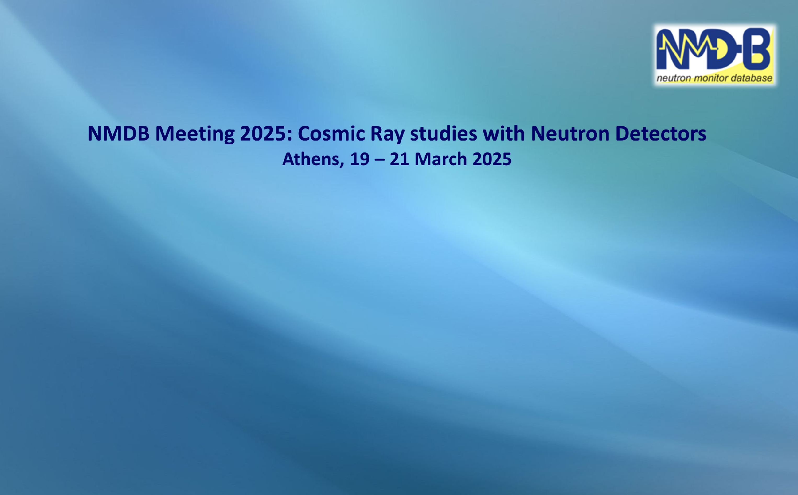

Shape and extend of the Heliosphere and Cosmic Ray Modulation and solar wind transition surfaces
Solar Alfven and Sonic surfaces
George Exarchos 1 Xenophon Moussas 2
1 Siemens, Athens, Greece
2 National and Kapodisrtrian University of Athens,
+306978792891 xmoussas@phys.uoa.gr, xdmoussas@gmail.com copyright: © X MOUSSAS, G EXARHOS and University of Athens 2025

Slide 2
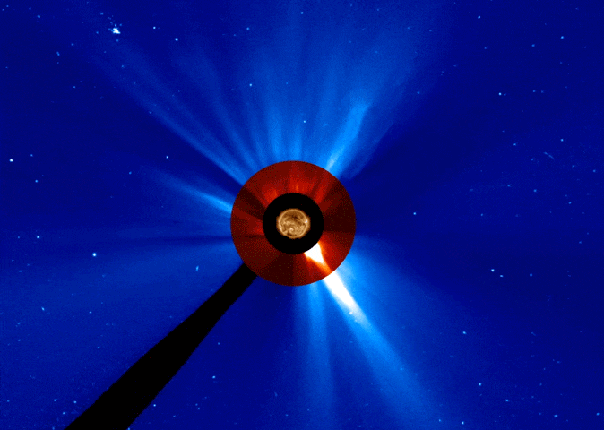
Shape and extend of the solar wind transition surfaces
Solar Alfven and Sonic surfaces
Xenophon Moussas 1 & George Exarchos 2
1 National and Kapodisrtrian University of Athens,
2 Siemens, Athens, Greece
+306978792891 xmoussas@phys.uoa.gr, xdmoussas@gmail.com
Image credit: NASA's Solar Dynamics Observatory and the NASA/ESA Solar and Heliospheric Observatory

Slide 3
Shape and extend of the solar wind transition surfaces
Solar Alfven and Sonic surfaces
Xenophon Moussas 1 & George Exarchos 2
1 National and Kapodisrtrian University of Athens,
2 Siemens, Athens, Greece
+306978792891 xmoussas@phys.uoa.gr, xdmoussas@gmail.com
RPW consortium meeting #31
25-28/11/2024, Athens University History Museum, Greece
https://sites.google.com/view/rpwmeetingnovember2024
Monday 25/11/2024
Image credit: NASA's Solar Dynamics Observatory and the NASA/ESA Solar and Heliospheric Observatory

Slide 4
Solar Alfven and Sonic surfaces
Xenophon Moussas 1 & George Exarchos 2
1 National and Kapodisrtrian University of Athens,
2 Siemens, Athens, Greece
+306978792891 xmoussas@phys.uoa.gr
3rd Workshop in Space Plasma Physics in Princeton Athens Center
Space Physics Group, Astrophysical Sciences Department, Princeton University,
the Seeger Center For Hellenic Studies,
the Princeton Athens Center
1,2 July 2024
Image credit: NASA's Solar Dynamics Observatory and the NASA/ESA Solar and Heliospheric Observatory

Slide 5
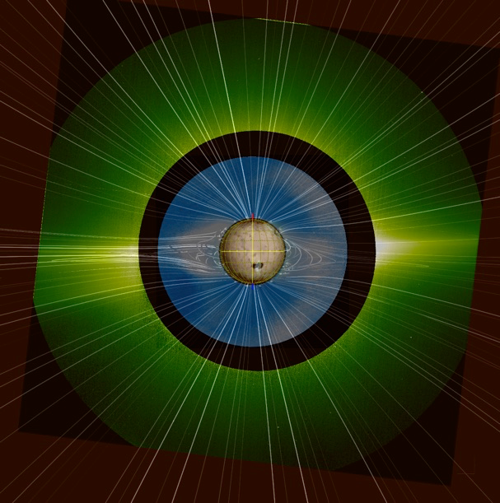
CREDIT
data NSSDCA, PSP OMNI
Solar Orbiter/Metis Team/ ESA & NASA; Mauna Loa Solar Observatory/HAO/NaCAR/NSF; Predictive Science Inc./NASA/NSF/AFOSR; NASA/SDO/AIA

Slide 6
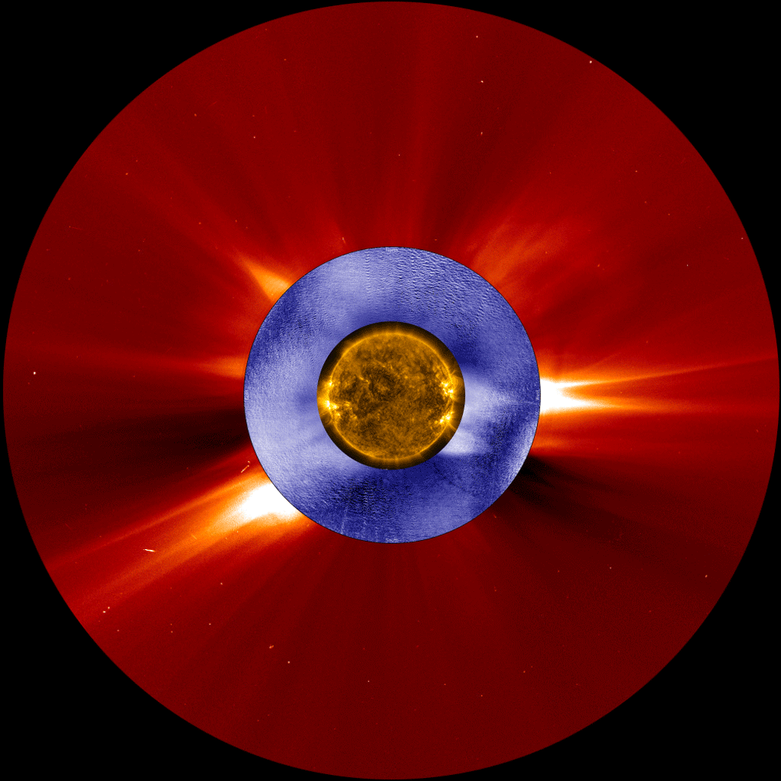
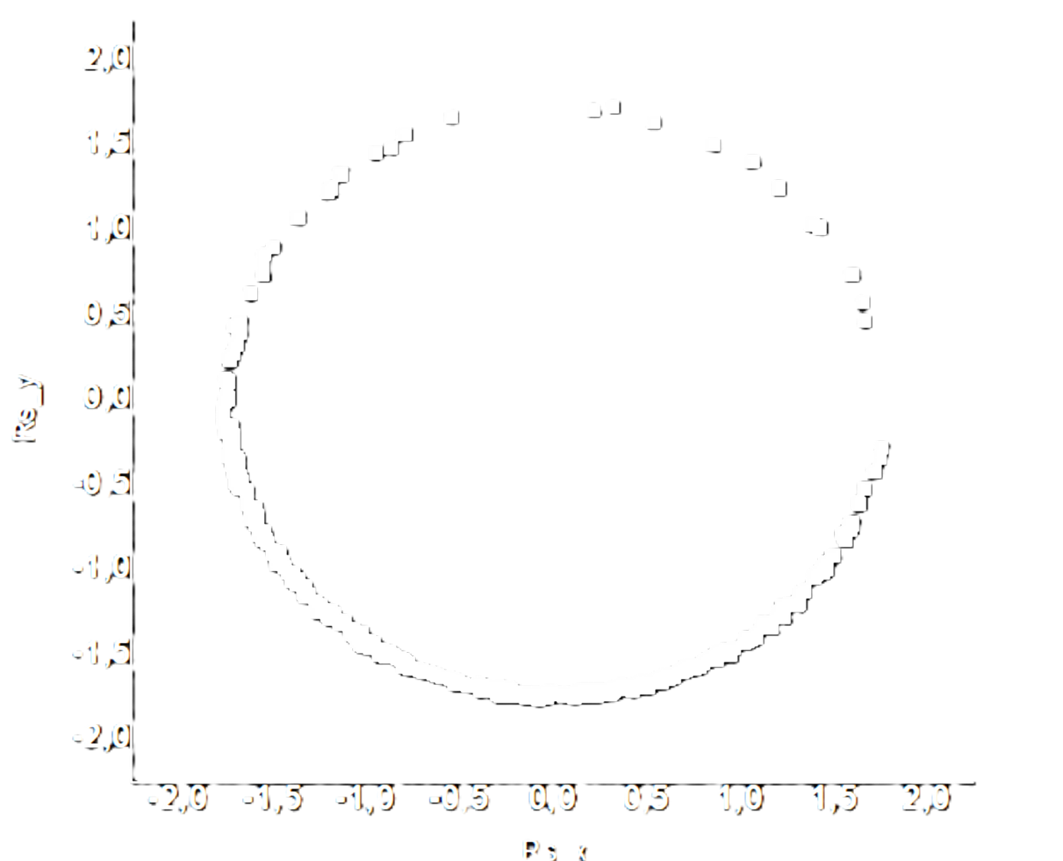
credit: NASA/ESA/SOHO/SDO/Joy Ng
and MLSO/K-Cor)

Slide 7

Minimum and maximum

Slide 8
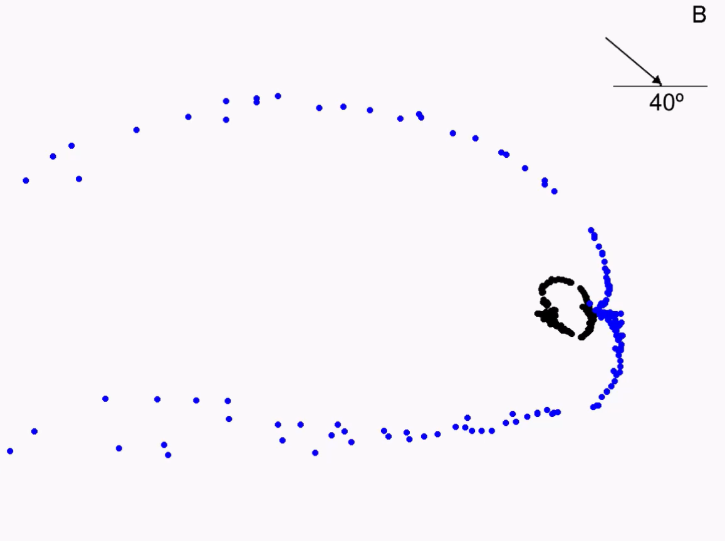
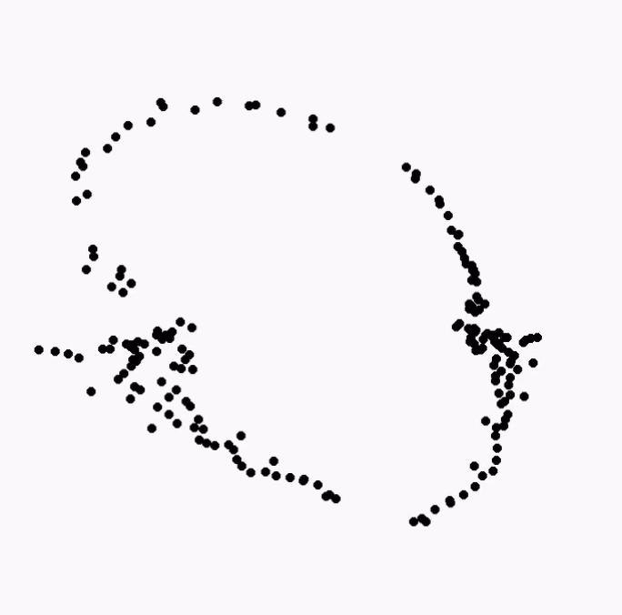
Shape and extend dependence
upon LISM magnetic field direction (~2000)

Slide 9
the shape of the heliosphere using Ulysses measurements

Slide 10
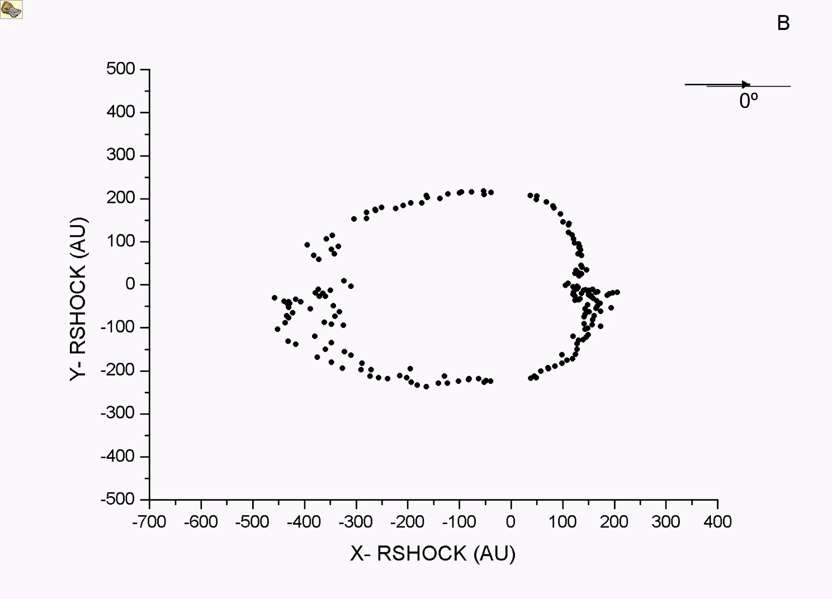
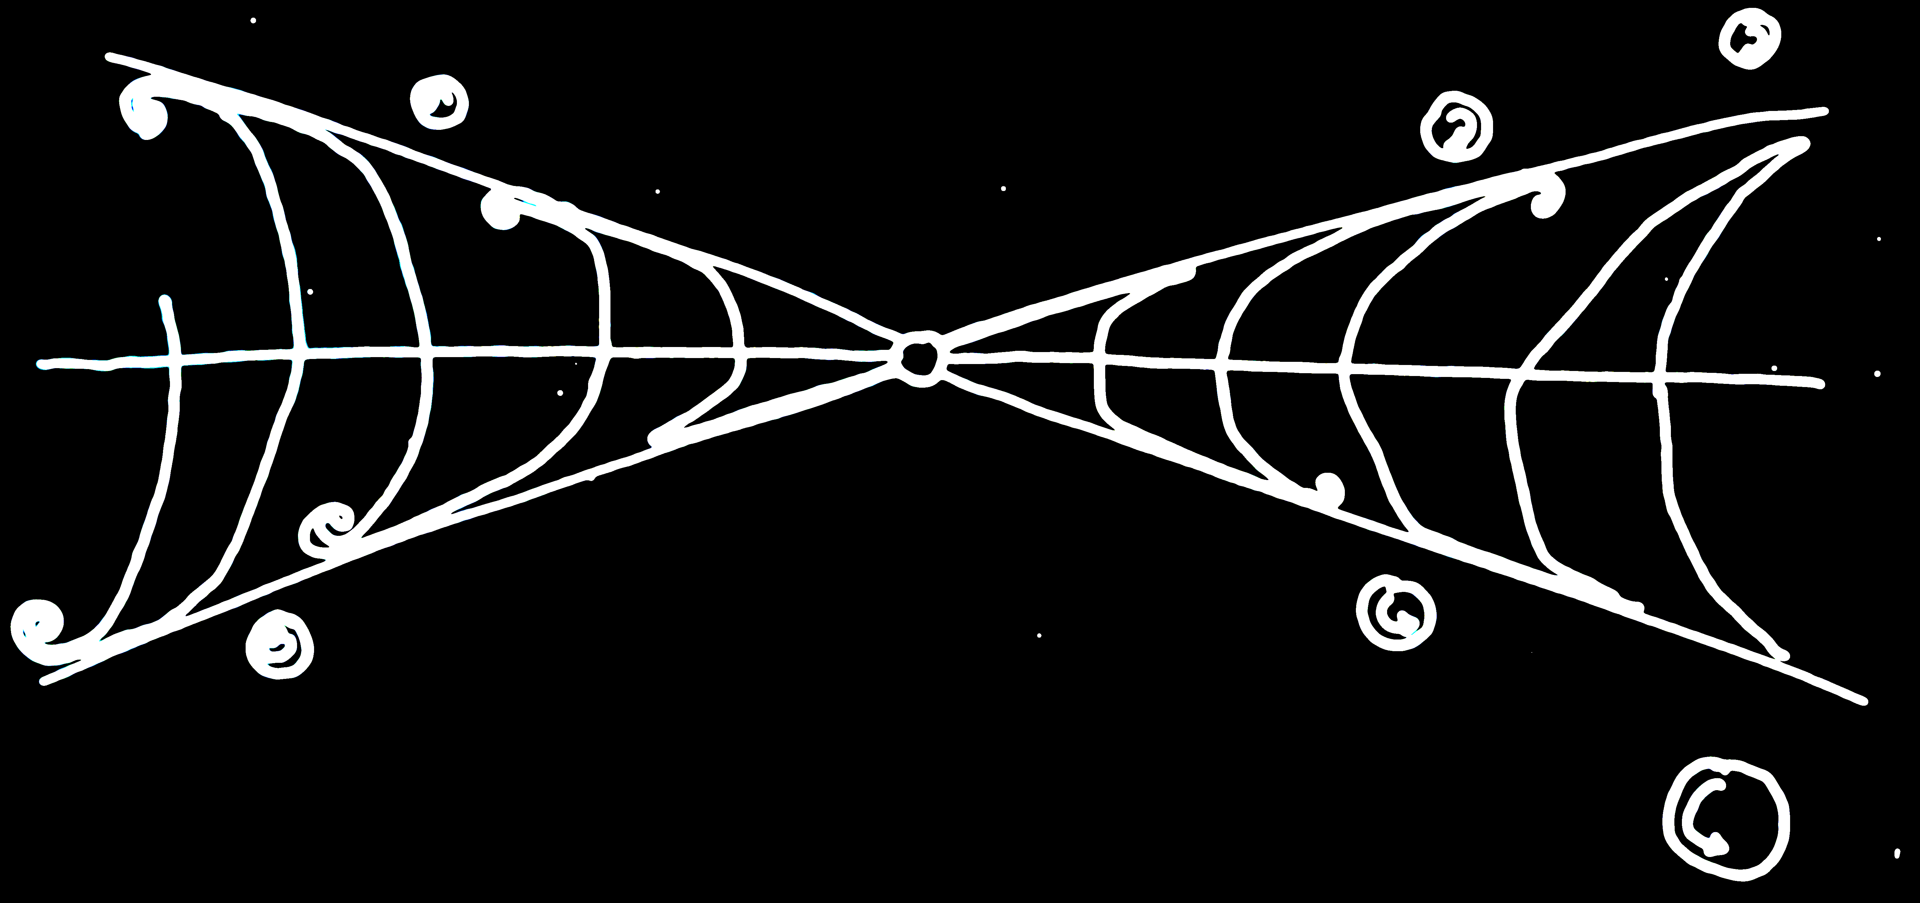
George Exarchos
Angeliki Nikolopoulou
Xenophon Moussas
National and Kapodisrtrian University of Athens, 2001
1st Workshop in Space Plasma Physics in Princeton Athens Center
Space Physics Group, Astrophysical Sciences Department, Princeton University,
the Seeger Center For Hellenic Studies,
the Princeton Athens Center
25th & 26th of July 2022

Slide 11
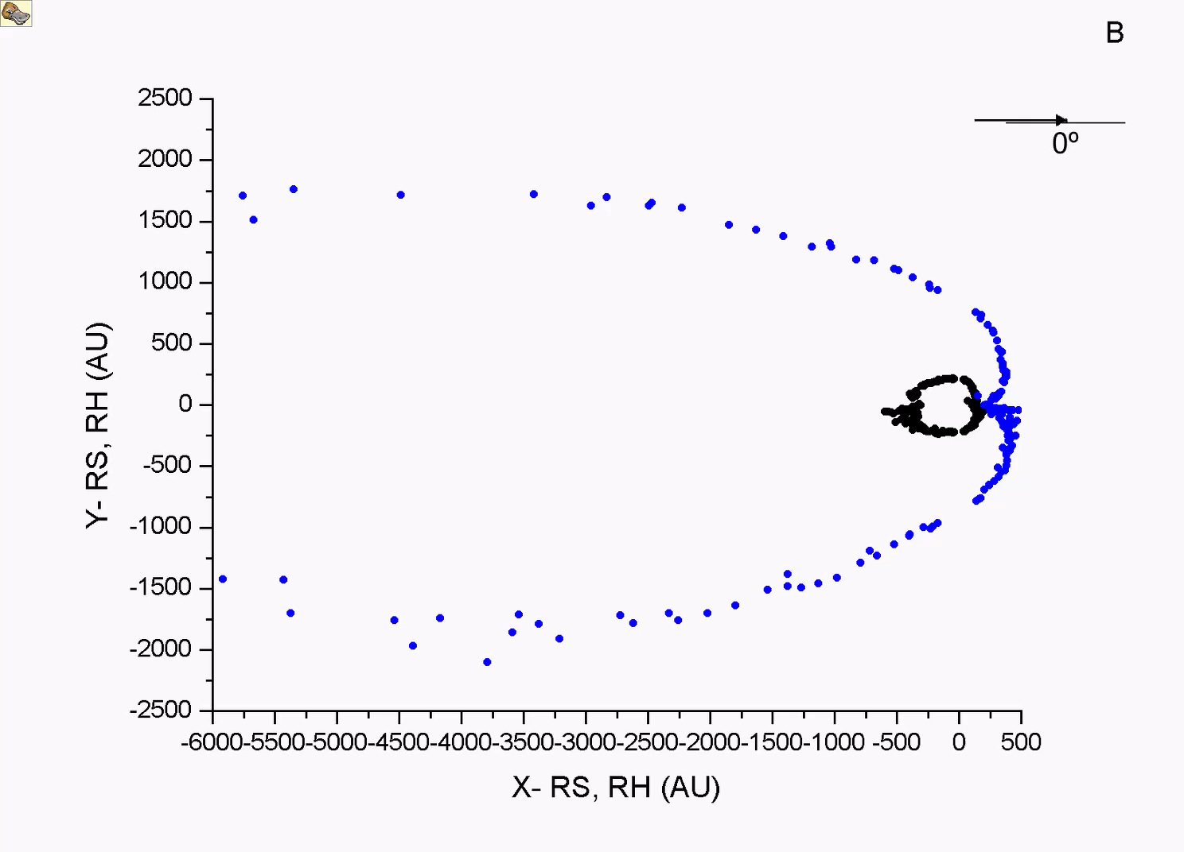
George Exarchos
Angeliki Nikolopoulou
Xenophon Moussas
National and Kapodisrtrian University of Athens, 2001
1st Workshop in Space Plasma Physics in Princeton Athens Center
Space Physics Group, Astrophysical Sciences Department, Princeton University,
the Seeger Center For Hellenic Studies,
the Princeton Athens Center
25th & 26th of July 2022

Slide 13
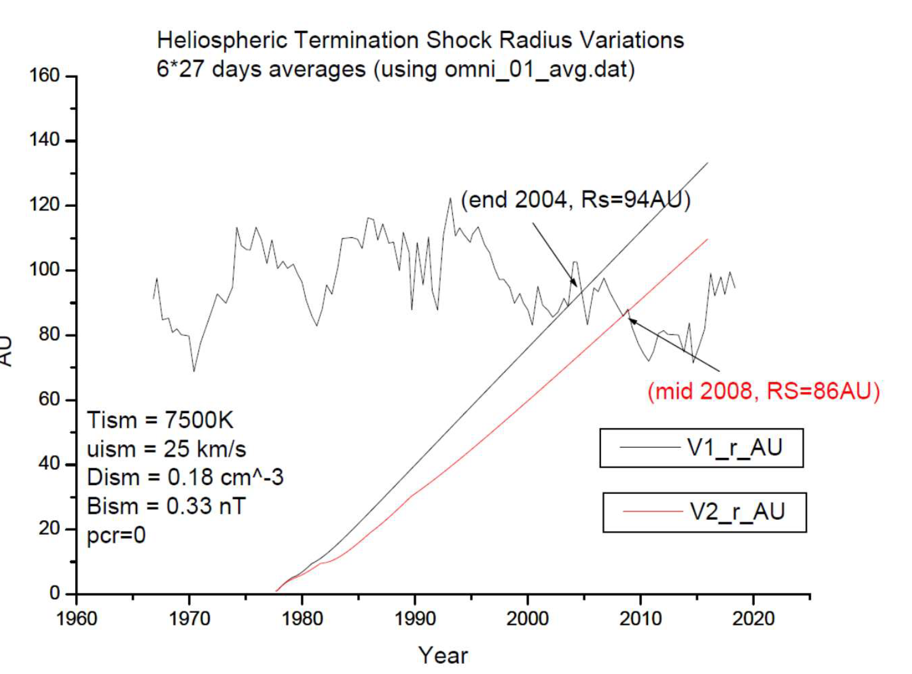

Slide 14
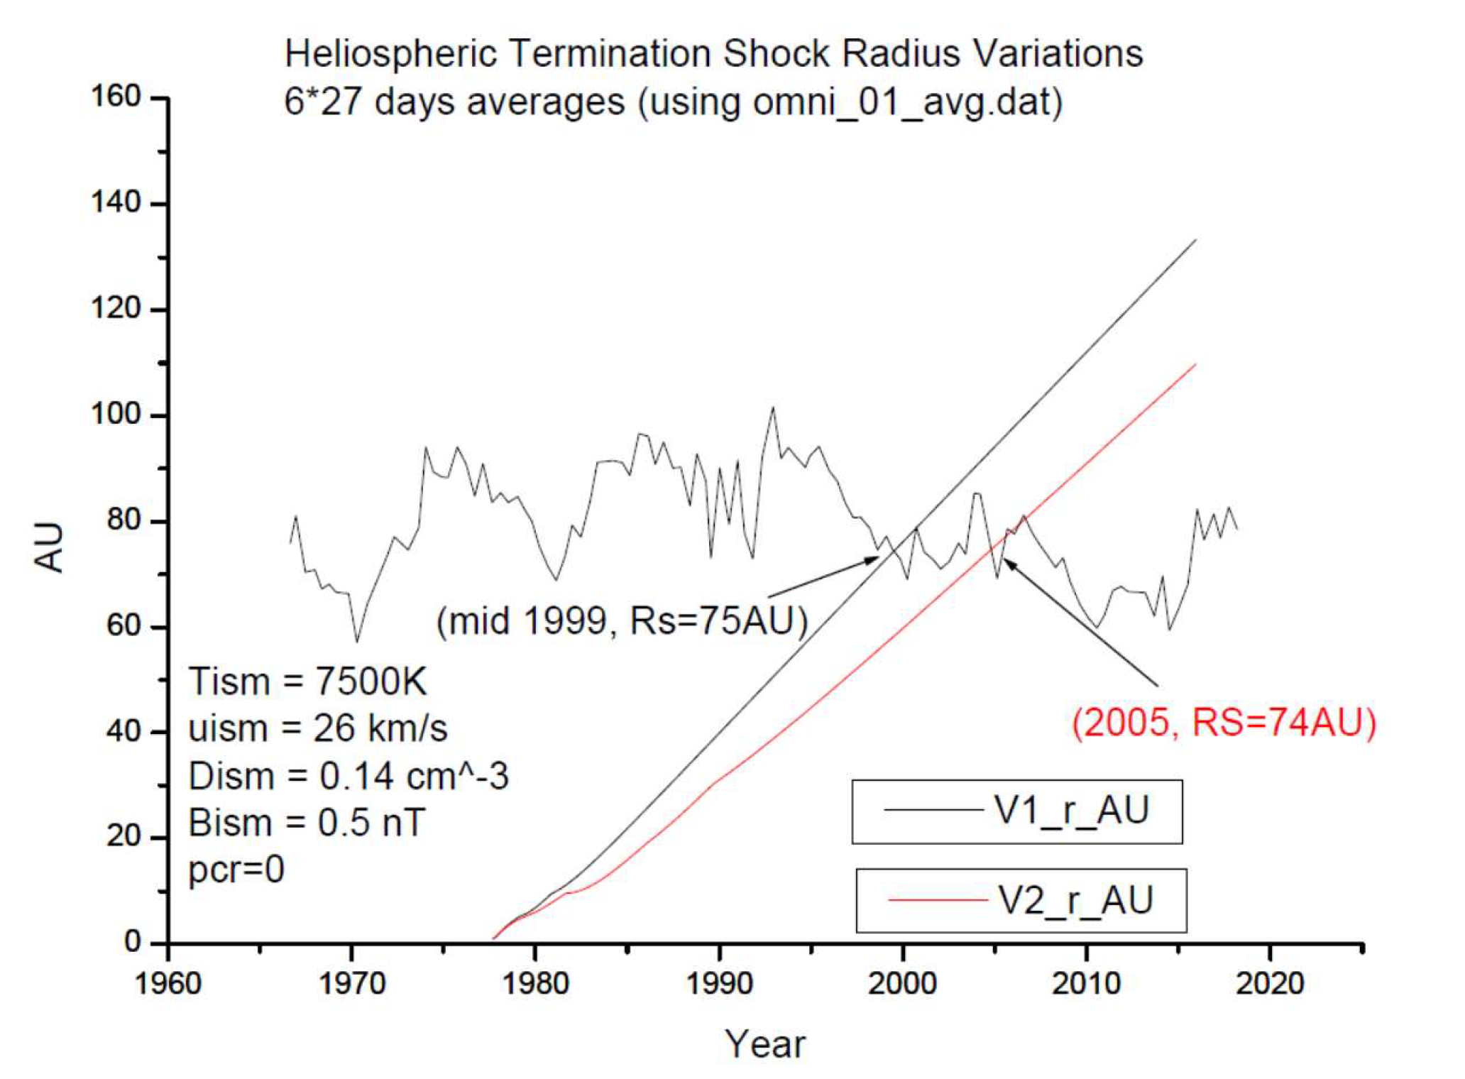

Slide 15
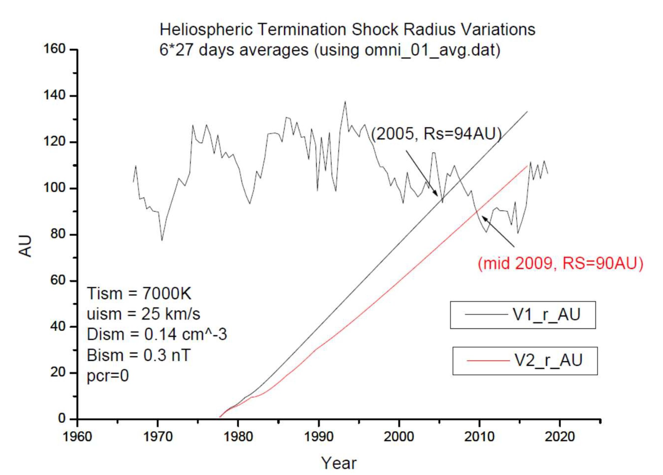

Slide 16
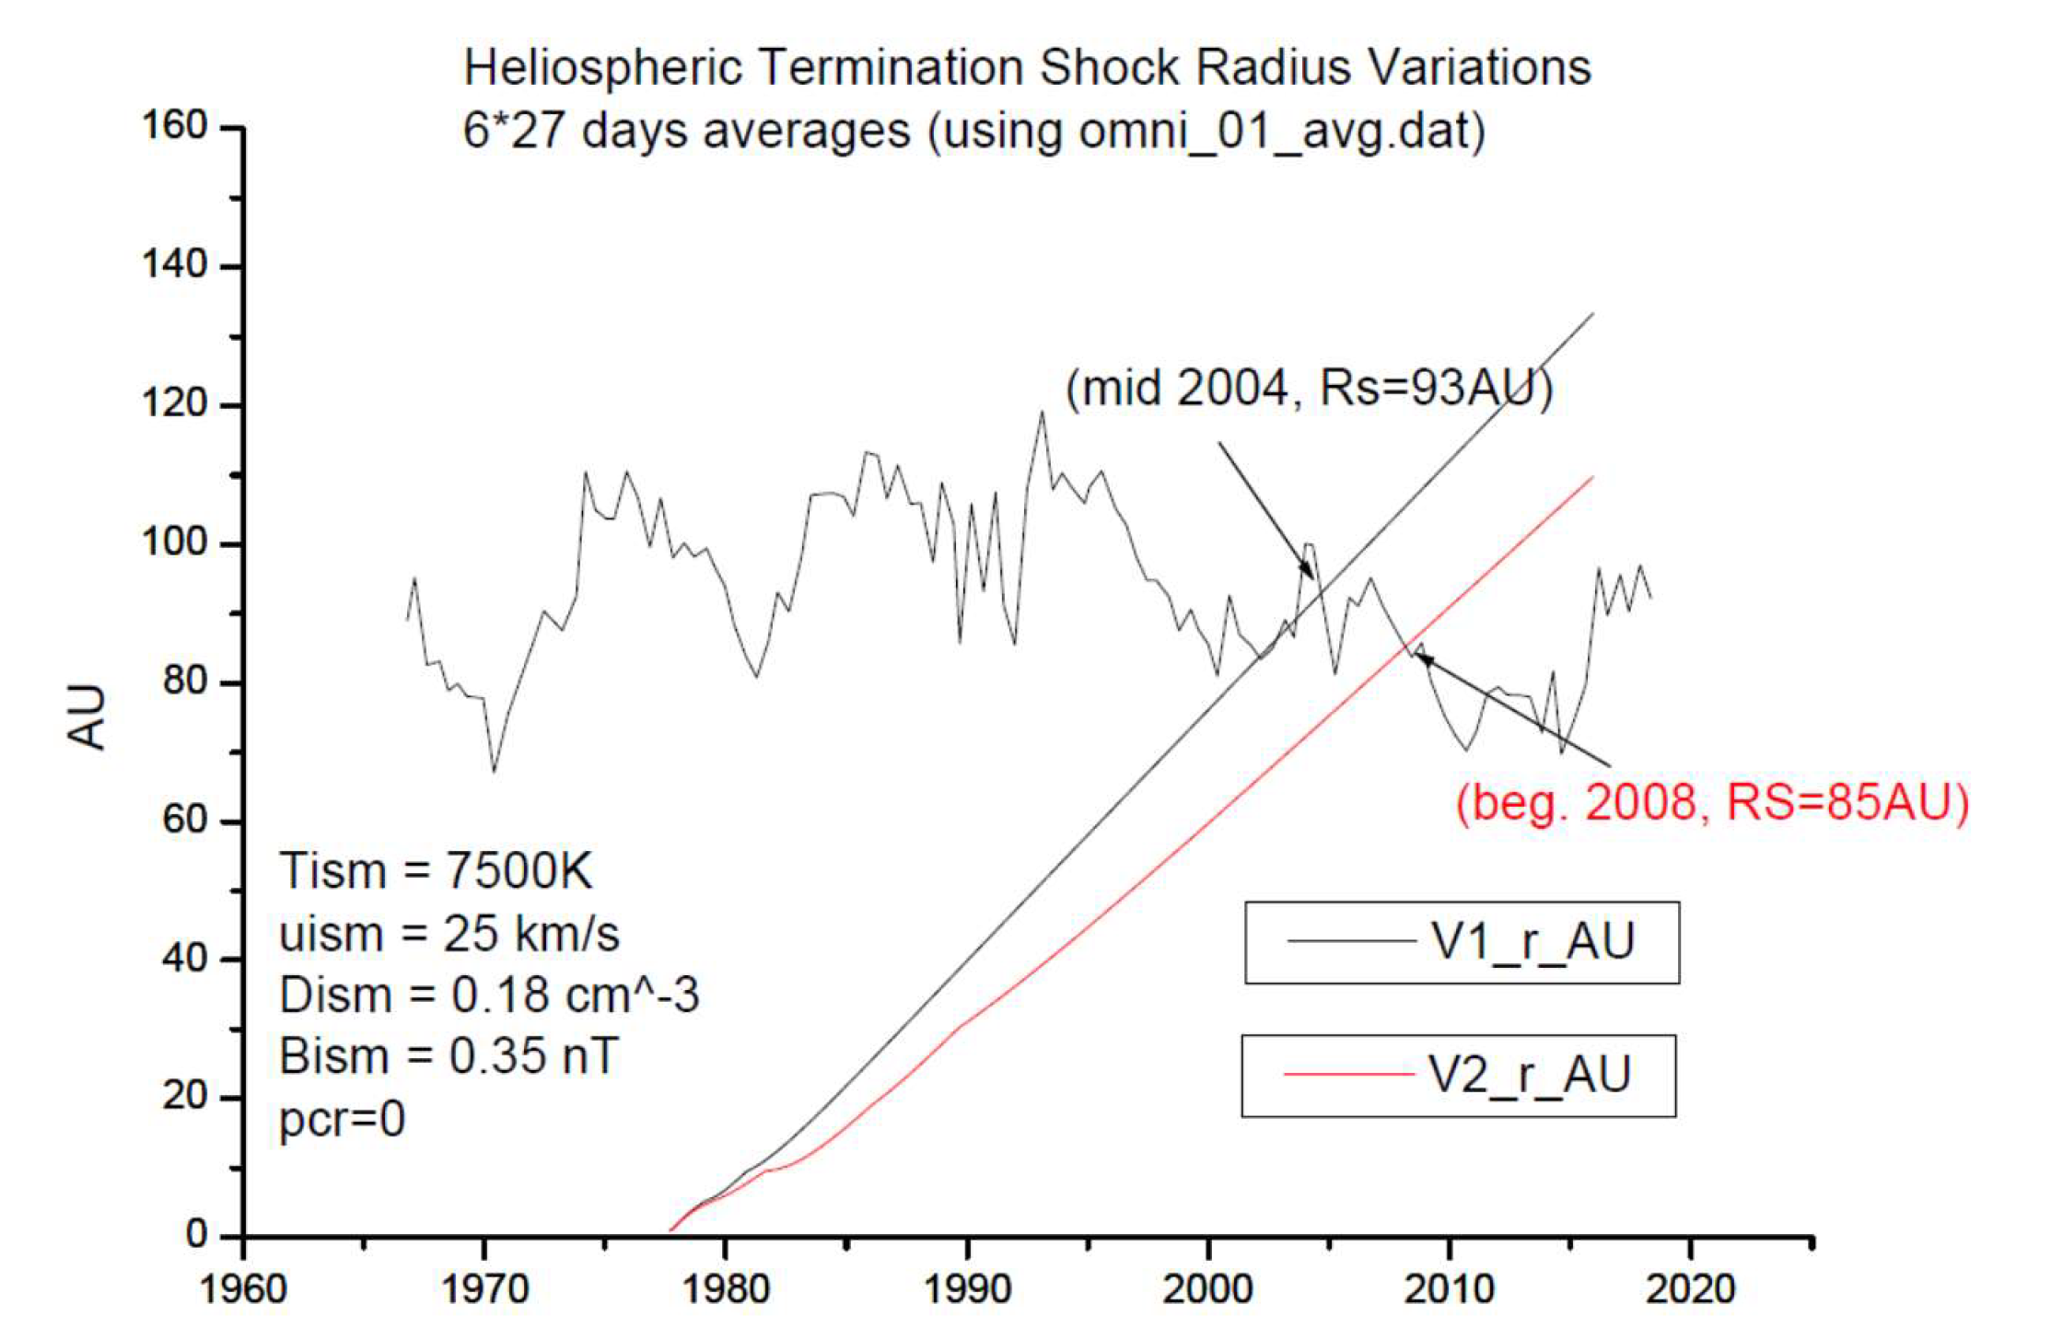

Slide 17
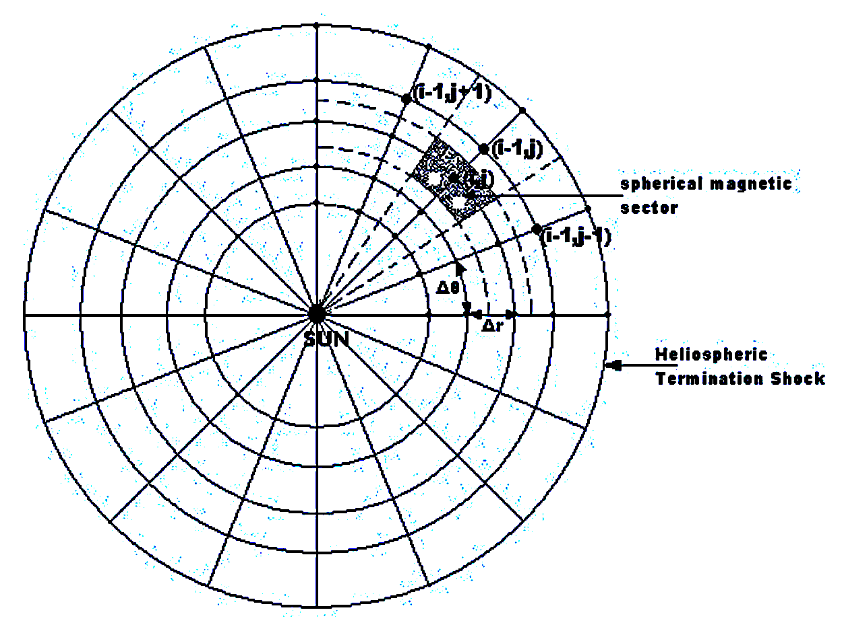
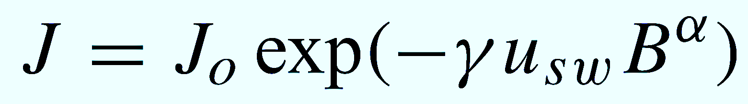
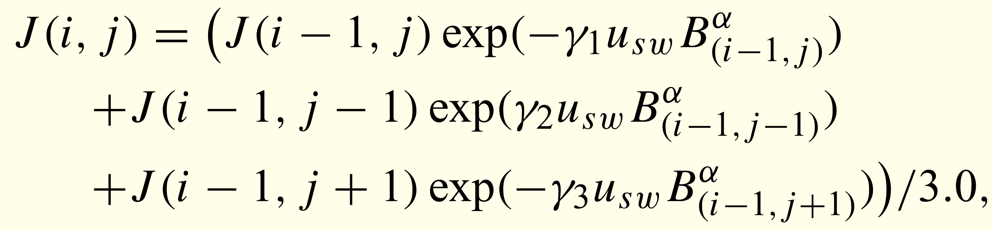
CR modulation
Using a simple diffusion-convection model (i.e. Parker 1965) assuming that the diffusion coefficient is proportional to 1/Β^{α}.

Slide 18
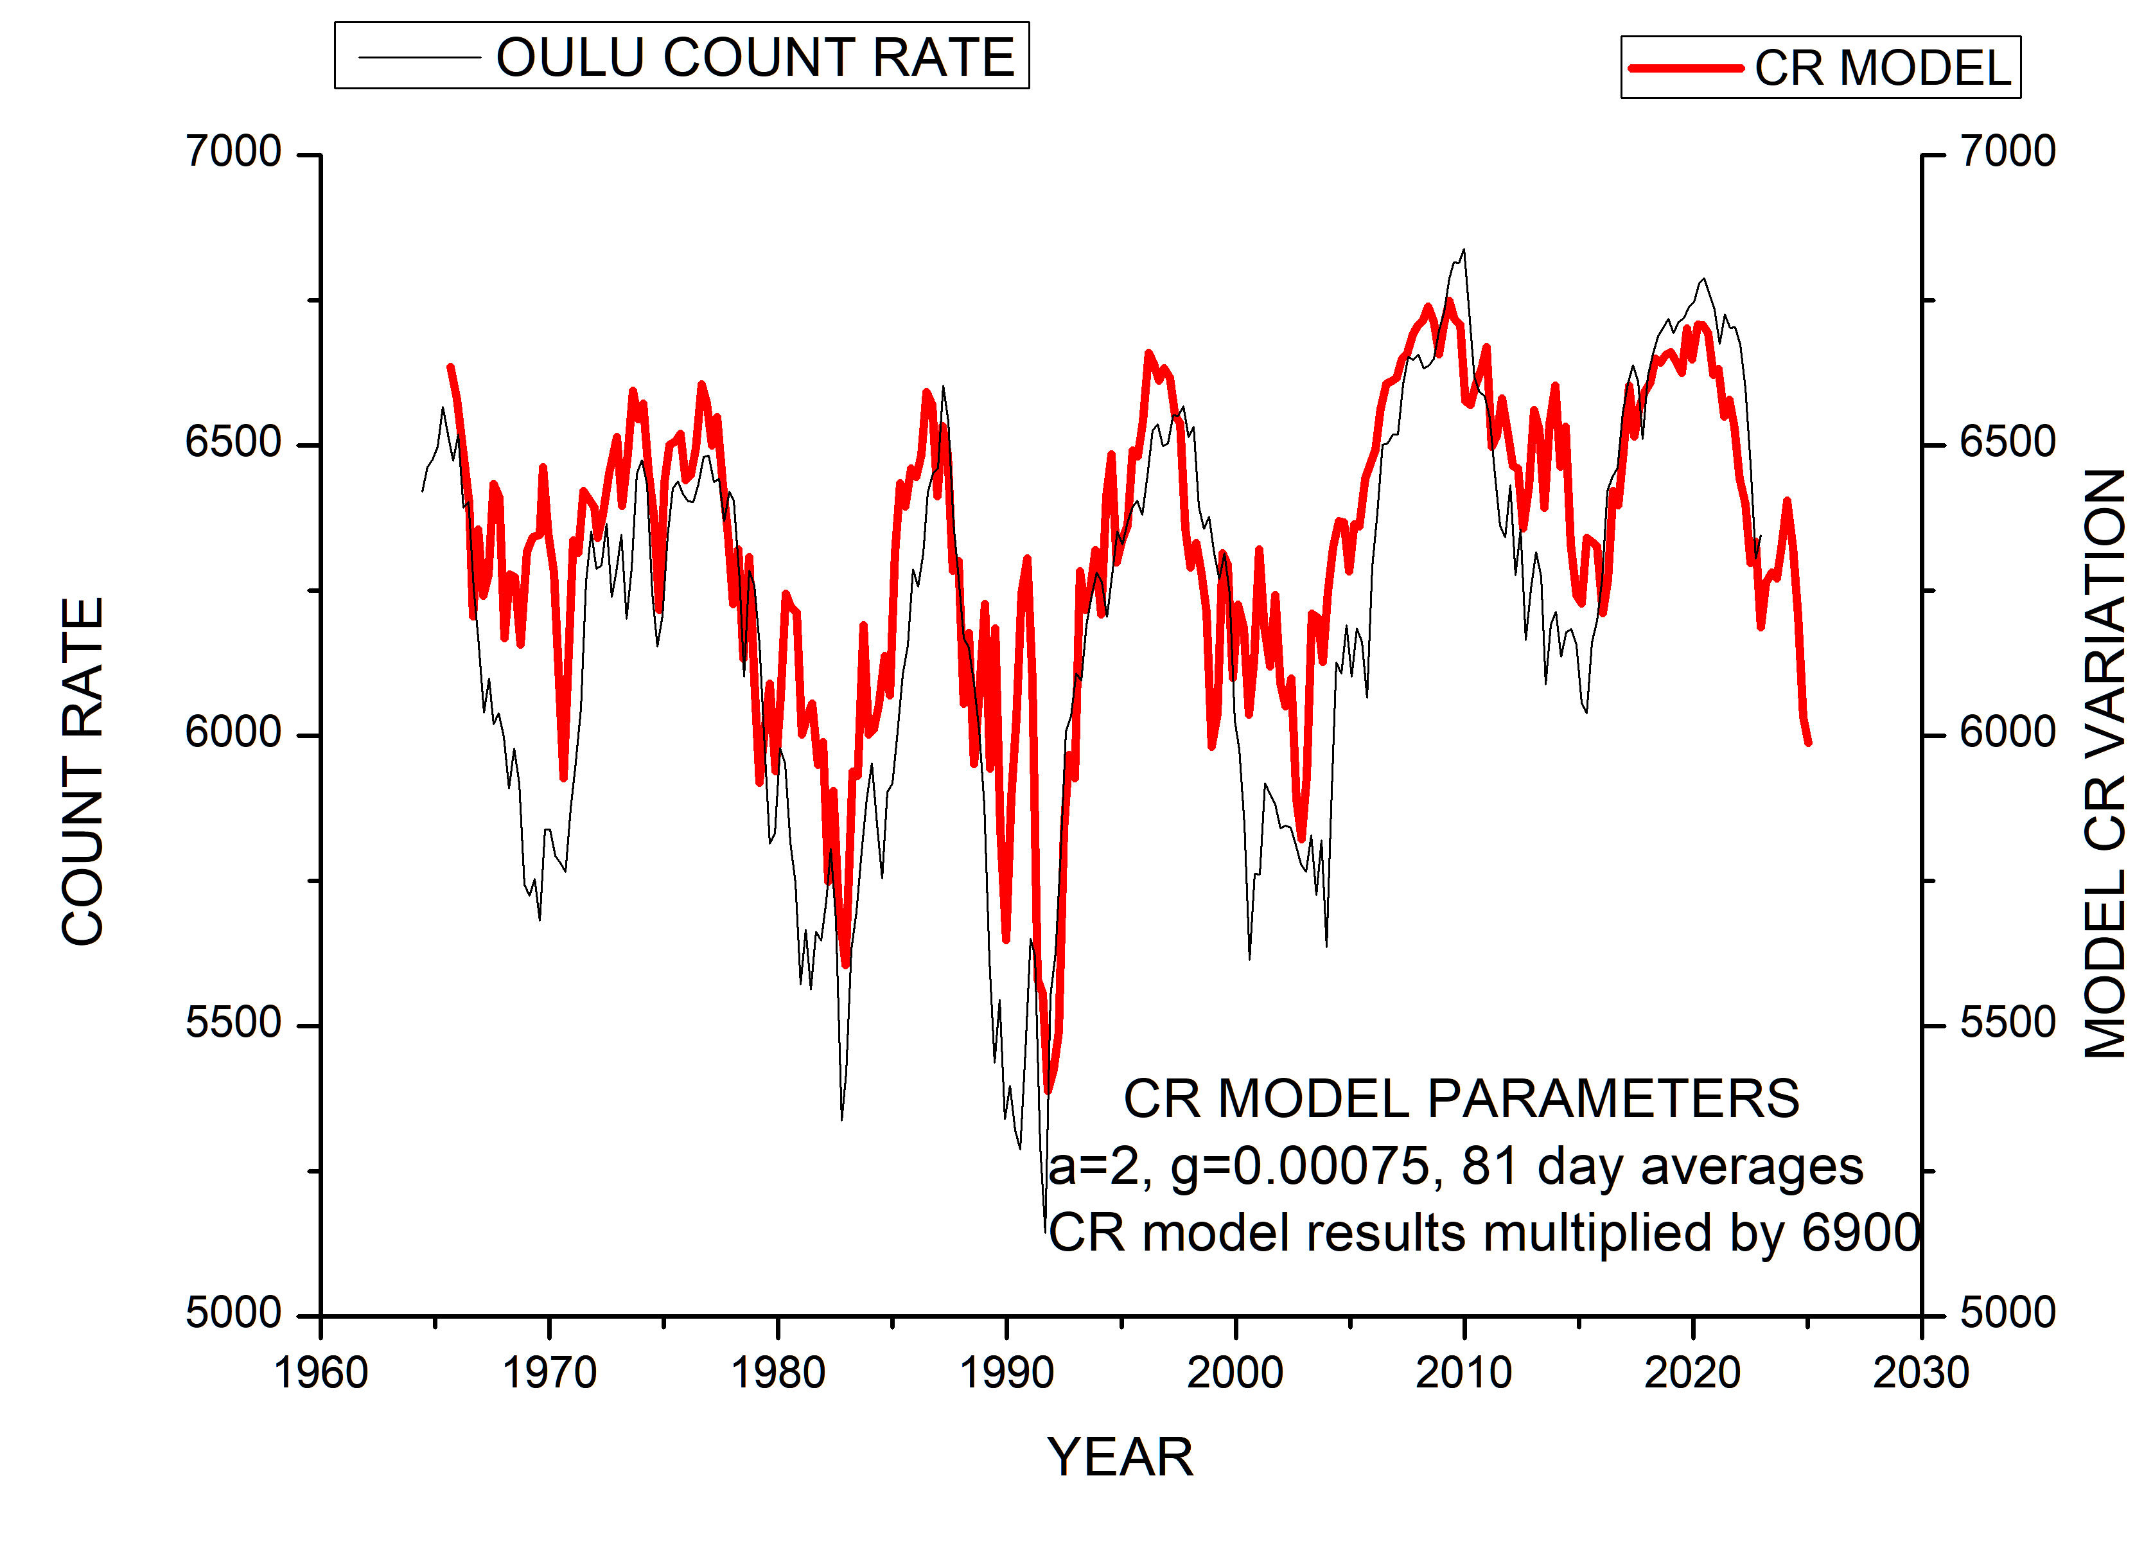

Slide 19
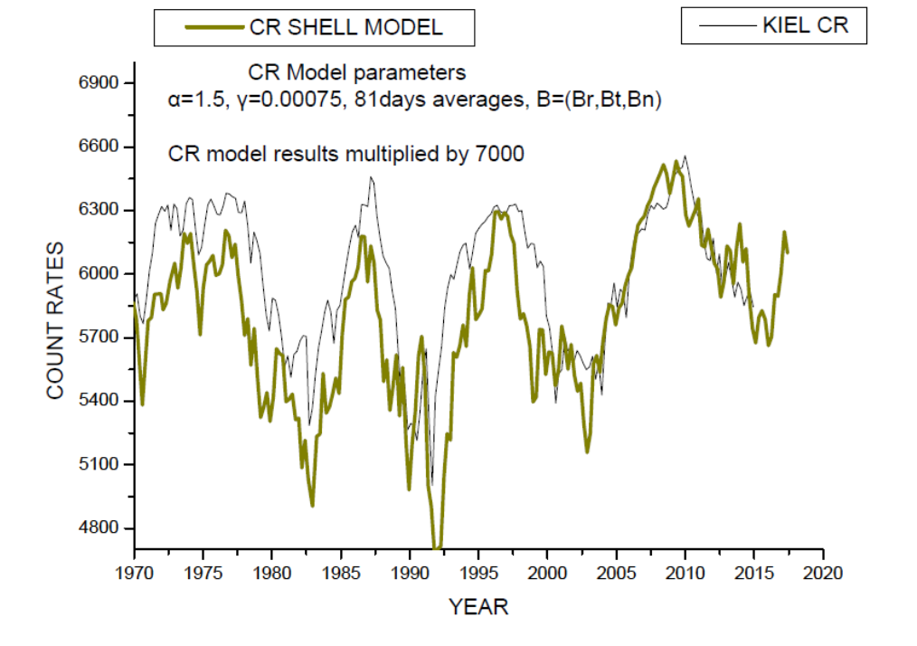
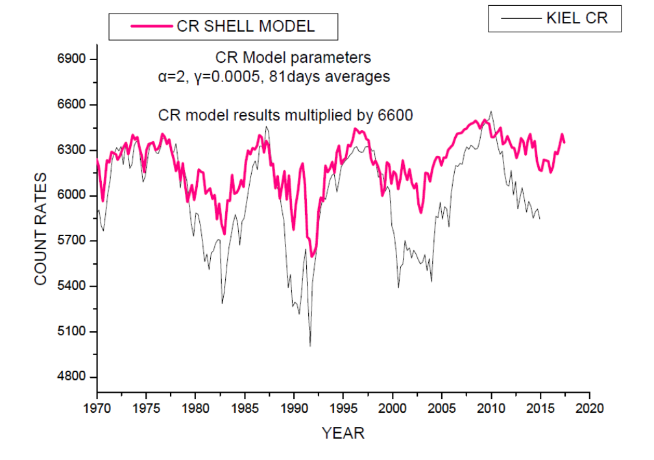
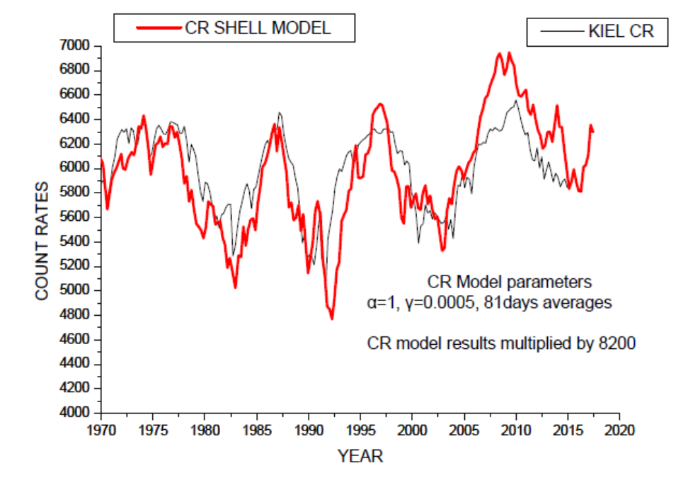
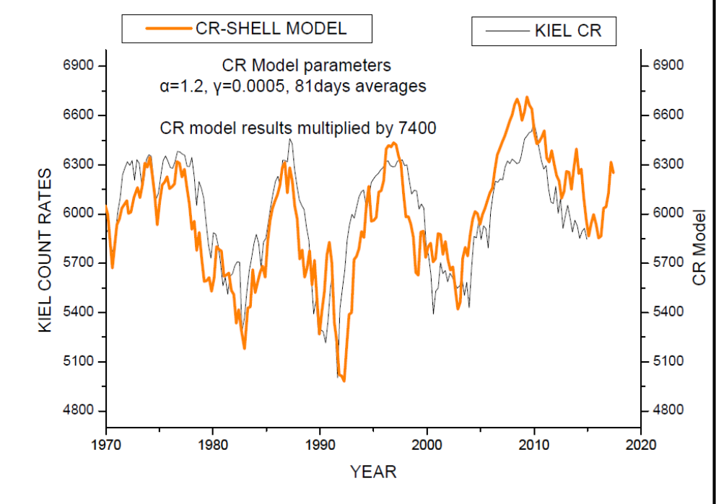

Slide 20
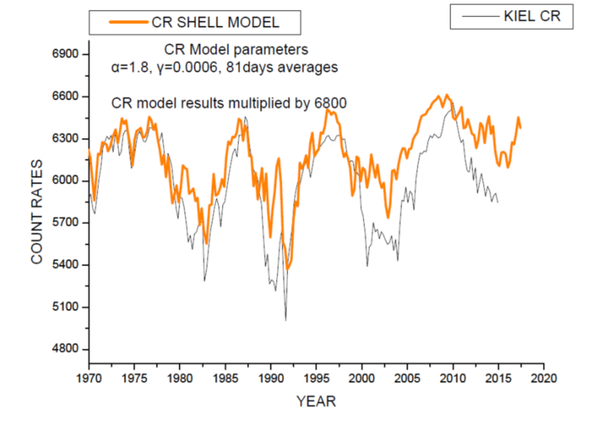
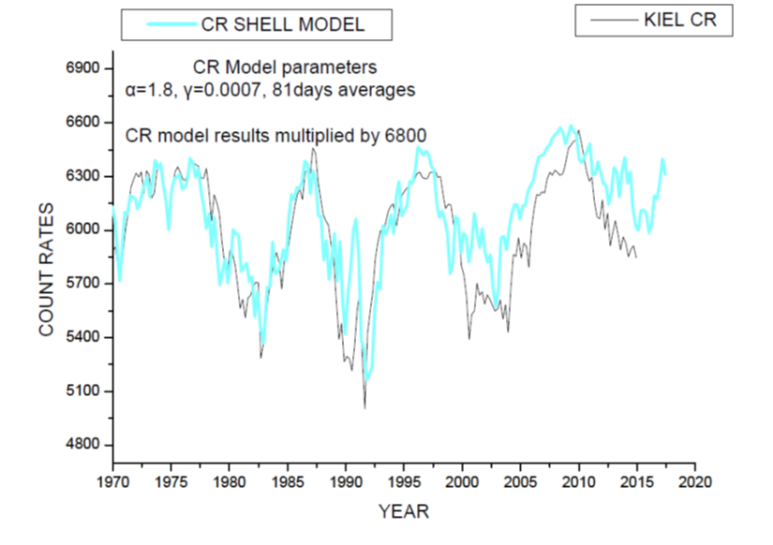
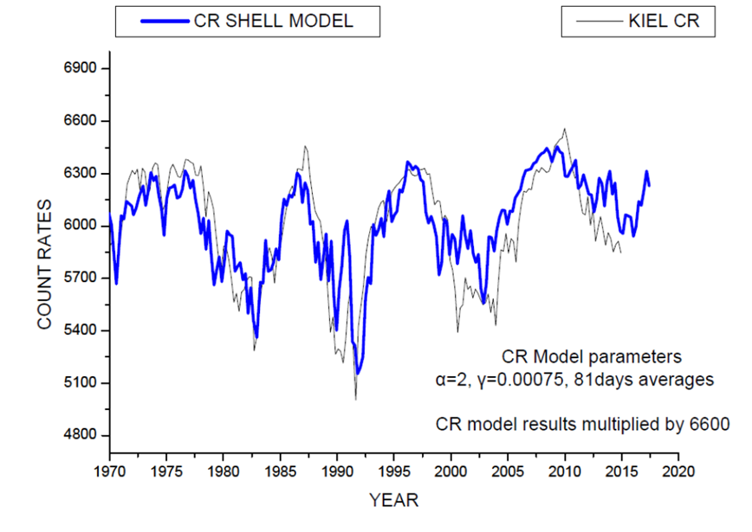
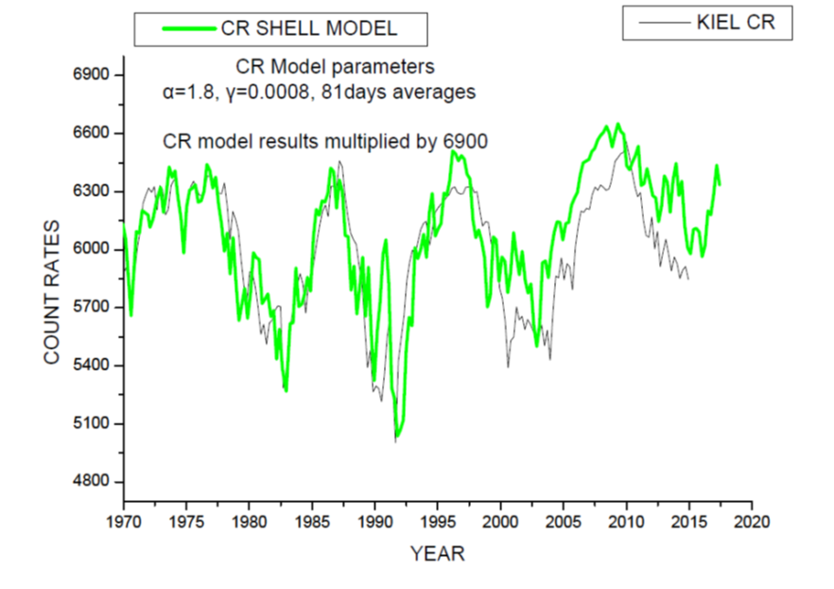

Slide 21
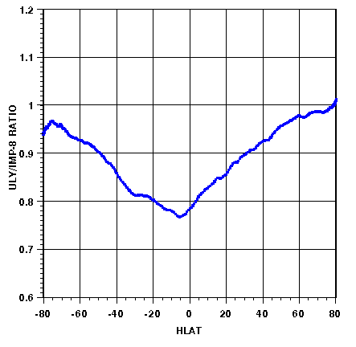

Slide 22
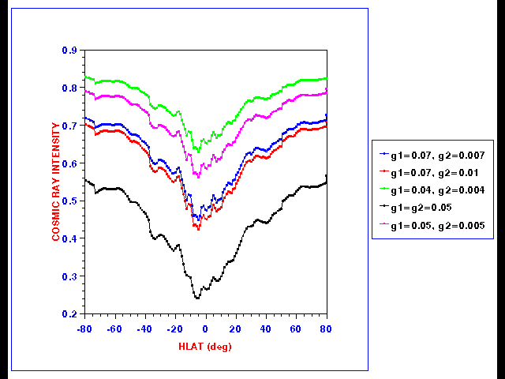

Slide 23
Cosmic ray 1D shell model (red), also diffusion only, adiabatic deceleration model compared with Climax Neutron Monitor

Slide 25
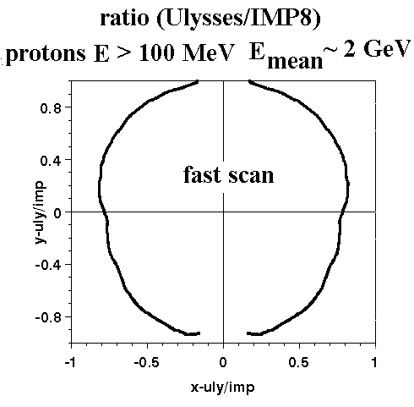
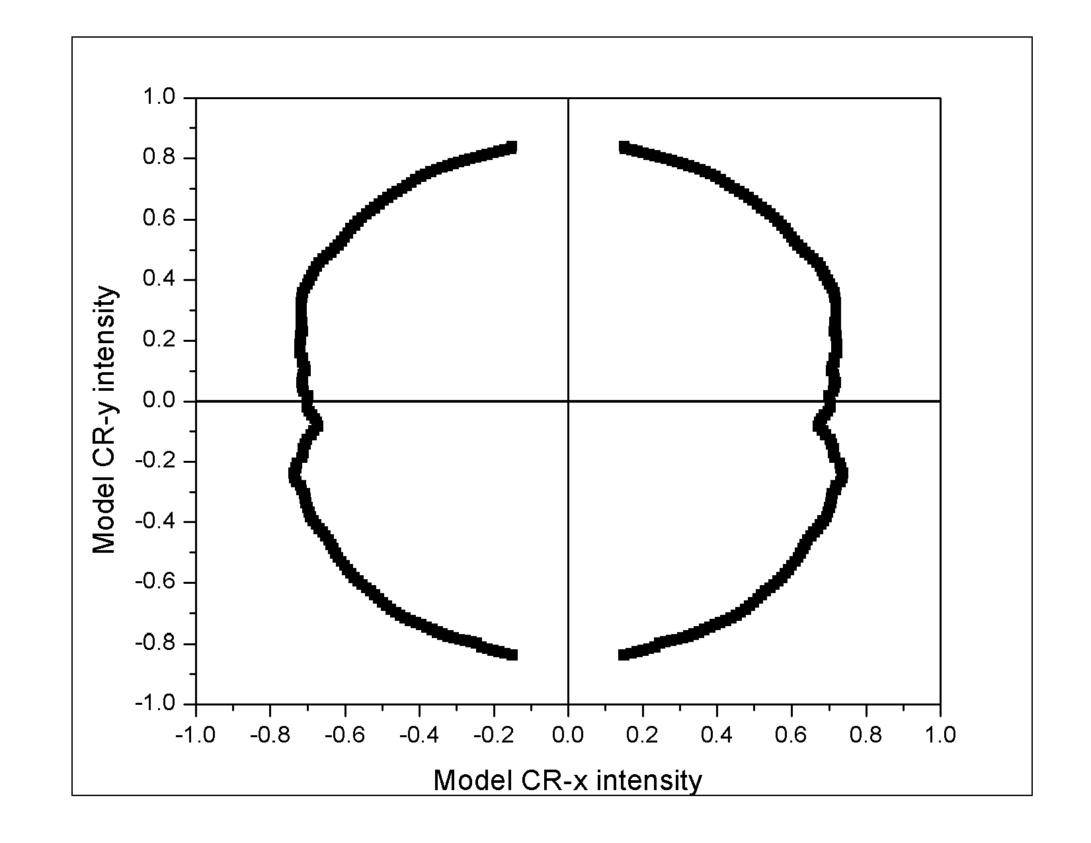

Slide 27


Slide 28
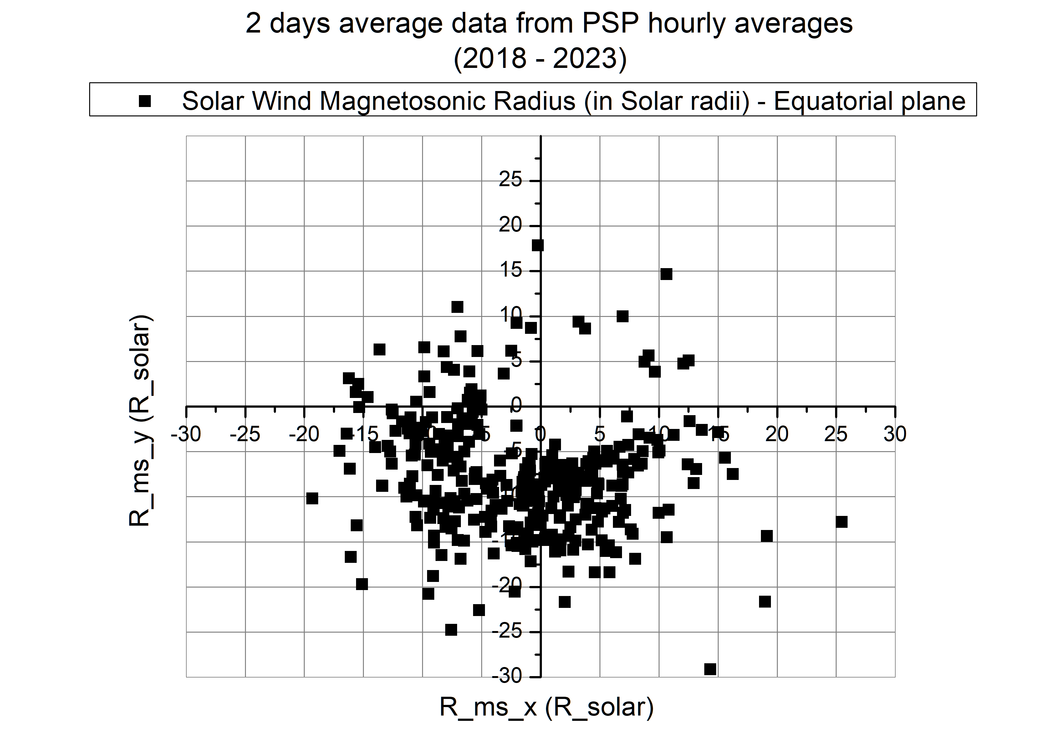
Magnetosonic surface

Slide 29
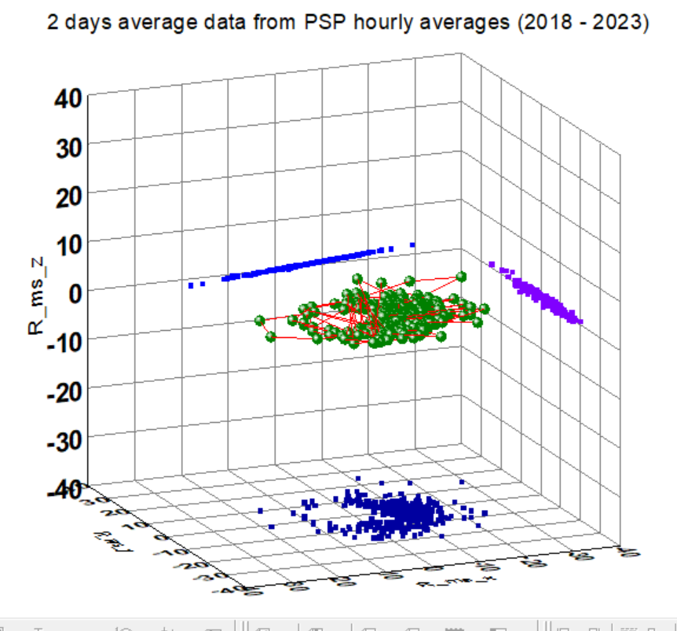

MS surface

Slide 30
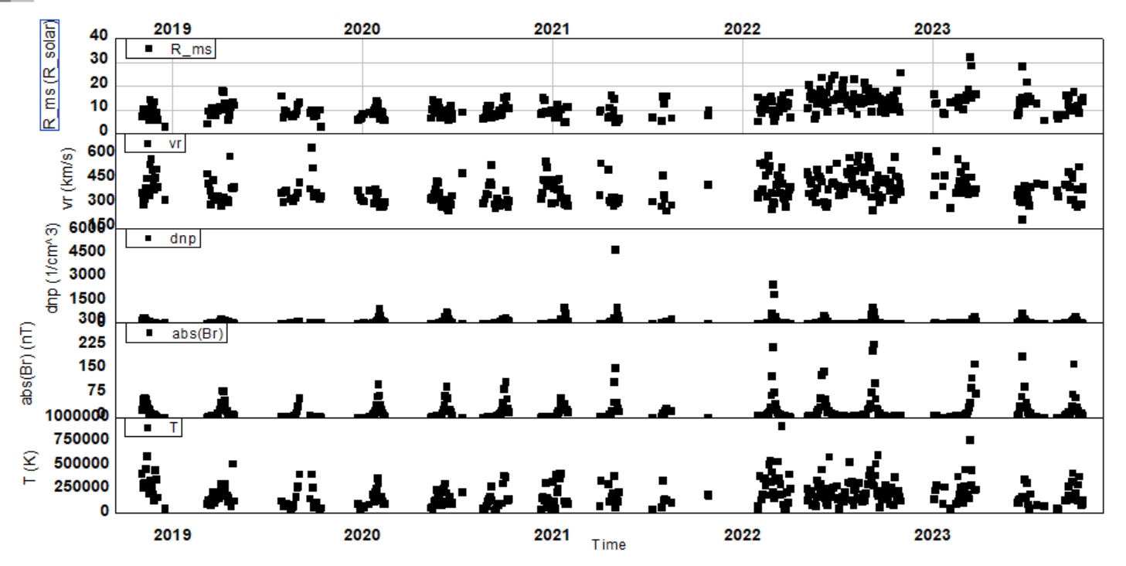

Slide 31
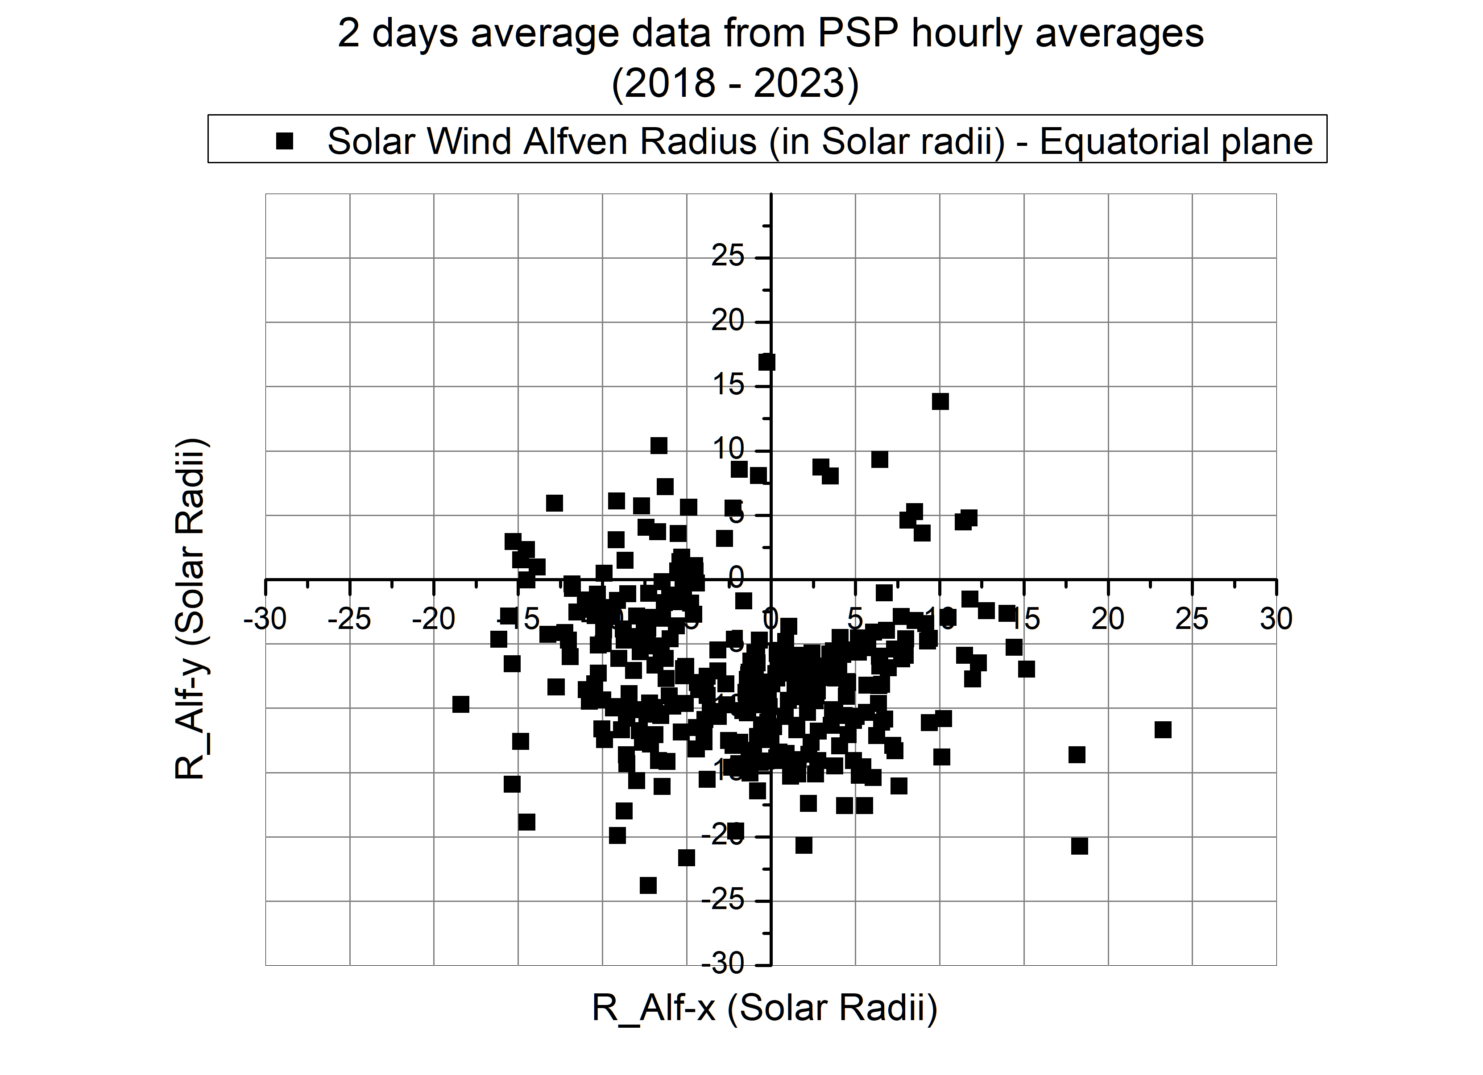
Alfven surface

Slide 32
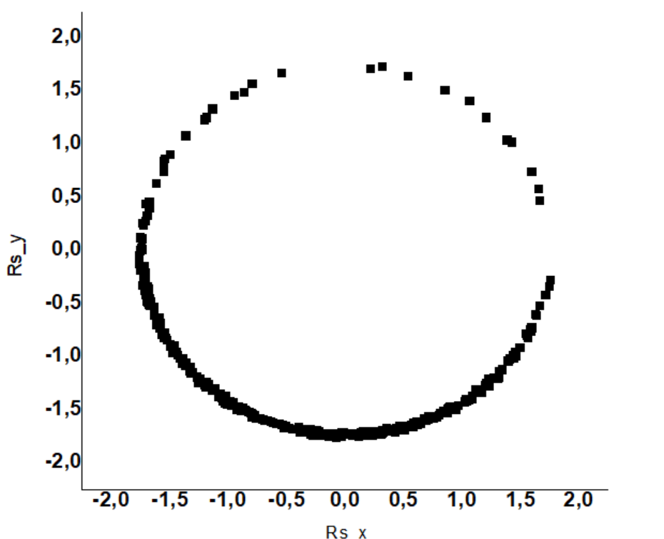
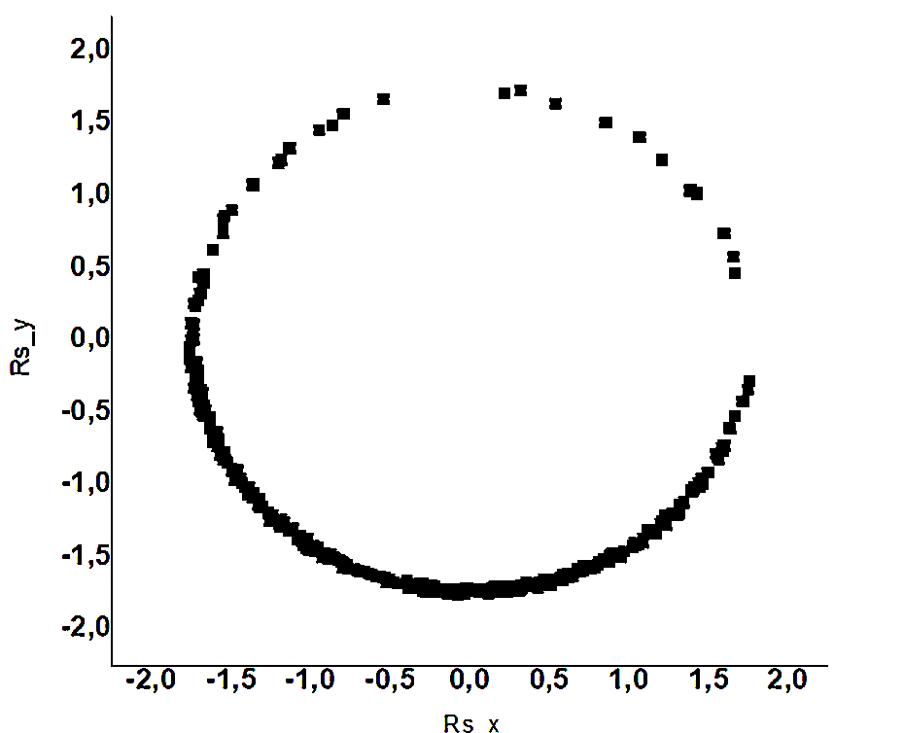
As expected magnetosonic and Alfven surfaces coinside
Sonic

Slide 33
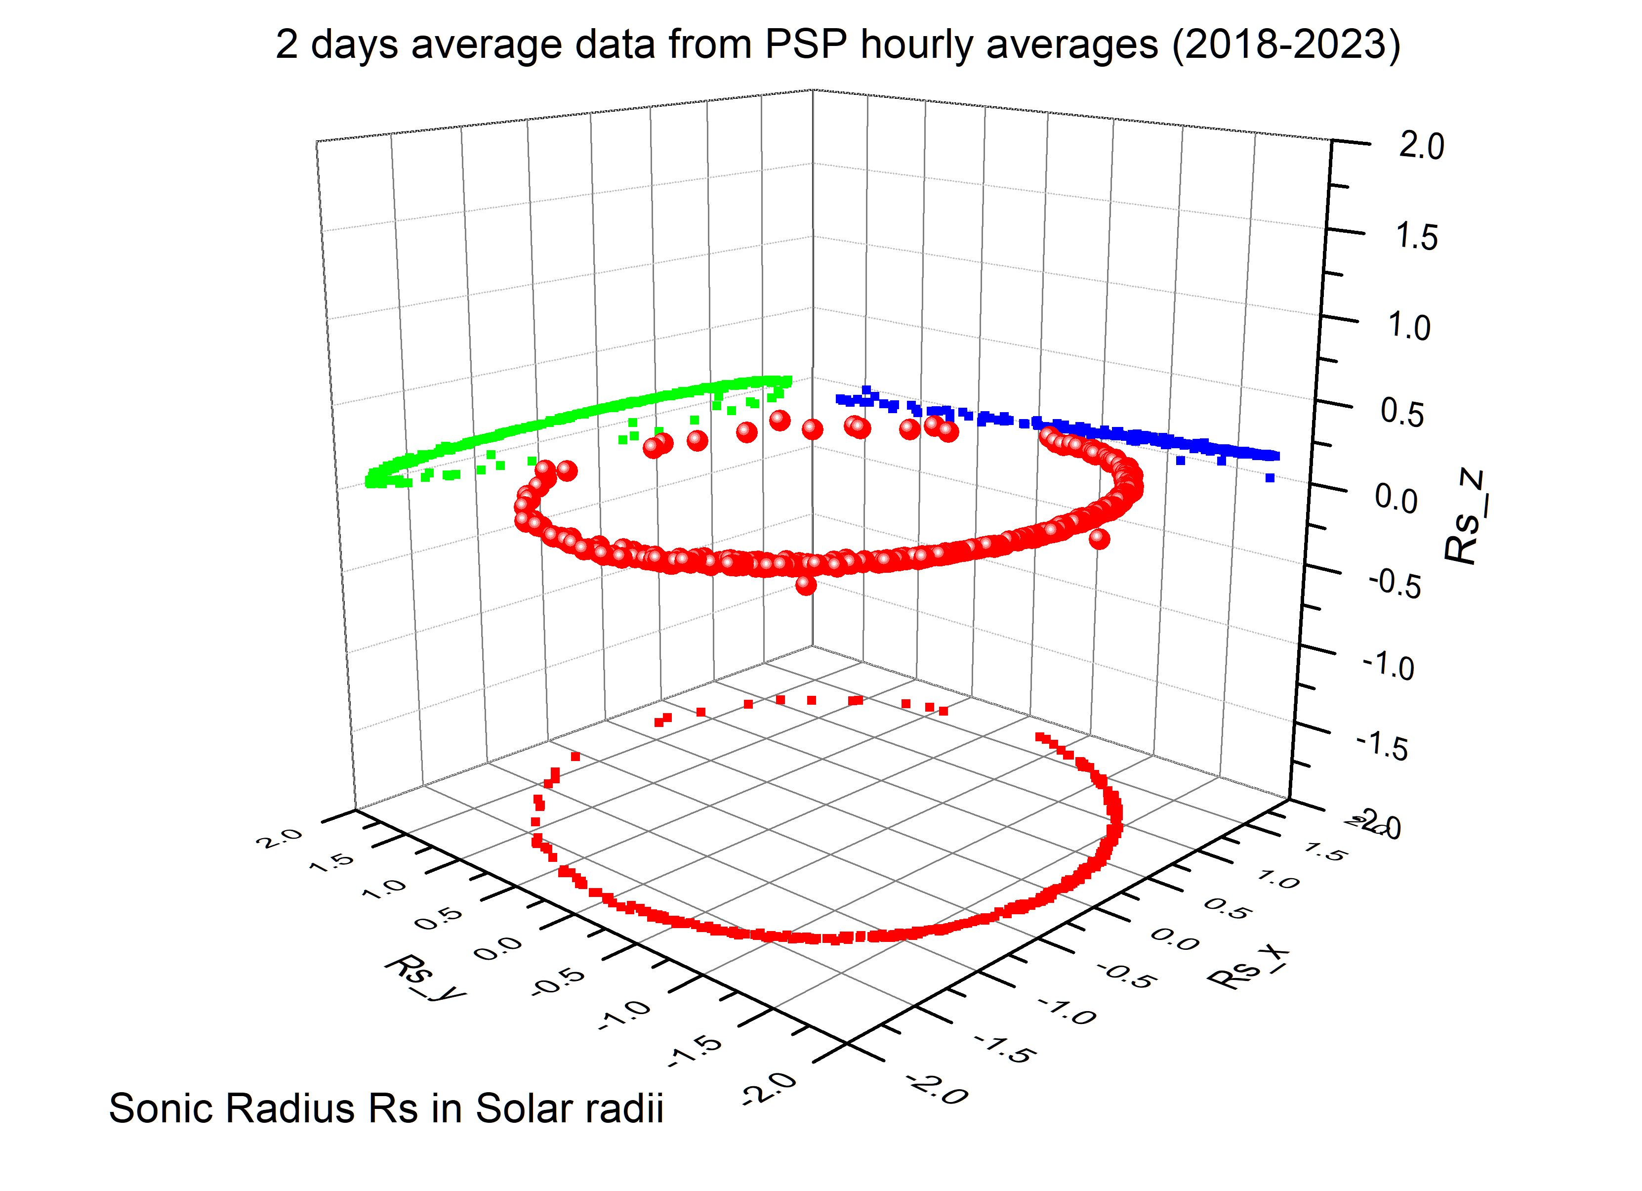
Sonic surface

Slide 34
Sonic surface

Slide 35
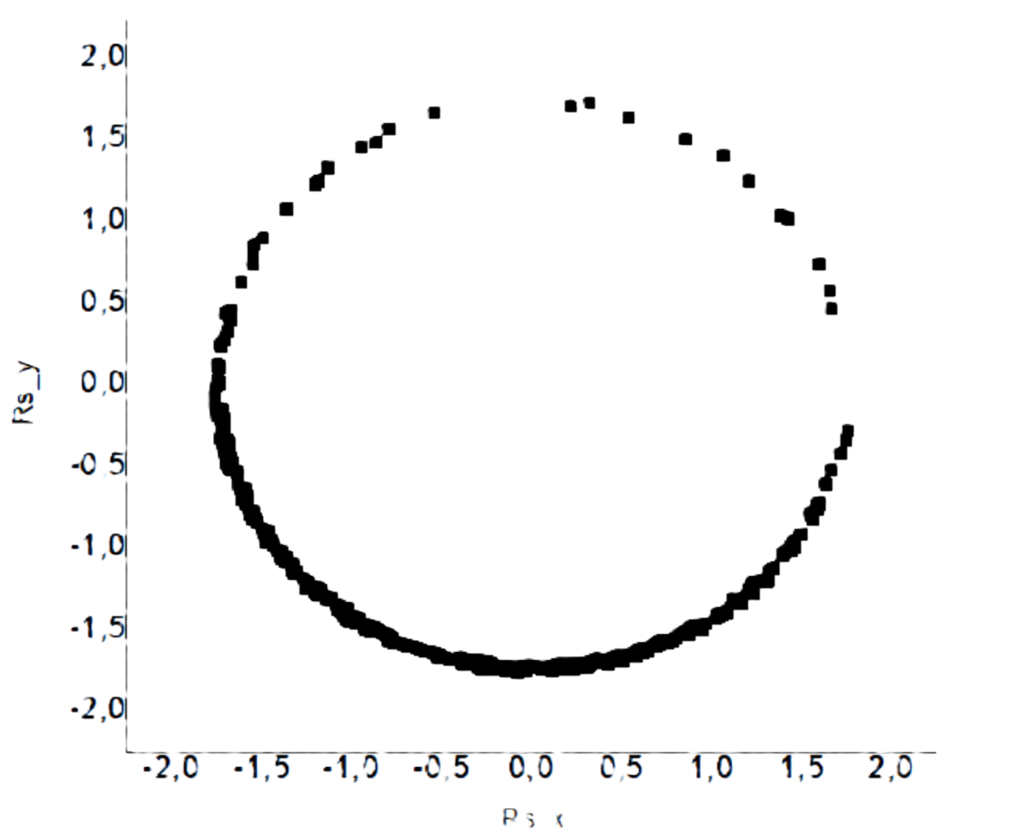
CREDIT
data NSSDCA, PSP OMNI
Solar Orbiter/Metis Team/ ESA & NASA; Mauna Loa Solar Observatory/HAO/NaCAR/NSF; Predictive Science Inc./NASA/NSF/AFOSR; NASA/SDO/AIA

Slide 36
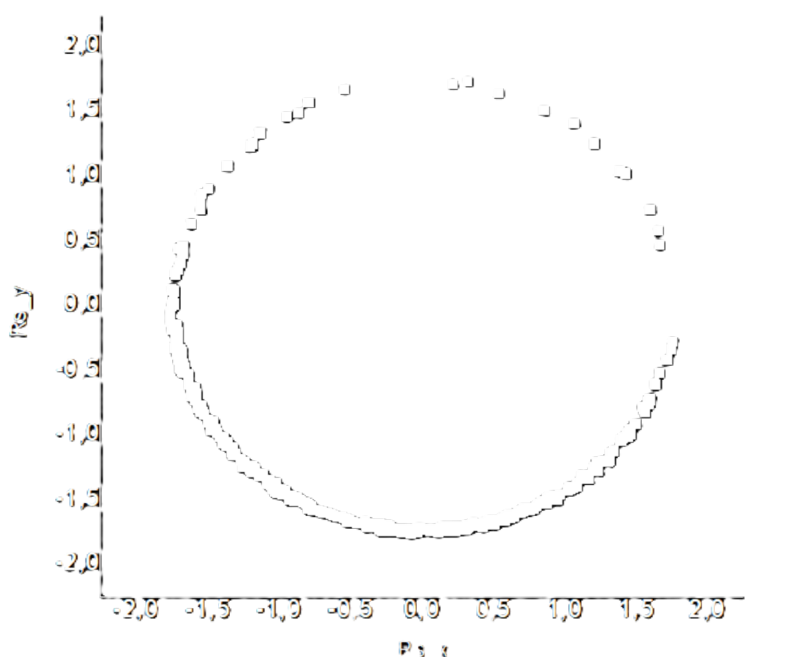
CREDIT
data NSSDCA, PSP OMNI
Solar Orbiter/Metis Team/ ESA & NASA; Mauna Loa Solar Observatory/HAO/NaCAR/NSF; Predictive Science Inc./NASA/NSF/AFOSR; NASA/SDO/AIA

Slide 37
credit: NASA/ESA/SOHO/SDO/Joy Ng
and MLSO/K-Cor)

Slide 38
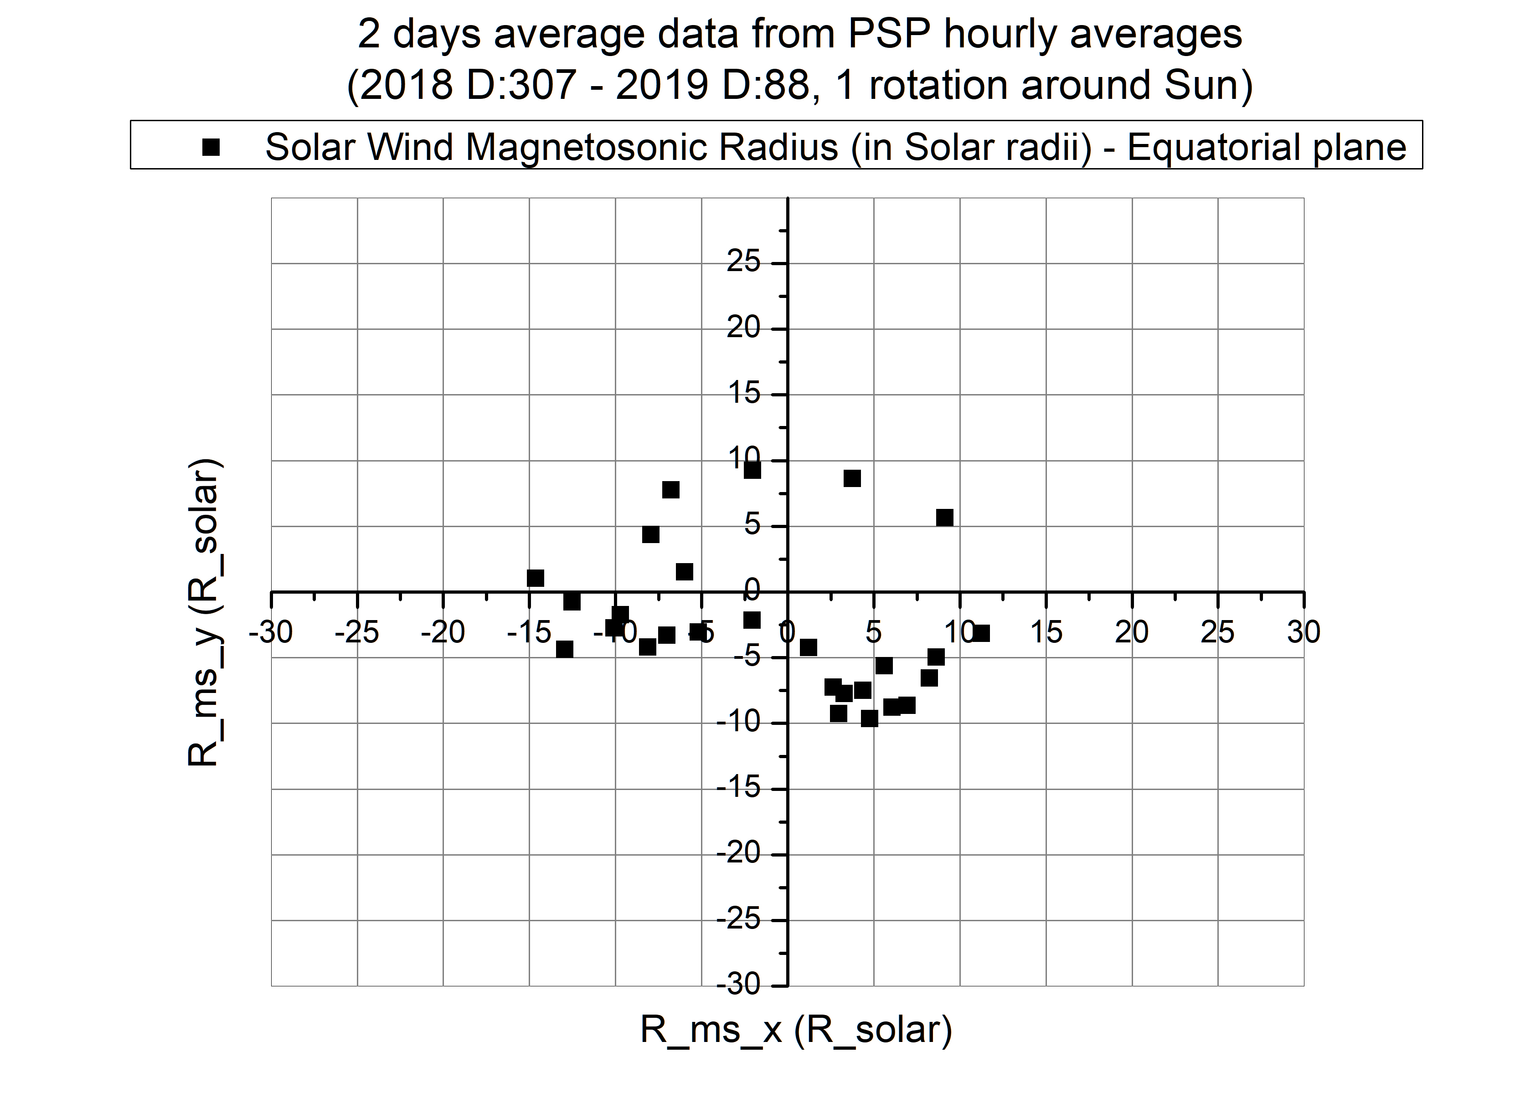

Slide 39
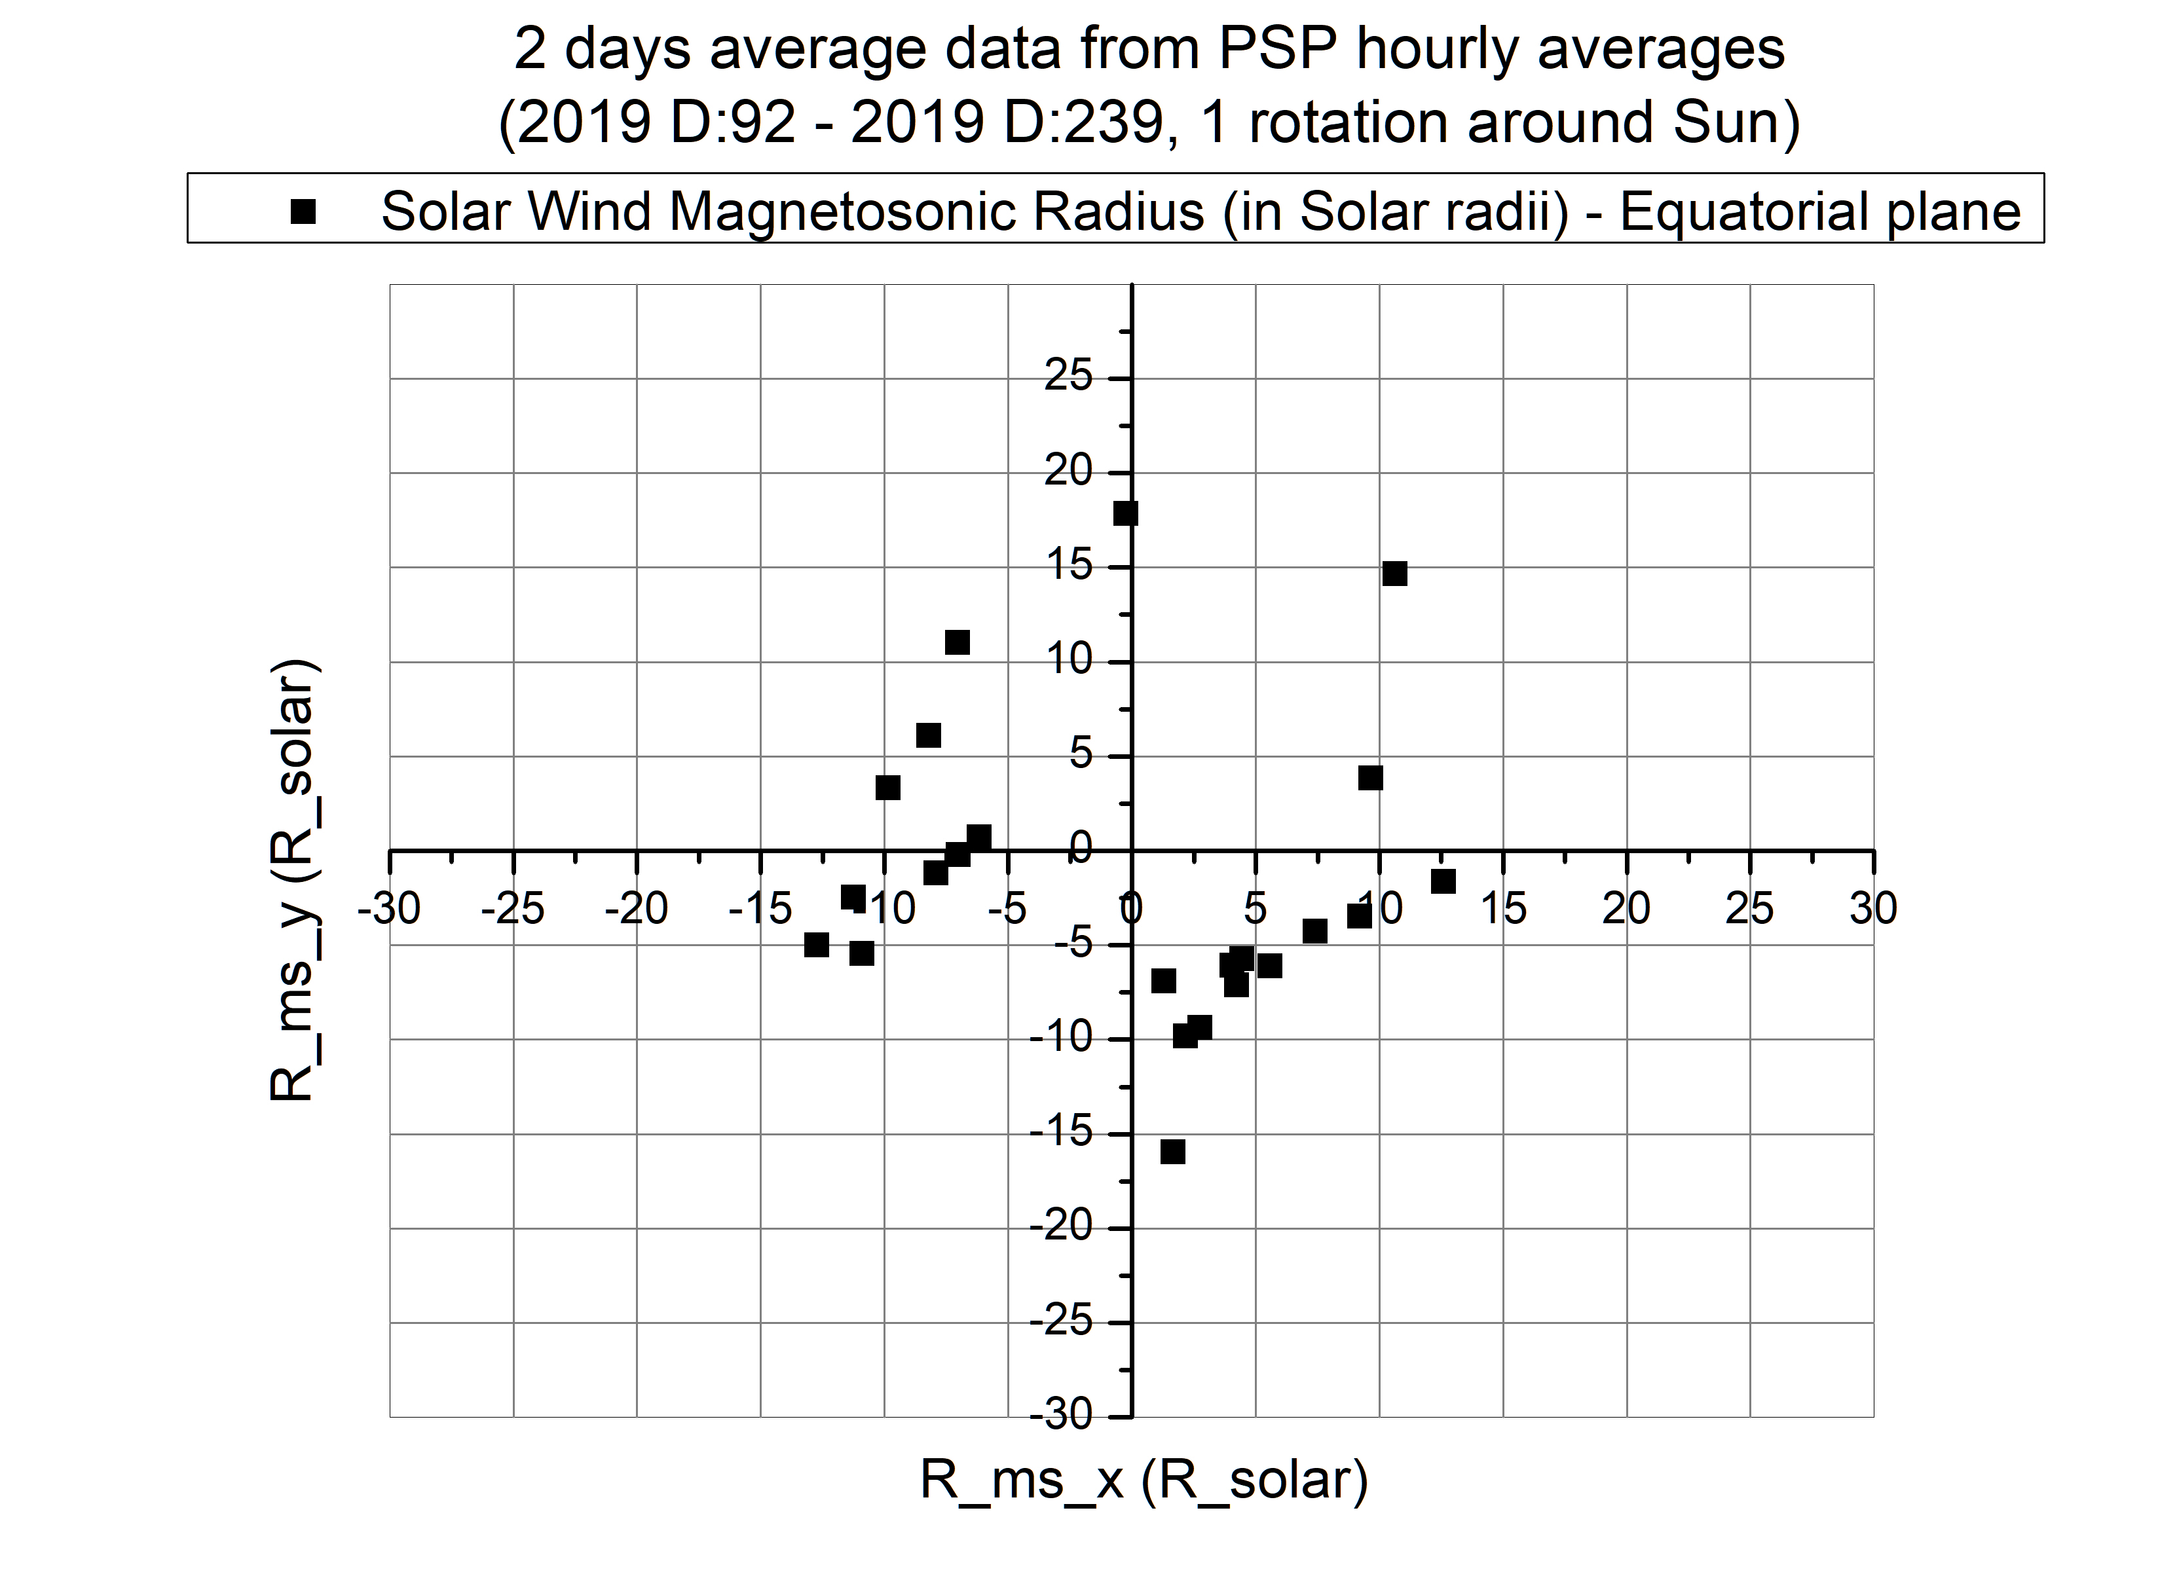

Slide 40
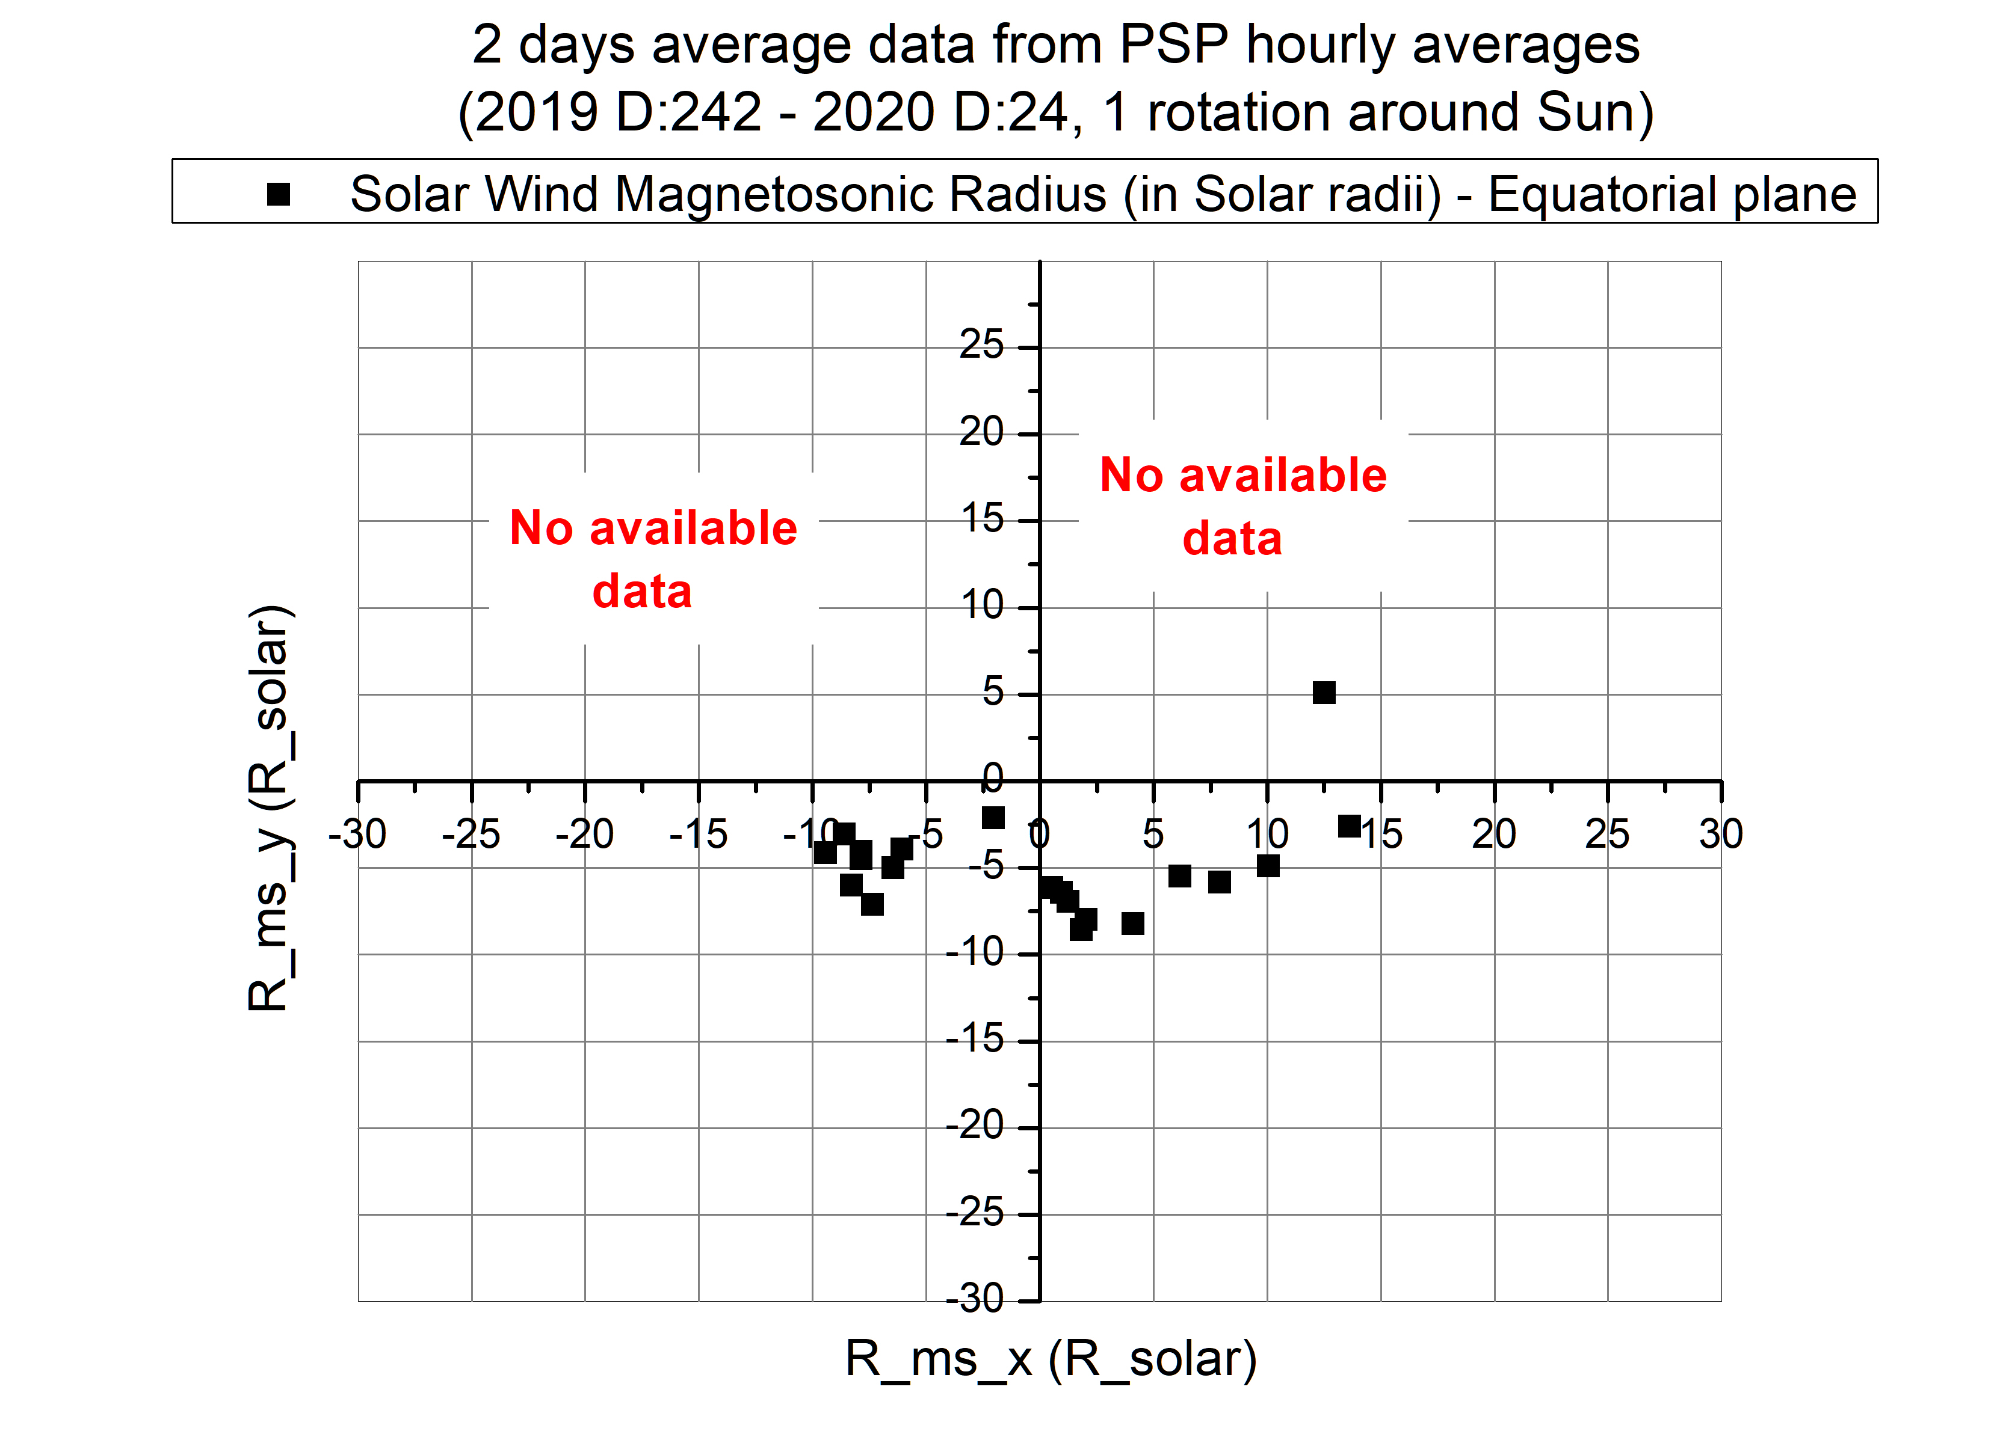

Slide 41
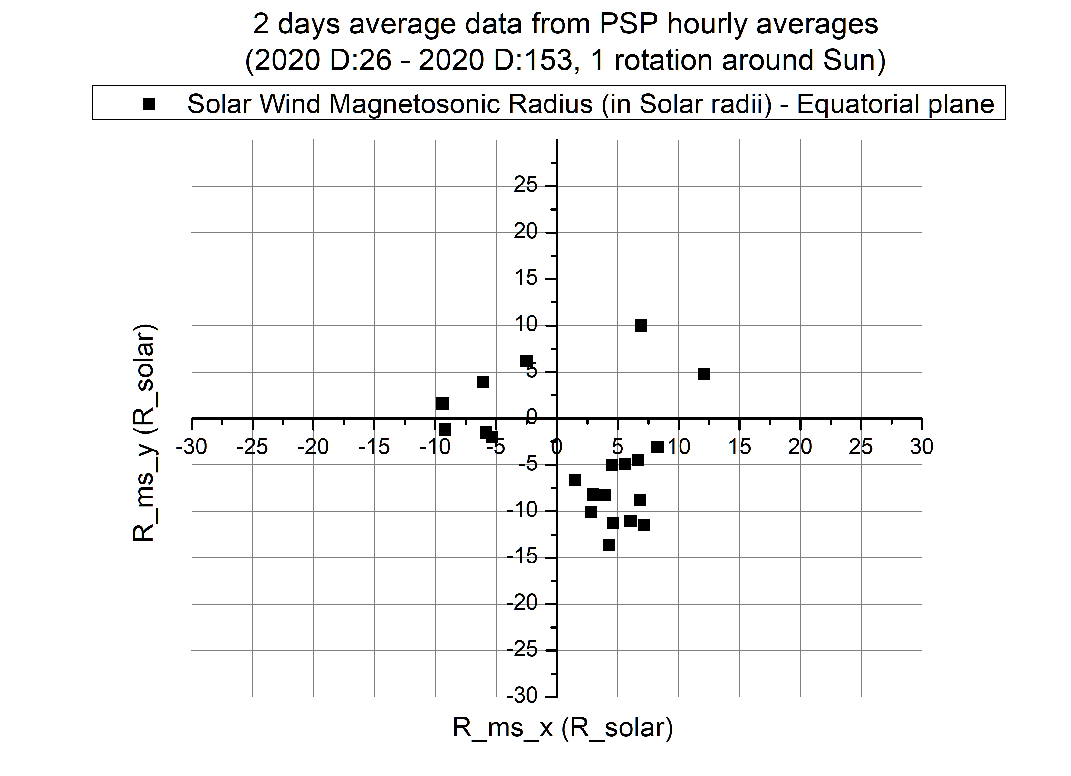

Slide 42
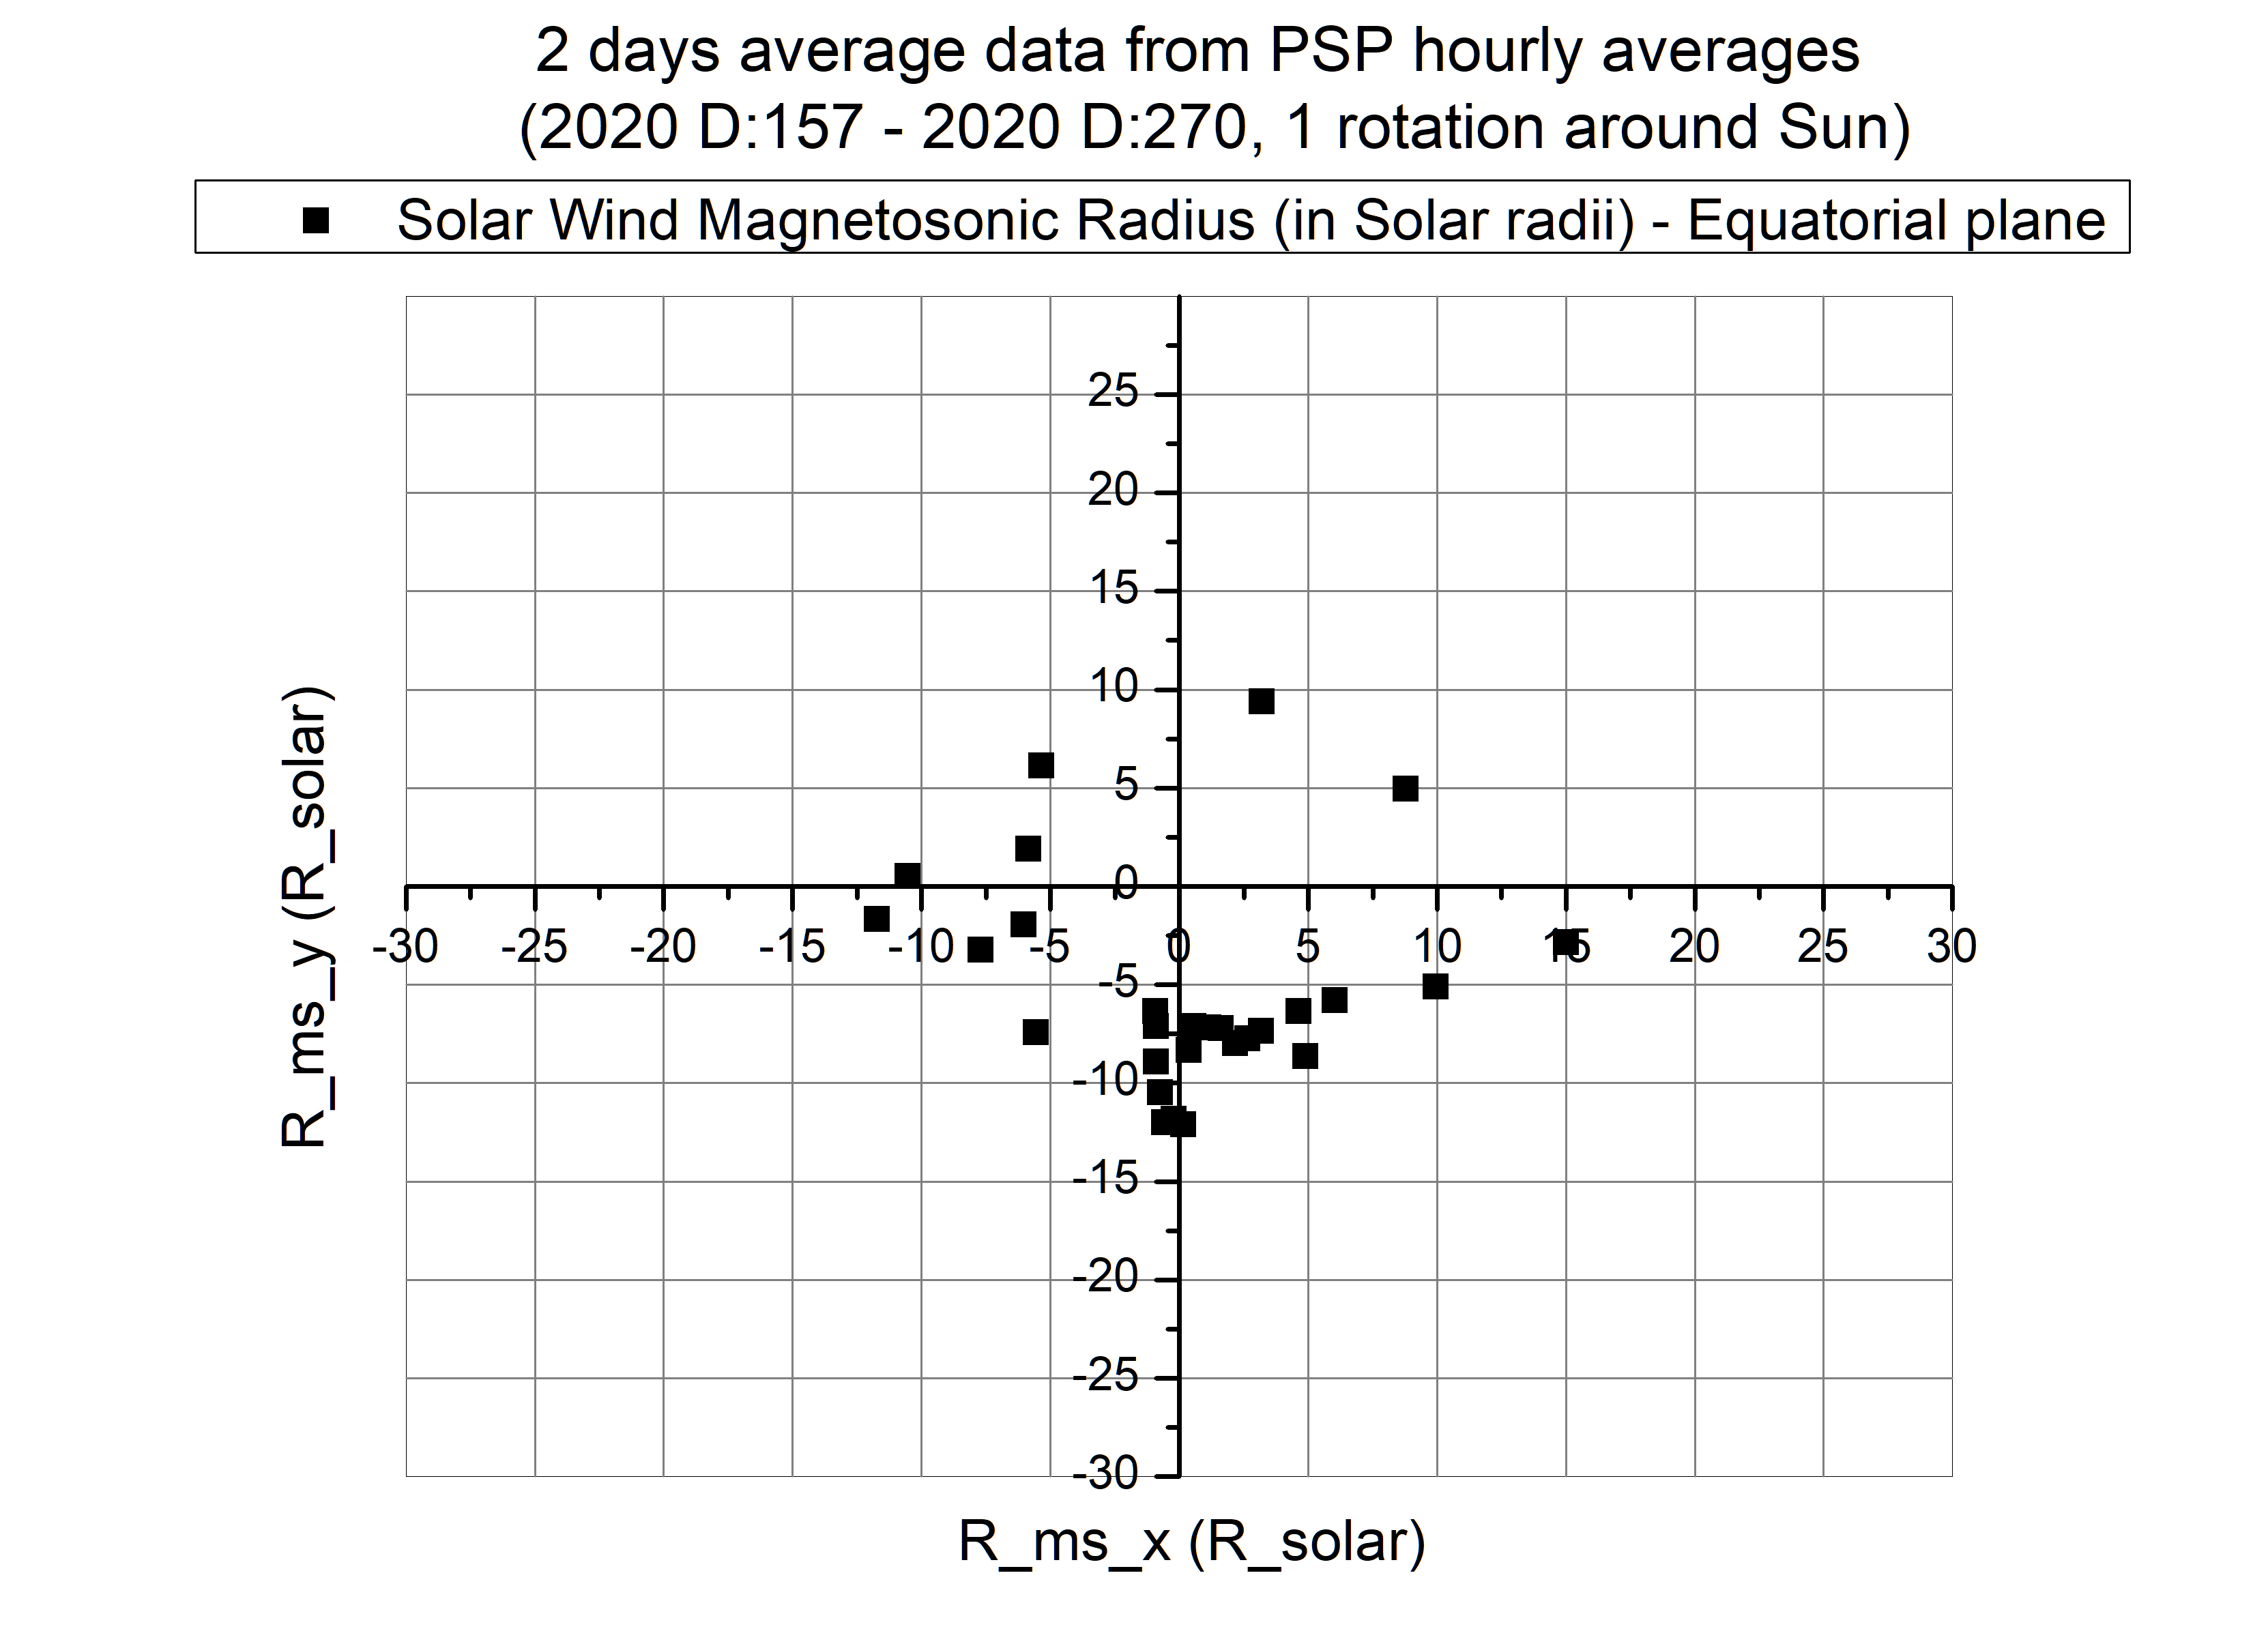

Slide 43
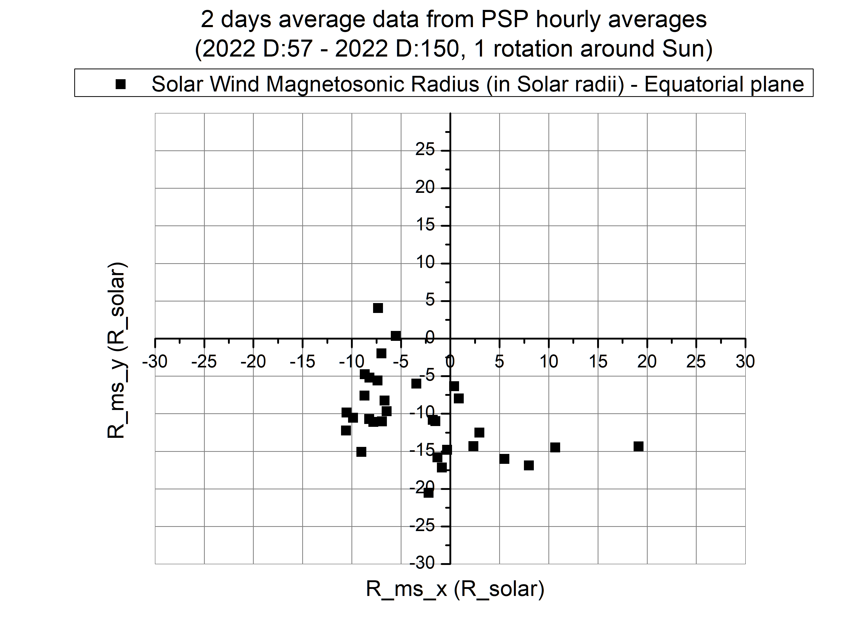

Slide 44
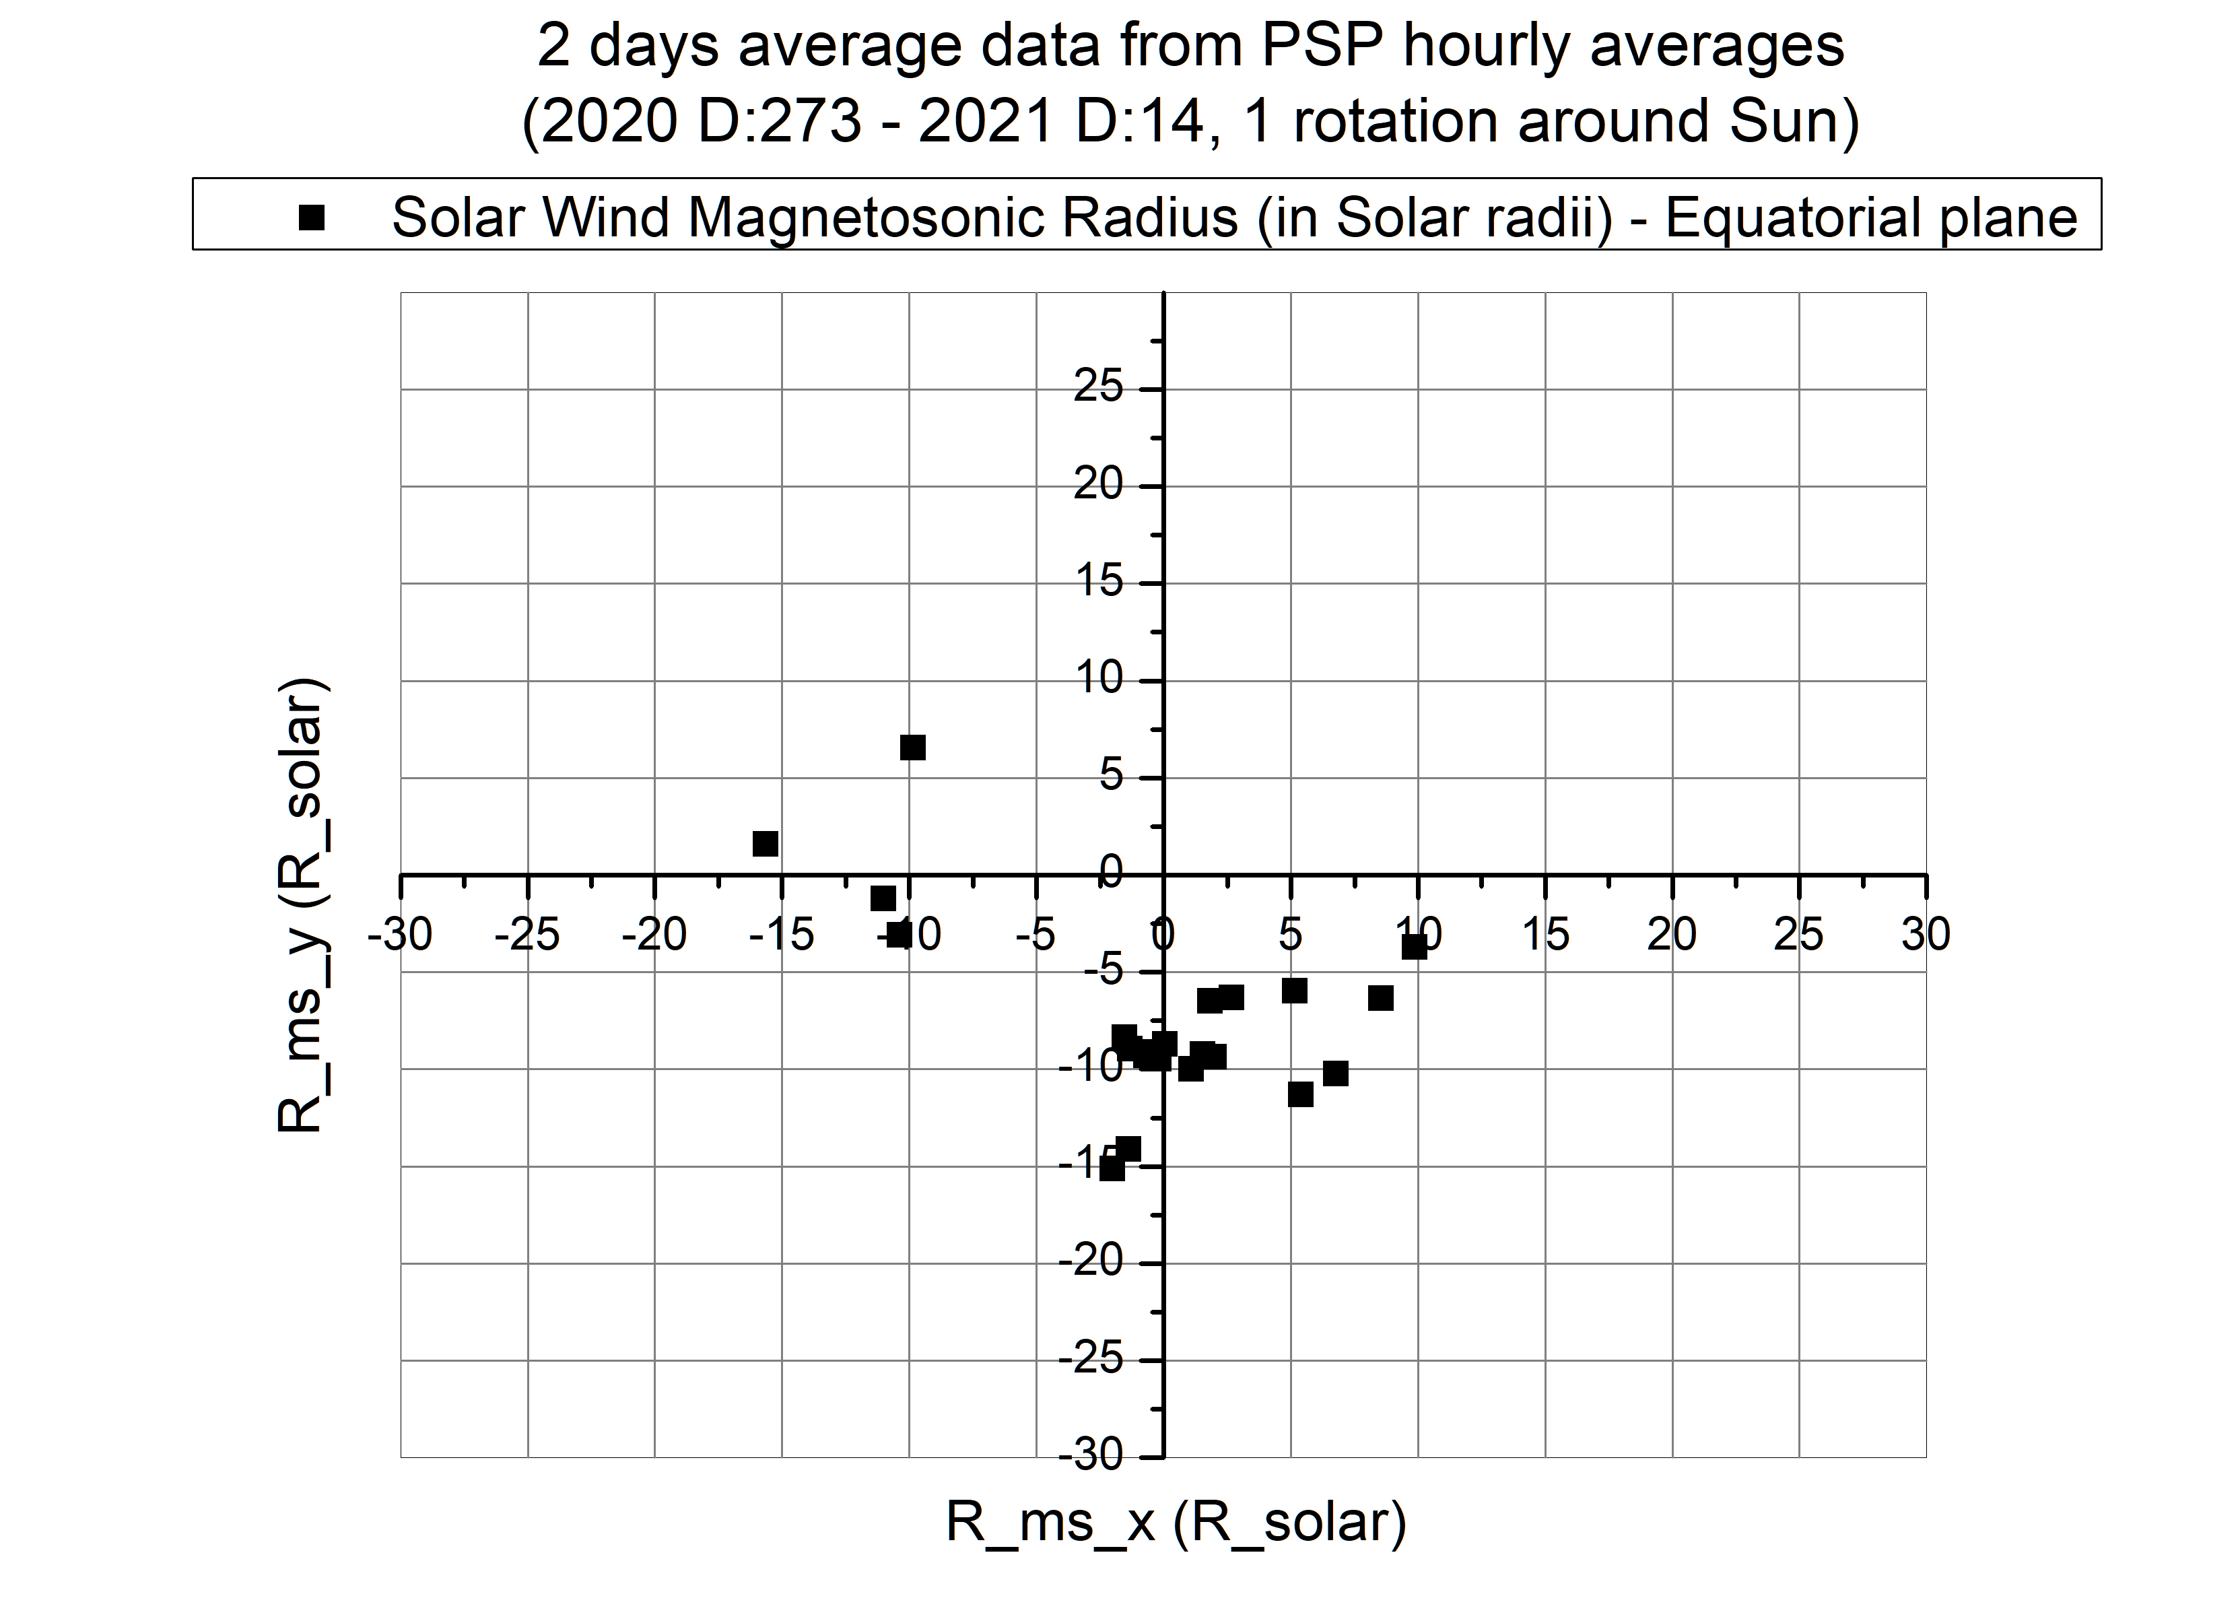

Slide 45
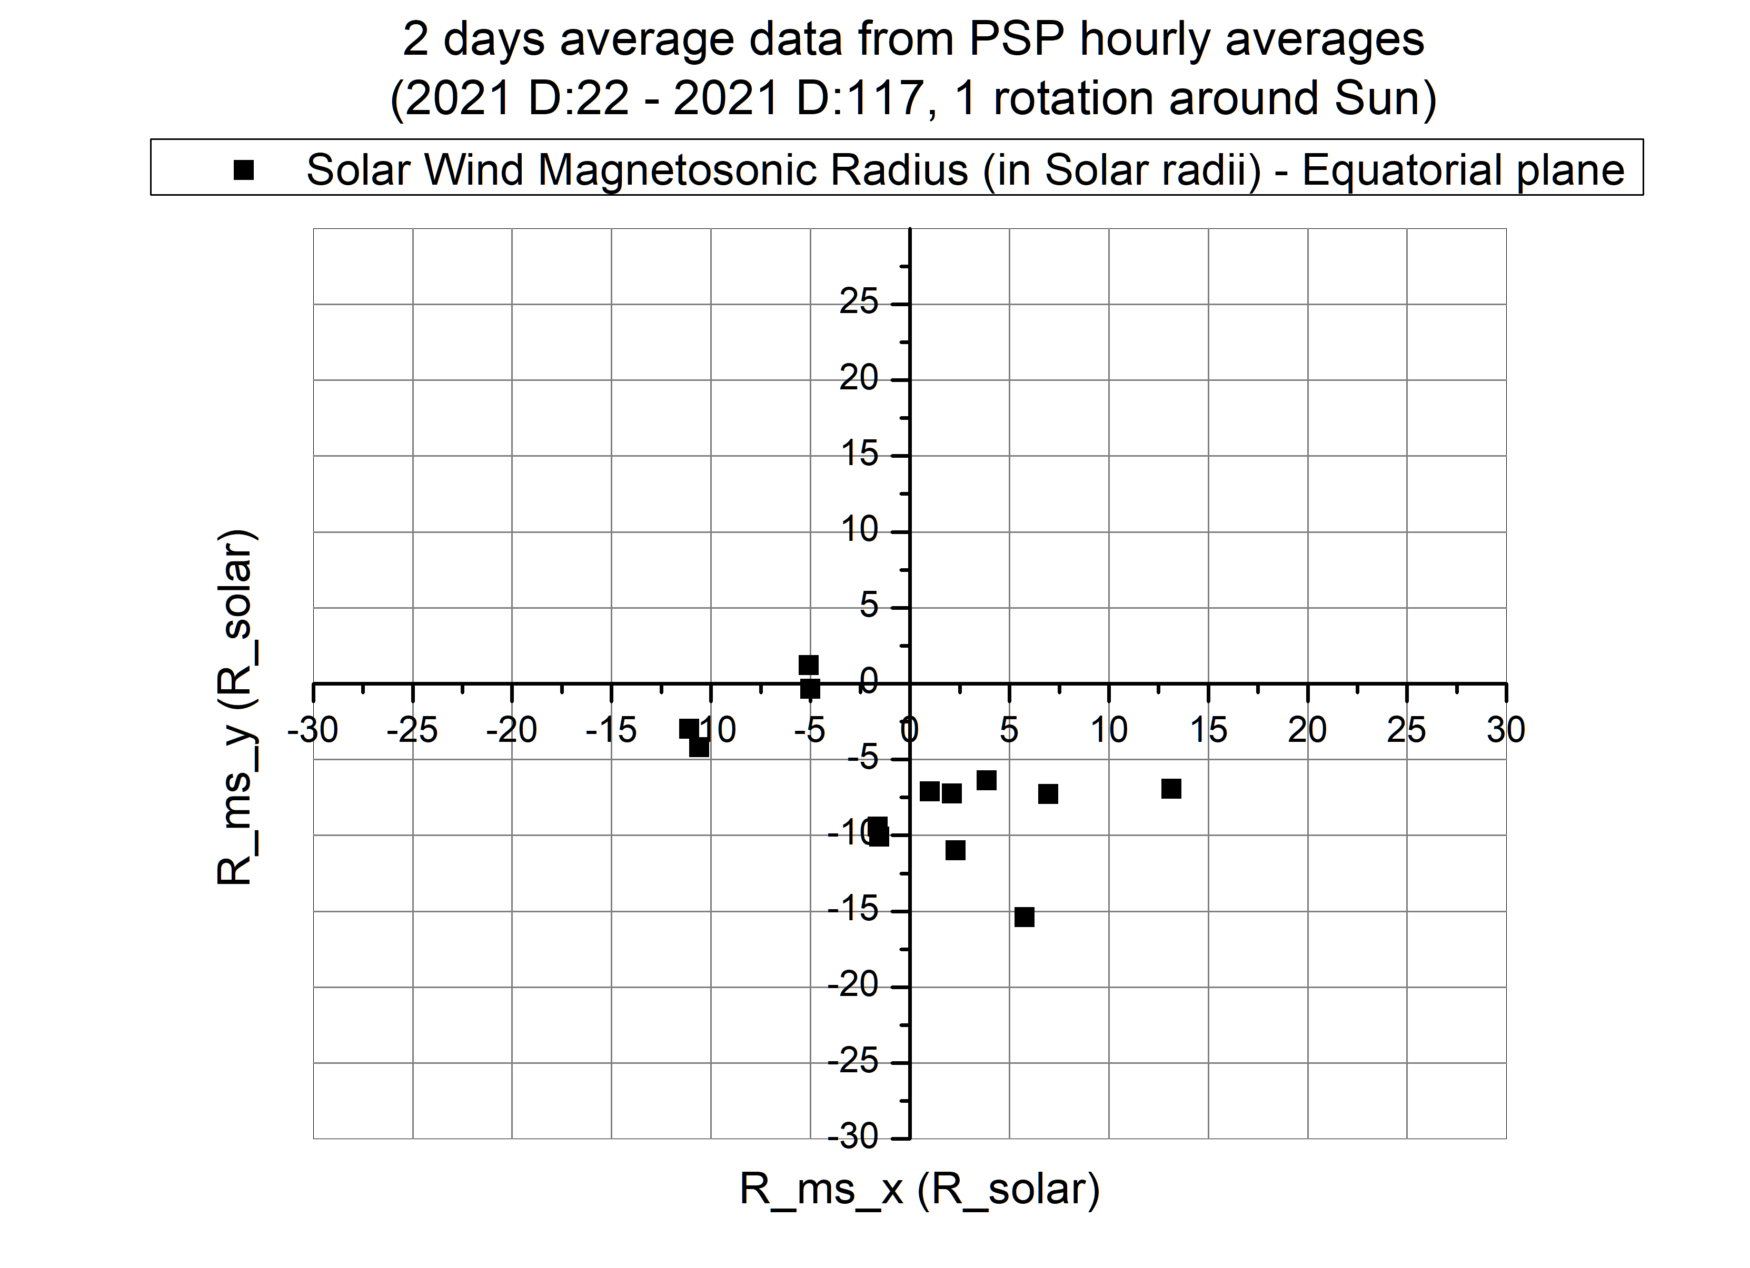

Slide 46
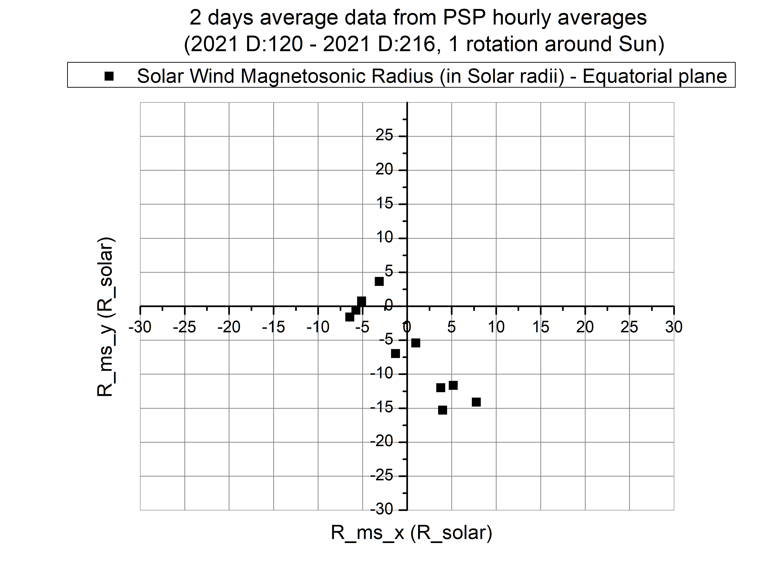

Slide 47
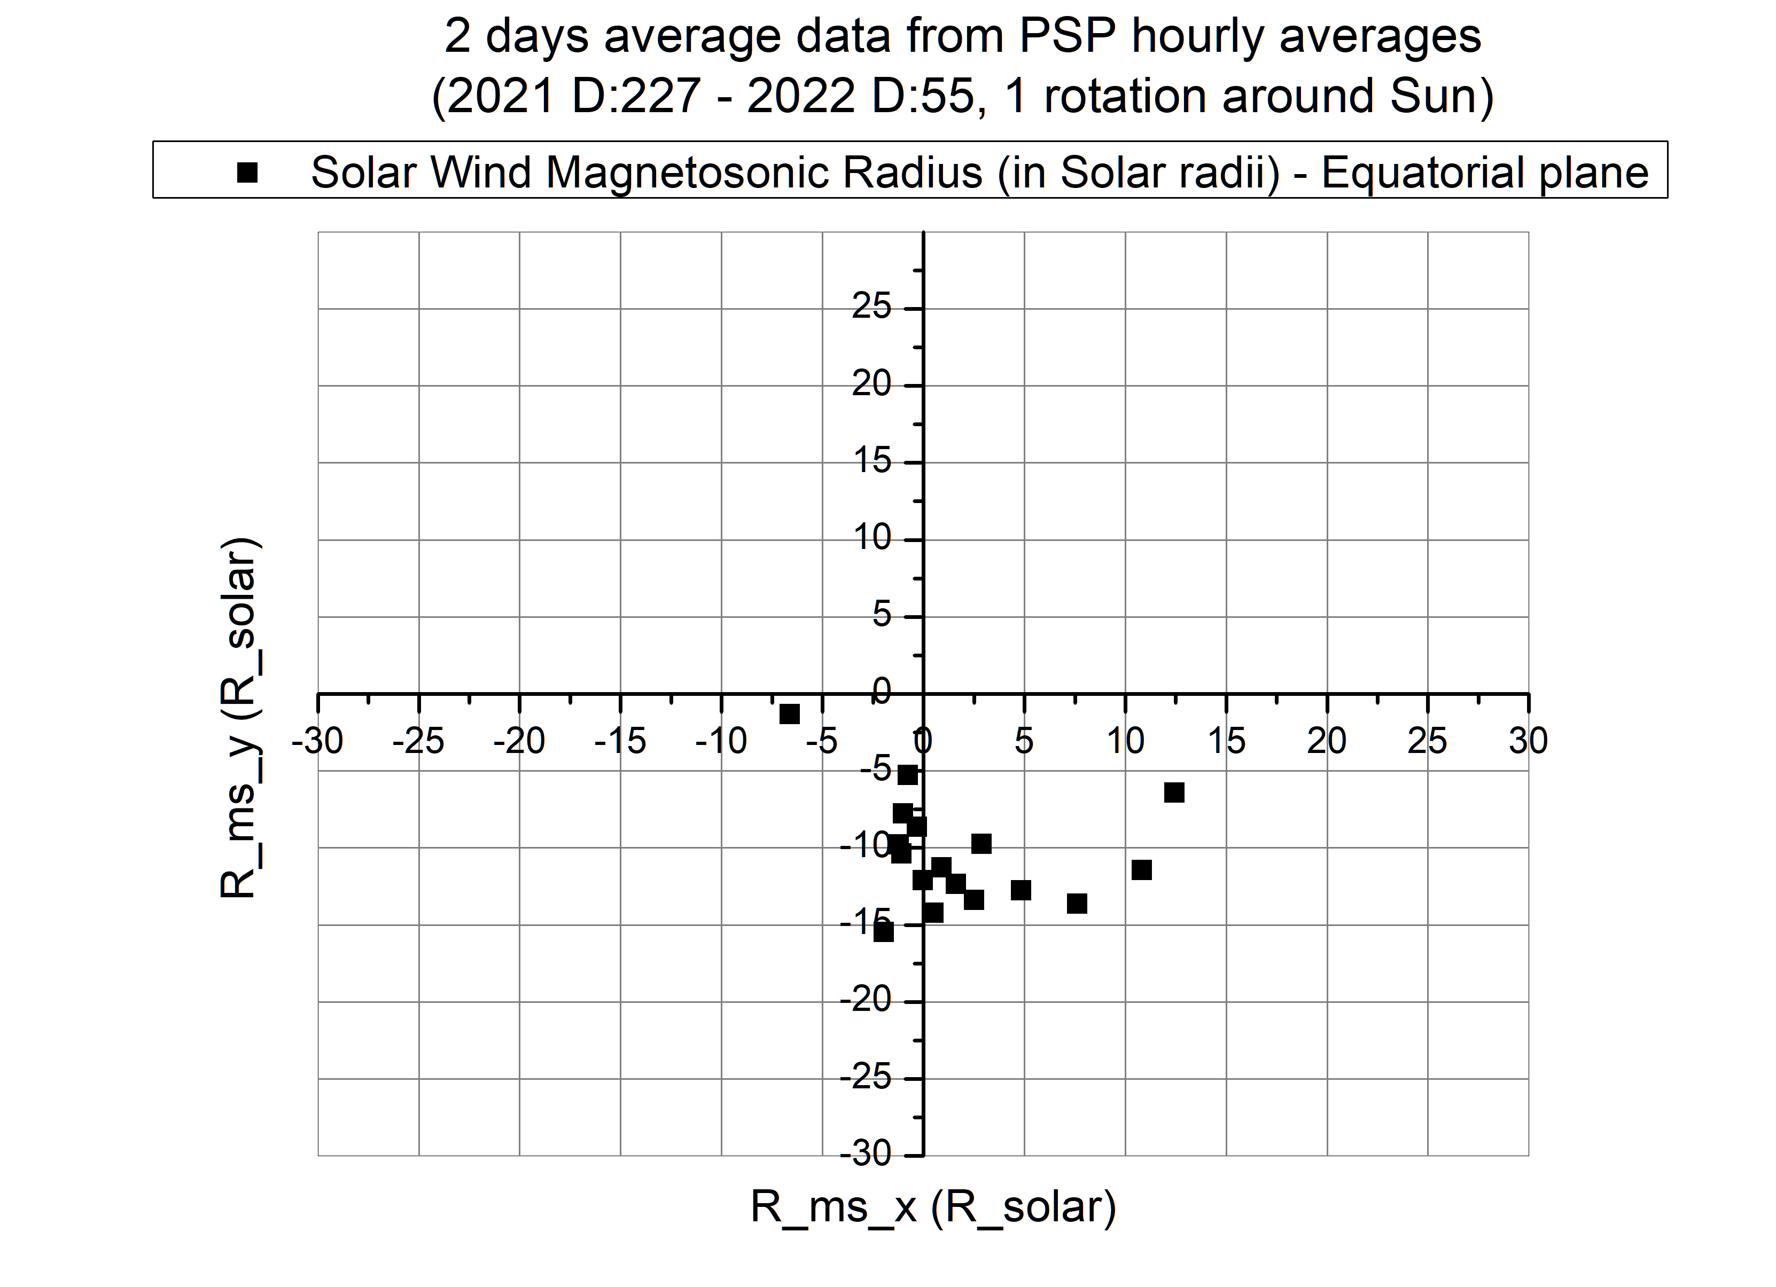

Slide 48
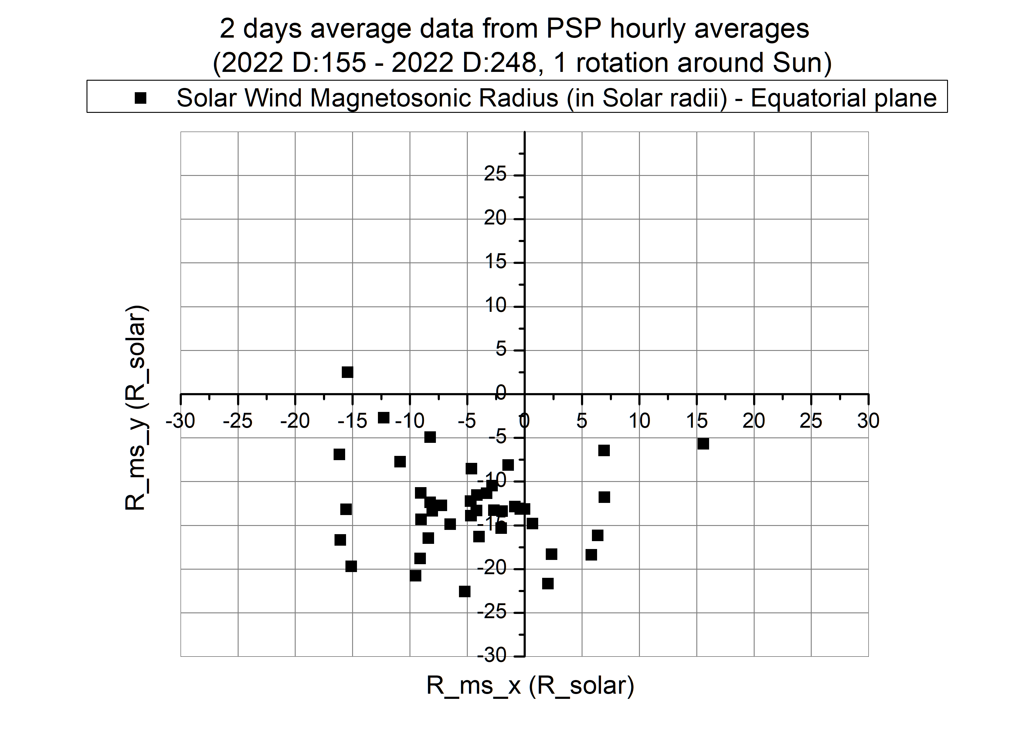

Slide 49


Slide 50


Slide 51


Slide 52


Slide 53


v

Slide 54


Slide 55


Slide 56


Slide 57


Slide 58
Sonic surface

Slide 60

appendix

Slide 61



Slide 63


Slide 64



Slide 65


We express the velocity potential of the flow after the termination
shock in the form (Fahr et al. 1993; Nerney & Suess 1995)
where P are the associated Legendre polynomials

Slide 66




Slide 67

the only unknown parameters are
the termination shock radius
and the heliopause radius r_{s} r_{h}
r_{s} (0) can be determined from:
r_{h}(0) can be determined from the one-dimensional model by
Khabibrakhmanov et al. 1996)
r_{h}(0)- r_{s}(0)=37.6 AU .

Slide 68


CR modulation

