Slide 1
Comparison of GLE event of 11 May 2024 and Magnetospheric effect 5 November 20-23.
Balabek Sargsyan, Ashot Chilingarian
A I Alikhanyan National Lab (Yerevan Physics Institute), Yerevan 0036, Armenia

Slide 2
Introduction
We examine the energy spectra of secondary particles linked to solar events to identify and research Forbush decreases (FD), ground-level enhancements (GLE), and magnetospheric effects (ME) detected by particle detector networks on Earth's surface. Our findings underscore the role of magnetic reconnection in allowing low-energy galactic cosmic rays (GCR) to penetrate the magnetosphere, leading to enhanced secondary particle fluxes through reduced cutoff rigidity—a phenomenon known as the magnetospheric effect (ME). In contrast, the Forbush decrease (FD) driven by the scalar magnetic field strength results in significant particle flux reductions. On May 10-11, 2024, the FD, directly linked to the enormous geomagnetic storm (GMS), was complicated by the simultaneous registration of secondary particles from the Solar Energetic Particle (SEP) event, which was energetic enough to generate secondary particles in space and on the ground, leading to increases in detector count rates, known as ground-level enhancements (GLEs). Using new experimental facilities, we reveal that secondary particles during ME events release up to 10 MeV energy (maximum energy of approximately 10 MeV), whereas, during the GLE event, the energy release extends to 100 MeV. These insights contribute to refining event classification schemes and predictive models of space weather.

Slide 3
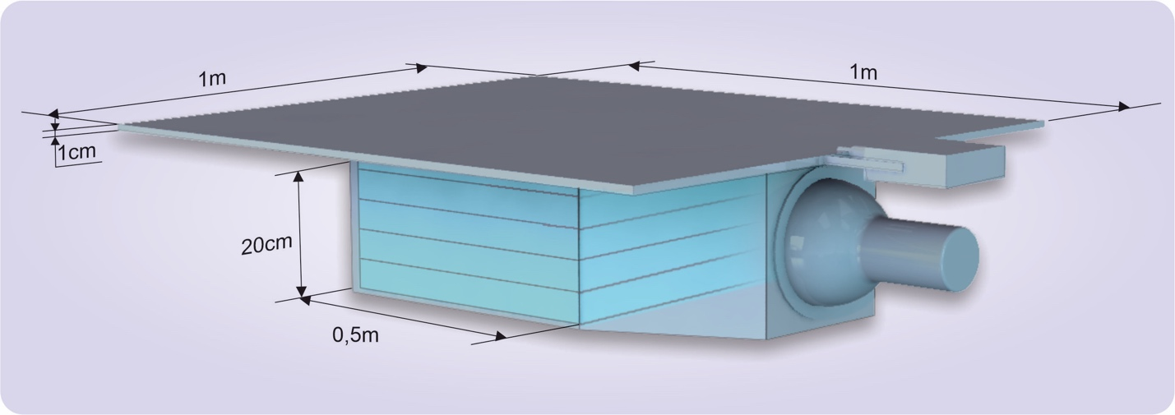
SEVAN light spectrometer
After recognizing that charged fluxes are as sensible to solar modulation as neutrons, we commissioned new SEVAN-light detectors with two layers without lead (see Fig. 1). Also, SEVAN’s electronics board was updated with a new capability to measure and store energy-release histograms of charged and neutral particles each minute. The logarithmic ADC provides linearity from 5 to 100 MeV. Using the veto signal from the upper thin scintillator, the detector separates charged and neutral fluxes: “01” coincidence the neutral particles, and “11” - charged particles.
The list of available information from SEVAN-light includes:
1-minute count rates of stacked 1 and 20-cm thick scintillators.
1-minute count rates of the coincidences “01”, signal only in 20 cm scintillator; “10” – signal only in the upper 1-cm thick scintillator, and “11” – signal in both scintillators.
Histograms of energy releases in the thick scintillator correspond to the abovementioned coincidences.
Table 1 shows the results of the SEVAN-light detector response calculation with the simulated cosmic ray flux on Aragats. As we can see in Table 1, the “01” coincidence (signal only in the bottom scintillator) comprises ≈32% of neutrons and ≈64% of gamma rays. The contamination of charged particles is negligible; thus, with the "01" coincidence, we achieve a large purity of selected neutral particles. The ”11” coincidence selects ≈63% of negative and positive muons and ≈23% of electrons and positrons; the share of neutral particles is ≈ 8%. Consequently, by the “11” coincidence, we select charged particles. Thus, using a SEVAN-light detector, we separate neutral and charged fluxes and measure the energy releases of each separately.
Figure 1. Detector SEVAN-light measuring charged and neutral species of cosmic rays and their energy releases.
Table 1. The share of cosmic ray species selected by different coincidences of the SEVAN-light detector in percent.
SEVAN-light | Neutron (%) | Proton (%) | mu+ (%) | mu- (%) | e- (%) | e+ (%) | gamma ray (%)
Coin. “01” neutral | 32,1 | 0,3 | 1,0 | 0,9 | 1,0 | 0,9 | 63,8
Coin.”11” charged | 1,6 | 6,4 | 33,3 | 29,6 | 12,1 | 10,4 | 6,5

Slide 4
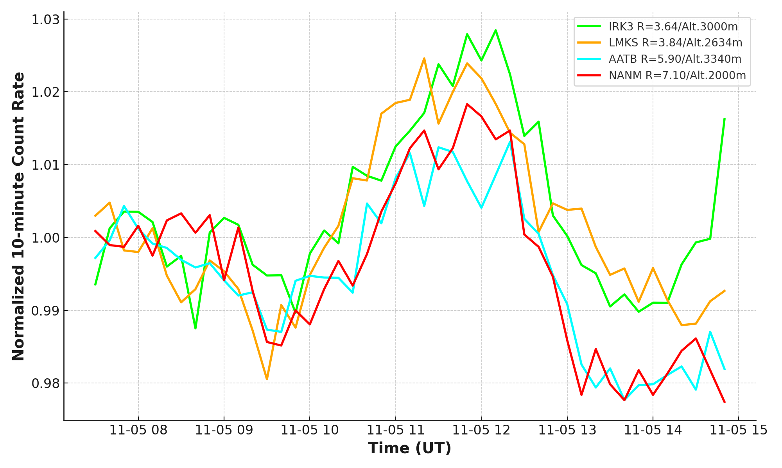
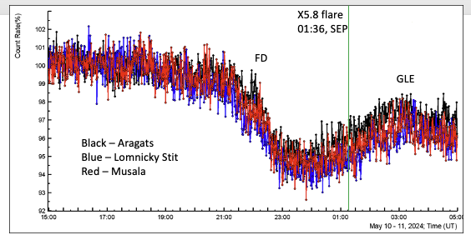
Results
Figure 2. Pronounced enhancement in the count rates of NMs located at middle latitudes and high altitudes.
Figure 3. Observation of FD and GLE by SEVAN network’s Aragats, Lomnicky Stit, and Musala detectors
In Fig. 2, we show correlated enhancements (3-4%) count rates at middle latitudes and high altitudes NMs. The time series are measured by NMs across more than 5500 km. The shapes of enhancements are similar, and correlations are obvious. In contrast, monitors located at sea level do not show enhancements due to the attenuation of the neutron flux in the thick air due to atmospheric cutoff (see Figs 5 and 6 of Chilingarian et al., 2024a).
Figure 3 shows a minute time series of precise correlated counts of the 5 cm thick, 1 m² area SEVAN upper scintillators on Mts. Aragats (40.25N, 44.15E, altitude3200 m), Musala (42.1N, 23.35E, altitude 2930 m) and Lomnicky Stit (49.2N, 20.22E, altitude 2634 m).

Slide 5
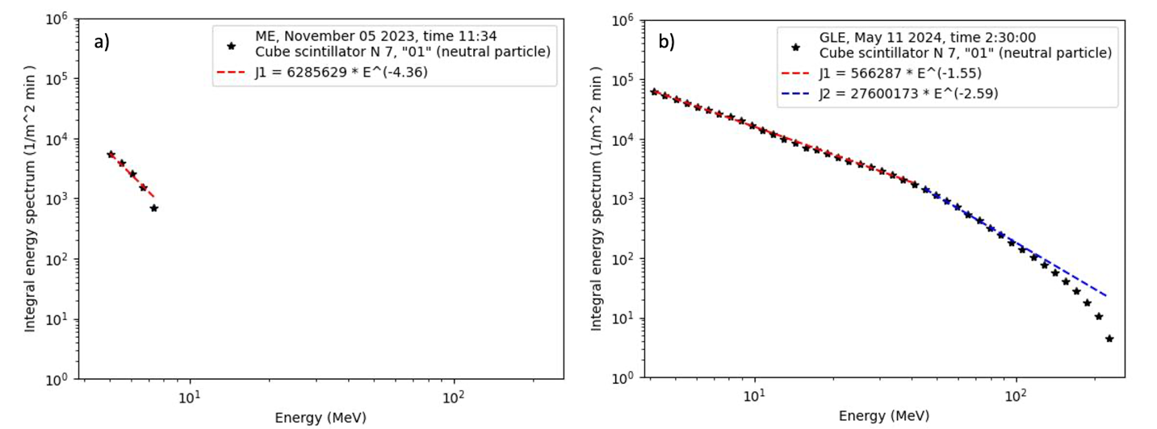
5. Conclusions
One of the key issues in assessing the potential damage from solar cosmic rays to satellites and terrestrial technologies is the “hardness” of the solar energetic particle energy spectrum. When the spectral index of SEPs at GeV energies is in the range of 5-6, abundant protons in the 50-100 MeV pose a serious threat to satellite electronics. Using the SEVAN-light detector, we measure the energy releases of neutral and charged particle fluxes during ground-level enhancement and magnetospheric effect events. The notable differences in the energy release patterns between these two event types confirm the sensitivity of our proposed method for assessing SEP energy spectra.
We also propose a refined definition of the Magnetospheric Effect. Our classification consists of the following criteria:
Observation by High-Latitude and Middle-Latitude Detectors: Antarctic and near-polar neutron monitors do not register flux enhancements, whereas middle-latitude NMs and muon detectors consistently observe count rate increases.
Influence of Atmospheric Cutoff Rigidity: Due to atmospheric cutoff rigidity, NMs and SEVAN detectors located on mountain tops at middle latitudes exhibit flux enhancements, while those at sea level do not.
Distinct Energy Spectra: The energy spectra of shower particles measured during ME events differ significantly from other causes of flux enhancement, making this criterion essential for ME identification.
Figure 4. The integral energy spectra of ME particles a), and GLE particles b) measured by SEVAN light spectrometer on Aragats.
The energy spectrum of the “additional particles” observed on 5 November 2023 is limited by 10 MeV, indicating low energy primaries giving rise to the ME event. The storm-induced weakening of the geomagnetic shielding allows primary GCR with energies below geomagnetic cutoff rigidity to enter the atmosphere and originate EASs. In contrast, the secondaries from SEP on May 11 (see details on the GLE event in Hayakawa et al., 2024 and Chilingarian et al., 2024b) are prolonged till 100 MeV, Fig. 3b. As we demonstrate in (Bostanjan et al., 2007; Chilingarian and Bostanjyan, 2009), the energies of solar protons can reach 20 GeV and more. Thus, SCR can produce secondaries with much larger energies than GCR below the geomagnetic cutoff during magnetospheric effects (less than 7 GeV).

Slide 6
6.References
Bostanjyan N., Chilingarian A., Eganov V., et al. (2007) On the production of highest energy solar protons on 20 January 2005, J. Adv. Space Res. 39, 1456.
Chilingarian, A. and Bostanjyan, N. (2009) Cosmic ray intensity increases detected by Aragats Space Environmental Center monitors during the 23rd solar activity cycle in correlation with geomagnetic storms. J. Geophys. Res. 114 (A9), A09107. doi:10.1029/2009JA014346
Chilingarian, A., Karapetyan, T., Sargsyan, B., Knapp, J., Walter, M., Rehm, T. (2024c) Increase in the count rates of ground-based cosmic-ray detectors caused by the heliomagnetic disturbance on 5 November 2023, EPL 148, 19001. doi: 10.1209/0295-5075/ad329c
Chilingarian, A., Karapetyan, T., Sargsyan, B., Asatryan, K., Gabaryan, G. (2024d) Influence of magnetosphere disturbances on particle fluxes measured by ground-based detector, EPL 148, 19001. doi:10.1209/0295-5075/ad7e4c
Hayakawa H., Ebihara Y., Mishev A., et al. (2024) The Solar and Geomagnetic Storms in May 2024, arXiv:2407.07665, 2024.

