Slide 1
The Forbush decrease observed by the SEVAN particle detector network in the 25th solar activity cycle
Tigran Karapetyan, Ashot Chilingarian
A I Alikhanyan National Lab (Yerevan Physics Institute), Yerevan 0036, Armenia

Slide 2
Introduction
The sun affects the Earth through electromagnetic radiation, plasma, and high-energy particles. Even though these particles' energy is a small fraction of visible light energy, they provide insights into fundamental particle acceleration processes (Dorman, 1974). They can also give timely information about space weather conditions that may impact space technologies and the Earth's environment.
Cosmic rays are direct messengers, conveying crucial information on solar-terrestrial relations. Networks of particle detectors continuously monitoring cosmic ray flux on the Earth's surface provide valuable insights complementary to spaceborne detectors operated by NOAA, NASA, and ESA. The temporal variations of cosmic-ray intensity, measured by ground-based detectors at various latitudes, longitudes, and altitudes, are related to the geophysical and solar phenomena. The latter are interplanetary coronal mass ejections and fast solar wind from coronal holes, which cause interplanetary magnetic field (IMF) abrupt variations near Earth. Interacting with the magnetosphere, they cause sudden global decreases (Forbush decreases, FDs) of intensity followed by gradual recovery. The amplitude of the flux depletion depends on the type and energy of the registered particle, which in turn depends on geographical coordinates and the detector’s energy threshold and selective power. SEVAN particle detector network with nodes in Europe and Armenia selects three types of particles that demonstrate coherent depletion and recovery and correspond to different energy galactic protons interacting with disturbed magnetospheric plasmas.
On November 3-4, 2021, an interplanetary coronal mass injection (ICME) hit the magnetosphere, sparking a strong G3-class geomagnetic storm and auroras as far south as California and New Mexico. All detectors of the SEVAN network have registered an FD of ≈ 5% depletion in a 1-minute time series of count rates. Approaching the maximum solar activity cycle, large variations of the particle flux intensity were registered on February 27, March 23, 2023, March 24, 2024, and May 10, 2024.
In this work, we present measurements of these FDs performed on mountain altitudes on Aragats (Armenia), Lomnicky Stit (Slovakia), Mileshovka (Czechia), and at sea level at DESY (Hamburg, Germany)and in Zagreb, Croatia. We compared FD measurements made by SEVAN detector and neutron monitors located on Aragats and Lomnicky Stit and made a correlation analysis of FD registration at different locations.

Slide 3
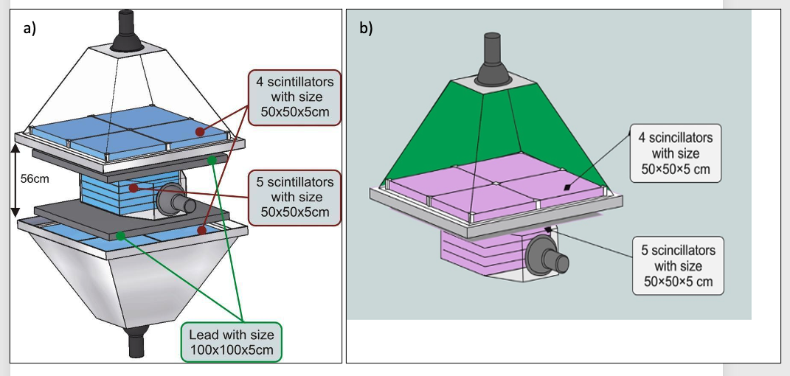
SEVAN detectors
The basic detector of the SEVAN network (Figure 1a, see Chilingarian et al., 2018) consists of standard slabs of 50 x 50 x 5cm³ plastic scintillators. Between two identical assemblies of 100 x 100 x 5 cm³ scintillators (four standard slabs), two 100 x 100 x 5 cm³ lead absorbers are positioned, and a thick 50 x 50 x 25 cm³ scintillator stack (5 standard slabs). Scintillator lights capture cones, and PMTs are located on the detector's top, bottom, and intermediate layers. The total weight of the SEVAN detector, including steel frame and detector housings, is ≈1,5 tons. In April 2023 we installed modernized SEVAN-light detector at the Umwelt-Forschungs-Station (UFS, Schneefernerhaus, 2650 m asl, see Figure 1b) near the top of the Zugspitze (2962 m), a site with a long history of atmospheric research, where Joachim Kuettner did his seminal experiments on the structure of the electric field in the lower atmosphere (Kuettner, 1950). Due to the building constraints at UFS, SEVAN-light should be compact, shorter, and much lighter than the basic SEVAN. Thus, SEVAN-light consists only of 2 layers, and the lead absorber is not included (total weight ≈100 kg).
Data Acquisition (DAQ) electronics register and store all logical combinations of the detector signals for further offline analysis and for online alert issuing, thus allowing the registration of 3 species of incident particles. If we denote by ‘‘1’’ the signal from a scintillator and by ‘‘0’’ the absence of a signal, then the following combinations of the 3-layered detector output are possible: 111 and 101—traversal of high energy muon; 010—traversal of a neutral particle;100—traversal of low energy charged particle stopped in the scintillator or the first lead absorber (energy less than ≈100 MeV). 110—traversal of a high-energy charged particle stopped in the second lead absorber. 001—registration of inclined charged particles.
Figure 1. Basic SEVAN detector(1a) and SEVAN-light detector (1b)
In Table 1, we present the purity of the particle detector flux observed by different coincidences of the SEVAN detector.
Table 1. Purity of the SEVAN coincidences measuring the ambient population of secondary cosmic ray flux (background) on Aragats (3200 m) in percent
Coincidence | neutron | proton | mu+ | mu- | e⁻ | e⁺ | γ
001 | 12.75 | 1.29 | 43.52 | 37.65 | 1.13 | 1.20 | 2.50
111 | 0.78 | 1.45 | 51.47 | 44.28 | 0.42 | 1.50 | 0.12
110 | 8.70 | 5.40 | 34.30 | 30.55 | 7.46 | 10.24 | 3.36
100 | 6.74 | 3.76 | 27.74 | 24.36 | 11.69 | 9.68 | 16.03
011 | 9.27 | 0.59 | 47.38 | 41.00 | 0.09 | 0.31 | 1.36
101 | 0.53 | 1.51 | 52.18 | 45.56 | 0.07 | 0.12 | 0.04
010 | 52.05 | 0.33 | 8.41 | 7.86 | 1.60 | 1.65 | 28.09

Slide 4
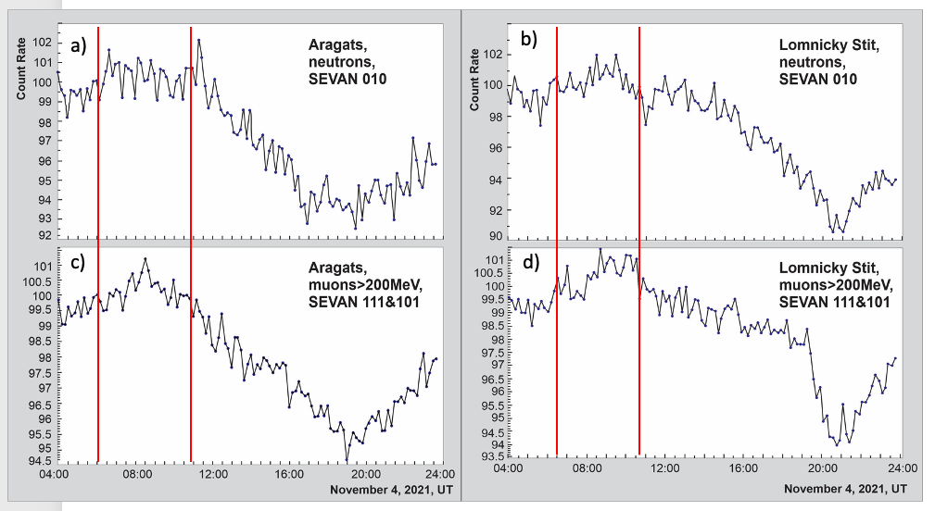
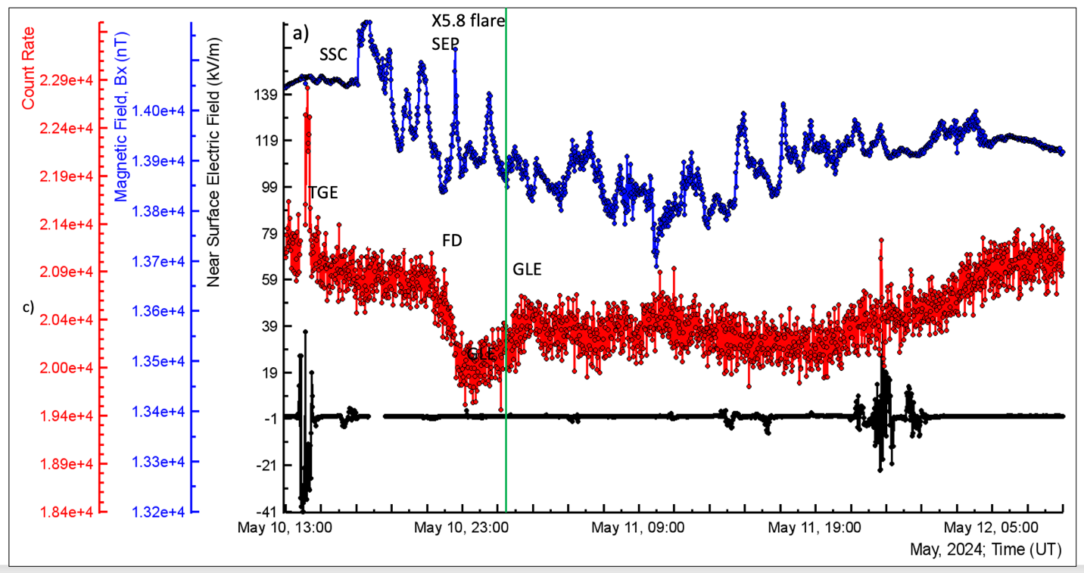
Results
Figure 2. Ten-minute time series of count rates measured at Aragats and Lomnicky Stit by joint SEVAN 111 + 101 coincidences; muons with energies >200 MeV. Red lines show the pre-FDs registered on both stations.
Figure 3. The X-component of the GMF measured by the Aragats magnetometer (blue), the disturbances of the near-surface electric field (black), and the count rate of the SEVAN-light detector (red).
The FD started with a significant pre-FD increase, which lasted nearly 4.5 hours from 6:00 to 10:00 on Aragats and nearly 4 hours from 6:30 to 10:30 on Lomnicky Stit. Mountain SEVAN detectors coherently registered a pre-FD increase in fluxes of high-energy muons (Eμ> 200 MeV, SEVAN coincidence 111 & 101, muons traversing 10 cm of lead).
After pre-FD, the SEVAN network registered the FD main phase on Aragats, Lomnicky Stit, Mileshovka, and Hamburg.
The electric field during solar events was quiet: no thunderstorms or lightning flashes were detected. Aragats magnetometer observed storm sudden commencement (SSC) at 17:05, which triggered the extreme geomagnetic storm with a Dst index of −412 nT at 2 UT on 11 May 2024, marking the sixth-largest storm since 1957. The magnetometer also shows a large compression upon the shock arrival, confirmed by THEMIS-E’s and Kakioka’s measurements on the magnetic field and plasma data (Hayakawa et al., 2024).

Slide 5
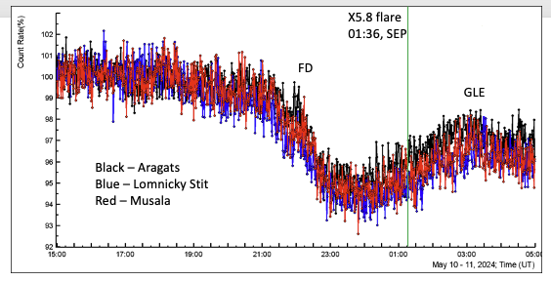
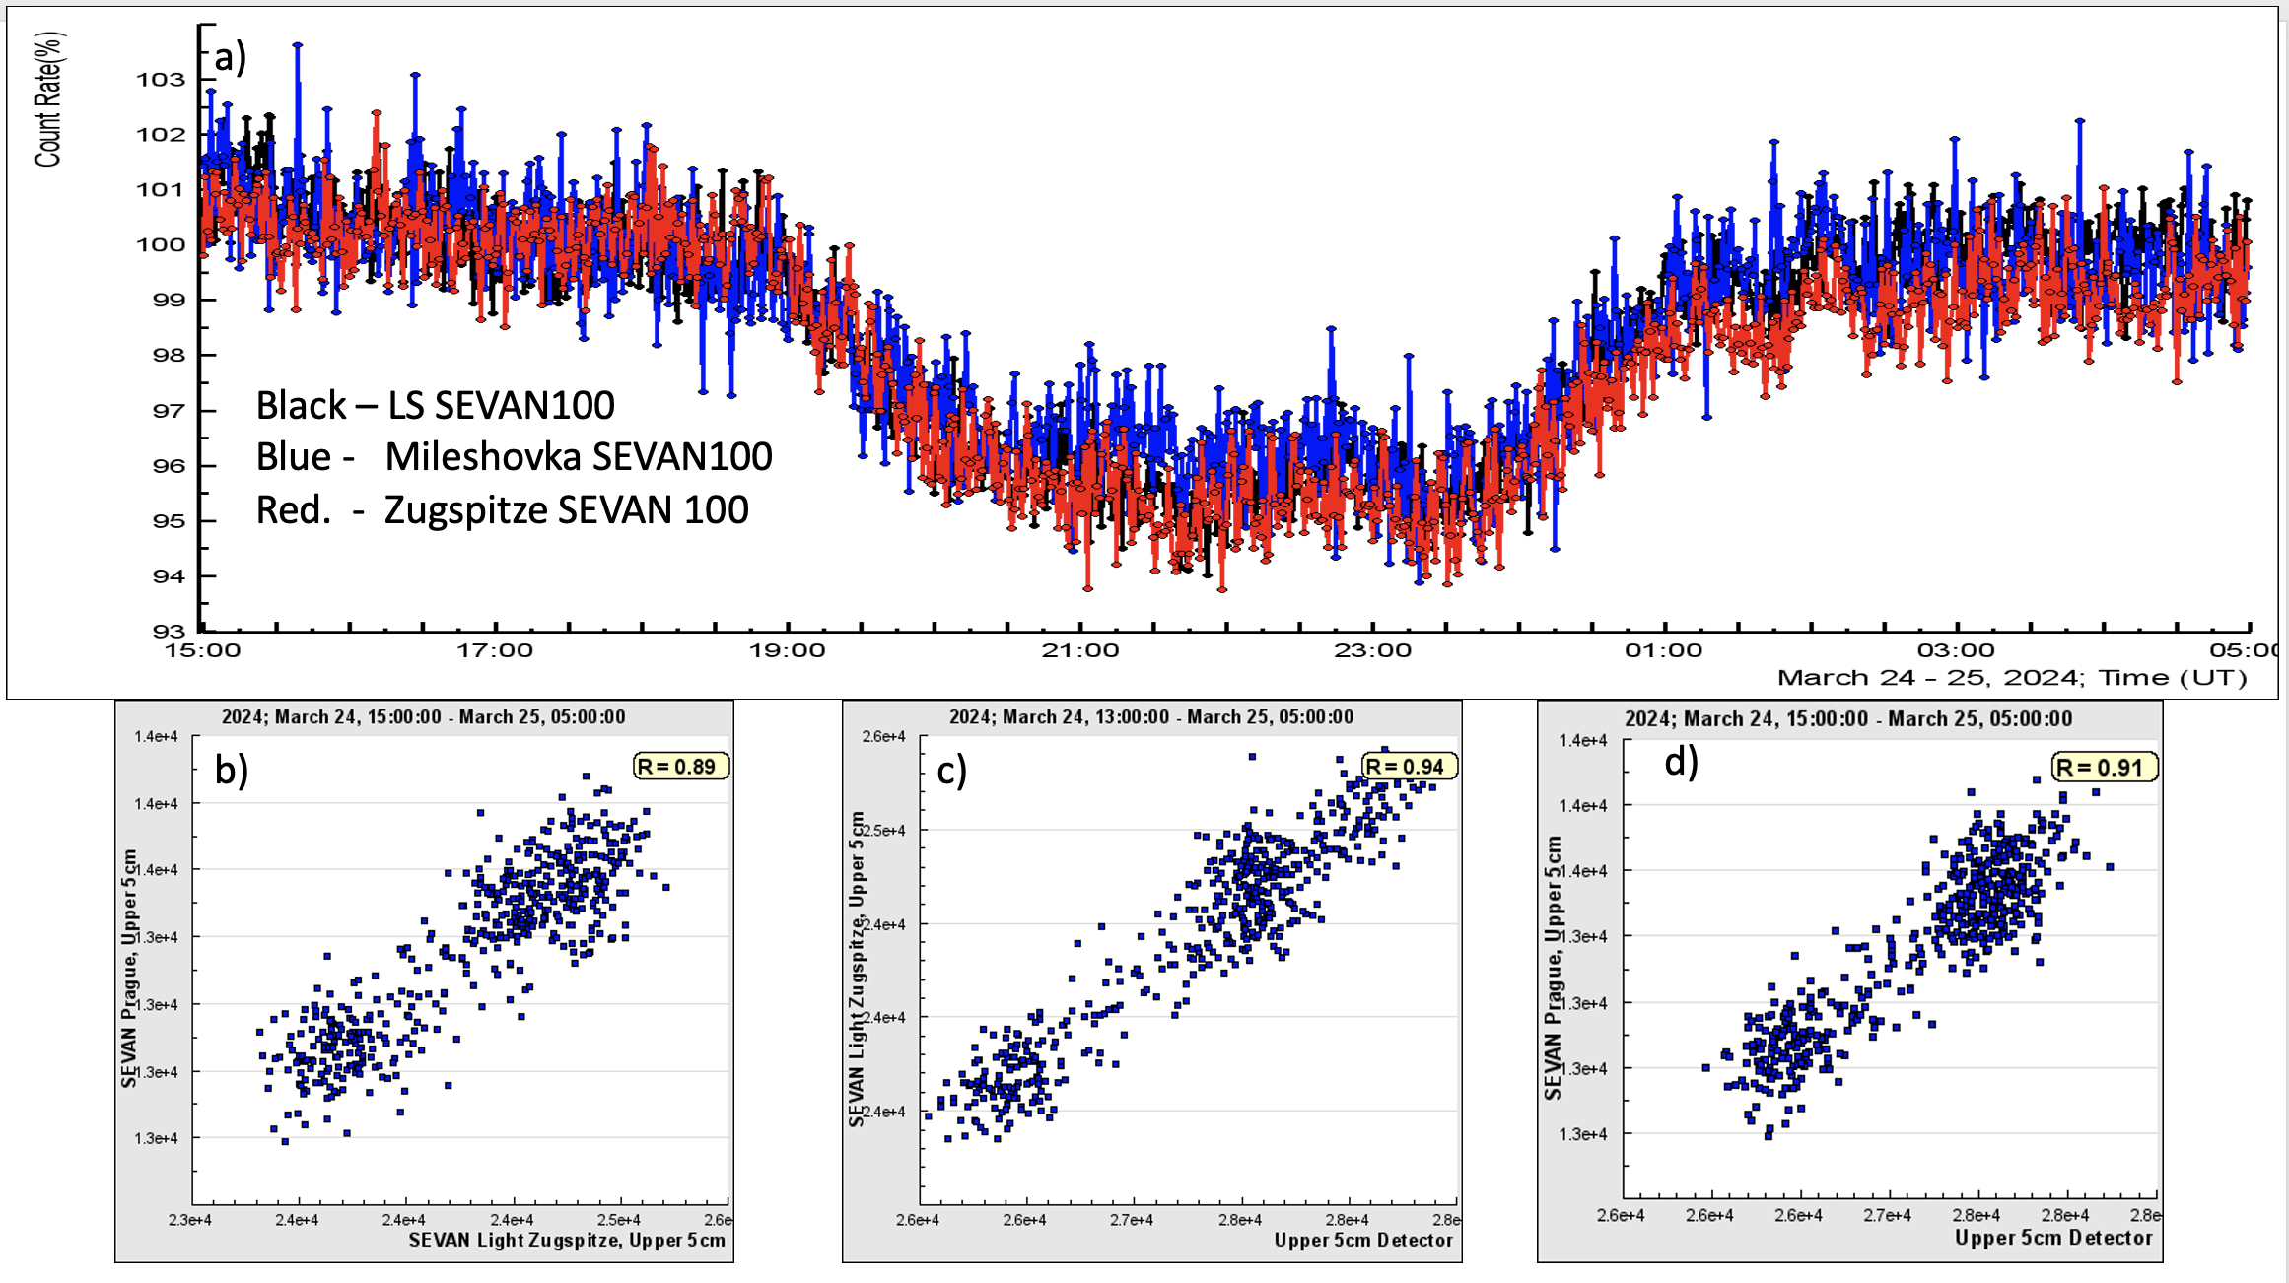
5. Conclusions
Figure 4. Observation of FD and GLE by SEVAN network’s Aragats, Lomnicky Stit, and Musala detectors
Figure 5. a) Time series of count rates of SEVAN 100 coincidence (mostly muons and electrons); b-d) pair-wise scatter plots of measurements by 3 SEVAN detectors.
Figure 4 shows a minute time series of precise correlated counts of the 5 cm thick, 1 m² area SEVAN upper scintillators on Mts. Aragats (40.25N, 44.15E, altitude3200 m), Musala (42.1N, 23.35E, altitude 2930 m) and Lomnicky Stit (49.2N, 20.22E, altitude 2634 m).
The table confirms that FD depends highly on the disturbed IMF rather than its Bz component. For all FDs, the IMF value was large during the FD depletion. Large IMF interactions with the magnetosphere create traps and cradles for galactic protons and nuclei, preventing their penetration into the atmosphere. The Bz component varies highly, changing from southward to northward. The Bx component of the geomagnetic field, showing the solar wind's compression of the southward magnetosphere, was highly disturbed, indicating a weakening trend. This differs from the magnetospheric effect (ME, Chilingarian, et al., 2024) measured during strictly southward Bz and compressed GM field.
Date/time | Duration (depletion phase) | Event type | Kp | -% of flux change | IMF nT | Bz nT | Bx % Depletion
4/11/2021 | 10:30 - 13:30 | FD | 5-6 | 8-9 | -10 - 40 | -20 - +20 | -0.5
27/2/2023 | 15:00 -19:00 | FD | 5-6 | 3 | 15 - -7 | -14 - -5 | 0
23/3/2023 | 14:00 - 18:00 | FD | 5-6 | 5-6 | 5-20 | 0 - -10 | 0
24/3/2024 | 18:30 - 01:30 | FD | 8-4 | 5-6 | 20 - 40 | -10 - +18 | -0.5

Slide 6
6.References
Chilingarian, A., Karapetyan, T., Sargsyan, B., Knapp, J., Walter, M., Rehm, T. (2024) Increase in the count rates of ground-based cosmic-ray detectors caused by the heliomagnetic disturbance on 5 November 2023, EPL 148, 19001. doi: 10.1209/0295-5075/ad329c
Dorman, L.I., 1974. Cosmic Rays, Variations, and Space Exploration. (Amsterdam, North Holland).
Hayakawa H., Ebihara Y., Mishev A., et al. (2024) The Solar and Geomagnetic Storms in May 2024, arXiv:2407.07665, 2024
Kuettner, J. (1950) The electrical and meteorological conditions inside thunderclouds. J. Meteorol., 7, 322–332. doi.org/10.1175/1520-0469(1950)007<0322:TEAMCI>2.0.CO;2

