Slide 1
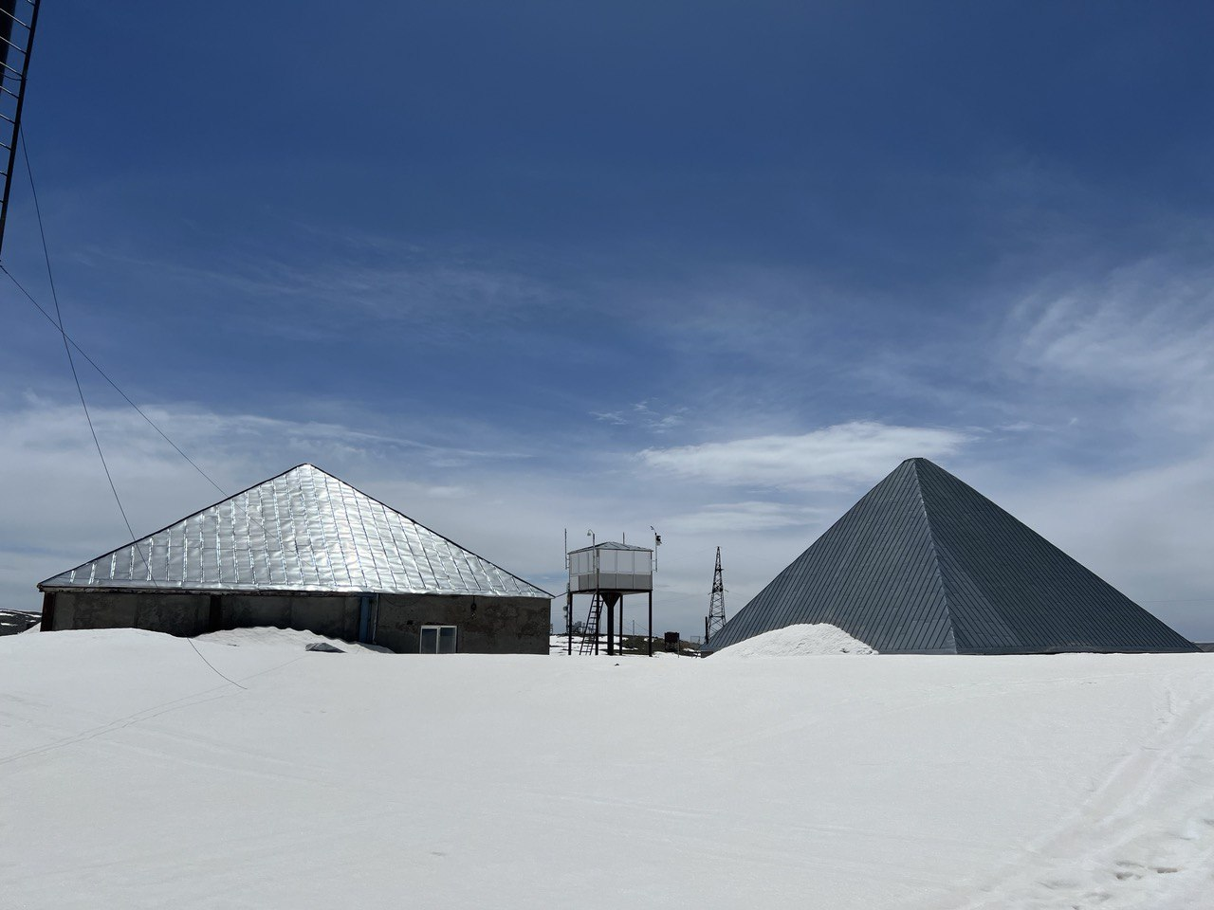
The solar event of the 25th activity cycle
Ashot Chilingarian, B.Sargsyan, T,Karapetyan A I Alikhanyan National Lab (Yerevan Physics Institute), Yerevan 0036, Armenia
New lab for the project
“Put your detector on Aragats”

Slide 2
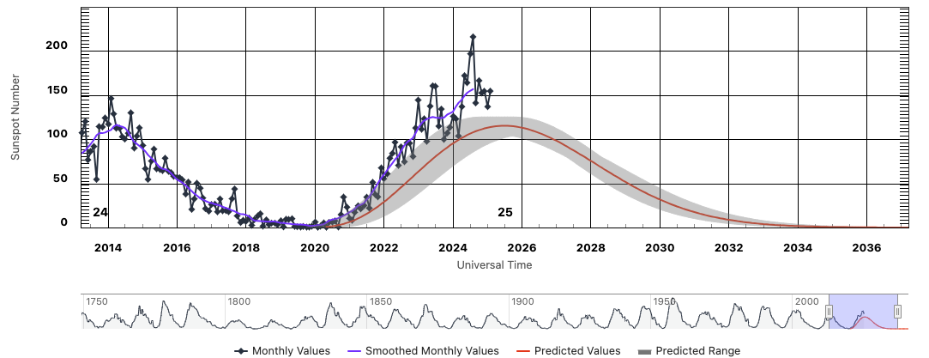
Panel predictions of the 25th solar activity cycle and experimental progression

Slide 3
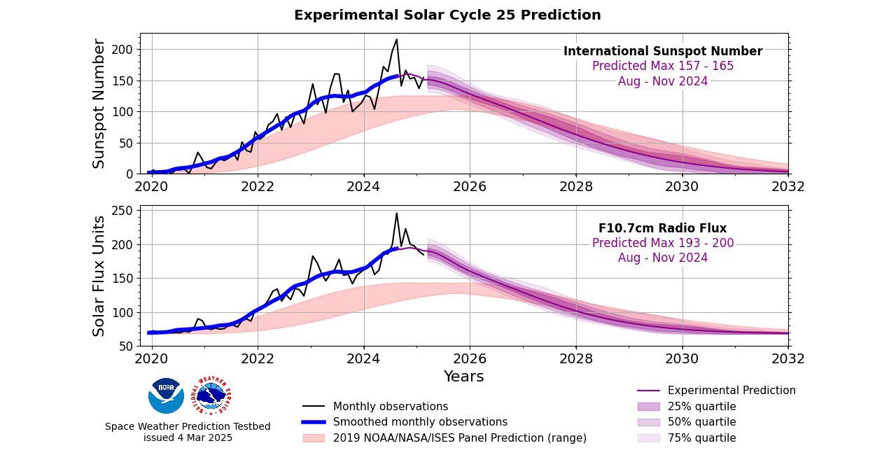

Slide 5
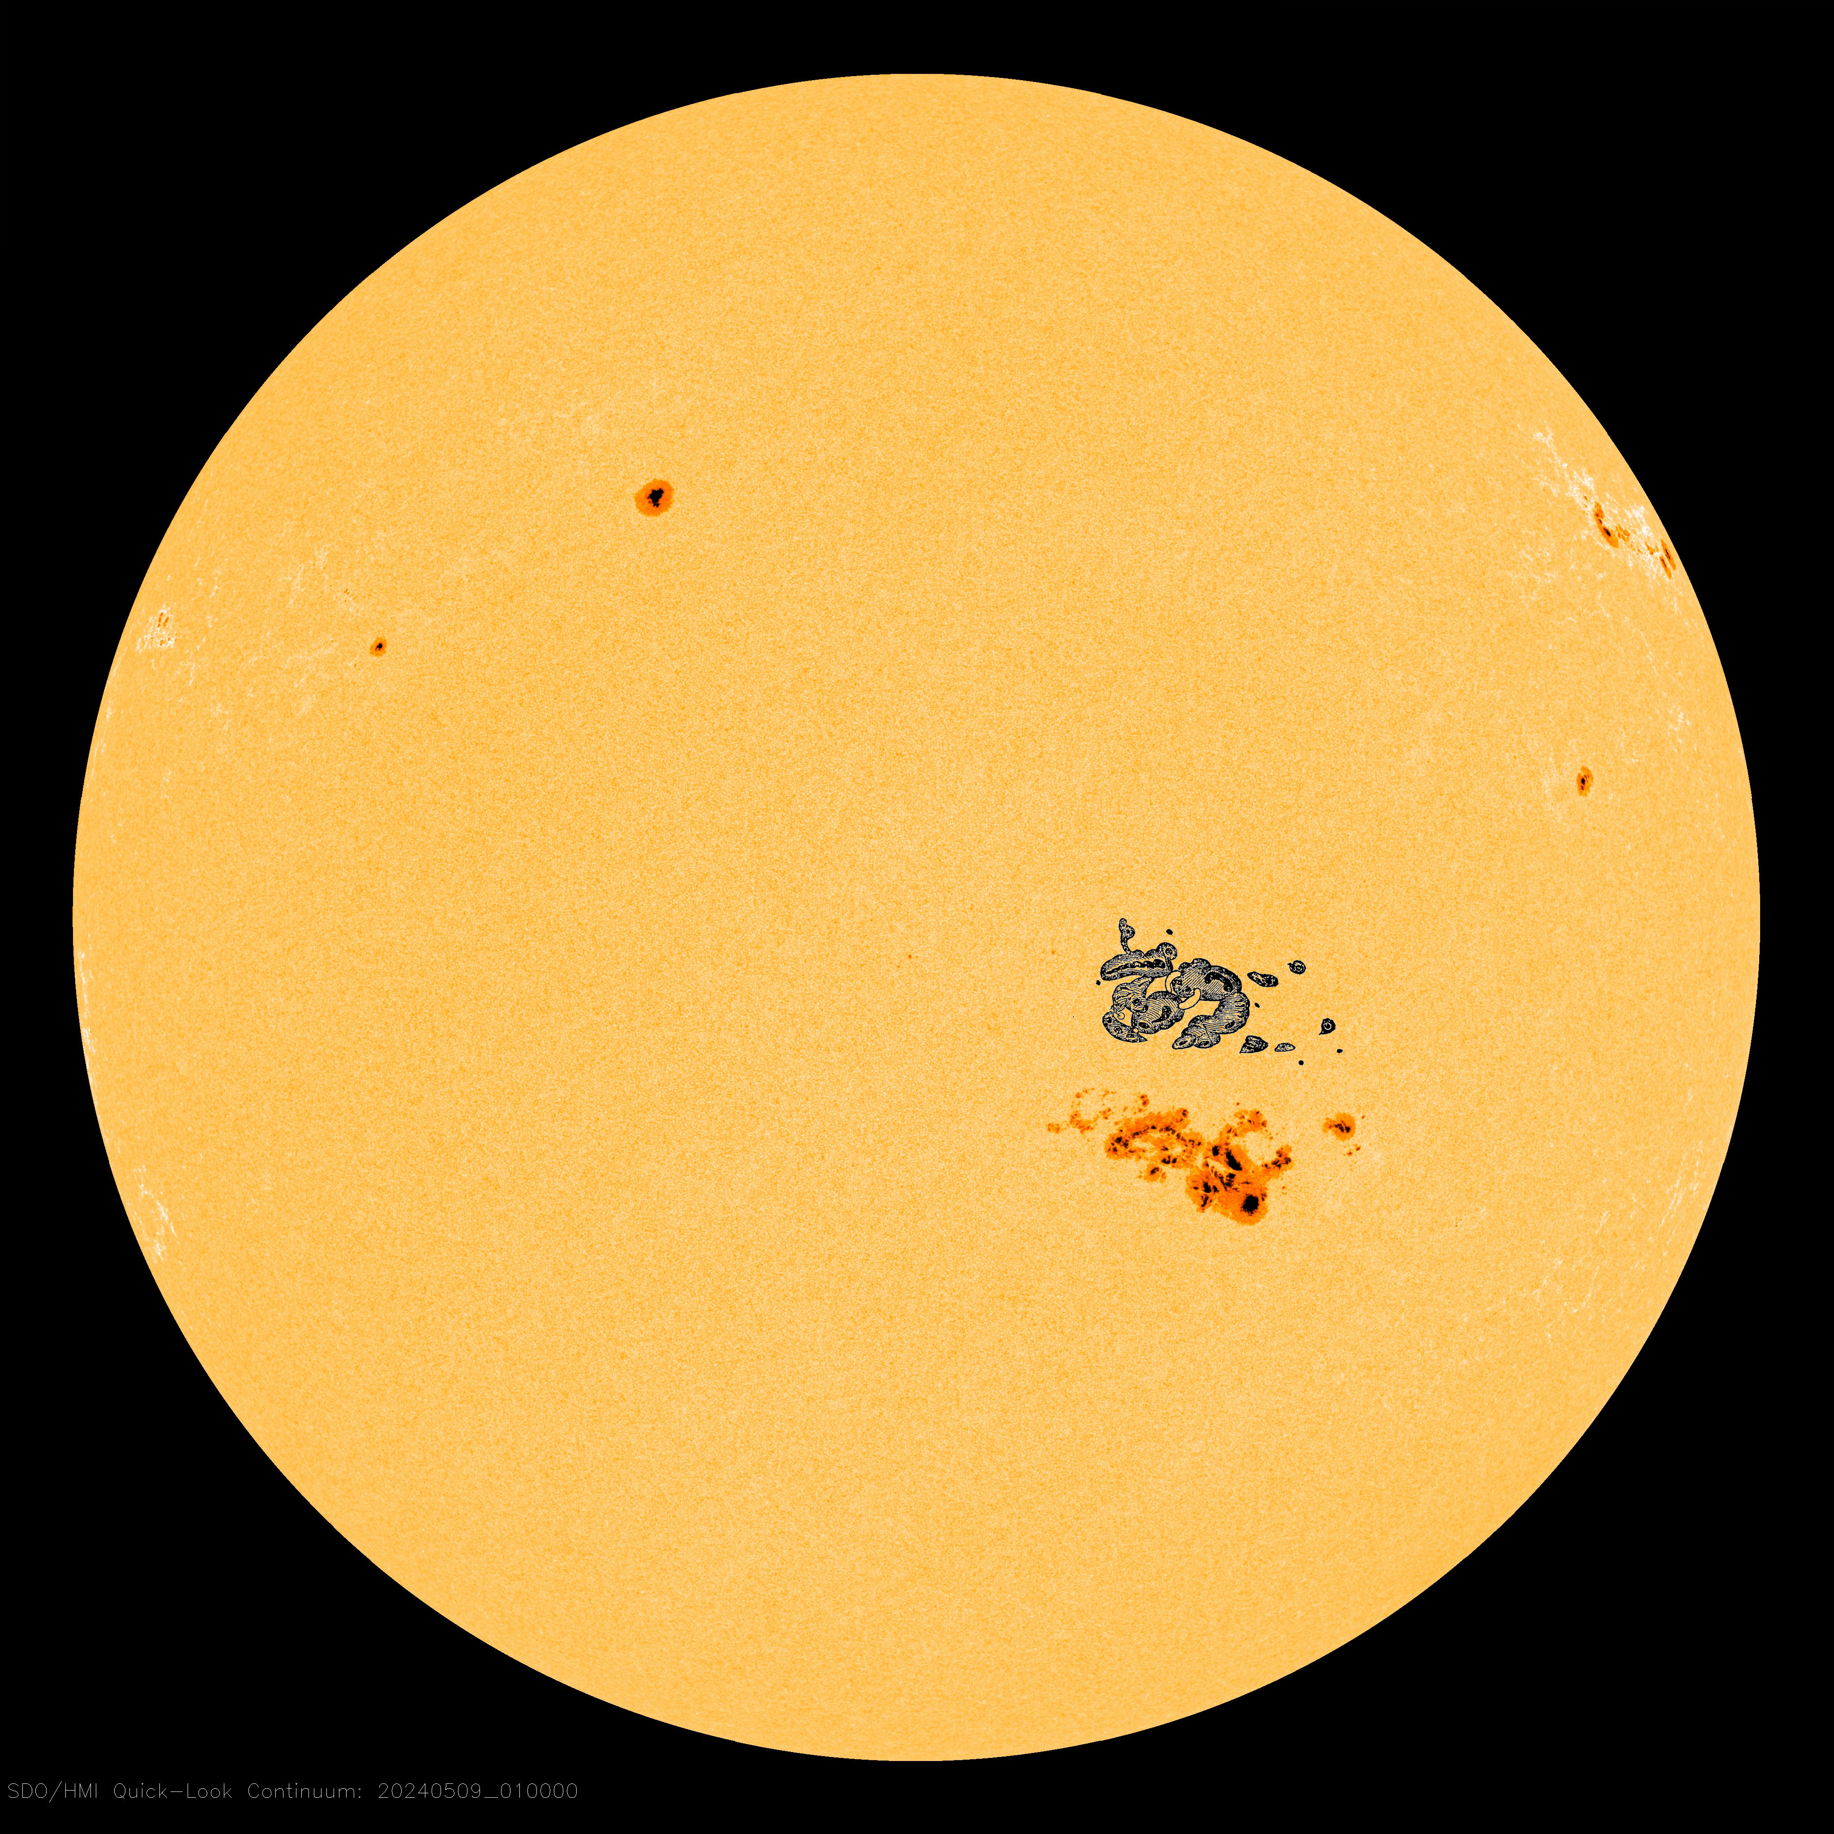
A CARRINGTON-CLASS SUNSPOT: Sunspot AR3664 has grown so large, it now rivals the great Carrington sunspot of 1859. To illustrate their similarity, we've added Carrington's famous sketch (to scale) to a NASA photo of today's sun. Sprawling almost 200,000 km from end to end, AR3664 is 15 times wider than Earth. You can see it through ordinary eclipse glasses with no magnification at all. Moreover, it is easy to project an image of this sunspot onto the sidewalk or a white screen just as Carrington did in the 19th century.
Carrington's sunspot is famous because in August and Sept. 1859 it emitted a series of intense solar flares and CMEs. The resulting geomagnetic storms set fire to telegraph offices and sparked auroras from Cuba to Hawaii. The "Carrington Event" has since become a touchstone of space weather in pop culture, with recent headlines stoking fears of an "internet apocalypse" if it repeats.
Indeed, it could repeat. Studies suggest that Carrington-class storms occur once every 40 to 60 years, so we're overdue. Don't worry, though. The four CMEs currently en route to Earth--even combined--are probably no match for the monster CME of 1859. The Carrington Event won't happen again this weekend. Nevertheless, it would be wise to keep an eye on this growing active region while Earth is in its strike zone.

Slide 6
Solar particle events events
Ground level enhancements (GLE) – GeV energy solar protons entering the terrestrial atmosphere create neutrons and muons that can reach Earth’s surface and be registered as impulsive enhancements with amplitudes dependent on cutoff rigidity and altitude. The last large GLE was detected on Aragats 20 January 2005 and 11 May 2024 (small and untypical)
Forbush decreases (FD) —In interactions of ejecta and geomagnetic fields, traps and cradles emerge, preventing galactic protons with energies above the cutoff rigidity from entering the atmosphere, and the flux of secondary particles registered by the surface detector decreases.
Magnetospheric effect (ME) – Southward directed Bz enables solar protons with energies below cutoff rigidity to enter the atmosphere and create secondaries comprising enhanced flux registered by surface detectors.

Slide 7
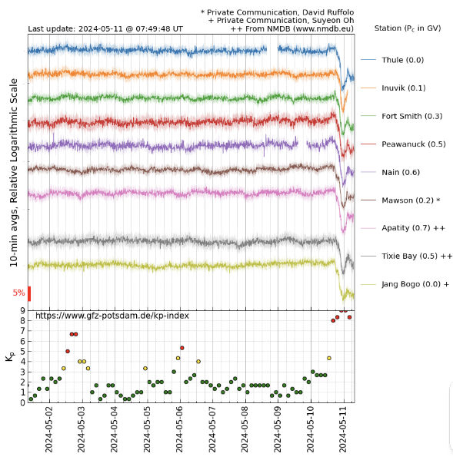
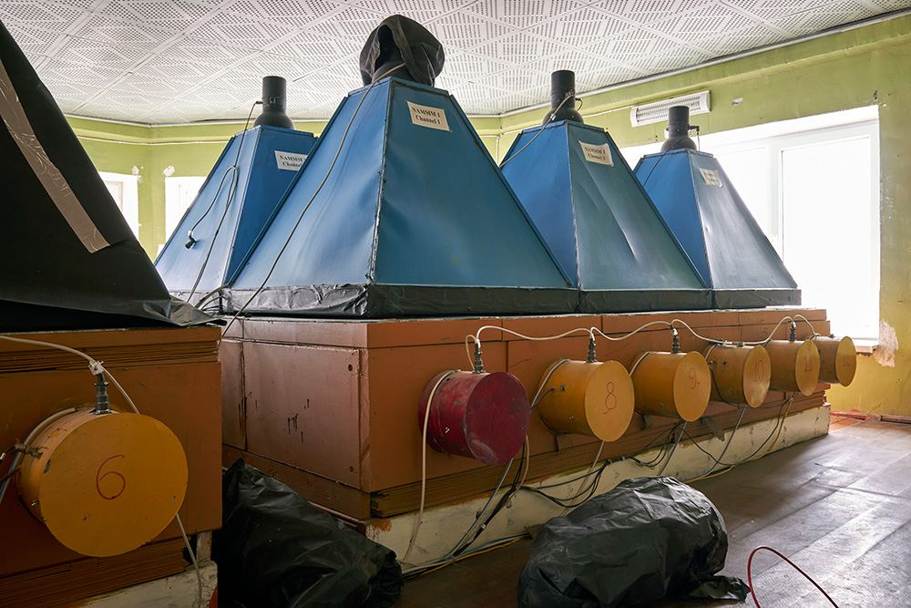
Network of Neutron Monitors 50 detectors from Antarctic to Arctic

Slide 8
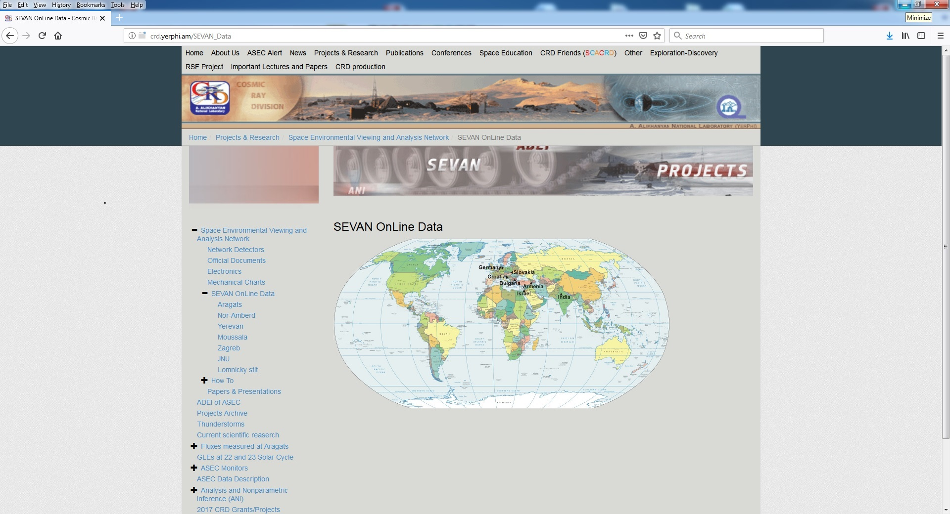
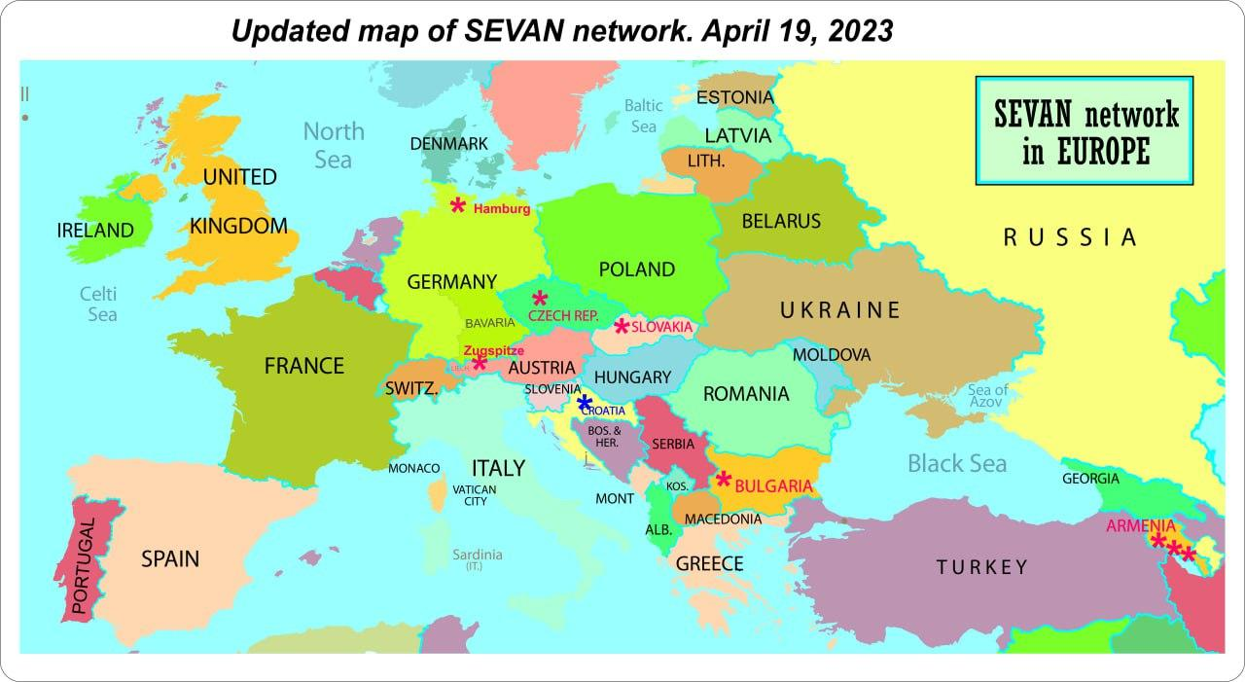
SEVAN home page:
http://crd.yerphi.am/SEVAN_Data
http://crd.yerphi.am/ADEI
EGU 2023

Slide 10
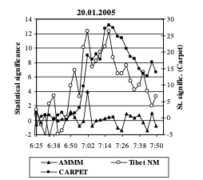
Rigidity dependence of the amplitude for the 20 January 2005 GLE. Carpet (R>6 GeV) – 28%, AMMM (R>20 GeV) – 4%)
Comparison of the time series of the particle detector sensitive to the highest energies of solar particles: CARPET (energy range >6 GeV), Tibet NM (>13 GeV) and AMMM (>20 GeV).
Credit: N.Kh. Bostanjyan et. al.,
On the production of the highest energy solar protons on 20 January 2005, Advances in Space Research 39 (2007) 1454–1457

Slide 11
Characteristics of Solar particle events at approaching the maximum of 25ths Solar cycle.
Date/time | Duration | Event type | Kp | % of flux chage | SEP> 1pfu | Bz nT | Bt | Bx | Max E MeV
5/11/2023 | 10:30-13:30 | ME | 5-6 | +5 | - | -20 - +20 | -10 - +40 | -0.5 | 10
24-25 /3/2024 | 18:30 – 1:30 | FD | 8-4 | -5 | 10 | +15 | +30 | D | 100
10/5/2024 | 23:30- | FD | 8-9 | -8 | 10 | +40 | +80 | D | 100
11/5/2024 | 2:00-6:30 | GLE | 9 | +4 | 100 | -30 - 0 | +20-+40 | D | 100

Slide 12
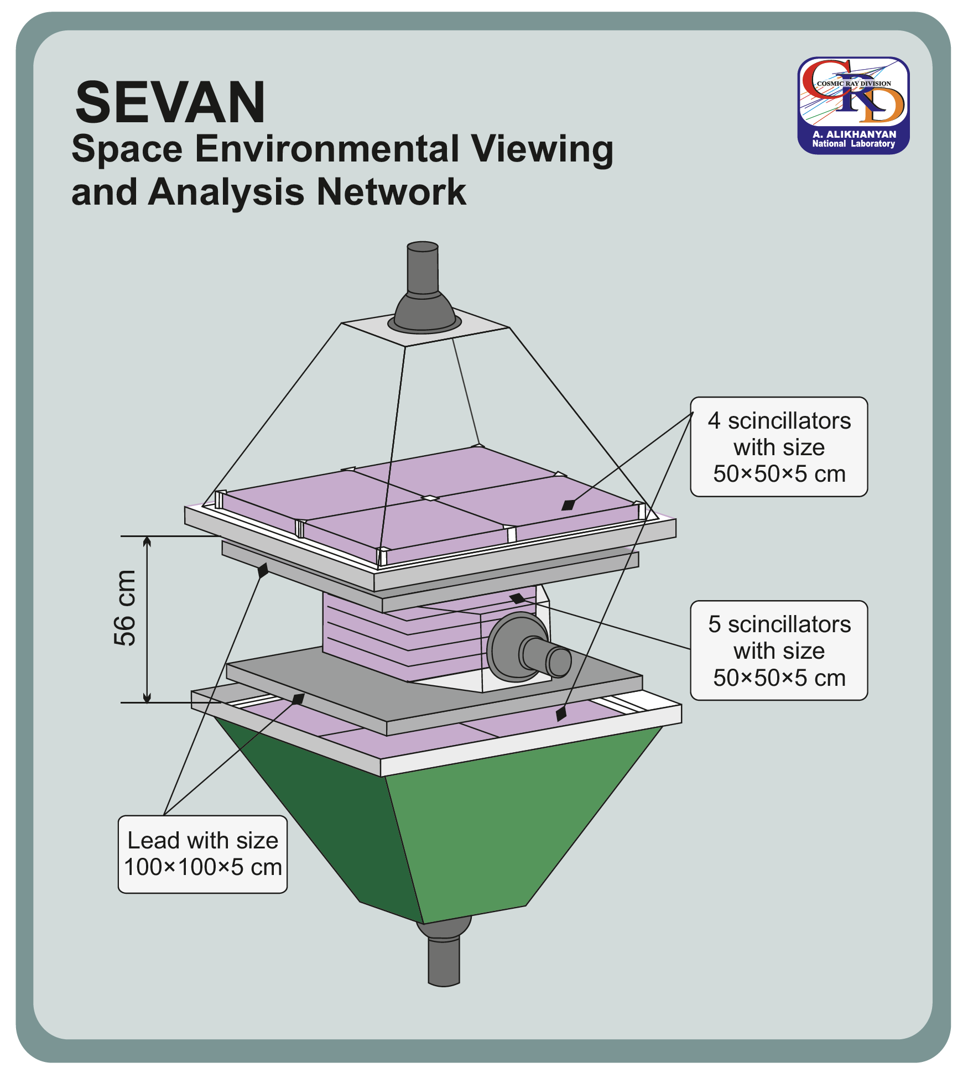
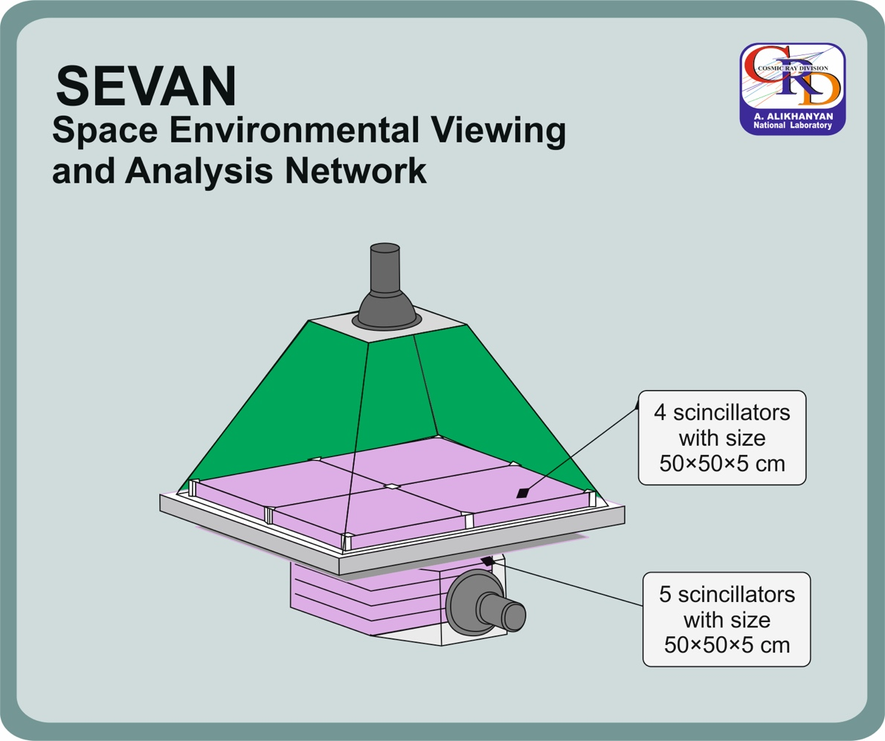
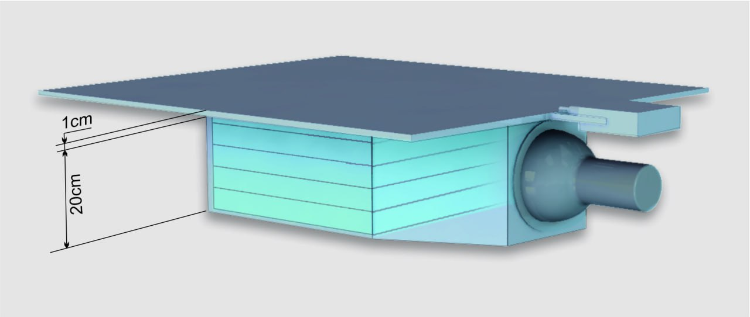

Slide 13
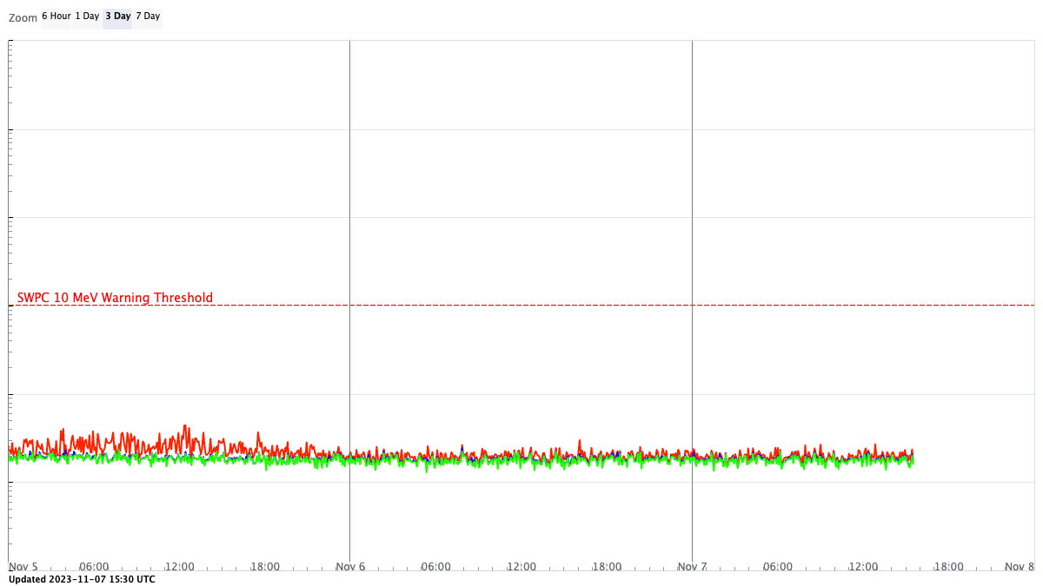
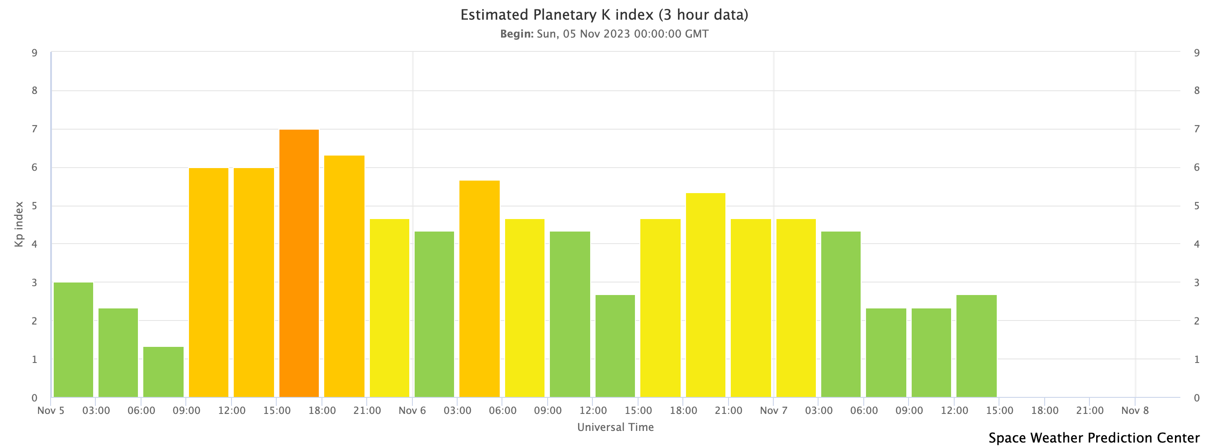
The magnetospheric effect observed at 10:20 – 13:40 on 5/11, 2023
"On Nov. 5th, the ring current was pumped up by hours of strong geomagnetic storming, with energy dissipating into these SAR arcs," says Jeff Baumgardner of Boston University's Center for Space Physics. "It was a global event. Our cameras registered SAR arc activity from Italy to New Zealand."
No proton flux
– no GLE!
Total magnetic field strength peaked at 45 nT at the NOAA DSCOVR satellite at 05/11:51 UT.

Slide 14
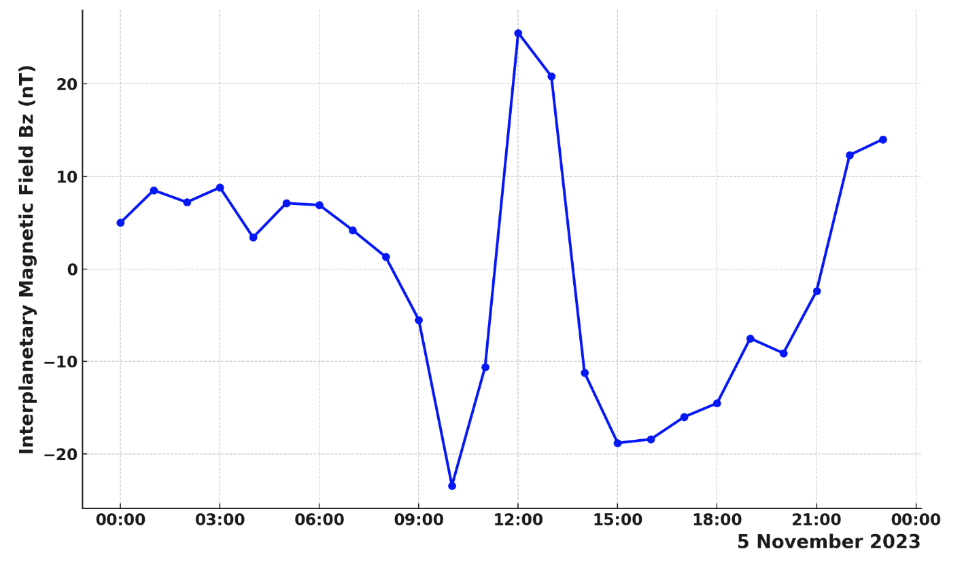
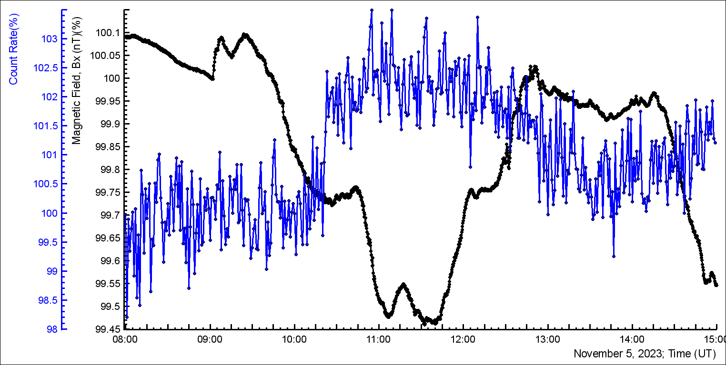
The interplanetary magnetic field peaked southward (Bz ≈ 27nT), coinciding with the reduction of the horizontal component of Earth's magnetic field (Bx ≈-0.5%). Thus making ideal conditions of magnetic reconnections and the entrance of solar protons with energies below cutoff rigidity into the terrestrial atmosphere (see the peak in the count rate of electron/muon detectors)

Slide 15
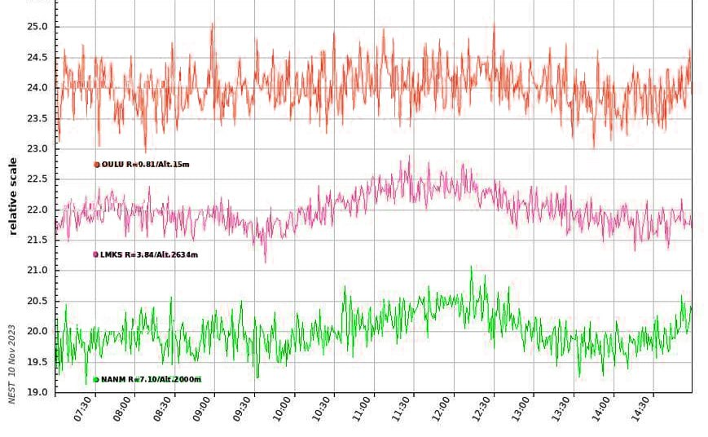
High-altitude stations show count rate enhancement, low-altitude (Ouly) – not!

Slide 16
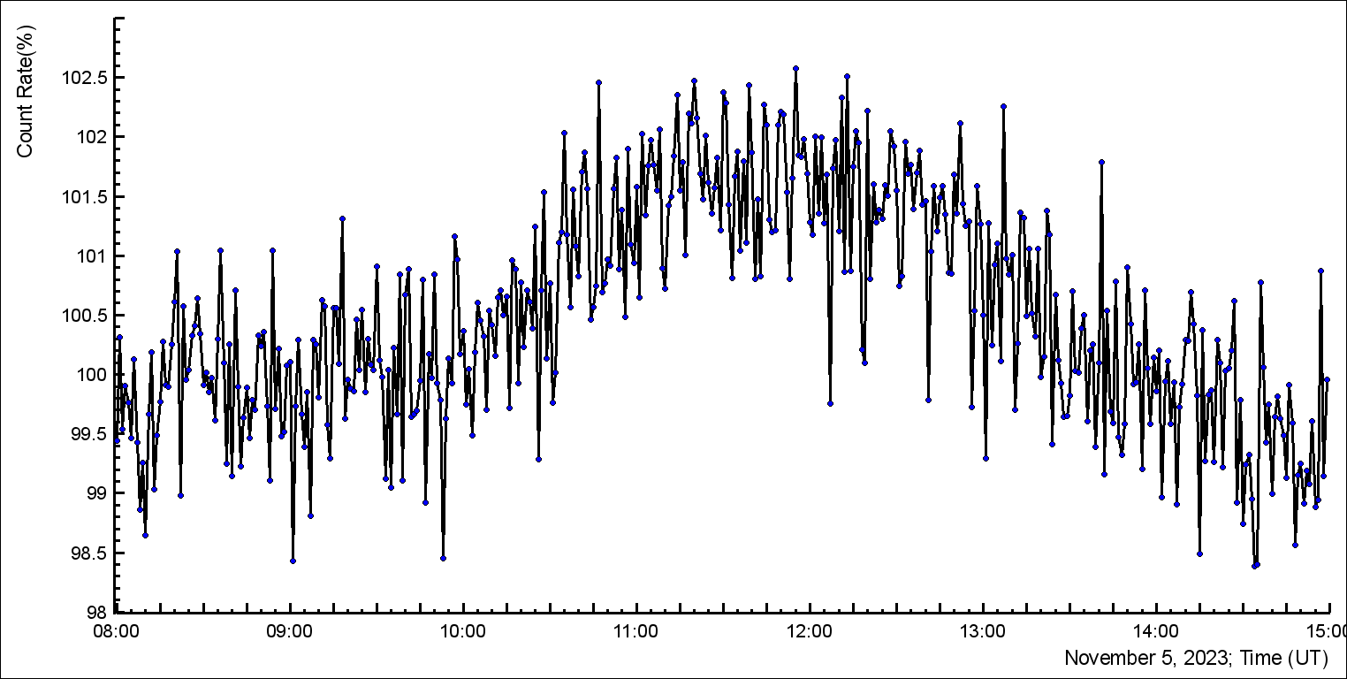
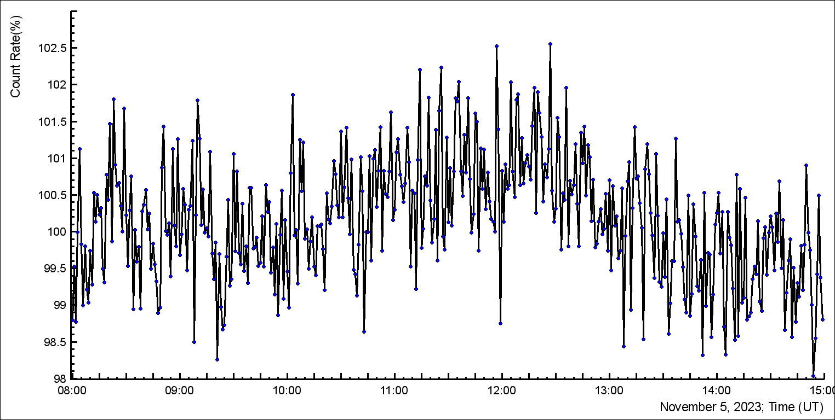
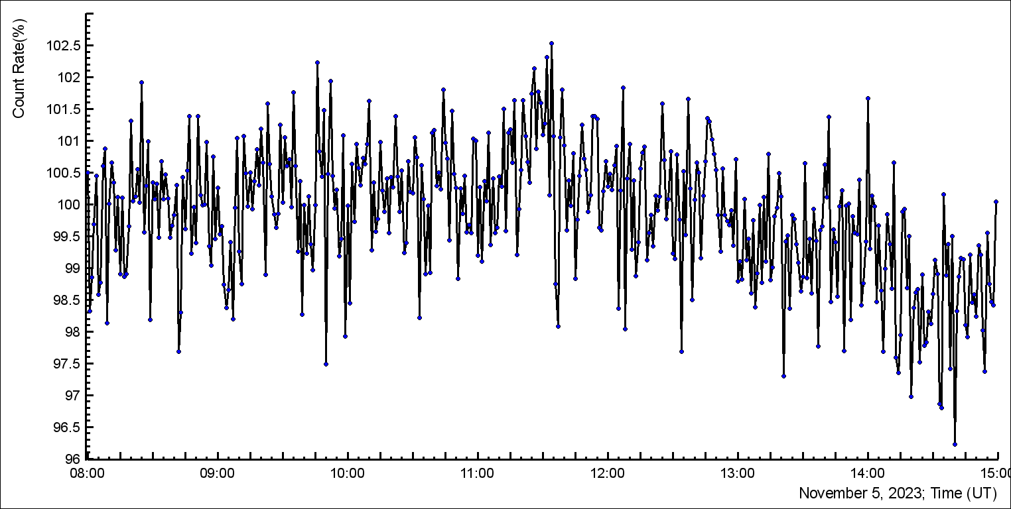
SEVAN network detection of the GE on 5/11, 2023. Upper 5 cm. thick scintillatoror
Aragats
Lomnicky Stit
Mussala
Mileshovka

Slide 17
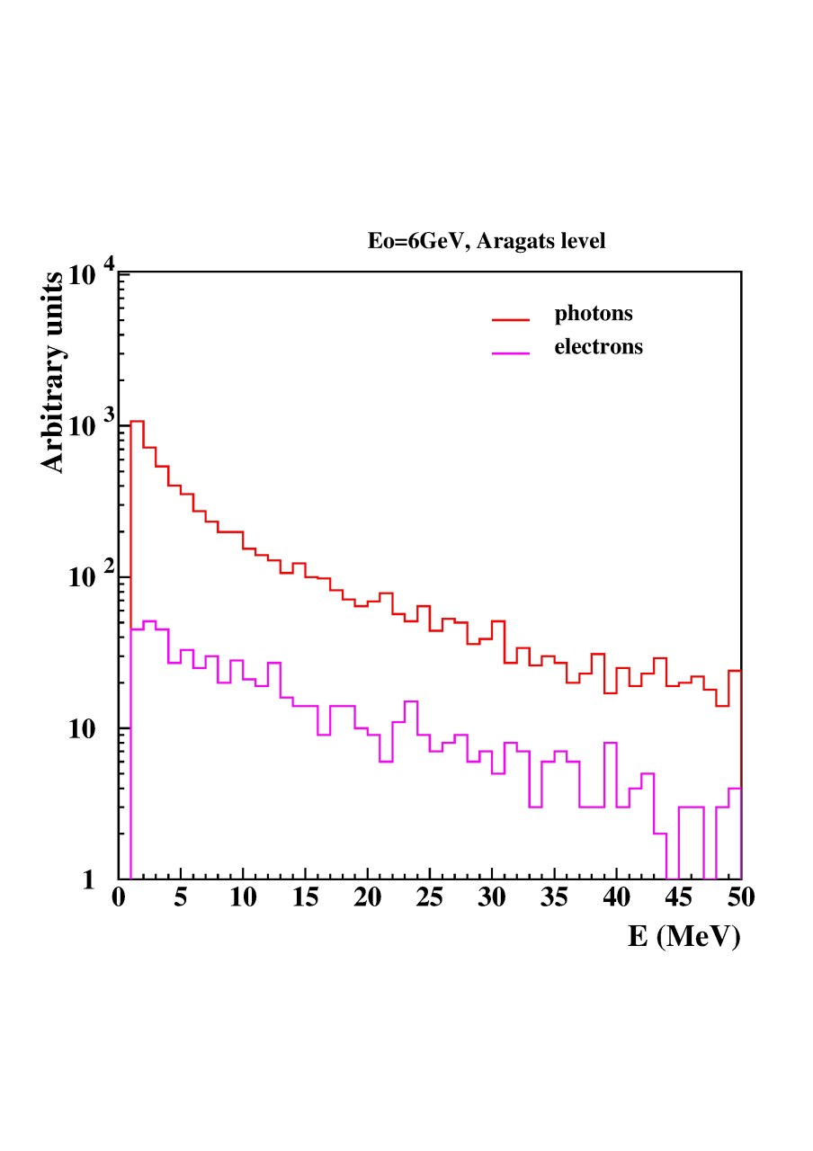
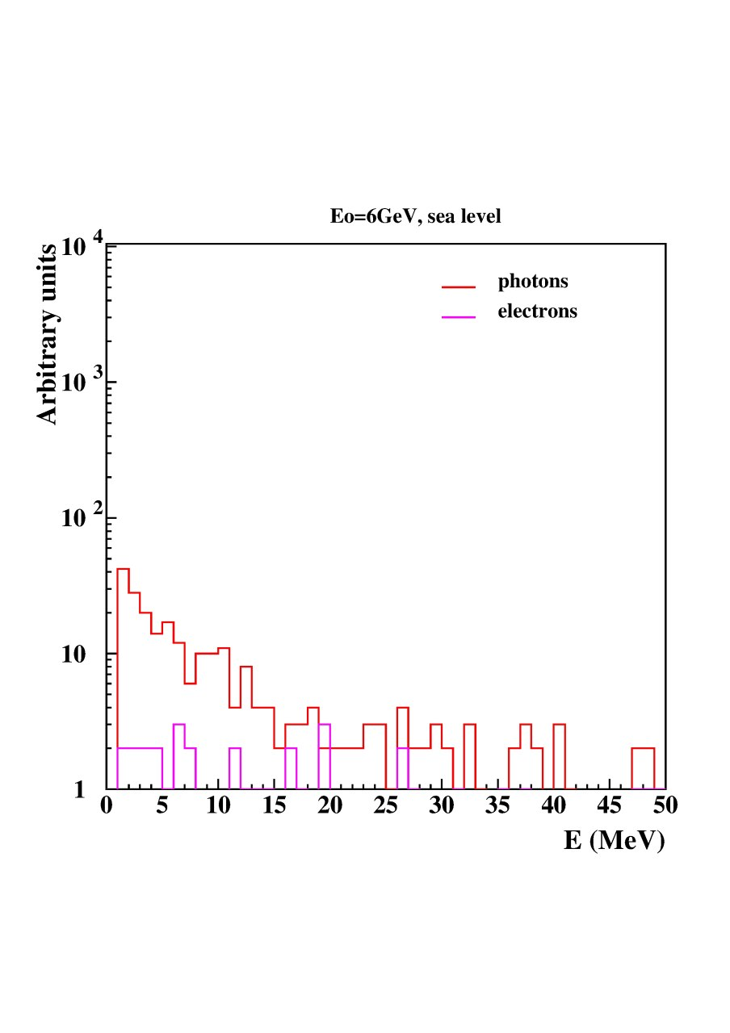
Corsika Simulations Primary particle – Proton with energy 6 GeV at Aragats and sea level

Slide 18
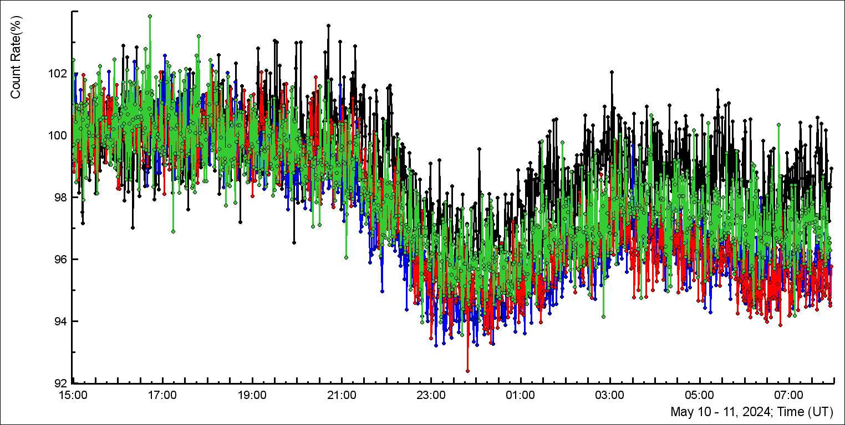
Enhancement after
X5.8 flare
SEVAN network: perfect correlation:
Aragats, Lomnicky, Musala, Mileshovka

Slide 19
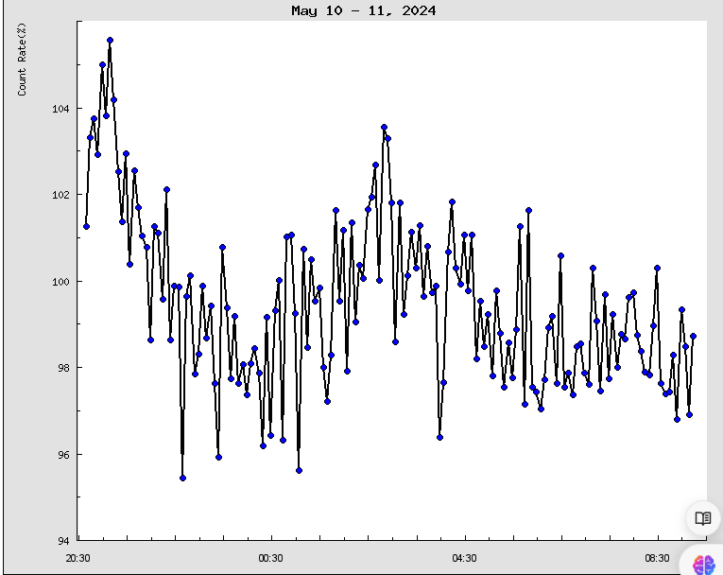
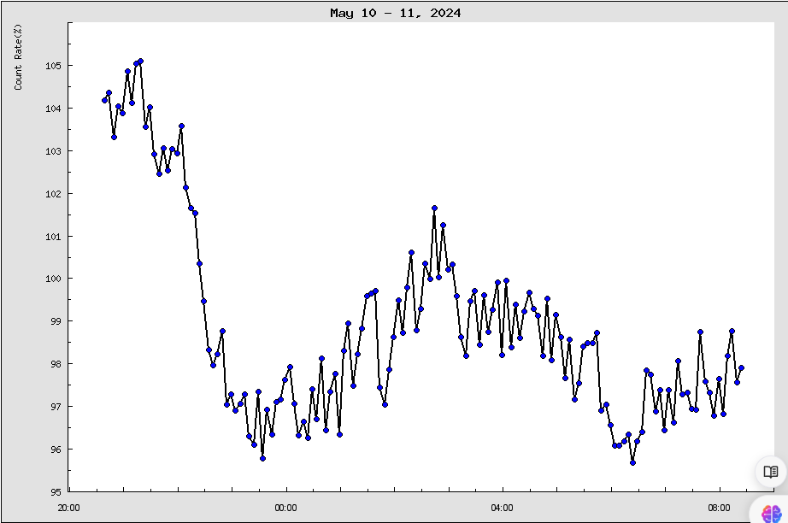
SEVAN 010: five-minute time-series
NANM Dead time 1.250 msec, Nor Amberd
SEVAN 010, Aragats

Slide 20
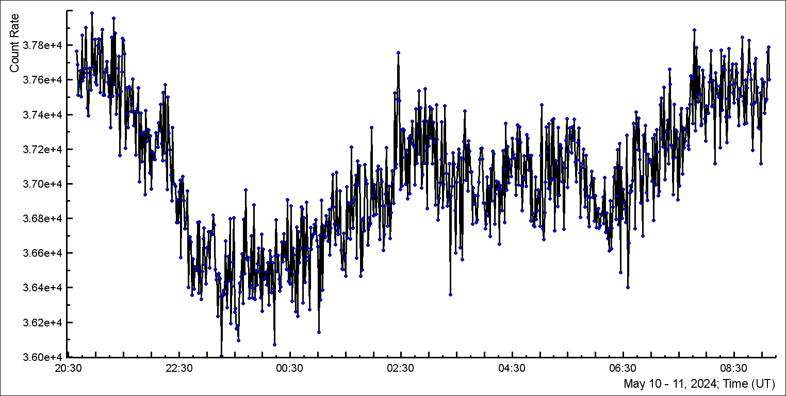
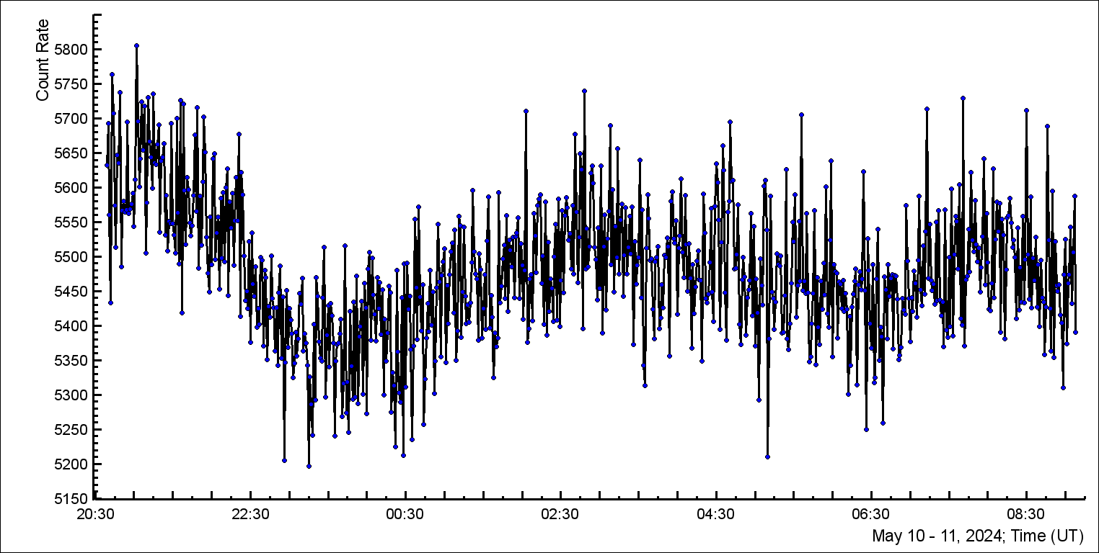
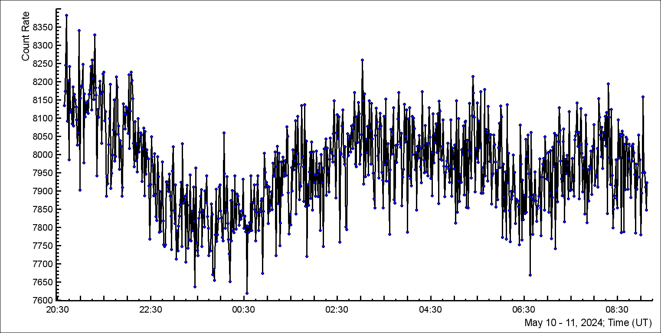
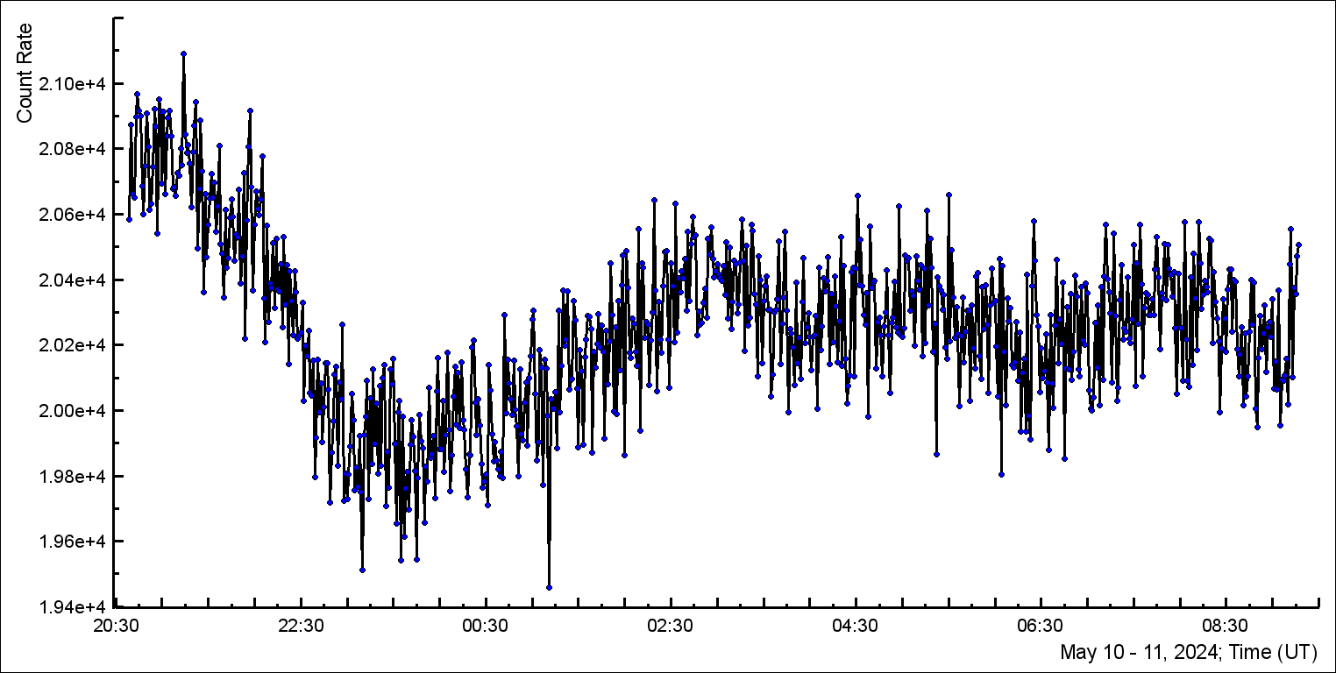
SEVAN light, 1 cm thick
SEVAN light, gamma rays
SEVAN 100
STAND3 1000

Slide 21
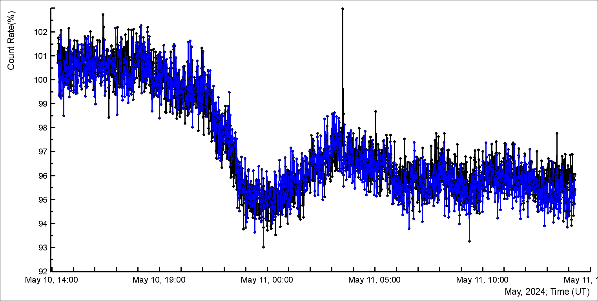
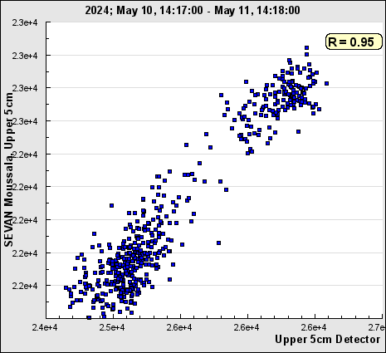
SEVAN upper 5 cm thick scintillator;
Exact correlations between Musala and Lomnicky Stit count rates

Slide 22
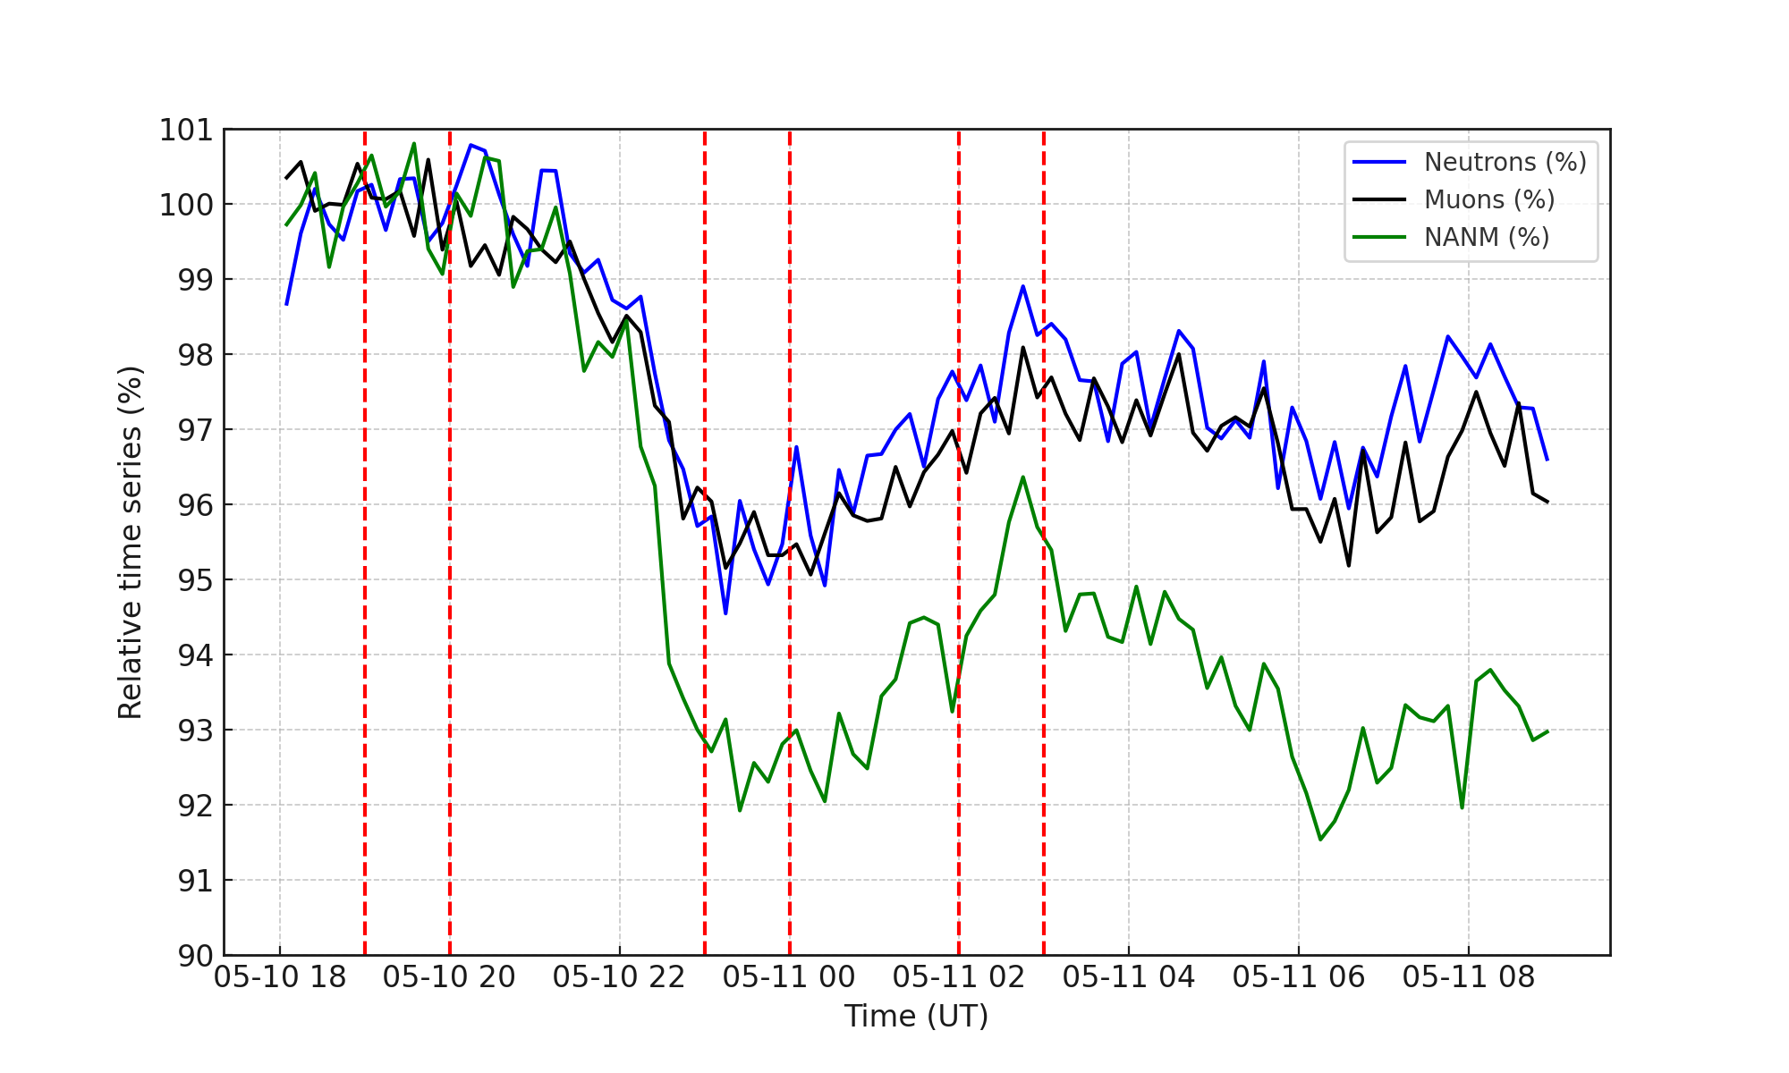
FD and GLE measured by Aragats detectors

Slide 23
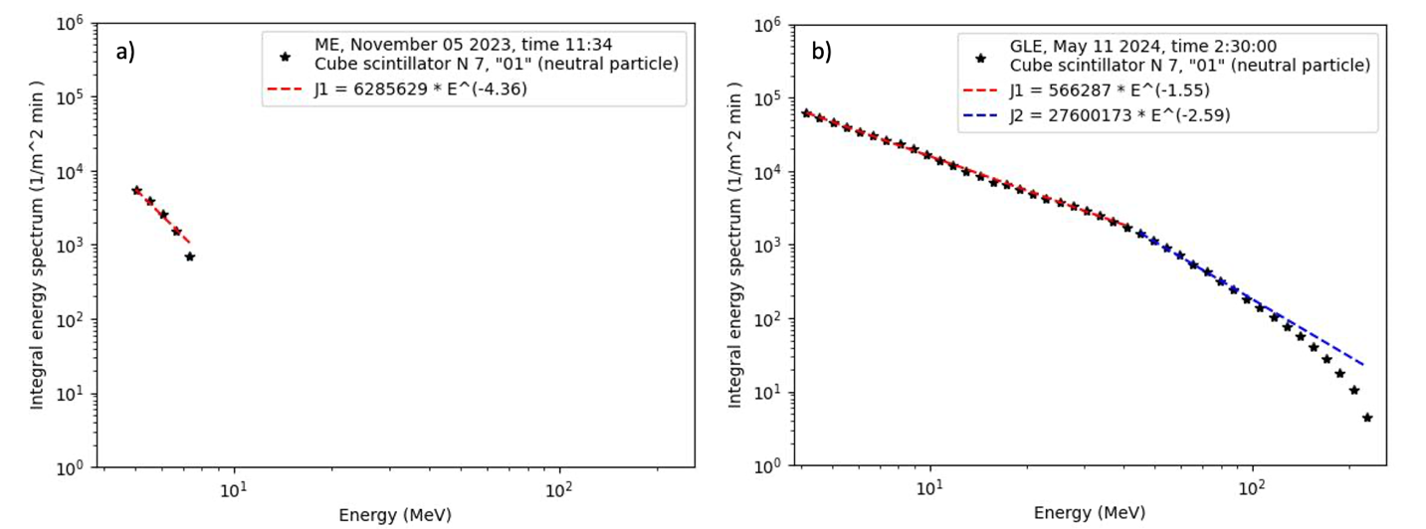
Energy spectra measured by SEVAN light spectrometer: ME and GLE

Slide 24
Approaching the maximum of the 25th solar activity cycle: as seen by particle detectors' networks.
We study how the reconnection of the "frozen" magnetic field within Interplanetary Coronal Mass Ejections (ICMEs) facilitates the increased penetration of solar wind particles into the magnetosphere. Thus, the fluxes registered by terrestrial particle detectors are amplified, and particle fluxes are enhanced through reduced cutoff rigidity (magnetospheric effect, ME).
Conversely, the orientation of the Bz component is less crucial for a Forbush decrease (FD); instead, the strength of the ejecta's scalar magnetic field (B) predominates, with a northward Bz component also potentially triggering a significant FD.
The study methodically explores how these magnetic field variations influence the detector flux of neutrons and muons, effectively modifying the observed rates of cosmic ray influx. Comprehensive data from the WIND magnetometer and Aragats spectrometers underline the direct relationship between ICME magnetic configurations and variations in ground-level particle fluxes.
Moreover, the energy spectra of additional particles during ME are limited to 10 MeV due to the low energy of solar protons that generate secondary particles in the terrestrial atmosphere. In contrast, the energy spectra of the “missing” FD particles can extend up to 100 MeV, demonstrating that magnetic traps and cradles formed by interactions between ejecta and Earth's magnetic fields can deflect high-energy solar protons.
These insights advance our understanding of geomagnetic modulation of particle fluxes and bolster predictive models of space weather impacts on particle detection technologies.

Slide 25
Definition of the Magnetospheric Effect. Our classification consists of the following criteria:
Observation by High-Latitude and Middle-Latitude Detectors: Antarctic and near-polar neutron monitors do not register flux enhancements, whereas middle-latitude NMs and muon detectors consistently observe count rate increases.
Influence of Atmospheric Cutoff Rigidity: Due to atmospheric cutoff rigidity, NMs and SEVAN detectors located on mountain tops at middle latitudes exhibit flux enhancements, while those at sea level do not.
Distinct Energy Spectra: The energy spectra of shower particles measured during ME events differ significantly from other causes of flux enhancement, making this criterion essential for ME identification.

Slide 26
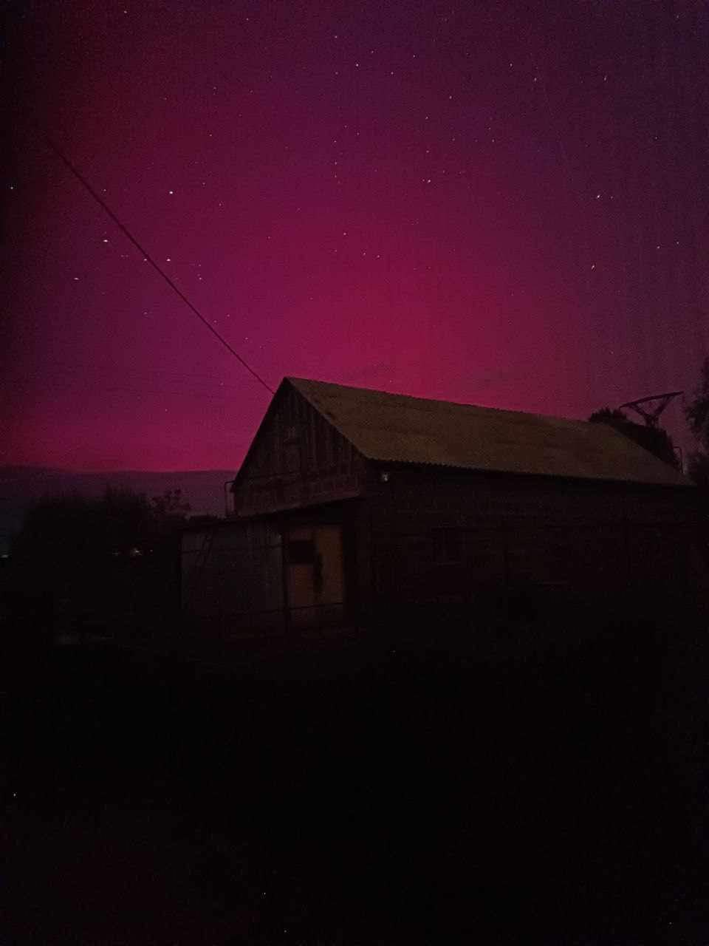
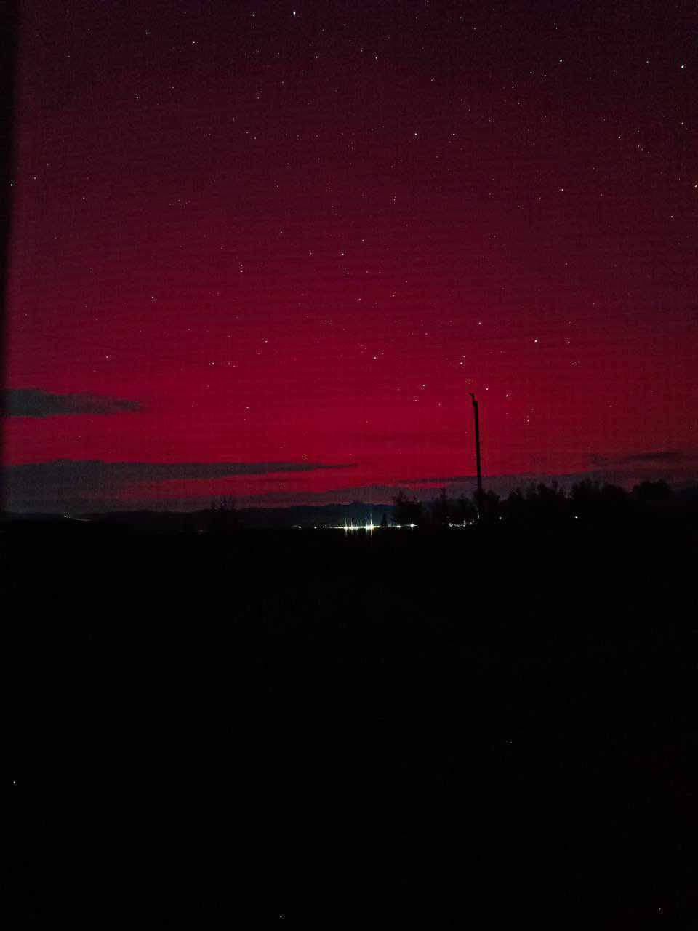
Ever first Aurora Boreal in Armenia 10/11 May 2024
Christina Khachatryan, Ararat region

