Slide 1
The response of the GLE Alert ++ system during GLE74, GLE75 and GLE76
National & Kapodostrian University of Athens Physics Department – Nuclear & Particle Physics Sector Athens Cosmic Ray Group – Α.Ne.Mo.S.
Maria Gerontidou, Pavlos Paschalis, Helen Mavromichalaki,
Maria Papailiou , Dimitra Lingri
¹National and Kapodistrian University of Athens, Physics Department
Athens Neutron Monitor Station (A.Ne.Mo.S.), NKUA
Website: http://cosray.phys.uoa.gr
NMDB Meeting 2025: Cosmic Ray studies with Neutron Detectors
Athens, 19-21 March 205

Slide 2
Outline
GLE74 on May 11, 2024
1. Space – borne observations
2. Ground – based recordings
3. GLE Alert ++ system
GLE75 on June 8, 2024
1. Space – borne observations
2. Ground – based recordings
3. GLE Alert ++ system
GLE76 on November 11, 2024
1. Space – borne observations
2. Ground – based recordings
3. GLE Alert ++ system
NMDB Meeting 2025: Cosmic Ray studies with Neutron Detectors
Athens, 19-21 March 205
Notes:
To begin with, let me give you a quick overview of the presentation. We will go over the key points of the GLE events that occurred in 2024 and how they were detected by the GLE ALERT system. We will go over key information about the three GLEs, including how they are detected in space by satellites, on Earth by ground-based neutron monitors, and how the GLE ALERT system responds to each event

Slide 3
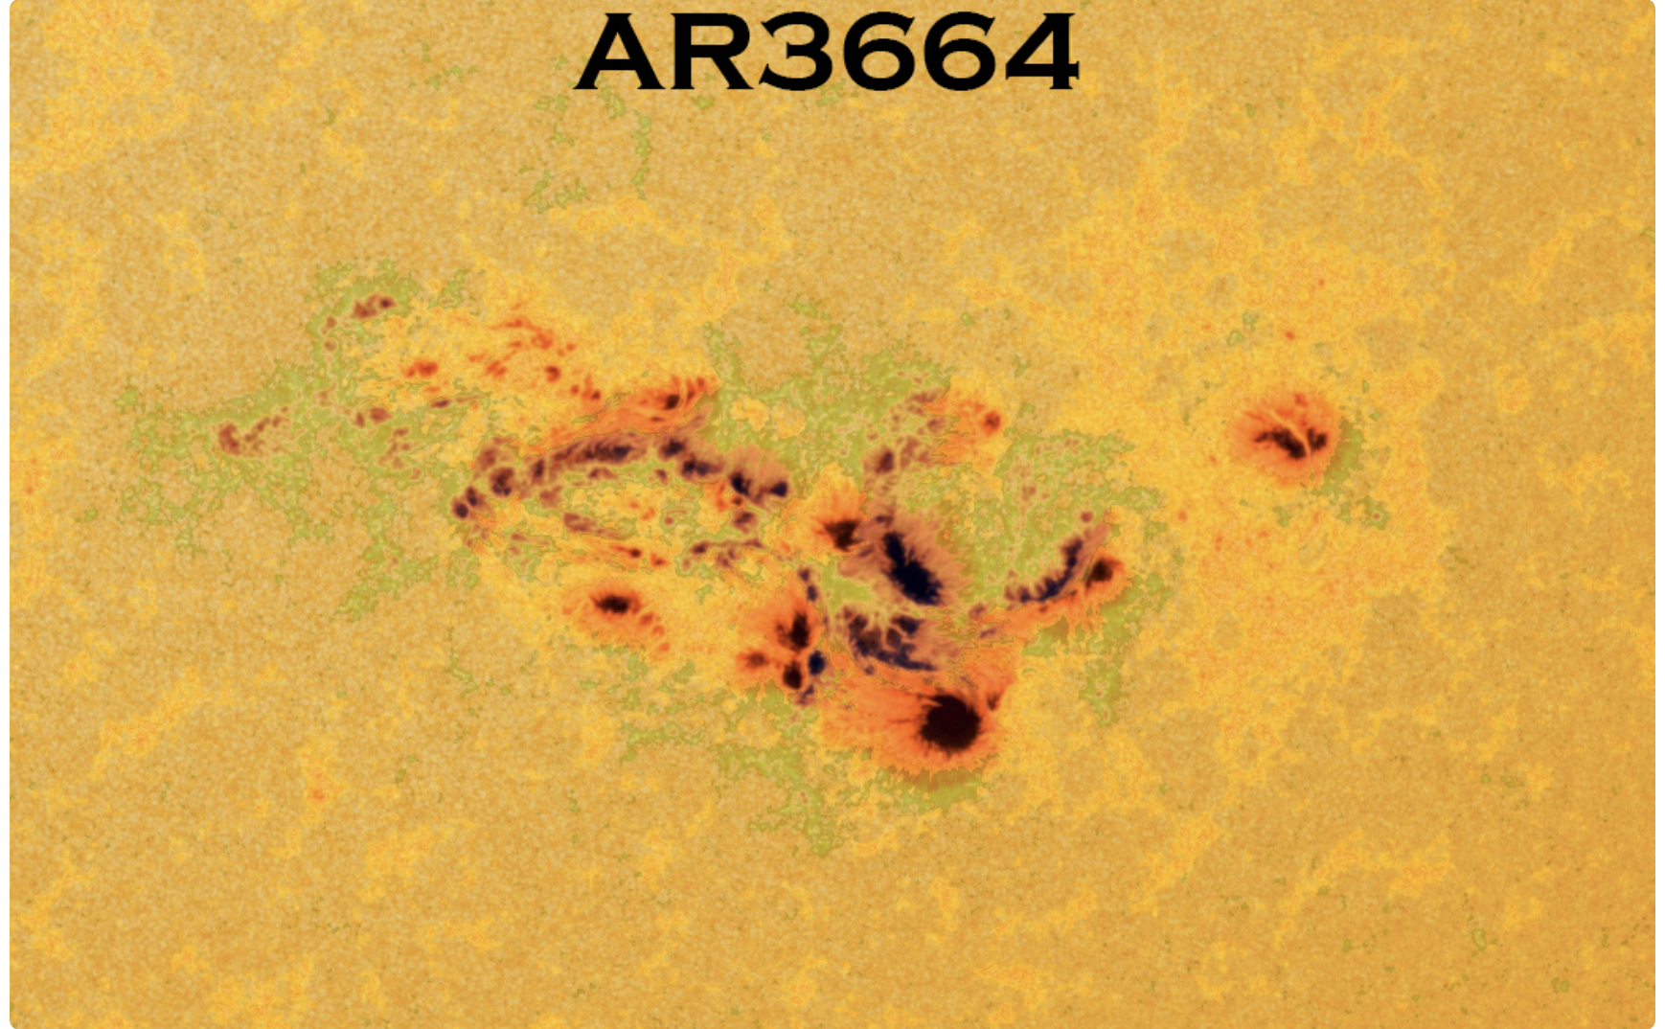
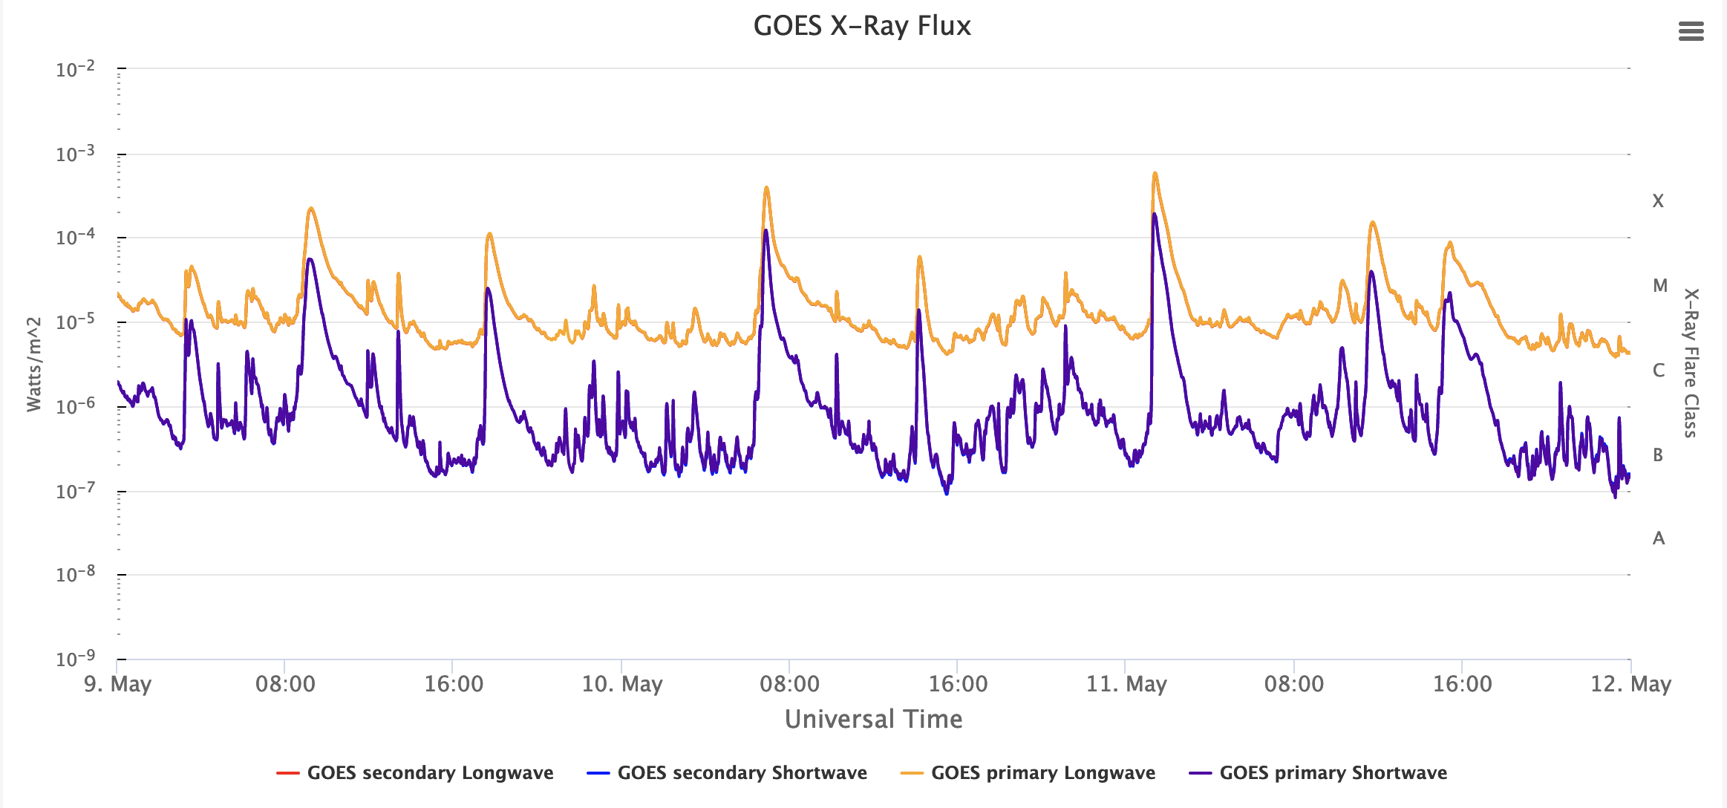
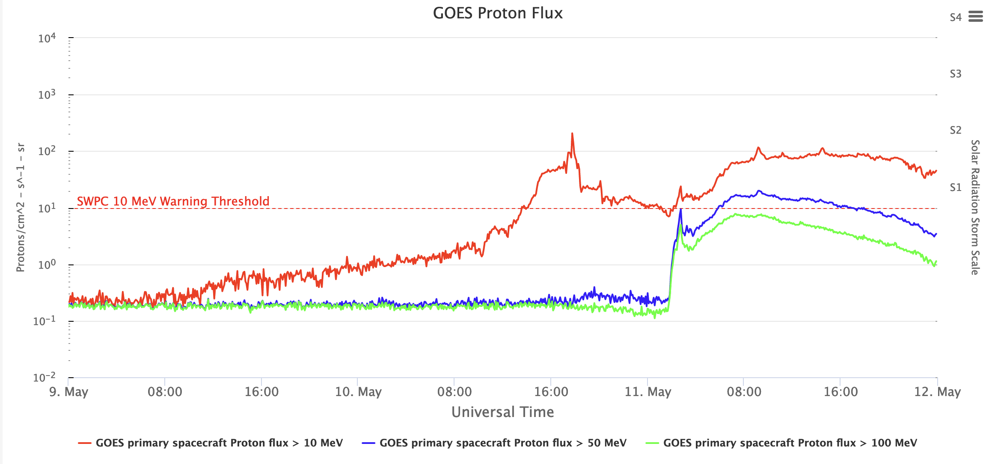
GLE74 – May 11, 2024
Space-borne observations
AR 13664:
8.May: 11 flares , with 3 of them being especially notable: X1.0, M8.7, and X1.0
9 May: 11 more M- and X-flares and CMEs
10 and 11.May: 2 more significant flares (X3.9 and X5.8), accompanied by halo CMEs with initial velocities of 1280 km/s and 1024 km/s respectively.
Solar radiation storm level
Increased solar activity started reflecting in proton flux levels on May 9.
At around 13:30 UT on May 10 the S1 level (minor solar radiation storm) threshold was reached.
At 16:40 UT on May 10 the levels peaked at the S2 (moderate solar radiation storm) threshold and dropped below the S1 level. As observed, the proton flux increased on the following day.
Figure 1a. GOES-16 X-ray fluence in 0.5–4.0 Å and 1.0–8.0 Å and GOES proton flux >10 MeV and > 100MeV as derived from NOAA (https://www.spaceweatherlive.com).
NMDB Meeting 2025: Cosmic Ray studies with Neutron Detectors
Athens, 19-21 March 205
Notes:
we want to examine the solar activity with this GLE it is essential to note that this event occurred during a highly active period in terms of solar activity. Just to refer that between May 2 and May 15, it produced 89 significant X-ray flares, 48 ones belonging to M-class and 10 - to X-class
Activity in AR13664 did not stop further and were registered on
May 9. Including X2.2 (at 08:45 UT) and X1.1 (at 17:23 UT) flares, accompanied by halo CMEs
with initial velocities of 1280 km/s and 1024 km/s respectively.
On May 10 and 11, the active region produced two more significant flares (X3.9 and X5.8),
with fast CMEs, which lead to an increase in observed proton fluxes according to GOES data
(https://www.swpc.noaa.gov/products/goes-proton-flux).

Slide 4
GLE74 – May 11, 2024
On May 11 at 01:00 UT a Solar XR flare with importance X5.8 erupted from Active Region 13664 and reached its maximum at 01:23 UT.
Space-borne observations
This resulted in an abrupt increase in proton flux >100 MeV, with the proton flux peaking at 02:45 UT.
Figure 1b. GOES-16 X-ray fluence in 0.5–4.0 Å and 1.0–8.0 Å and GOES proton flux >10 MeV and > 100MeV as derived from NOAA (https://www.spaceweatherlive.com).
NMDB Meeting 2025: Cosmic Ray studies with Neutron Detectors
Athens, 19-21 March 205
Notes:
Nearly three years after the first recorded Ground Level Enhancement (GLE 73) of Solar Cycle 25 on October 28, 2021, a new GLE occurred on May 11.
This event occurred during a highly active period in terms of solar activity. Just to refer that between May 2 and May 15, it produced 89 significant X-ray flares, 48 ones belonging to M-class and 10 - to X-class
Activity in AR13664 did not stop further and were registered on
May 9. Including X2.2 (at 08:45 UT) and X1.1 (at 17:23 UT) flares, accompanied by halo CMEs
with initial velocities of 1280 km/s and 1024 km/s respectively.
On May 10 and 11, the active region produced two more significant flares (X3.9 and X5.8),
with fast CMEs, which lead to an increase in observed proton fluxes according to GOES data
(https://www.swpc.noaa.gov/products/goes-proton-flux).

Slide 5
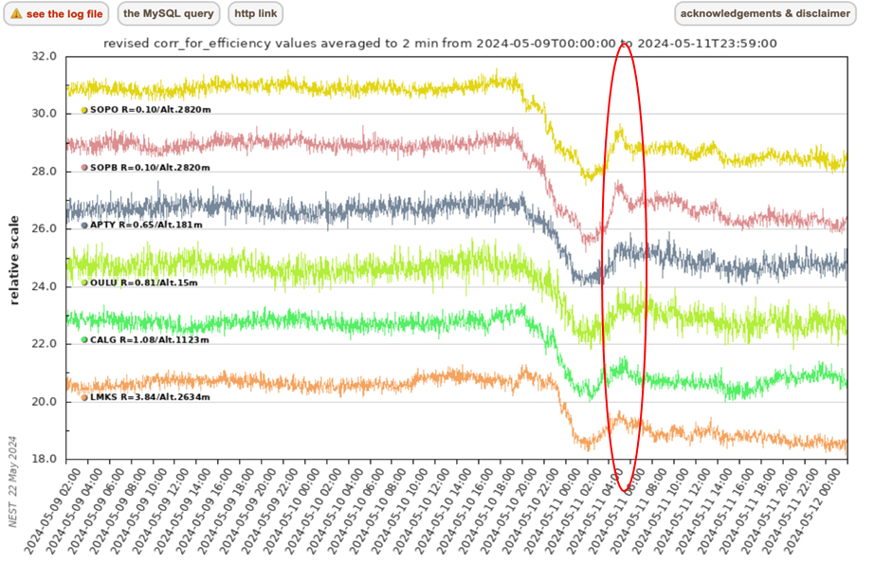
Ground – based recordings
GLE74 took place in a highly disturbed background during the deep phase of a large Forbush decrease.
May 7 – 11, multiple strong solar flares and at least seven CMEs stormed toward Earth.
Figure 2. Several neutron monitor stations recorded enhancements in their data (NMDB; https://www.nmdb.eu/nest/).
Station | Latitude (º) | Longitude (º) | Altitude m | Rigidity GV | Date / Time (MM.DD. HH:MM) | Increase_{max} % | Date | Time
DOMB | 75.1 | -123.38 | 3233 | <0.01 | 05.10 23:00 – 11.05 01:00 | 9.23 | 11/05/24 | 04:20
DOMC | 75.1 | -123.38 | 3233 | <0.01 | 05.10 23:00 – 11.05 01:00 | 7.51 | 11/05/24 | 03:35
DRBS | 50.1 | 4.6 | 225 | 3.18 | 05.10 23:30 – 11.05 01:30 | 4.12 | 11/05/24 | 02:55
NAIN | 56.6 | -61.7 | 0 | 0.3 | 05.10 23:30 – 11.05 01:30 | 5.67 | 11/05/24 | 03:45
SNAE | -71.67 | -2.85 | 856 | 0.73 | 05.10 23:30 – 11.05 01:30 | 5.45 | 11/05/24 | 03:10
SOPB | -90 | 0 | 2820 | 0.1 | 05.10 23:30 – 11.05 01:30 | 9.96 | 11/05/24 | 02:45
SOPO | -90 | 0 | 2820 | 0.1 | 05.10 23:30 – 11.05 01:30 | 8.67 | 11/05/24 | 03:00
7 best stations that recorded GLE74 according to OULU GLE database (https://gle.oulu.fi/#/)
NMDB Meeting 2025: Cosmic Ray studies with Neutron Detectors
Athens, 19-21 March 205
Notes:
The high-energy tail of this SPE is registered by Neutron Monitor Network
From May 7 – 11, multiple strong solar flares and at least seven CMEs stormed toward Earth.
74 occurred during an irregular Forbush Decrease with sharp amplitude reduction and rapid recovery. Specifically, a 15% decrease was recorded, followed by an exceptionally fast 10% recovery within 1.5 hours, as observed by the Oulu neutron monitor station.This event triggered the strongest geomagnetic storm in two decades (May 10–11, 2024), causing auroras at unprecedented latitudes worldwide. OULOU about 5% LMKS 4%

Slide 6
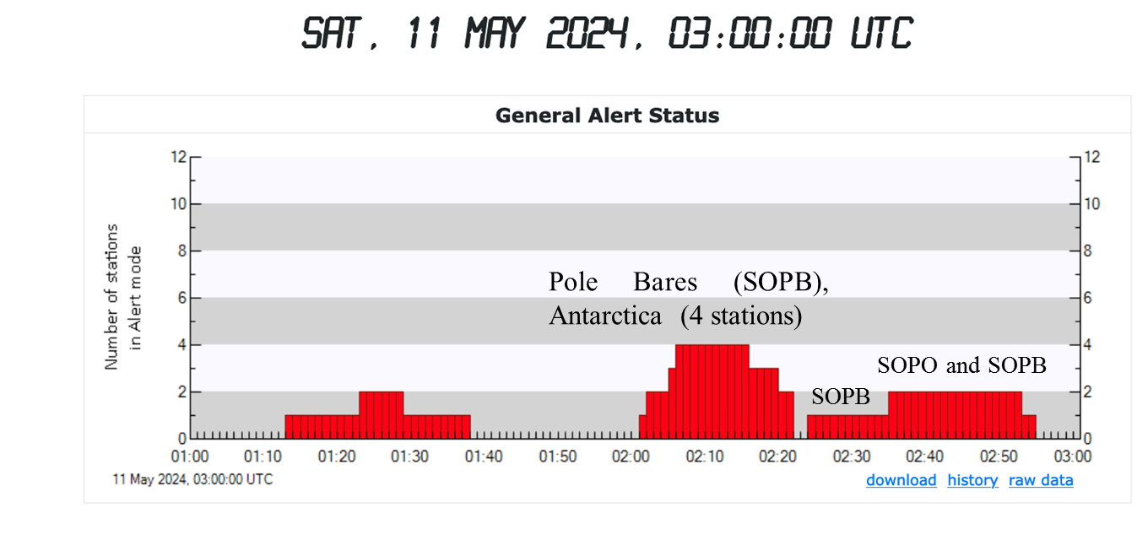
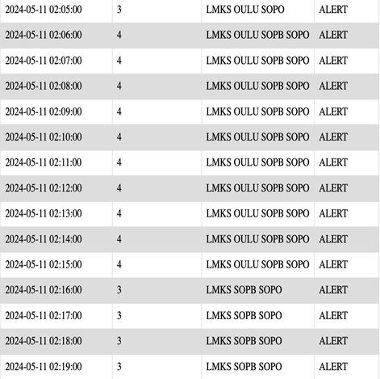
Real-time Alert on May 11 2024 at 02:05UT from the GLE Alert++ system
Alert Status
May 11, 2024
An alert was issued at 02:05 UT
Oulu, Finland (OULU, R= 0.81, 15m asl),
South Pole, Antarctica (SOPO, R=0.10GV, 28020m asl)
Lomnický štít, Slovakia (LMKS, R=3.84GV, 2634m asl).
One minute after the initial alert, a new polar station, South Pole B (SOPB), also entered into Alert mode.
Figure 3. Evolution of the GLE Alert ++ for GLE74. The alert status: Real-time Alert on May 11 2024 at 02:05 UT.
NMDB Meeting 2025: Cosmic Ray studies with Neutron Detectors
Athens, 19-21 March 205
Notes:
The response of the GLE Alert to this enhancement was to first activate Alert status at the OULU station

Slide 7
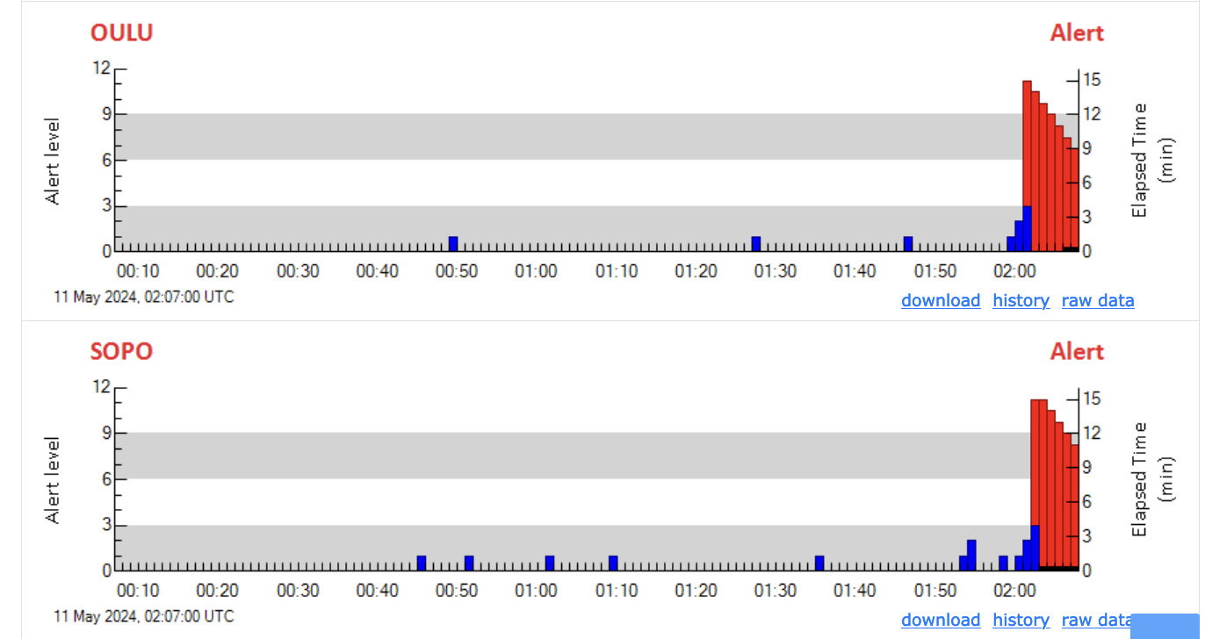
Evolution of GLE Alert ++ for GLE 74
At 02:01 UT OULU NM status entered in alert mode,
At 02:02 UT SOPO entered in Alert mode
At 02:05 UT LMKS entered in Alert mode
At 02:06 UT SOPOB ( While the system was in Alert status )
Figure 4. Screenshots of the GLE Alert++ system on 11.05.204 during the GLE74 for the stations OULU, SOPO, LMKS and later SIOPB in Alert mode.
NMDB Meeting 2025: Cosmic Ray studies with Neutron Detectors
Athens, 19-21 March 205
Notes:
The evolution progressed as depicted in these figures. Initially, t

Slide 8
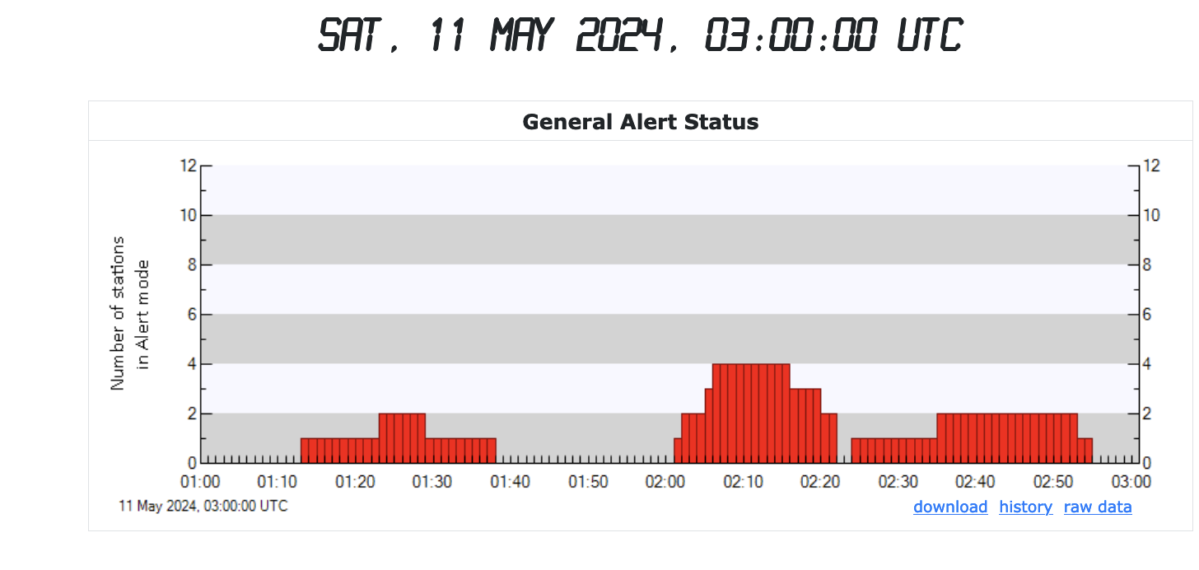
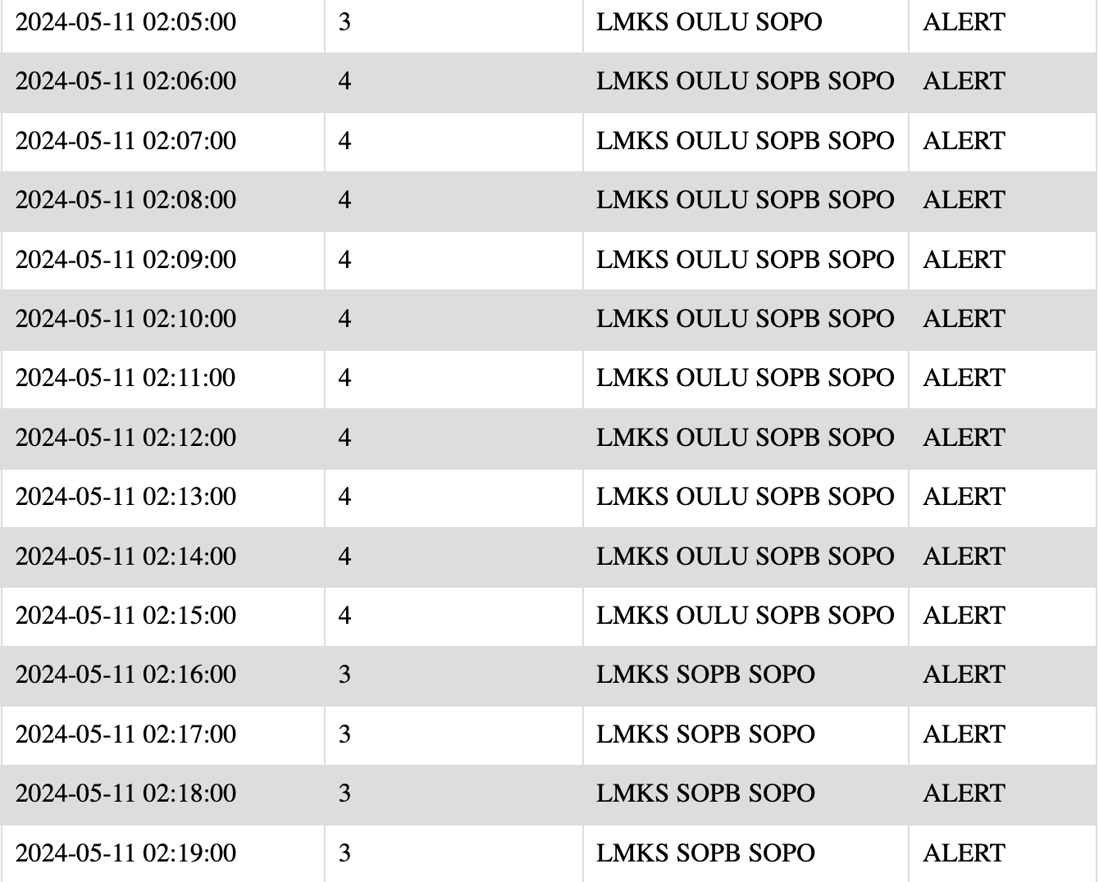
Evolution of GLE Alert ++ for GLE 74
Pole Bares (SOPB), Antarctica (4 stations)
SOPO and SOPB
SOPB
2:05 UT until 2:19UT General Alert Status
Figure 5. Screenshots of the GLE Alert++ system on 11.05.204 during the GLE74
NMDB Meeting 2025: Cosmic Ray studies with Neutron Detectors
Athens, 19-21 March 205
Notes:
GLE Alert ++ has successfully generated and issued a GLE alert notification at 2:05UT (based on ANeMos server timestamp)

Slide 9
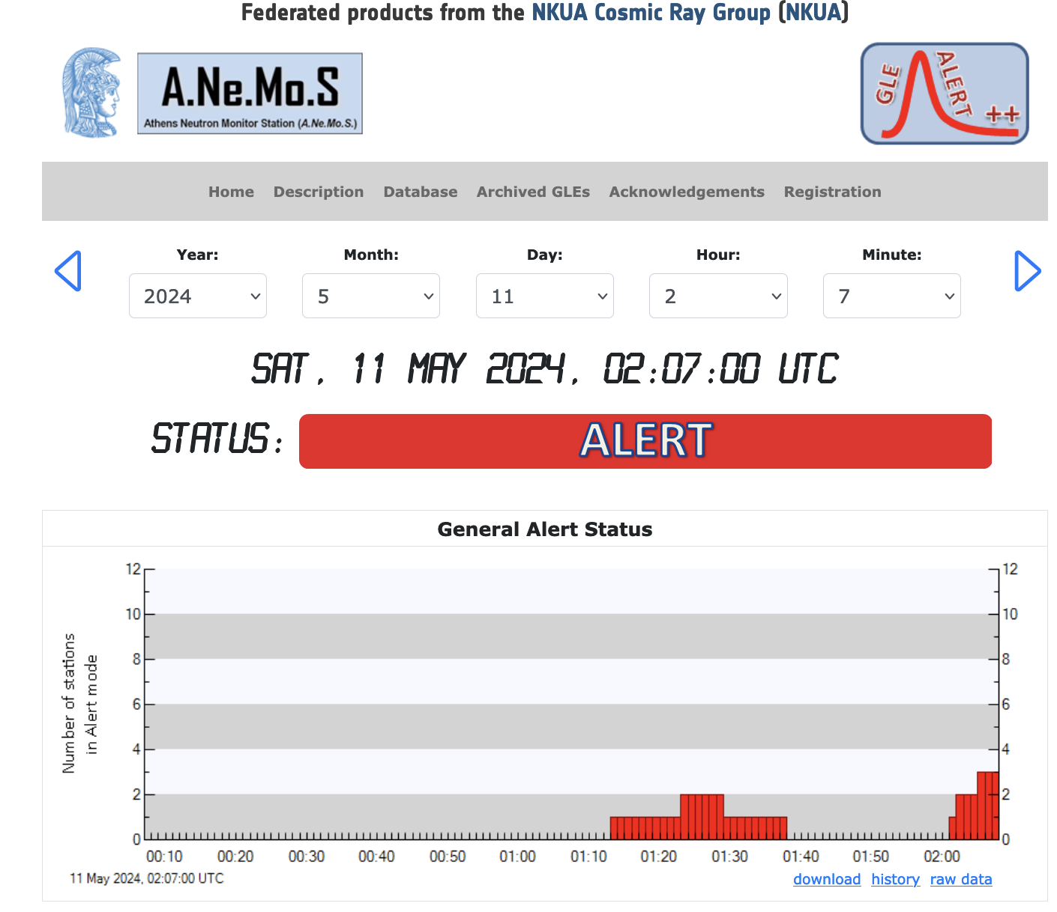
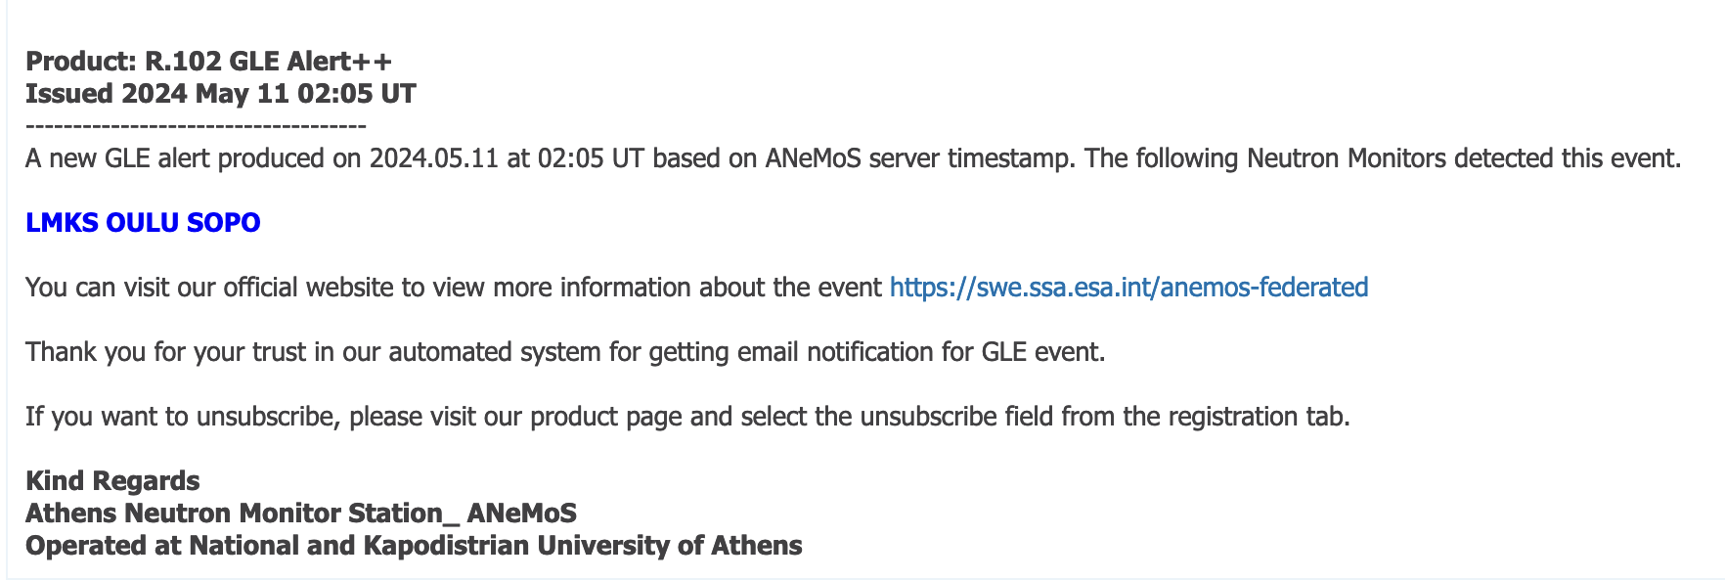
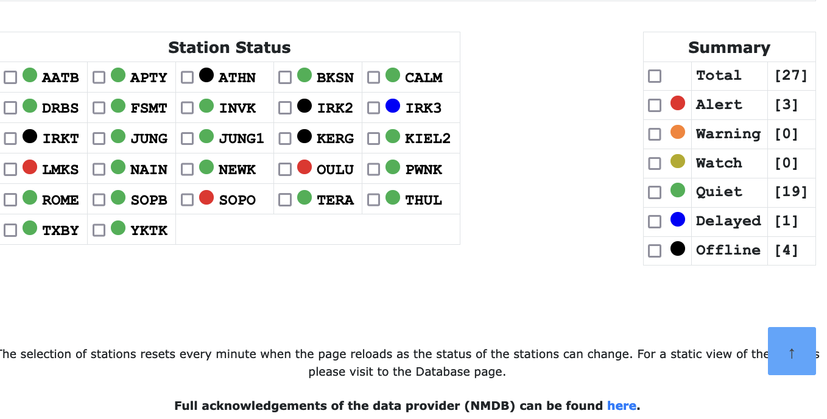
GLE Alert++ system
Figure 7. On May 11, 2024 at 02:05 UT a notification was sent to all registered users.
Figure 6. General Alert status on May 11, 2024 at 02:07 UT (https://swe.ssa.esa.int/anemos-federated).
(Mavromichalaki et al., 2024)
NMDB Meeting 2025: Cosmic Ray studies with Neutron Detectors
Athens, 19-21 March 205

Slide 10
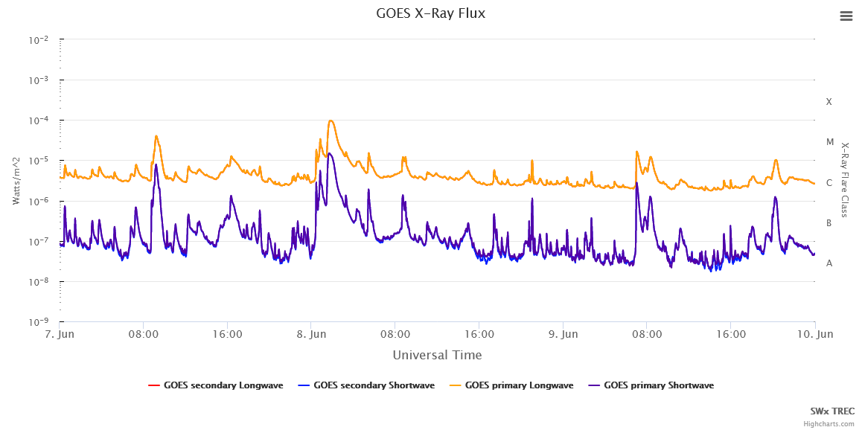
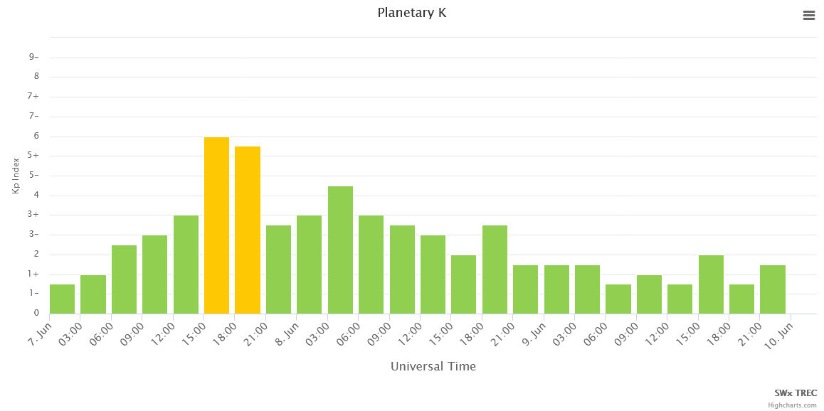
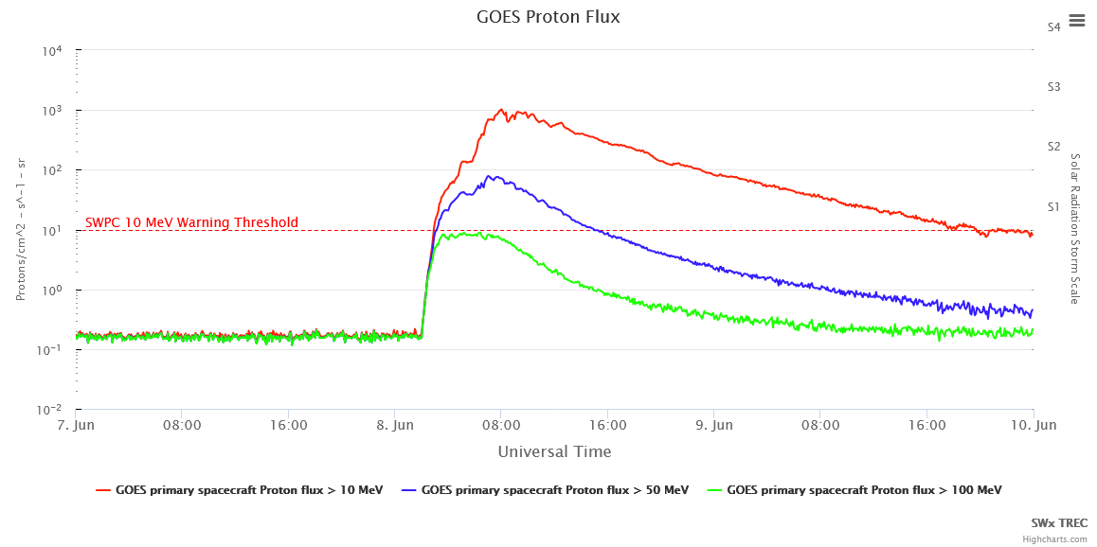
GLE75 – June 8, 2024
Space-borne observations
M1.3 at 01:53 UT
Geophysical Activity
Quiet geomagnetic field on June 8, 2024
Increase at 2:50UT,
Figure 9. Kp – index values for the time period from June 7 – June 10, 2024 (https://lasp.colorado.edu/space-weather-portal/goes-proton-flux/).
Figure 8. GOES-16 X-ray fluence in 0.5–4.0 Å and 1.0–8.0 Å and GOES proton flux >10 MeV and > 100MeV as derived from https://lasp.colorado.edu/space-weather-portal/goes-proton-flux/.
NMDB Meeting 2025: Cosmic Ray studies with Neutron Detectors
Athens, 19-21 March 205
Notes:
We have performed a careful analysis of the sub-GLE of 08-Jun-2024 and found that it meets the criteria for the GLE definition: in addition to SOPO/B and DOMC/B, a weak but statistically significant response (~2 %*hr) was found in PWNK (Peawanuck pioounak) dataset. A paper about that is in preparation.
Kp index does not directly measure interplanetary conditions, it is influenced by them. Specifically, high-speed solar wind streams, coronal mass ejections (CMEs), and strong southward IMF components (Bz) can enhance geomagnetic activity, leading to higher Kp values.
Thus, the Kp index reflects geomagnetic activity, which is driven by interplanetary conditions.
Thus, the SEP event of 08-Jun-2024 becomes GLE#75, while that of 21-Nov-2024 is GLE#76.

Slide 11
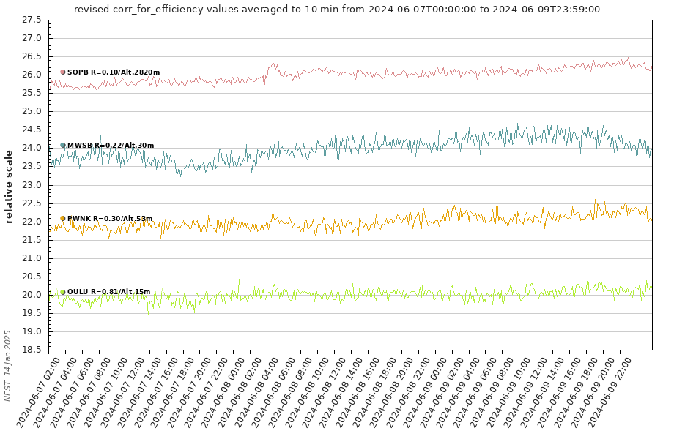
Ground – based recordings
Figure 10. The GLE75 as recorded by the OULU, PWNK, MWSB and SOPB neutron monitor stations (NMDB; https://www.nmdb.eu/nest/).
Station | Latitude (º) | Longitude (º) | Altitude m | Rigidity GV | Date / Time (MM.DD. HH:MM) | Increase_{max} % | Date | Time
DOMB | 75.1 | -123.38 | 3233 | <0.01 | 08.06 00:00 – 08.06 02:00 | 8.65 | 08/06/24 | 04:35
DOMC | 75.1 | -123.38 | 3233 | <0.01 | 08.06 00:00 – 08.06 02:00 | 5.76 | 08/06/24 | 02:30
MWSB | -67.60 | 62.88 | 30 | 0.22 | 08.06 00:00 – 08.06 02:00 | 3.43 | 08/06/24 | 03:25
OULU | 65.05 | 25.47 | 15 | 0.8 | 08.06 00:00 – 08.06 02:00 | 2.89 | 08/06/24 | 02:55
PWNK | 54.98 | -85.44 | 53 | 0.00 | 08.06 00:00 – 08.06 02:00 | 2.7 | 08/06/24 | 02:45
SNAE | -71.67 | -2.85 | 856 | 0.68 | 08.06 00:00 – 08.06 02:00 | 2.64 | 08/06/24 | 03:00
SOPB | -90 | 0 | 2820 | 0.1 | 08.06 00:00 – 08.06 02:00 | 2.66 | 08/06/24 | 03:15
7 best stations that recorded GLE76 according to OULU GLE database (https://gle.oulu.fi/#/)
NMDB Meeting 2025: Cosmic Ray studies with Neutron Detectors
Athens, 19-21 March 205

Slide 12
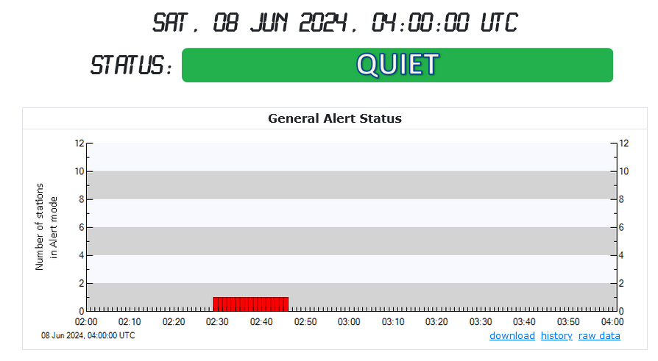
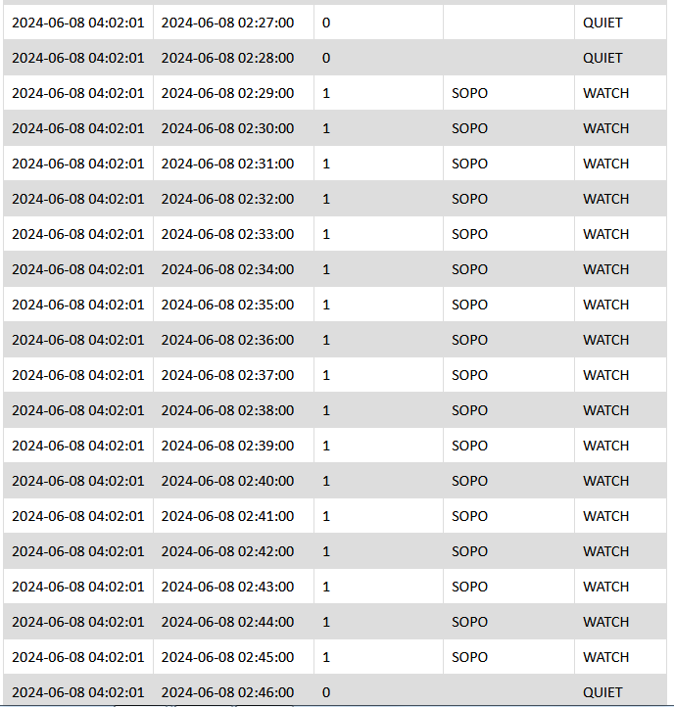
GLE Alert++ system
SOPO
Figure 11. The SOPO station entered in Alert mode.
Figure 12. The timestamps from the GLE Alert++ system on June 8, 2024 from 02:27UT until 02:46UT.
NMDB Meeting 2025: Cosmic Ray studies with Neutron Detectors
Athens, 19-21 March 205

Slide 13
GLE Alert++ system
The GLE Alert ++ system could not be in General Alert status, as there were no three stations in Alert mode simultaneously, possibly due to the small amplitude of the event.
NMDB Meeting 2025: Cosmic Ray studies with Neutron Detectors
Athens, 19-21 March 205

Slide 14
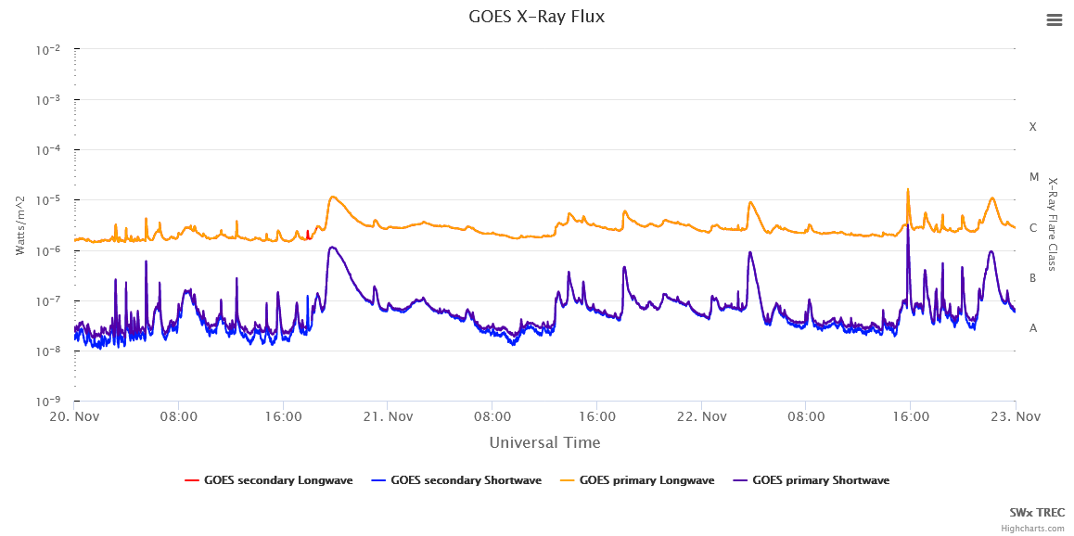
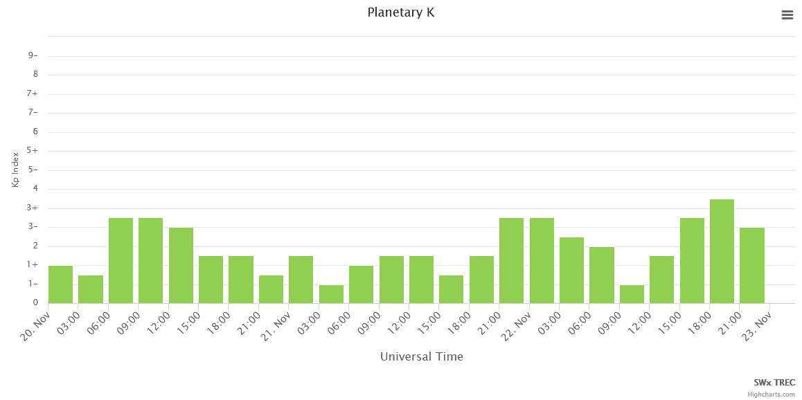
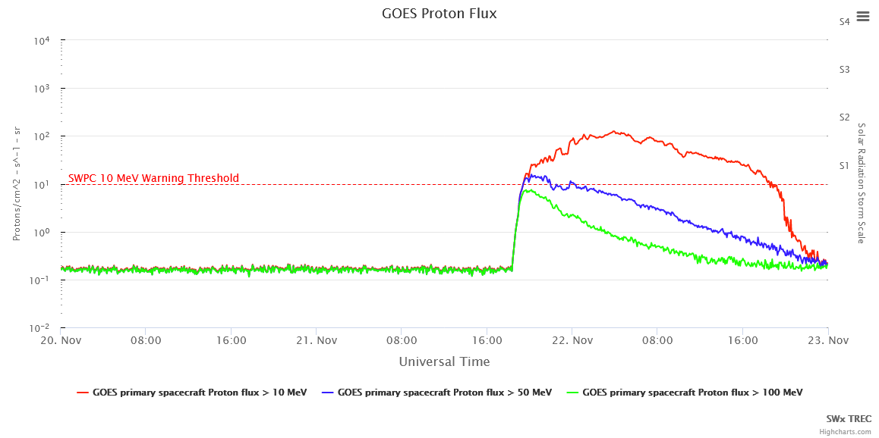
GLE76 – November 21, 2024
Space-borne observations
AR3889 erupted on November 20 at 19:48 UT peak time producing a M1.2-Class solar flare. No obvious Earth directed CMEs were observed in available LASCO imagery on November 18-20.
GOES Proton Flux for particles with energies above 10 MeV exceeded the SWPC 10 MeV warning threshold on November 21 at 19:20 UT (S2 solar radiation storm).
Geophysical Activity
Quiet geomagnetic field on November 20-21, 2024
Figure 14. Kp – index values for the time period from November 20 – November 23, 2024 (https://lasp.colorado.edu/space-weather-portal/goes-proton-flux/).
Figure 13. GOES-16 X-ray fluence in 0.5–4.0 Å and 1.0–8.0 Å, as derived from https://lasp.colorado.edu/space-weather-portal/goes-proton-flux/.

Slide 15
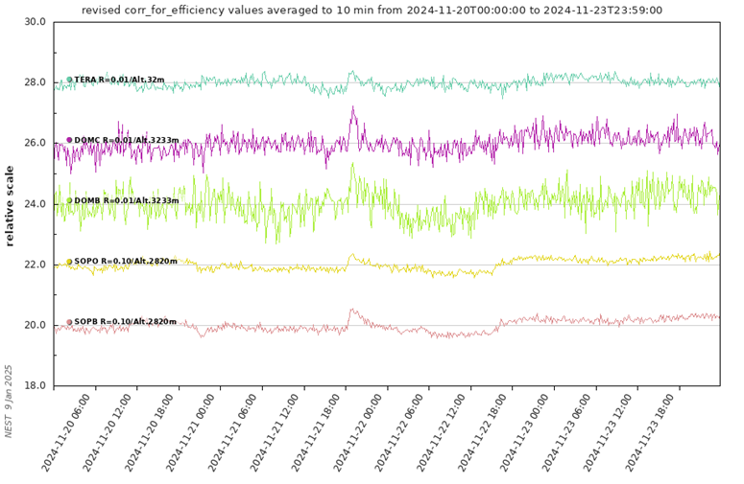
Ground – based recordings
Figure 15. Cosmic ray intensity variations for the time period from November 20 to November 23 for the neutron monitor stations TERA, DOMC, DOMB, SOPO and SOPB (https://www.nmdb.eu).
Station | Latitude (º) | Longitude (º) | Altitude m | Rigidity GV | Date / Time (MM.DD. HH:MM) | Increase_{max} % | Date | Time
DOMB | 75.1 | -123.38 | 3233 | <0.01 | 21.11 16:00 – 21.11 18:00 | 8.64 | 21/11/24 | 20:05
DOMC | 75.1 | -123.38 | 3233 | <0.01 | 21.11 16:00 – 21.11 18:00 | 6.98 | 21/11/24 | 19:05
TERA | -66.65 | 140.00 | 32 | 0.02 | 21.11 16:00 – 21.11 18:00 | 4.25 | 21/11/24 | 19:00
SOPB | -90 | 0 | 2820 | 0.1 | 21.11 16:00 – 21.11 18:00 | 3.68 | 21/11/24 | 19:00
CALM | 40.64 | -3.16 | 708 | 6.95 | 21.11 16:00 – 21.11 18:00 | 3.85 | 21/11/24 | 16:10
5 best stations that recorded GLE76 according to OULU GLE database (https://gle.oulu.fi/#/)
NMDB Meeting 2025: Cosmic Ray studies with Neutron Detectors
Athens, 19-21 March 205

Slide 16
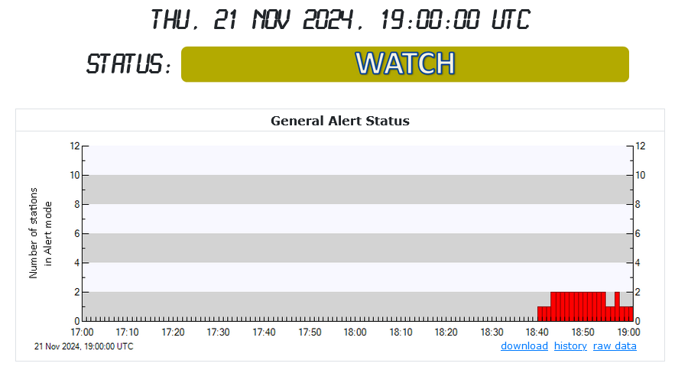
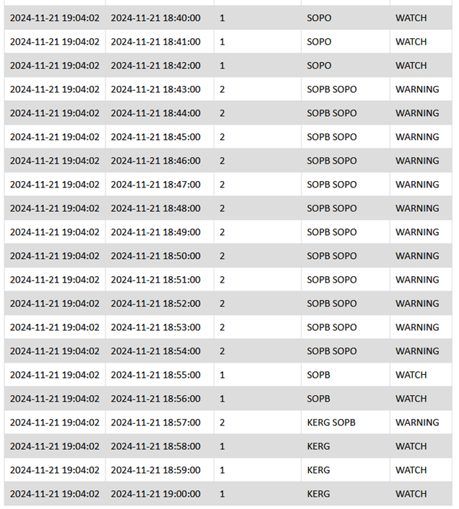
GLE Alert++ system
In the GLE Alert++ system at first, two polar stations, SOPO and SOPB, were in Alert mode (18:43 - 18:54UT) and the system’s status was Warning. For the next 2 minutes (18:55 - 18:56UT) only SOPB was in Alert mode and the system’s status was Watch. At 18:57UT two stations (KERG and SOPB) were in Alert mode and the system’s status was again Warning. From there on only the station KERG was in Alert mode and the system’s status was Watch.
SOPB
KERG
SOPO
Figure 16. The two stations in Alert mode (SOPB and SOPO) are marked.
Figure 17. The timestamps from the GLE Alert++ system on November 21, 2024 from 18:40UT until 19:00 UT.
NMDB Meeting 2025: Cosmic Ray studies with Neutron Detectors
Athens, 19-21 March 205

Slide 17
GLE Alert++ system
So, the GLE Alert ++ system could not be in General Alert status, as there were no three stations in Alert mode simultaneously.
NMDB Meeting 2025: Cosmic Ray studies with Neutron Detectors
Athens, 19-21 March 205

Slide 18
Thank you
Acknowledgments: We acknowledge the NMDB database (www.nmdb.eu), founded under the European Union's FP7 programme (contract no. 213007) for providing data, and individual monitors following the information given on the respective station information page.
This form retrieves data from the NMDB server located at the University of Kiel (NMDB) that distributes official data provided by the PIs of the neutron monitor stations. Data of different origin may not have been validated or authorised by the respective PI, and any deviation with respect to the authorised data is not his/her responsibility. According to NMDB terms of use, this data is free for non commercial use within the restrictions imposed by the providers. If you use such data for your research or applications, please acknowledge the origin by a sentence like "We acknowledge the NMDB database (www.nmdb.eu), founded under the European Union's FP7 programme (contract no. 213007) for providing data.", and acknowledge individual monitors following the information given on the respective station information page (see subpages under www.nmdb.eu).
This research is supported by ESA SSA SWE Space Radiation Expert Service Centre activities (ESA contract number 4000113187/15/D/MRP) and the ESA Space Safety Program’s network of space weather service development and pre-operational activities (ESA contract number 4000134036/21/D/MRP). The authors would like to thank the PIs of the High- Resolution Neutron Monitor Database (NMDB) for kindly providing cosmic ray data. The authors are grateful to all the solar, geomagnetic and interplanetary data providers.

