Slide 1



Applied and Environmental Theatre 1st Symposium
Community Theatre and Environmental Pressures in the Coastal Communities of the Mediterranean (THEATRE2SEA)
25-26 May 2026

Slide 2
The Knight with the enchanted armor: The iron burden
Facilitators:
Stella Hatziaggeli,
Eleni Karydi,
Theodora Mega,
Konstantinos Peristerakis,
Spyros Roussis,
Ilektra – Ioanna Souliou

Slide 3
Title: The Knight with the enchanted armor: the iron burden
Reference group: Community residents next to a garbage dump
Central Question: “How is it like to find the best solution for the community in adverse conditions?”
Common Role: Blacksmiths – Craftsmen (The best in the area!)
Roles of the Animator: The Knight (1st viewpoint), The Witch (2nd viewpoint)
Where: in a castle state
When: sometime, maybe recently, maybe not
The Knight with the enchanted armor: The iron burden

Slide 4
Storytelling
Sometime, recently or not, in a castle state there was a group of the most talented craftsmen and blacksmiths working in their workshop.

Slide 5
Space Building activities
Use a long rope to demarcate the workshop area. Then, along the length of the rope, place various metal and iron objects such as tools, hammers, screwdrivers, chains, horseshoes, etc.
Complete the list of services the craftsmen provide, located at the entrance of the Workshop.

Slide 6
Role Building Activites
Draw the most recent order the craftsmen received.
After defining a short route with a starting and an end point, add a chair in the middle, posing as the new construction of the craftsmen for the city. Then, divided into pairs, depict the reaction of the citizens seeing the new craft, while they are crossing the road.

Slide 7
Storytelling
Now that we created the entrance, every time you are inside the office you embody the Craftsmen. Someone will visit you soon.

Slide 8
1st point of view- The knight
The knight visits the craftsmen at their workshop. He presents to them the enchanted armor that he must always wear. The armor ensures he wins every fight, but there is a burden to bear: With the passage of time it will cause more and more problems to his health.
The Witch that once gave him the armor is now refusing to take it back, so he is asking the craftsmen for help.

Slide 9
Assimilation activity A
Using your body and voice, embody how the enchanted armor affects the health of the Knight.

Slide 10
Assimilation activity B
  While in a circle with a chair placed in the middle, express the thoughts of the citizens for the things the Knight has achieved for the common good of the city.

Slide 11
Storytelling
Now you will get into the workshop area once again. Remember each time you get there you are not yourselves, but the blacksmiths! After a little bit of discussion, someone will visit you once again.

Slide 12
2nd point of view- The Witch
The Witch visits the Craftsmen. She is looking for the Knight, concerned after his letter to her asking to take the armor off.
She explains that she gave him the armor in the past after his request, so he can save the city from every threat. She also explains how she warned him of the bad consequences to his health, but he insisted.
Without the enchanted armor, danger will encapsule the city.

Slide 13
Assimilation activity A
You are part of the audience at a talk show. A facilitator will go around asking each person about something they do that negatively impacts their health.

Slide 14
Assimilation activity B-Forum Theatre
Meeting between the Witch and the Knight in front of the new craft of the Craftsmen in the middle of the city.
The symbols (Witch’s hat, Sword) alternate, and when the dialogue is interrupted, it must continue exactly from the point it was stopped. The drama facilitator may also begin or take the symbol if they wish to highlight a certain aspect.

Slide 15
Storytelling
For a last time you get inside the workshop as craftsmen and discuss about the decision. In a little bit the Knight will come for an answer!

Slide 16
Action - announcement of decision
The Knight returns. The craftsmen talk to him and announce their decision.

Slide 17
Reflection
Time skip:
20 years later, a headline is published at the local newspaper with a picture of the Knight. The sentence starts like this:
“10 years passed since….”
Finish the sentence.

Slide 18
Materials
Rope
Iron tools (tools, hammers, screwdrivers, chains, horseshoes)
Witch’s hat
Fake sword
Chair
Paper Sheets & Pencils

Slide 19
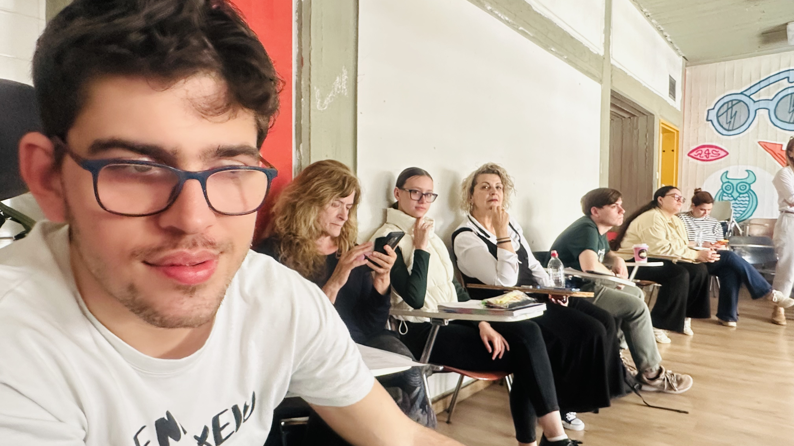

Slide 20
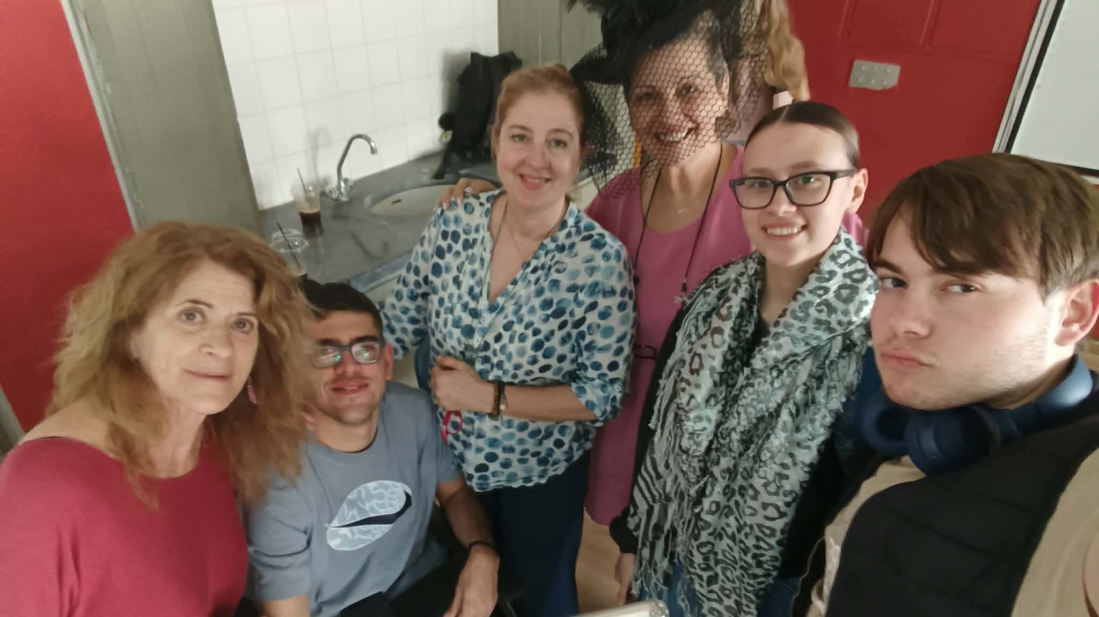

Slide 21
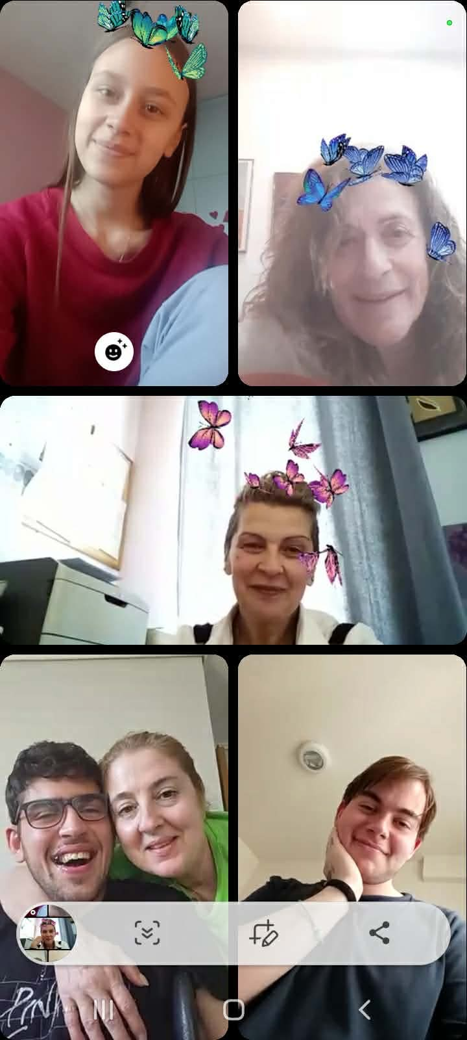

Slide 22
Thank you

