Slide 1
Applied and Environmental Theatre 1st Symposium Community Theatre and Environmental Pressures in the Coastal Communities of the Mediterranean (THEATRE2SEA) 3-4 June 2024

Slide 2
Sustainable Tourism
Professor: Ekaterini Diakoumopoulou
Course: Applied Theater
Team: Ioannis Gkionis, Maria Karambatsi, Vasiliki Chatzichampi, Eleni Kordelou, Dimitrios Markos

Slide 3
Full Plan of environmental theatre
Title: Sustainable turism
Reference group: Tourists
Central Question: How is to waste water recklessly even when you are not at home
Common Role: Naiads (water nymphs)
Roles of the Animator: A local, the mayor
Where: A central touristic island
When: At some point

Slide 4
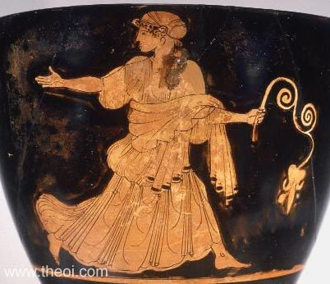
Ancient Greek fresh water nymph- Naiad

Slide 5
Storytelling
At some point in a central touristic island leaved some Naiads, or so I ‘ve heard. Mythical creatures in balance with nature that protect the island waters.

Slide 6
Building space activities
Built the water spring with the following materials : long blue fabrics and 2 grey pillows
2) Using your body movement and whatever material you wish including the ones of the spring, bring the spring to life

Slide 7
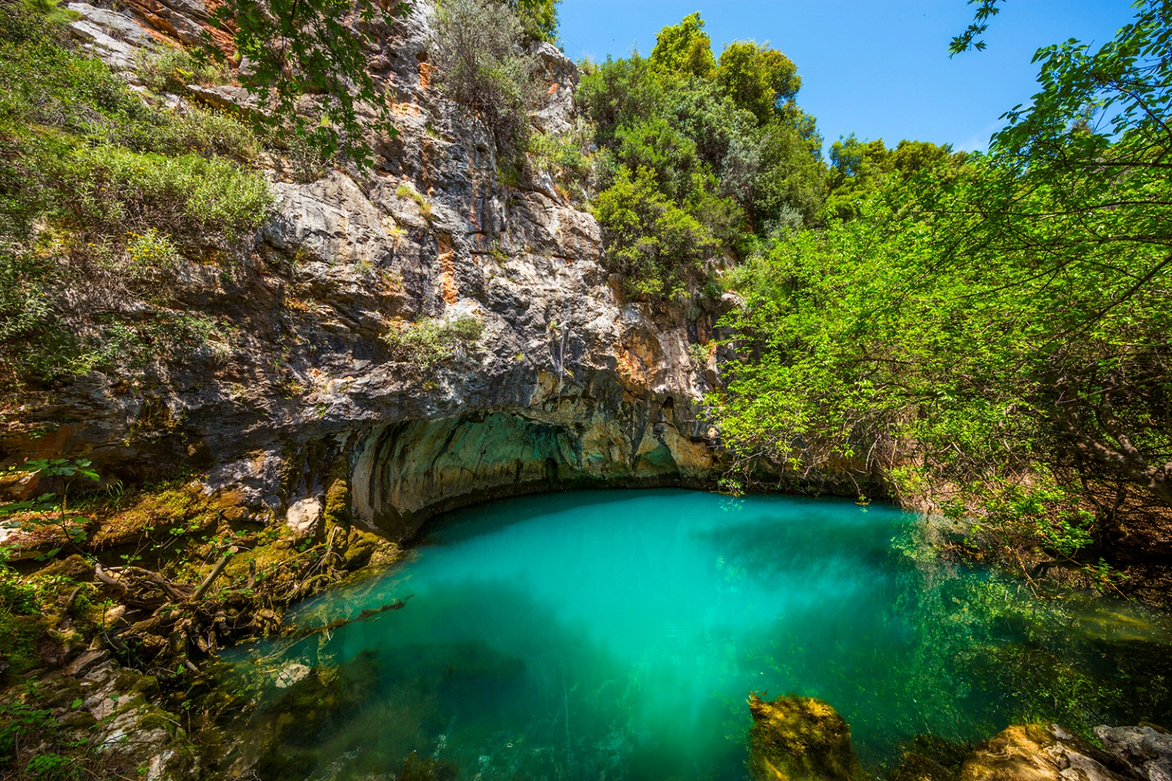
Water spring in a Greek island of the Aegean sea

Slide 8
Building role activities
Create the sacred daily responsibilities of the Naiads around the water element, in teams without words.
2) Individually write the Hymn of the Naiads which shows connection, balance with the water and nature

Slide 9
Action, 1st point of view
One day a local goes to the spring of the Naiads to express his frustration for the lack of water that he and the rest of the people experience. The reason being is the extravagant celebrations that the mayor organizes every year for guests that will benefit financially the island. This way there is not enough water left for the daily lives of the locals.
Straw hat symbol of the locals

Slide 10
Assimilation activity A
In a frozen frame image show us in groups what water means to you

Slide 11
Assimilation activity B
Create grafiti in papers and/or slogans that comment on the luck of water

Slide 12
Assimilation activity C
Inspired from the Balkan rain dance create your own type of choreo-performance, you will be provided with traditional water whistles and other props that you can choose to include (half empty bottles of water, handmade rain stick and what else the want to use.

Slide 13
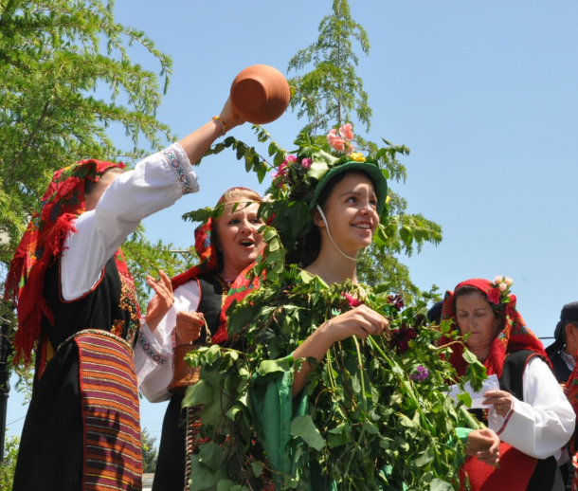
Photo of Balkan traditional dance of the rain in Romania

Slide 14
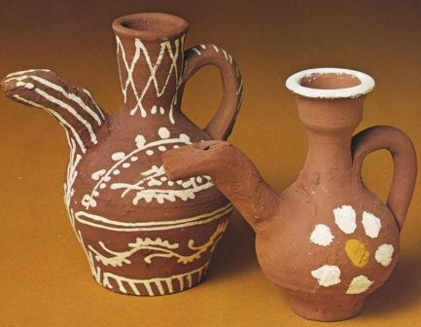
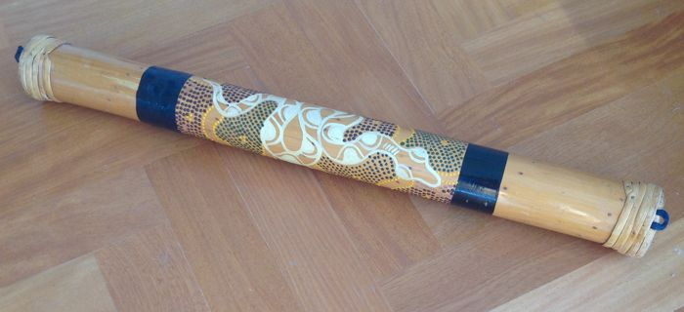
Rain stick
Traditional water whistles

Slide 15
Traditional songs for the rain/water
https://www.youtube.com/watch?v=NayG68DyrDA, https://www.youtube.com/watch?si=7B8u3wORgcy6DwmW&v=2zBMw8ajvbY&feature=youtu.be

Slide 16
Action, 2st point of view
The next day the Mayor visits the spring to express how he things the water of the island should be used for the upcoming celebrations
Tie symbol of the mayor

Slide 17
Assimilation activity A
In teams create the tourism advertisement spot of the island

Slide 18
Assimilation activity B
The Mayor makes a speech to the locals, another person is doing the mayors hand gestures and the groups change. b) The speech continues and arguments are presented about the necessity of these celebrations, at a claps notice the mayor will move his mouth like talking but we will hear how the locals translate the speech into what it means for their life and future.

Slide 19
Assimilation activity Forum Theatre
Forum theatre Mayor and local hold a conversation about their different viewpoints. Groups change

Slide 20
Action - announcement of decision
The Naiads decide how to share the water and they announce their decision in the local and the mayor of the island.

Slide 21
Reflection
Many years later a hot evening the citizens gathered with their families to play water wars with water pistols. Depending on the outcome of the previous activities they will be more or less water in the pistols and it will end when the given water ends or earlier if they choose to
2) Years later when tourists come what would they capture with their phones, how does that island look like. In groups represend that future you think it came based on the previous activities

Slide 22
Materials
Traditional Balkan dance of the rain
Traditional Greek song about water https://www.youtube.com/watch?v=NayG68DyrDA, https://www.youtube.com/watch?si=7B8u3wORgcy6DwmW&v=2zBMw8ajvbY&feature=youtu.be
Greek mythology
Traditional instruments, pictures and customs.

Slide 23
“Κι αν διψάσεις για νερό
Θα στύψουμε ένα σύννεφο”
Νίκος Γκάτσος
If you get thirsty
We will squeeze a cloud
Nikos Gatsos
“Καθένας μας θα ζυγιστεί με σταγόνες
Το νερό είναι στοιχείο και στοιχειό”
Χρήστος Θηβαίος
“ Everone will weight as a drop
Water is an element and a haunt”
Christos Thivaios
“Περπερούνα περπατεί,το Θεό παρακαλεί για να βρέξει μια βροχή,μια βροχή μια σιγανή. [...] Για να γίνουν τα σιτάρια και της Γης τα χορταράκια”
Παραδοσιακό τραγούδι
“Perperouna walks and begs the God for rain,a soft rain. [...] For the wheat to grow and the herbs of the earth.”
Traditional song

