Slide 1
Applied and Environmental Theatre 1st Symposium Community Theatre and Environmental Pressures in the Coastal Communities of the Mediterranean (THEATRE2SEA) 3-4 June 2024

Slide 2
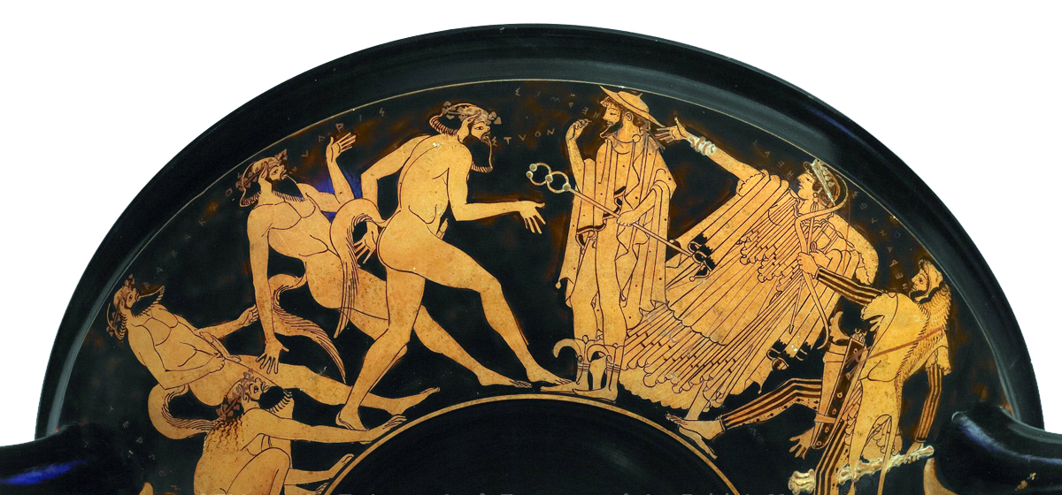
satyrs' feast
Applied Theatre
Professor: Aikaterini Diakoumopoulou
Kamila Jumadilova, Despoina Frantzeskou, Anna-Darina Kounavi, Sotiria-Andriani Tsapatsari, Natalia Sakatou, Aristea Kapsioti

Slide 3
Full Plan of environmental theatre
Title: Satyrs' feast
Reference group: Young parents
Central Question: How to break the cycle of overconsumption? (and become a good example for your child)
Common Role: Satyrs
Roles of the Animator: King Midas, Dionysus
Where: Satyrs' feast
When: In ancient times

Slide 4
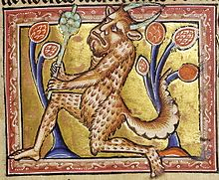
Storytelling
Once upon a time in ancient days, near one kingdom, there was a glade in the forest where some creatures, the Satyrs, used to feast.

Slide 5
Building space activities
Activity 1:
The participants with a jar and leaves, given by the facilitator, form the space in which the feast takes place, the jar should be placed in the middle. The place should have an entrance and exit.
Activity 2:
Each participant shapes an object out of plasticine that could be found at a satyr feast.

Slide 6
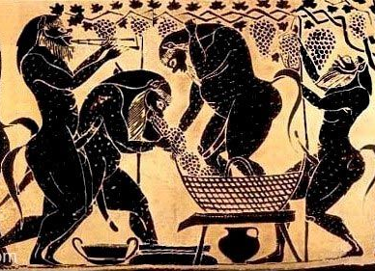
Building role activities
Activity 1:
On a piece of paper, draw your satyr's mask.
Activity 2:
Using a special app, the participants create music that they think suits the satyrs.

Slide 7
Storytelling
“One beautiful night the satyrs were feasting, dancing and just enjoying their lives in the glade. Now you will enter the feast and become satyrs. Remember that every time you go in, you are a satyr. Every time you go out, you become yourselves. ".

Slide 8
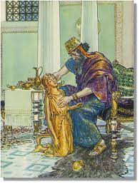
Action, 1st point of view
The music they had made before is playing, the participants enter the feast, become the Satyrs and dance. When the facilitator wears gloves, he is the king. The king enters the feast and says: "Sorry to interrupt. Have you seen Dionysus? I'm looking for him because I need his help. He granted one of my wishes, and now everything I touch turns to gold. At first, everything was fine but now because of this, my daughter has become a golden statue. I don't know what to do, I have regretted my wish. Please if you see Dionysus tell him that I am looking for him to help me."
After this speech, which may be interrupted by questions from the satyrs, the king leaves.

Slide 9
Assimilation activity A
Participants make a line and one after another in random order should take a position to create a statue that reflects the theme "A wish of a modern parent". They can present a separate statue that reflects the theme or can complete the statues of others. The goal is to create a unified image from many statues in the end. Once this is done, everyone should explain in a sentence/word/statement what their statue shows.

Slide 10
Assimilation activity B
The group makes a circle, and one person steps out and stands in the middle. This person represents the king and puts on the gloves. The king randomly picks one person from the circle and this person asks one question, and the king answers. The person who asked the question becomes the king and the activity continues.

Slide 11
Storytelling
Now you will enter the feast again, become satyrs, and continue. You can also discuss the king's situation and whether you want to help him if it is needed”

Slide 12
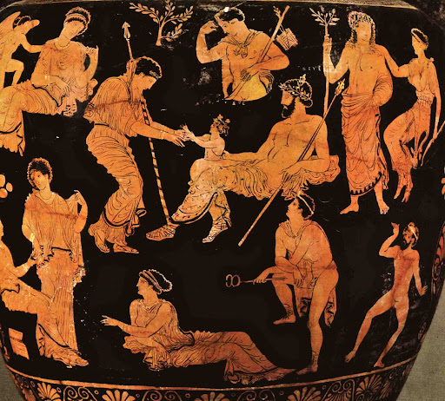
Action, 2nd point of view
The facilitator puts on a wreath and becomes Dionysus. He says to the satyrs: "I have heard that the king is looking for me to help him. I don’t pity him at all, he is a greedy man, all he cares about is money. He never bothered about his daughter, he had left her uneducated. He deserves what happened to him. If you have an opinion different than mine, I want to hear it. I will do what you tell me"
(The satyrs debate with him and can either agree with Dionysus or disagree.)

Slide 13
Assimilation activity A_Forum Theatre
“The king desperately continues to search for Dionysus in the forest. He begs him to appear, and god appears in front of him”.
The king is the facilitator (wears gloves), and Dionysus is one of the participants (wears a wreath). The king begs for his daughter to be saved. The conversation continues and the people who play the king and Dionysus change throughout the activity. The participants take turns wearing the gloves and the wreath, becoming king and Dionysus, and having a dialogue. The whole group is in a circle.

Slide 14
Assimilation activity B
Participants stand in a line. The facilitator gives them the beginning of the phrase and they should end it on their own, the participants says their own sentence one after another. For example, facilitator gives the beginning “I need ..” and first participant ends with “money for my child”, the next participant repeats “I need ..” with their own ending, and so on. This action continues for a few rounds until the facilitator stops it. The same activity with the phrases "I don't need", "I want to", "I don't want to".

Slide 15
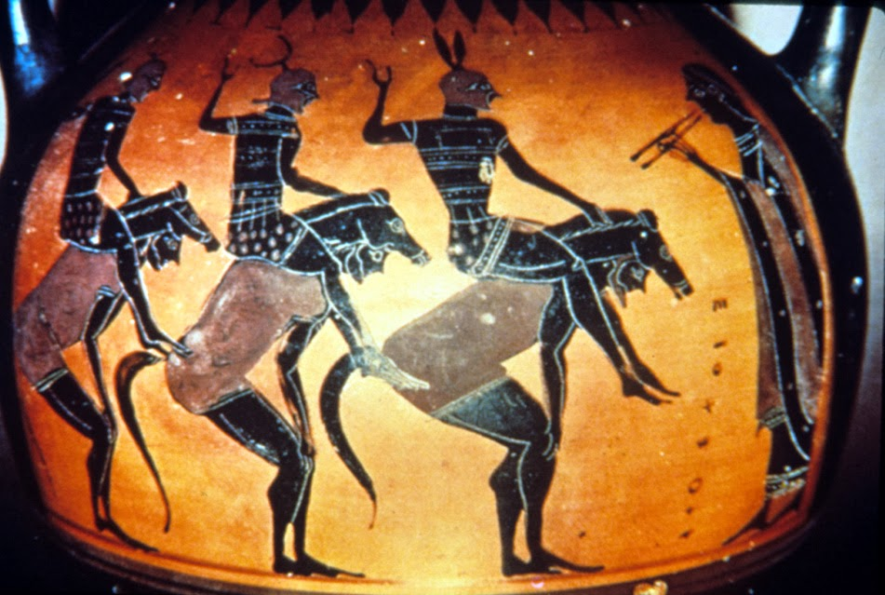
Storytelling
“Now you will enter the glade, become satyrs, and continue your feast. Very soon the king will come to you, and you have to decide whether you want to help him or not. Because Dionysus' decision will be up to you”

Slide 16
Action - announcement of decision
The king enters the satyrs' feast, and they tell him whether they have decided to help him and convince Dionysus or whether they agree with God and think he deserves his punishment.

Slide 17
Reflection
After a while, bearers come to the kingdom from the surrounding regions because the king’s story has spread all around the kingdom, and they want to find out how it ended so they can bring news to their cities.
Activity 1
Write a letter as king’s daughter to her father. Her thoughts, her feelings after all that has happened.
Activity 2
Participants divide into groups and get a task to make a video. This video should explain what has happened in the kingdom after the satyrs’ decision. This can be done in any form: for example, a broadcast, a report, a news story, a music video, a traveling show, an interview with a citizen, the king, his daughter, or anyone, etc.

Slide 18
Instructions
“When you enter the feast, you are Satyrs. When you exit the feast, you are participants”
“When I wear gloves, I am the King. When I take them off, I’m facilitator”
“When I wear the wreath, I am Dionysos. When I take them off, I’m facilitator”

Slide 19
Materials
Jar
Leaves
Gloves
Wreath
Phones

