Slide 1
Applied and Environmental Theatre 1st Symposium Community Theatre and Environmental Pressures in the Coastal Communities of the Mediterranean (THEATRE2SEA) 3-4 June 2024

Slide 2
Applied and Environmental Theatre
Professor: Ekaterini Diakoumopoulou
"Methexi"
Chrysagi Sophia
Komninou Maria Nefeli
Lampraki Christina
Michas Giorgos
Poulakis Omiros

Slide 3
Full Plan of environmental theatre
Title: Life in the wetland.
Reference group: Group of 15 substance abuse addicts, who are voluntarily committed in a drug addiction centre, aiming their social reintegration.
Central Question: What is like being a substance abuse addict and seeing the government provide all its financial resources for the environmental protection, which is plagued by the ecological crisis.
Common Role: The ministry Council of the wetland, which consists of foxes.
Roles of the Animators: A duck as a representative of the banished animals and two other animators representing the protected area and impersonating an eagle and an owl.
Where: In a wetland called Earth.
When: Once.

Slide 4
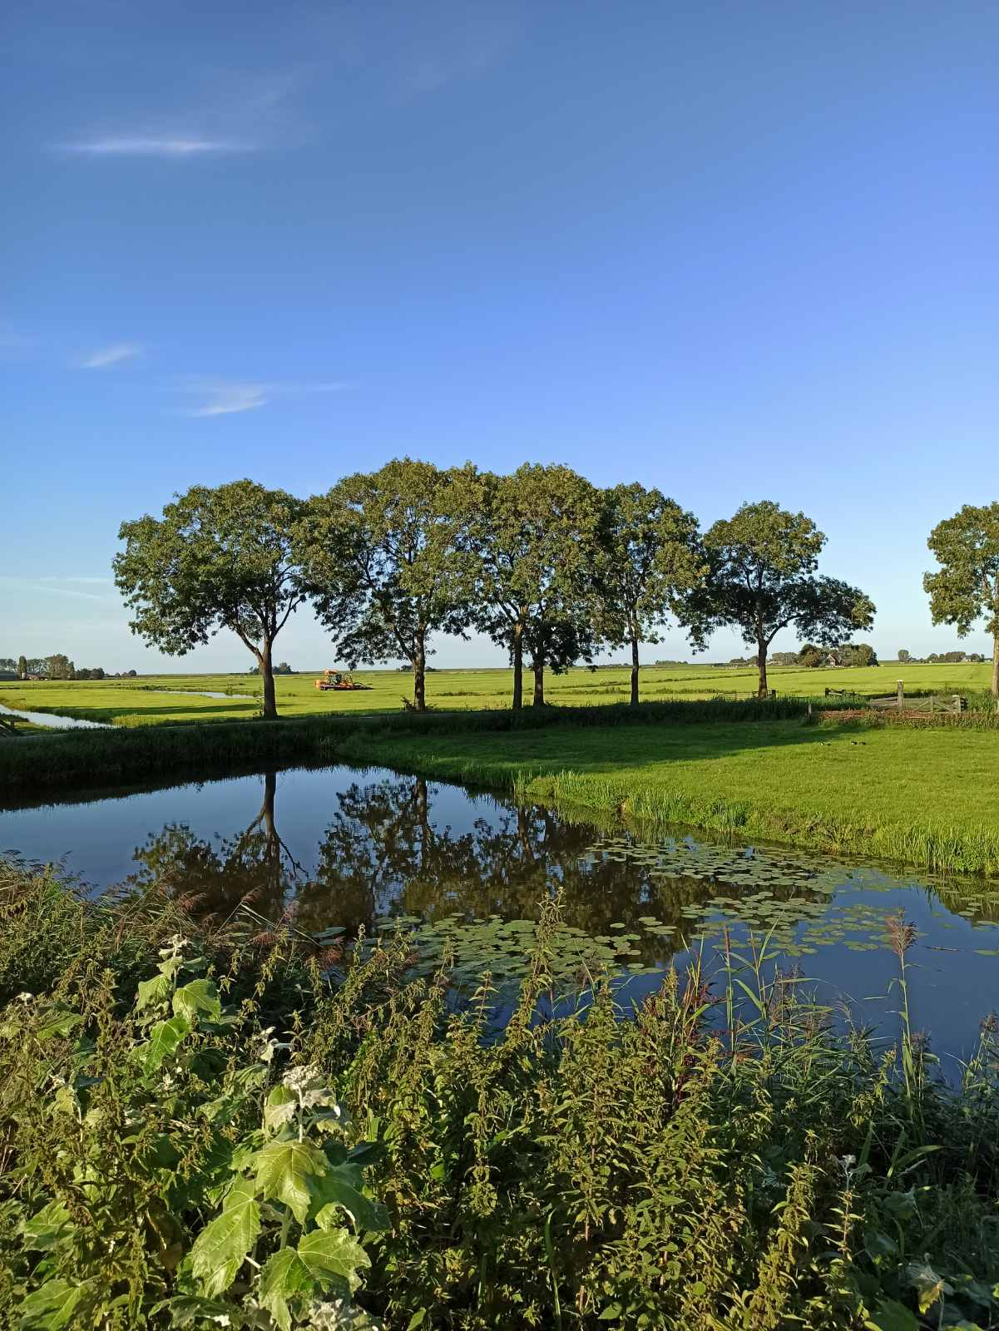
Storytelling
Once upon a time in a wetland called Earth, was the Council, which was responsible for the proper functioning of the communities and the management of financial resources.

Slide 5
Building space activities
Activity 1
The group, with props given by the animator, will be asked to delineate and create the «room» in which the Council meetings will take place and will have a specified entrance and exit.
Activity 2
The animator gives the group clear instructions that every time they enter the «room» it will be the Council. Then asks the participants to enter the «room» to use the props and stay there for a while, to feel more comfortable in the space.

Slide 6
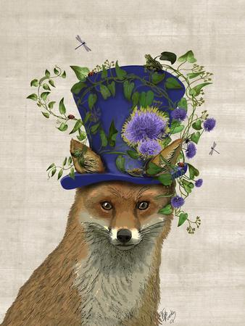
Building role activities
Activity 1
Draw a Constitution (3 articles), which will be as a result through a game of adding words by the participants in the group (each one will say one word after the other in order to create a sentence).
Activity 2
The animator will ask the group to create the portraits of the ministers, using the props and taking pictures with their mobile phones.

Slide 7
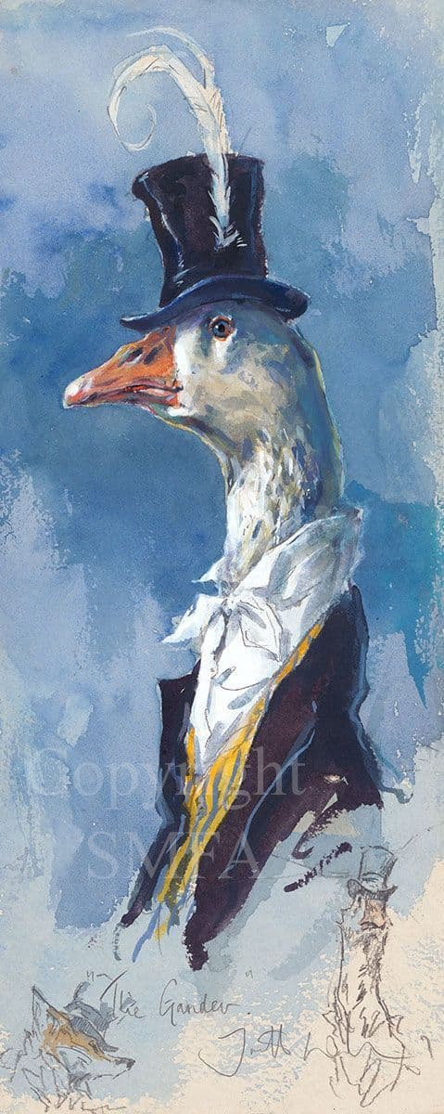
Storytelling
One day during the Councils meeting, to resolve daily community issues the meeting was interrupted by a visitor.

Slide 8
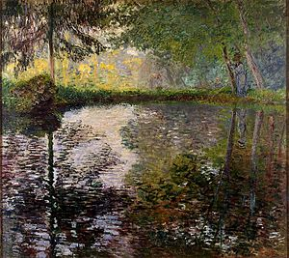
Action, 1st point of view
(The animator instructs the participants to enter the «room», wearing a hat with feathers, pretending to be a duck, visits them in the «room»)
Duck: Hello. I come as a representative of the animals that have been exiled to the other side of the dam, because they were plucking their wings off. We would like to ask for the dam to be opened so that we too have clean and running water. And now if you'll excuse me but I have to go, because I'm not allowed to be here much longer as my leave of absence expires shortly.
Claude Monet, Pont at Montgeron,, 1877

Slide 9
Assimilation activity A
The animator asks the group to show the ways in which the exiled animals have been expressing their claims for so many years.
Assimilation activity B
The animator asks the group to show what was the crucial event that led these animals to go to the Council.
Assimilation activity C
The group is divided into 3 groups of 5 and asked to show the ways in which the exiled animals have fun.

Slide 10
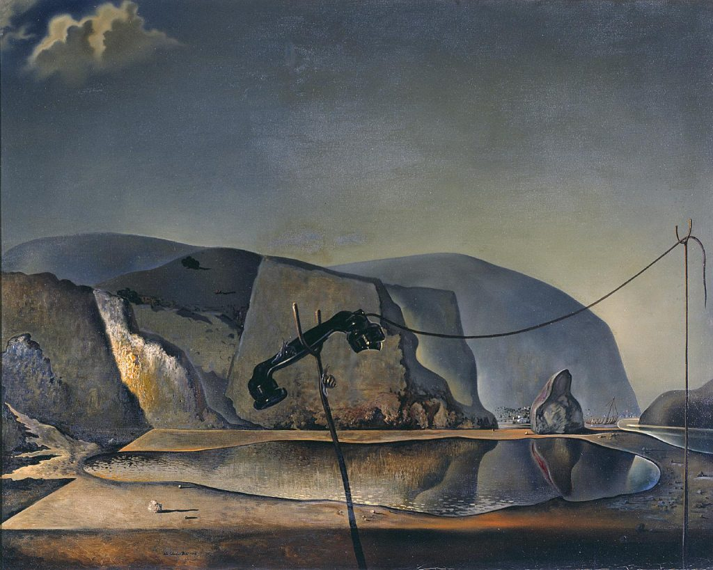
Storytelling
Οne day during a Councils meeting, voting on bills, two visitors appear.
Salvador Dali, Mountain Lake, 1938

Slide 11
Action, 2st point of view
(The animator instructs the participants to enter the «room» and he alongside another animator, one wearing a bandana and one a scarf, impersonating respectively the eagle and the owl, visits them in the «room»)
Eagle: we come to you as representatives of the animals that live in the protected area. we learned that the duck asked to open the dam. However, this shouldn’t be done at the moment as forecasting systems show upcoming heavy rainfalls that levitate the risk of destroying the ecosystem of the wetland.
owl: we are not opposed to the opening of the dam, but not immediately, right now the protection of the wetland is a first priority. Maybe it is better the animals on the other side to be more patient and the opening to take place in four- five years.

Slide 12
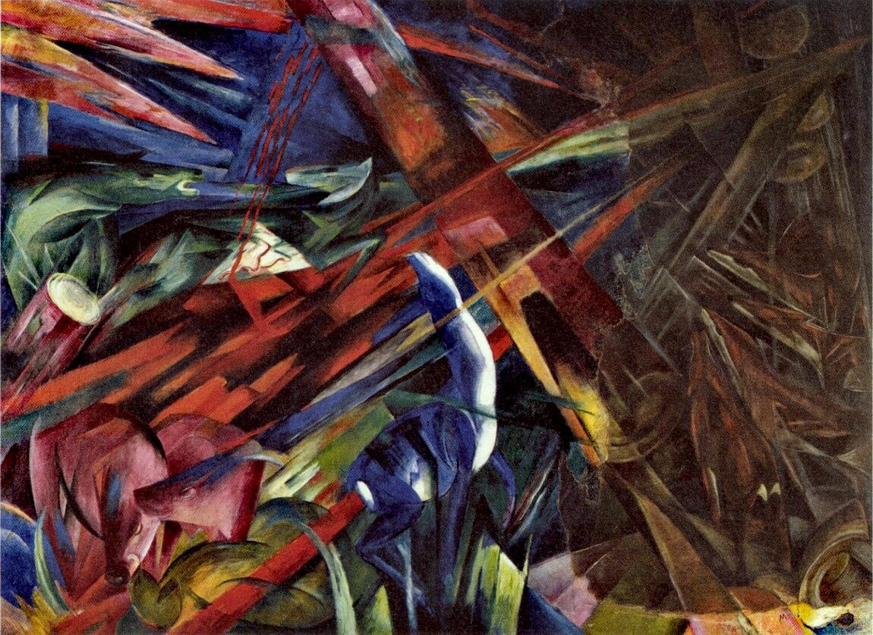
Assimilation activity Α
Τhe group is asked to divide into sub-groups of three people and present past testimonies of eagles, informing past Councils for the upcoming danger, but were not heard. The groups will be able to use other «room» of the space, in order create the sensation that they controlled the area in a larger range.
Franz Marc, Fate of the Animals, 1913

Slide 13
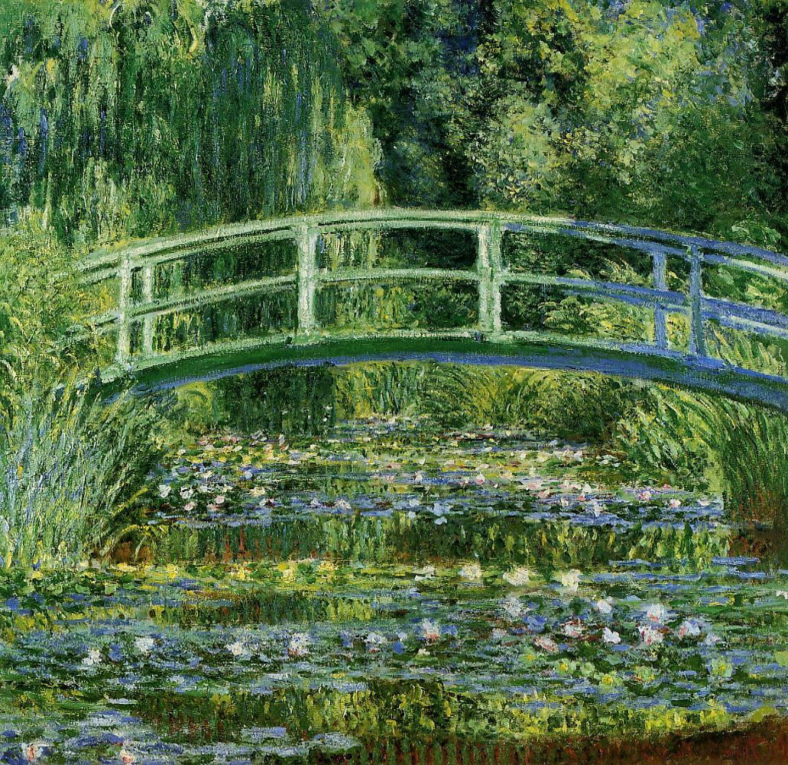
Assimilation activity Β Forum Theatre
Τhe duck and the owl meet by chance outside the entrance gates of their communities and discuss, each defending their point of view.
Claude Monet, Bridge over a pond of water Lilies, 1899

Slide 14
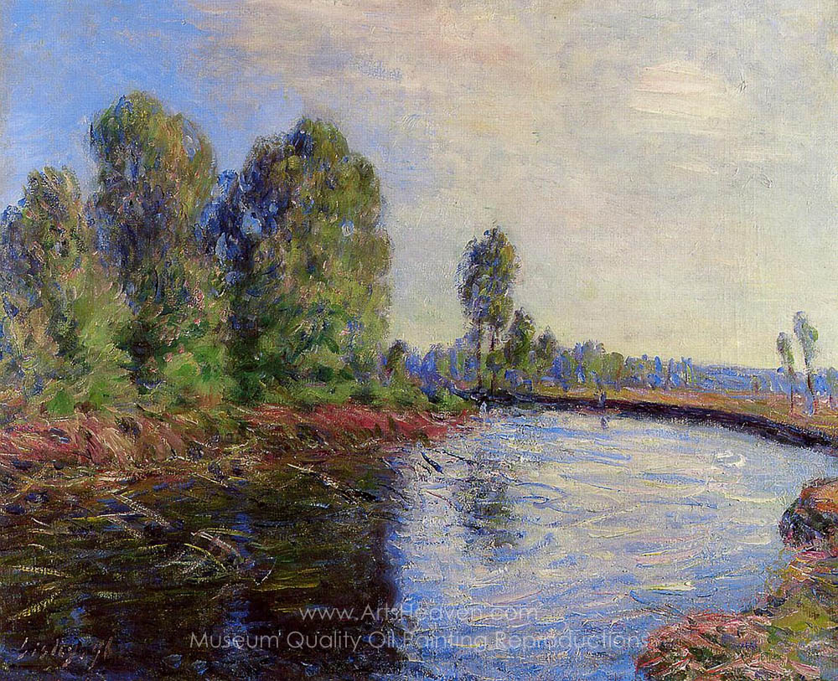
Storytelling
The Council after listening to all the animals of the wetland ordered an emergency meeting to make a decision regarding the opening of the dam.
Alfred Sisley, Banks of the Loing, 1896

Slide 15
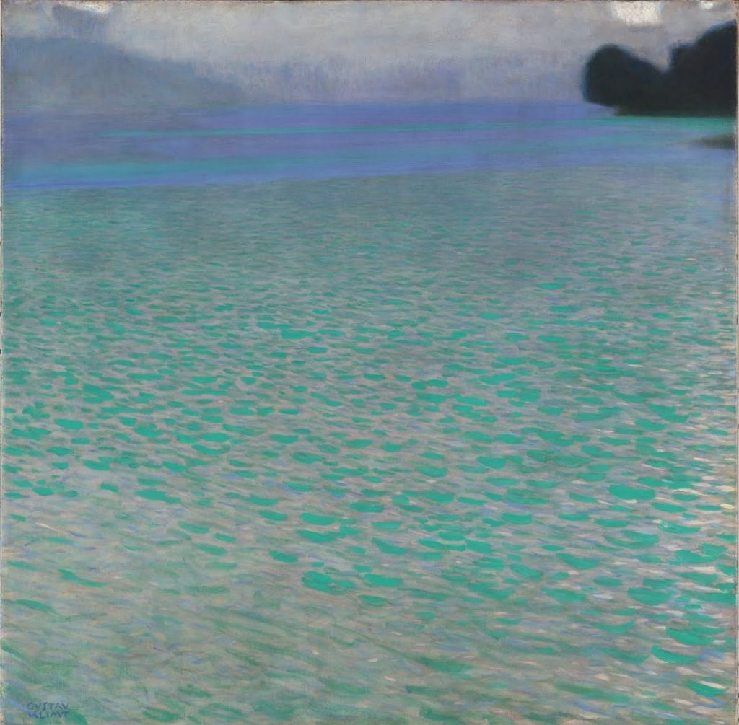
Action - announcement of decision
(The animator instructs the participants to enter the «room». The Council calls the duck to announce their decision. )
The chairman of the Council: Duck, we called you here today to announce our decision, which is as follows:...
Gustav Klimt, On Lake Attersee, 1900

Slide 16
Reflection
After 50 years.
Activity 1: Τhe group is asked to read from the history book the chapter that refers to the events related to the opening of the dam.
Activity 2: The participants only with their bodies and without any words will be asked to represent the state of the wetland after 50 years.

Slide 17
Instructions
Τhe participants every time they enter the «room» will be the Council.
Τhe group will enter and exit the «room» from a specific entry and exit point.
Τhe meeting «room» will be strictly bounded and the participants, every time they are inside, will stay strictly within these limits.
Τhe start and end of the activities will be signalled by the animator using a whistle.
Τhe animators and the participants when wearing the props will play the roles.
Τhe duck will wear a hat with feathers, the eagle a bandana on the head and the owl a scarf around the neck.

Slide 18
Materials
Carpets
Chairs
Pen
Notebooks
Bottles with water
Plastic glasses
Plastic basin
Eye glasses
Mobile phones

Slide 19
Claude Monet, Blue water Lilies,1916-1919 The end

