Slide 1



Applied and Environmental Theatre 1st Symposium
Community Theatre and Environmental Pressures in the Coastal of the Mediterranean Communities (THEATRE2SEA)
3-4 June 2024

Slide 2
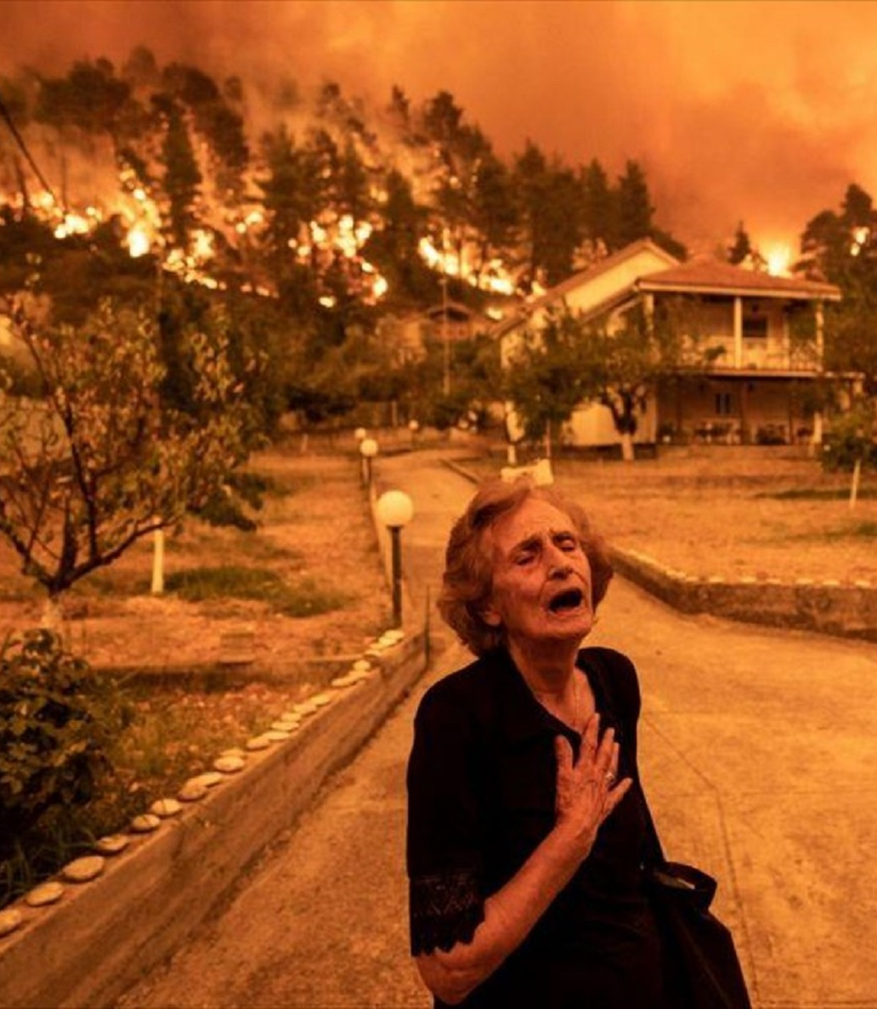
"How could the natural environment help improve the mental health of individuals who suffer from depression?"
Applied Theatre Plan
Undergraduate Students Group B
Barbara Goula
Ioulieta Karachaliou
Anna Markazou
Aimilia - Anna Kalantzi
Konstantina Daratsianou
Assistant Professor: Aikaterini Diakoumopoulou
Course: Applied Theater (68ΘΕ175)

Slide 3
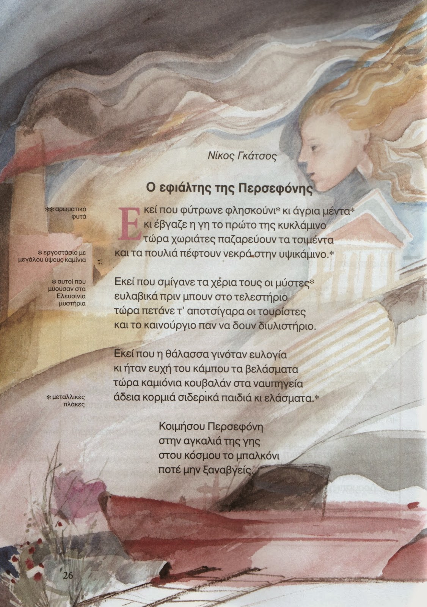
Full Plan of environmental theatre
Title: Τhe nightmare of Persephone
Reference group: People with depression, in treatment
Central Question: How could the natural environment help improve the mental health of individuals who suffer from depression?
Common Role: Town Council
Roles of the Animator: Citizen and Interior Minister
Where: In a Greek village
When: Summertime a few years ago

Slide 4
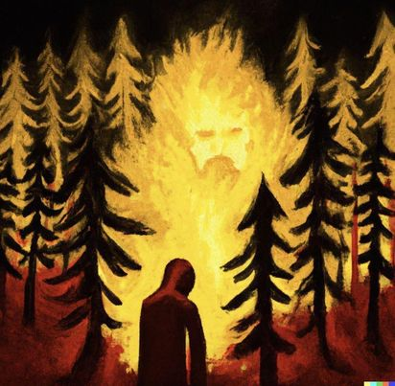
Storytelling
Once, somewhere in a village in Greece (during the summer some years ago), the Town Council held a meeting to decide on the future of the village after a fire.

Slide 5
Building space activities
1st activity: Chairs
Participants are invited to use the chairs in the room to set up the conference room of the Town Council.
2nd activity: Announcements
The group creates announcements (this can be rules, incentives, signs) which they place in the conference room.

Slide 6
Building role activities
1st activity: Speech
The participants, after gathering in a circle, give a 15- second speech, each stating the reason why they became a councillor.
2nd activity: Badges
Blank cards are given to the participants. On one side (outside) they write 5 characteristics of a good citizen. On the other side (inside) they write 5 emotional characteristics of a good citizen. Then they create their councillor badge.

Slide 7
Storytelling
The Citizen (Panagiotis) enters the Town Council and asks the councillors to relocate him immediately to another municipality because he is indignant about the bad state of the village.

Slide 8
Action
1st point of view
“Good morning, I hope I am not interrupting, I came to the council to make a request.
I have been a citizen of the village for several years and after the fire that broke out, I decided that I want to transfer to another municipality.
The poor state of the village makes me sad and choked up.
I have to go to work now, I will come back after my shift to receive your reply.”

Slide 9
Assimilation
Activity A
Cardboard
The animators give the participants a cardboard. One side of the cardboard has a healthy ecosystem and the other one a burnt one. The participants are asked to write their thoughts on whichever part of the cardboard they want.

Slide 10
Assimilation
Activity B
March
The participants are asked to create a march and shout slogans with the words they wrote on the cardboard.

Slide 11
Storytelling
The Minister of the Interior (Nikos Keraseos) makes an appearance at the Town Council. The minister refuses to allow any relocation because of the small population of the village. He asks the councillors to find a solution.

Slide 12
Action
2nd point of view
“ Good morning, I wish you a good start as councillors.
I understand the citizens of the village are asking to relocate to another municipality.
Unfortunately, due to the small population of our village, I cannot allow it.
I will leave now because I have to visit other villages. I will return later for further updates.”

Slide 13
Assimilation
Activity A
Phone Call
Team members are divided into pairs. An improvisation is requested in which the minister (who is wearing the hat) is informed with phone call by someone (the members decide what character is making the phone call) about the fire that has broken out. Every 20 seconds the roles are reversed

Slide 14
Assimilation
Activity B
Briefcase
The minister forgets his briefcase. Inside it, participants find pieces of paper on which they can write down ways to rebuild the environment. Then someone takes on the role of the minister (people in the group take turns standing up), they read the papers and lastly, they vote.

Slide 15
Storytelling
The Citizen after getting off work, returns to the Town Council to receive a response about his relocation to another municipality.

Slide 16
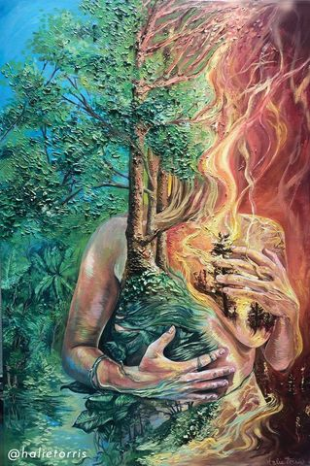
Action
Announcement of decision
The councillors will have to decide whether to allow the Citizen to relocate or to obey the order of the Interior Minister and prohibit any movement.

Slide 17
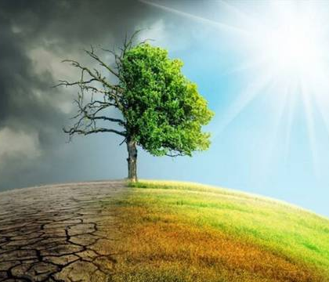
Reflection
After 10 years, the participants are a trekking group that goes hiking on a mountain in the village.
The members of the group are put in a line, in which the first one does an action (mime, words etc) and the rest imitate him. When the animator claps, the first person goes to the end of the row.

Slide 18
Instructions
When the participants sit in the chairs and put on their badges, they take on the role of the Councillor. When they stand up and take off your badges, they are no longer members of the Town Council.
Whoever wears the shirt takes the role of the Citizen and whoever wears the hat takes the role of the Interior Minister.

Slide 19
Materials
Hat
Button up shirt
Papers to write announcements
Badges
Cardboard
Markers
Briefcase
Small papers
Pens

Slide 20

THANK YOU
FOR YOUR ATTENTION

