Slide 1
Applied and Environmental Theatre 1st Symposium Community Theatre and Environmental Pressures in the Coastal Communities of the Mediterranean (THEATRE2SEA) 3-4 June 2024
Overfishing

Slide 2
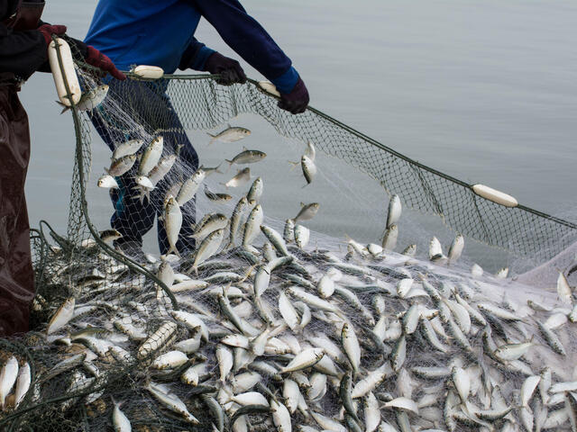
Filling the nets, emptying the marine life
Marianthi Antzoulatou
Sofia Dimou
Dimitra Theodoropoulou
Vasilis Kalfakis
Alcyonides

Slide 3
Full Plan of environmental theatre
Title: Filling the nets, emptying the marine life
Reference group: Fishermen
Central Question: What is it like to cause your own self-destruction and not prevent it, to do nothing about it?
Common Role: Disciples of Christ
Roles of the Animator: Matthew the pearl merchant of the village of the lake (panama hat), president of the village and the merchants' association (tie)
Where: Lake, a coastal area on an island (dramatic space)
When: Indeterminate dramatic time

Slide 4
Storytelling
‘‘Once upon a time, somewhere, there was a large lake. One day, I don't know when exactly, a wandering group arrived in the area who said they were disciples of Christ, disciples of disciples of Christ; whether they were or weren't, we'll never know. And in every place they would resort to, people would rush to consult them’’

Slide 5
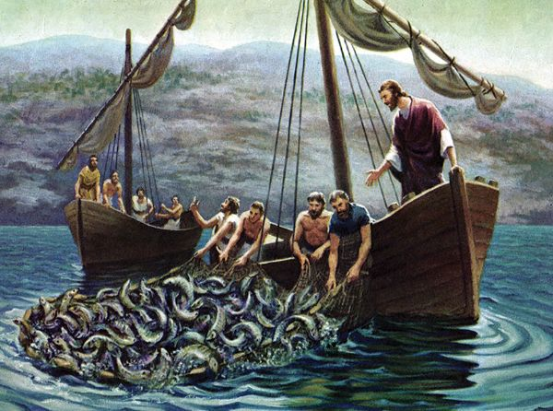

Slide 6
Building space activities
Activity 1. ‘‘Next to the lake, there was a hill, a forest, and by the shores of the lake, a beach. On arrival, the disciples of disciples of Christ had to decide where to pitch their tent and name the place’’
The animator provides clear, recurring instructions. Participants are divided into groups. Each team is asked to draw one of three places they would prefer to pitch their tent to and choose a name for the resulting drawing. The location most preferred by the teams wins. Then they decide final name for the place
Activity 2. Building a tent with materials
The animator gives instruction. Also, provides the participants with objects (such as buckets, crates, tarpaulins) to create the disciples’ of disciples of Christ tent in a designated area in which they must anticipate that everyone will fit. They construct the entrance. They can only enter and exit from this specific point

Slide 7
Building role activities
Activity 1. Anthem
After setting up their tent they thought they were missing an anthem of their team... The animator gives instructions. Participants create an anthem of their group within 5 to 7 minutes
Activity 2. Secret Greeting
Participants find the secret greeting of the group. Anyone who became a member of this group knew the secret greeting

Slide 8
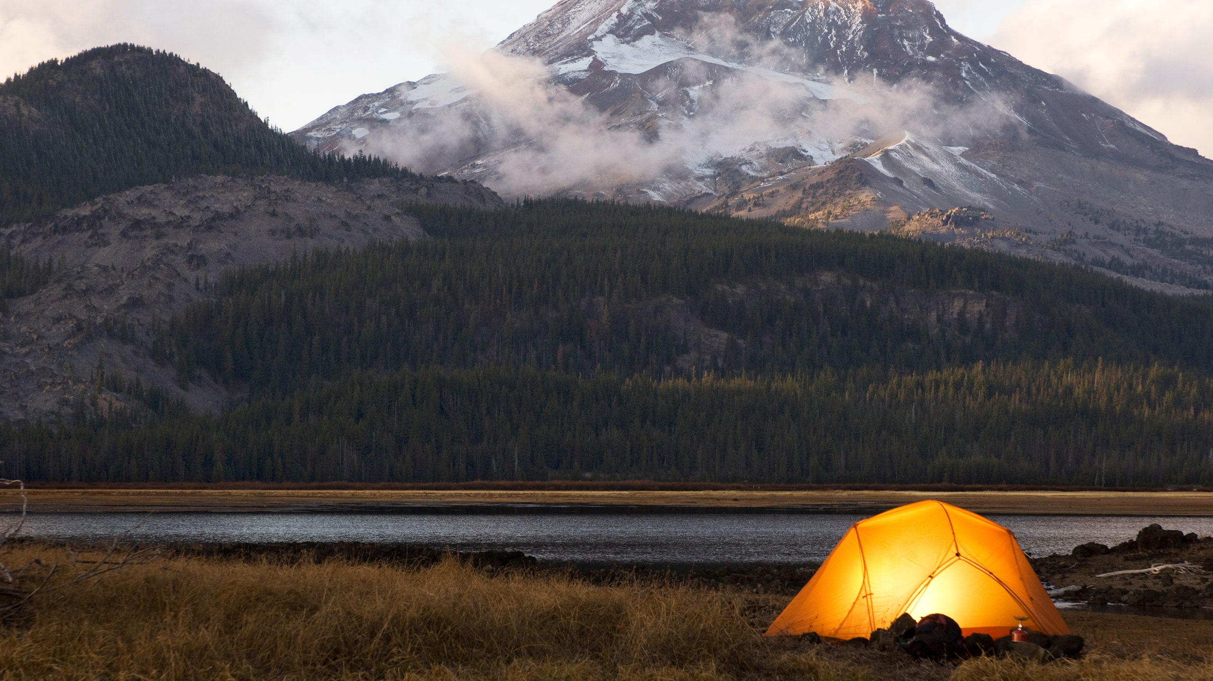

Slide 9
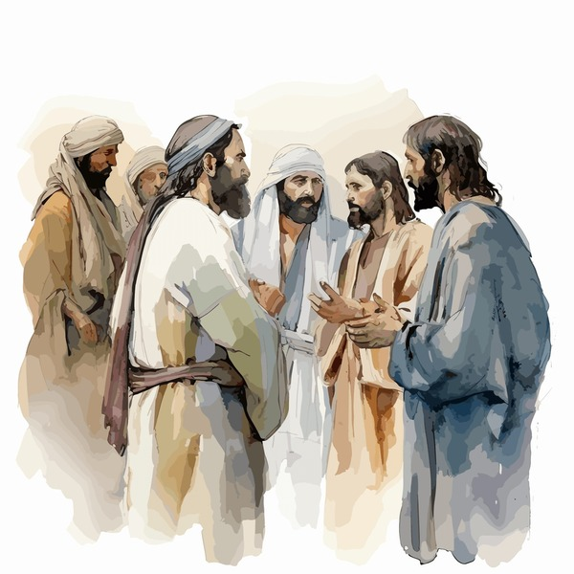
Storytelling
The lake’s bed was filled with precious oysters and pearls, which were collected and sold by the village merchants. One day, they discovered something rather strange. The merchants went pearl hunting and noticed that the lake was starting to evaporate. The village is in turmoil. The disciples gather in their tent to discuss
[The animator gives the rules again in repeat: ‘‘Every time you enter the tent, you become disciples. The first guest who comes in will wear a straw hat." The strict rules also apply to the facilitator; “When I wear the hat, I am in character. When I take the hat off, I step out of the role’’]
The animator provides instruction. The participants enter the tent and become the disciples. The merchant enters the tent and presents the 1st point of view

Slide 10
Action, 1st point of view
1st point of view: ‘‘I am collecting more pearls but my job is threatened’’
‘‘Hello, I need your help. My name is Matthew, and I am a merchant from the village by the lake. I've been collecting more pearls lately, but I'm encountering a problem. The lake isn't producing as many pearls as we need. Along with the President's team, I have been secretly collecting more pearls. I'm doing this because I require more money, and I am also a confidant of the president. We have a confidentiality agreement in place, and I fear the consequences if this activity is discovered. The president claims that studies have been conducted on the lake, absolving us of any blame. He supports us and the village by providing modern machinery for harvesting. I initially thought I was doing something beneficial. However, I am now considering how to approach the other merchants for help without breaching the confidentiality agreement or risking my job and safety...”

Slide 11
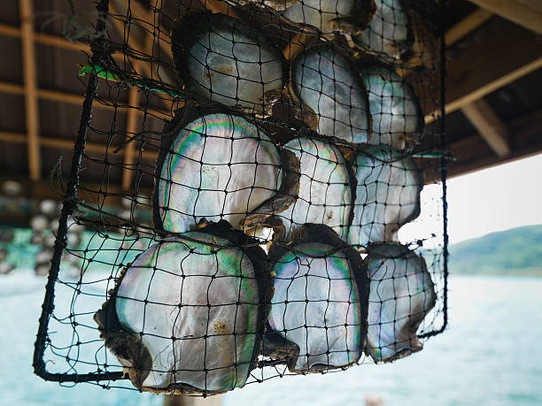
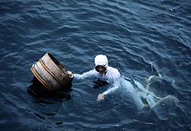

Slide 12
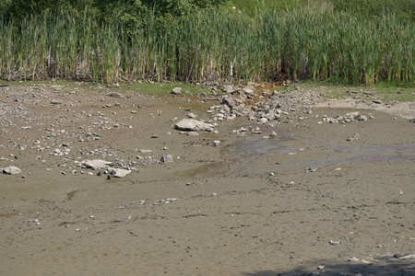
Assimilation activity A
Residents began to wonder what was happening to the lake. For a long time they thought about what could go wrong...
The animator gives instruction. Participants write on sticky notes five habits or things that we as humans want to do but which may harm us at some point. Then they are divided into pairs. They roll the dice and the one who brings the highest number sticks a piece of paper to the other. The one with the most cards at the end loses (is destroyed)

Slide 13
Assimilation activity B
An expert scientist of pearls, all of a sudden, arrives in the area. He has been informed about the existence of rare pearls that inhabit in the lake and wants to examine them. He reaches the lake and, with the assistance of local residents, starts collecting pearls
The sacks and the oysters
In this activity, there is a sack containing several pieces of paper rolled up like balls, with different quantities of pearls written on them. The participants are divided into groups, and each participant from each group can take as many pieces of paper as they want. However, it's not clear whether taking a lot or a little is advantageous. The team that exceeds a certain limit, which is defined as the total capacity of the lake, will lose because they will empty it

Slide 14
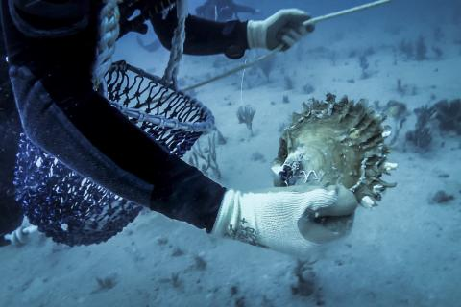
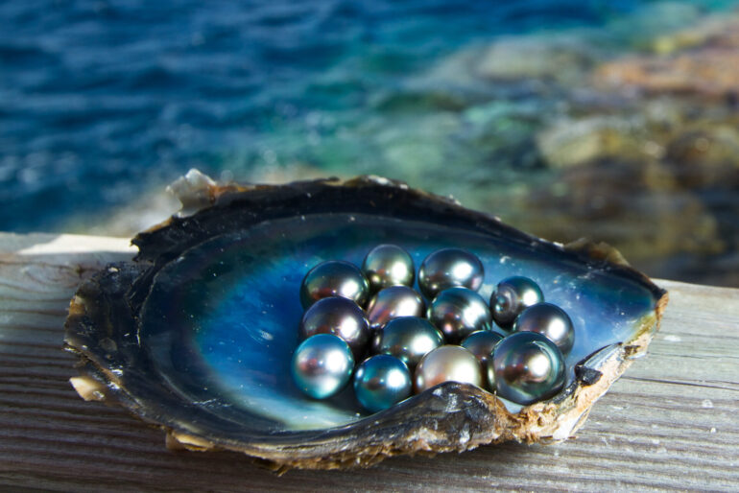

Slide 15
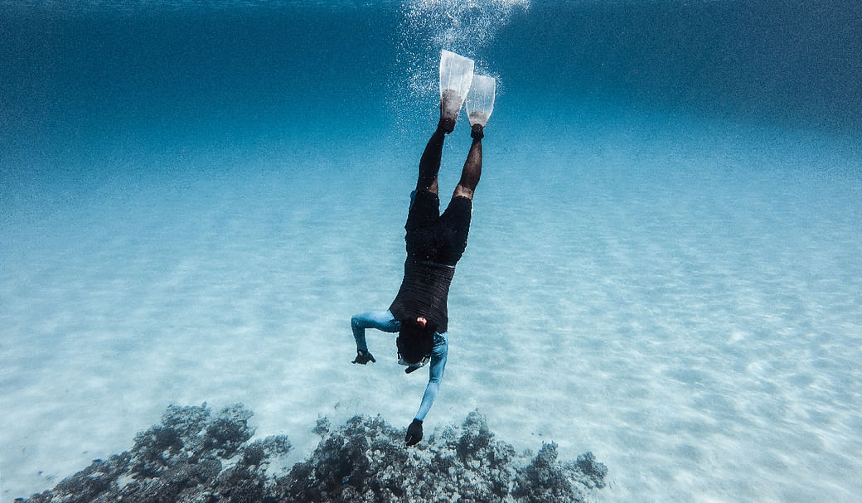
Storytelling
The Expert Scientist of Pearls has discovered, through his research, that someone may be secretly collecting extra pearls from the lake. However, he doesn't have concrete evidence of this. Nonetheless, he shares his suspicions at the local coffeehouse, and the rumor quickly spreads throughout the village
The disciples of Christ are gathered in their tent, engaged in lively conversation
The animator provides instruction. Participants will enter the tent and become the disciples of Christ

Slide 16
Action, 2st point of view
The president arrives at the tent. 2st point of view : ‘‘ He believes he acts for the greater good and defends his actions and policies.’
‘‘Goodmorning! May I introduce myself or do you already know me? Everybody knows me! I am the President of the village and also President merchants‘ cooperative. I need your help. I would like to hear your opinion. Have you noticed anything unusual happening in the lake? It seems like someone is destroying the pearls and the lake is gradually emptying. Rumors are circulating about this. I'm trying to locate Matthew, my confidant. Does anyone have information about his whereabouts? He is responsible for managing the pearl collection process…
I assist the villagers and manage the village. I promote the export of pearls. Our products attract visitors, increasing tourism. I also support local merchants’’

Slide 17
Assimilation activity A
A secret ballot
By coincidence, the village is currently holding elections for president
during this period
Participants are invited to a secret ballot

Slide 18
Assimilation activity B_Forum Theatre
President for a day
In the lake area, there is a very ancient custom where every year,
every resident becomes the president for a day
Each resident, as president for a day, presents their proposal for managing the lake to the village assembly

Slide 19
Action - announcement of decision
The disciples are in the tent. Matthew is coming back. Decision
Announcement
The board of review arrives! Will they decide to offer the “Golden Seashell” prize for this year?

Slide 20
Reflection
Ten years later, the Expert Scientist of Pearls, returns to the lake for scientific research and writes a paper about it. What will the title of this paper be?

Slide 21
Instructions
The animator always gives clear and repeated instructions
The facilitator does not direct or guide the participants. Does not identify the reference group, their status with the common role, does not lead them into engagement
In the context of the actions and activities, constraints and rules are given
Participants have a set time limit to complete the planning activities
In the built-up area, the bounding framework must be strict. Tent = I am a student/ Off tent = I am a member of the community. The strict demarcation also applies to the animator
The animator uses the performing text. He/she listens and uses the positions/oppositions/contexts

Slide 22
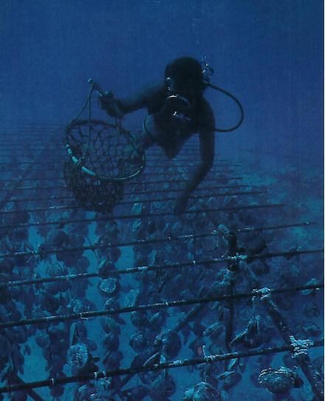
Materials
symbols: a panama hat, a tie
Sketchbook
Buckets
Piece of tarpaulin
Crates
Post-it stickers
Dice
Paperballs

Slide 23
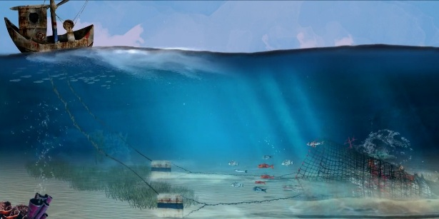
Thank you for your attention

