Slide 1
Applied and Environmental Theatre 1st Symposium Community Theatre and Environmental Pressures in the Coastal Communities of the Mediterranean (THEATRE2SEA) 3-4 June 2024

Slide 2
Food Waste: Just (don’t) do it
Students of the Master Program “Greek and World Theatre: Drama, Performance, Education”, Department of Theatre Studies, School of Philosophy, NKUA.
Ioanna Dardagou
Rinio Balkou – Papadopoulou
Helena Bitri
Professor in charge:
Katerina Diakoumopoulou

Slide 3
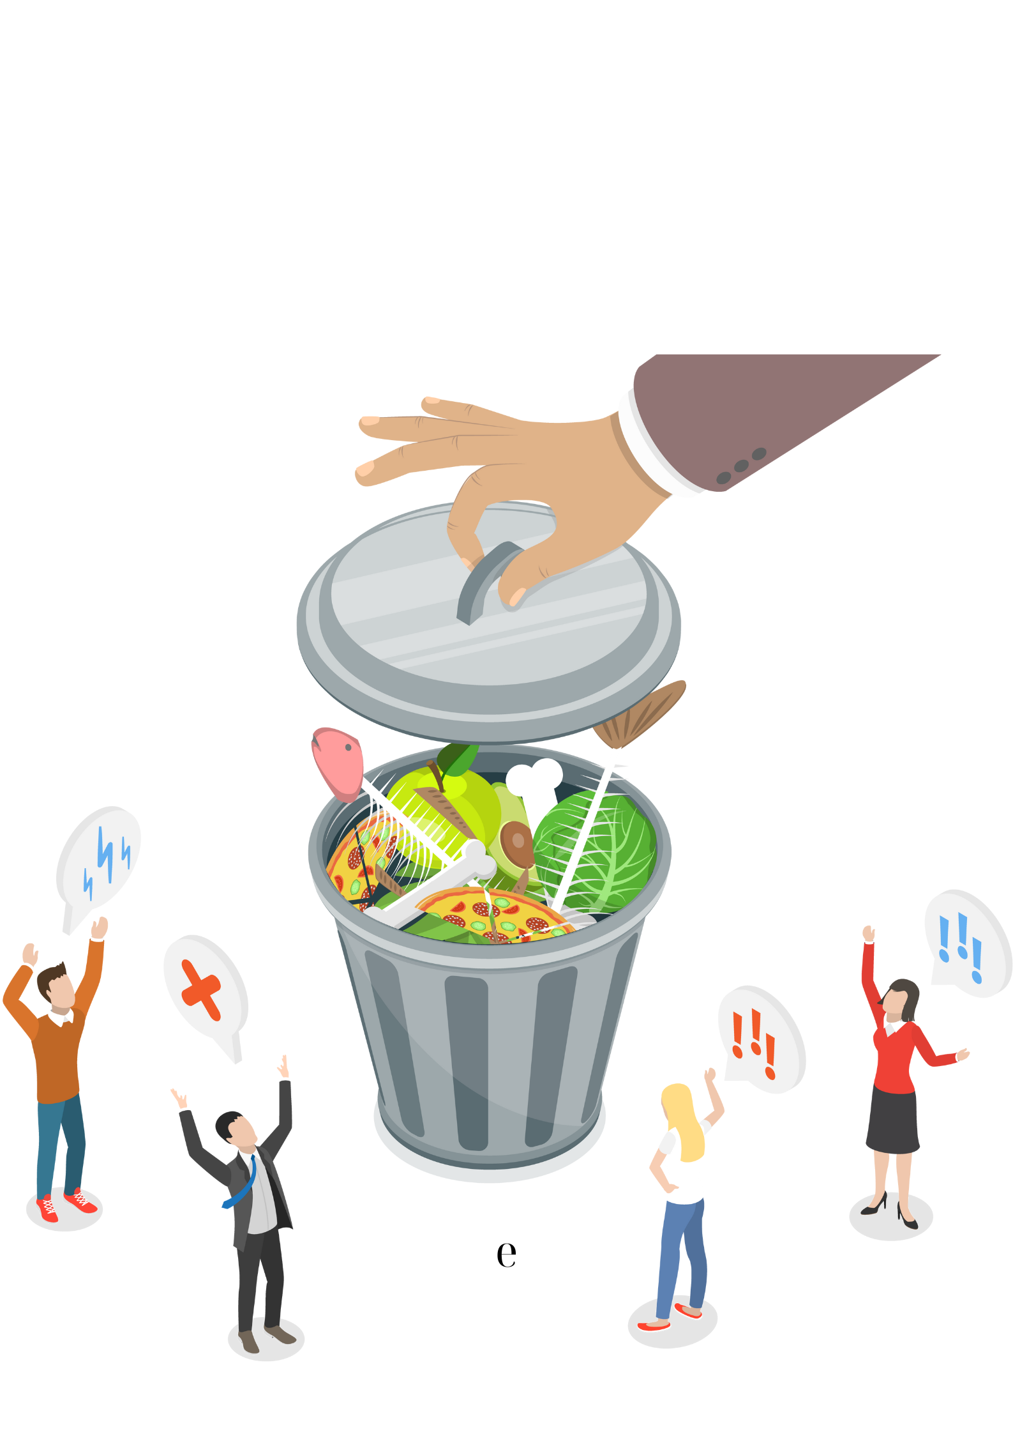
Full Plan of Environmental Theatre
Title: Food Waste: Just (don’t) do it
Reference group: Advertisers
Central Question: How is it to play key role in the modern Food Waste problem?
Common Role: Community’s group of advisors
Roles of the Animator: Head cook Fotis, Lord Nikolaos
Where: A small town
When: Once upon a time..

Slide 4
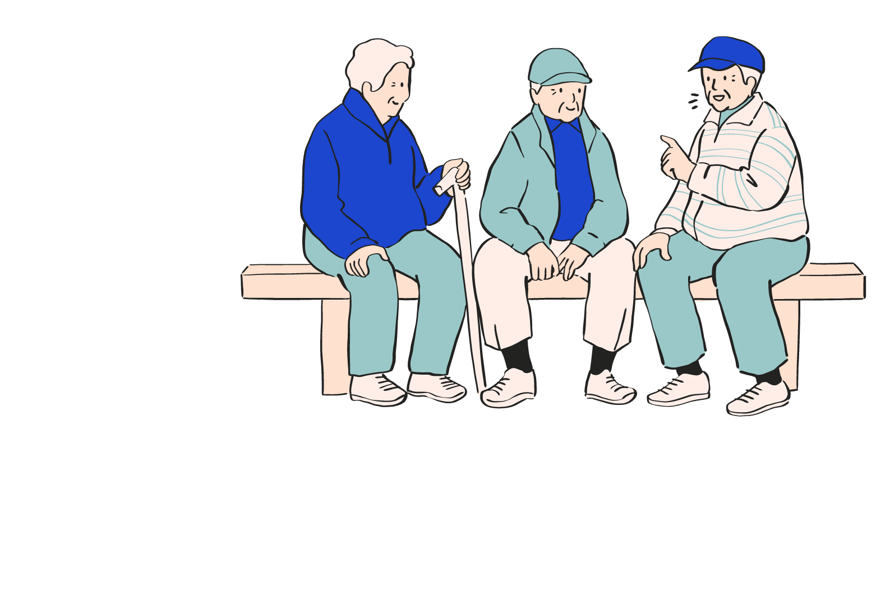
Storytelling
“Once upon a time, I don't know when, in the old days but not too long ago, there was a small town, not very different from ours. The residents of this town liked to talk a lot, they didn't leave anything without discussion. They discussed everywhere: in the squares, in the shops, at school, at the market, in their homes, so that they could always find the best solutions to the issues that concerned them. There was also a group of people to whom the residents turned when they wanted a little more advice, the opinion of an outside observer... I don't know why, they probably gave good advice eventually, and the community trusted them. This group used to meet at the top of a hill, high above the town, at the ruins of an ancient temple. I think it was the temple of Hermes, and rumor has it that the city's great trade route used to pass in front of it.”

Slide 5
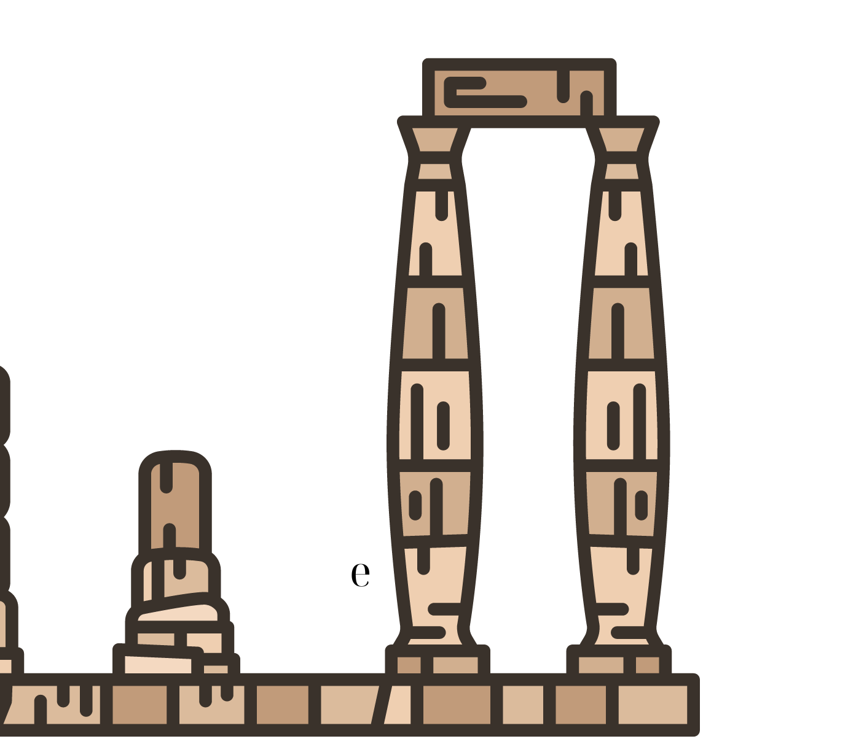
Building space activities
First activity:
The animator gives the instruction: “I would now like you to use the objects in our space and this paper tape to create in 5 minutes the space where this group meets. Attention, in this space you must all fit and there must be an entrance and exit through which you will strictly go in and out.”
Second activity:
The animator gives the instruction: “I would now like you to imagine the sounds of the temple’s environment and try to create them with objects that can be found in the room.”
Third activity:
The animator gives the group a large white cardboard and colours. Then he/she gives the following instruction: “ Outside the temple, this group had placed a flag with its badge. I want you to co-decide and co-create this flag.”

Slide 6
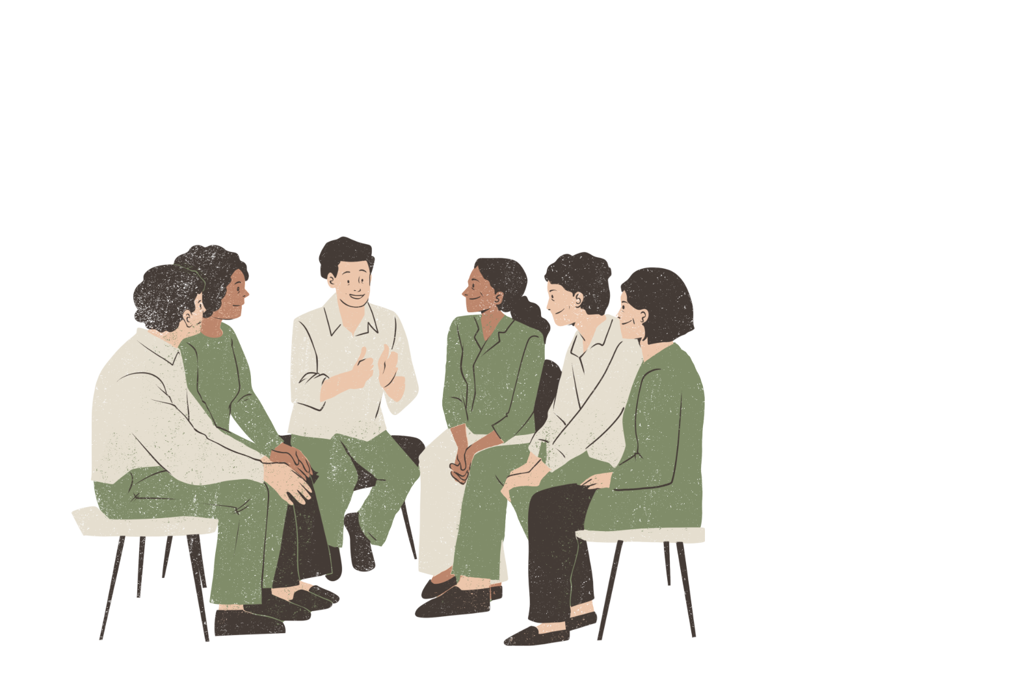
Building role activities
First activity:
This group had decided that its name should express the principles they stand for. The animator gives the instruction: “I want you to make up the name of this group as an acronym, so that each letter of its name represents one of their principles.” *
Second activity
The animator divides the participants into as many groups as the letters of the acronym-name they created. Each group gets one letter and therefore one principle.
The animator instructs: “Each group should create a frozen image that expresses the principle you have been given.”
The frozen pictures are photographed.
*From now on, the word group will be replaced by the acronym that the team created.

Slide 7
Instructions
The animator explains to the participants that when they enter the temple, they will take on the role of the members of the group. “Every time you are in the temple, you will be the members of the group. When you come out of the temple, you come out of the role.”
The first visitor who comes in will wear a hooded coat. I'm wearing the coat and I'm in character. I take off the coat, I get out of character.
The animator gives the instruction: “Enter the temple.”

Slide 8
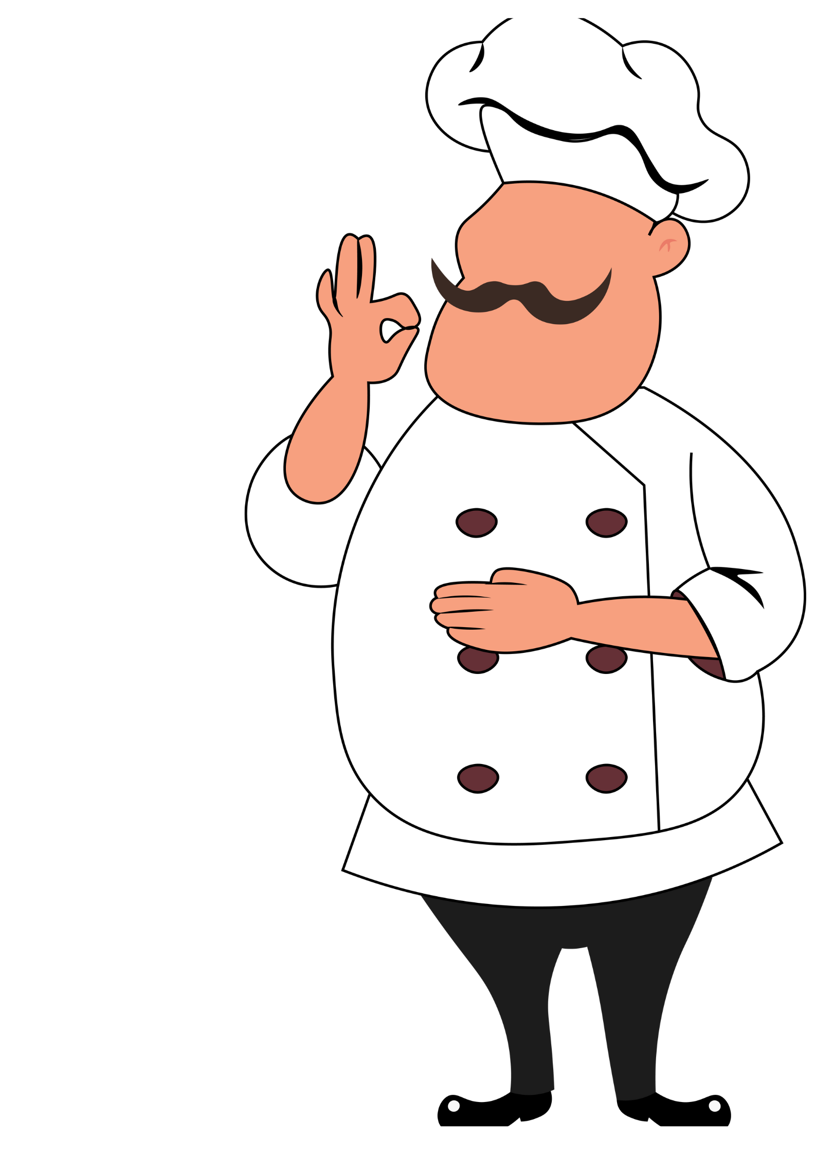
Action, 1st point of view
“As the head cook of Lord Nikolaos, I administer his food and distribute the ones that are close to their expiring date to the poor. Because of that, the Lord is hunting me with his personal guard, so I have come to you for refuge.”

Slide 9
Assimilation of the 1st point of view: activity A
The Lord announces to the town the proclamation of his head cook. There is great confusion in the city. Everyone discusses what has happened.
The animator divides the participants into groups, each representing a union of the city (policemen, priests, merchants, farmers, teachers, livestock breeders, homeless people).
The animator gives the instruction: “Each union is asked to make a public statement in support or not to the head chef Fotis.”

Slide 10
Assimilation of the 1st point of view: Activity B
The animator asks from two members to take on the roles of the city’s greengrocers. Each grocer is given exactly the same photos, showing fruits and vegetables in different stages of ripening, for example: tomatoes firm and tomatoes ripe, bananas unripe and bananas very ripe, etc. The purchase price of the product is written on the back of each photo. The animator then will ask each greengrocer, on their own, to price their products (in whole numbers). Once they have finished, the animator asks them to display the products with their prices and "open" their shops.
The animator gives to the rest of the participants equal pieces of paper, each representing one euro, along with the instruction: “You are in the city market, this is your money, spend them as you see fit.”
After the group's shopping is completed, the animator instructs: “As a team, calculate and discuss which greengrocer came out the most profitable, taking into account the income and wastage, if any.”

Slide 11
Instructions
And while this is happening in the city, our group is in the temple discussing....
The animator gives the instruction: “Enter the temple.”
The second visitor to come, will hold a cane. I hold the cane and am in character. I let go of the cane and get out of the role.

Slide 12
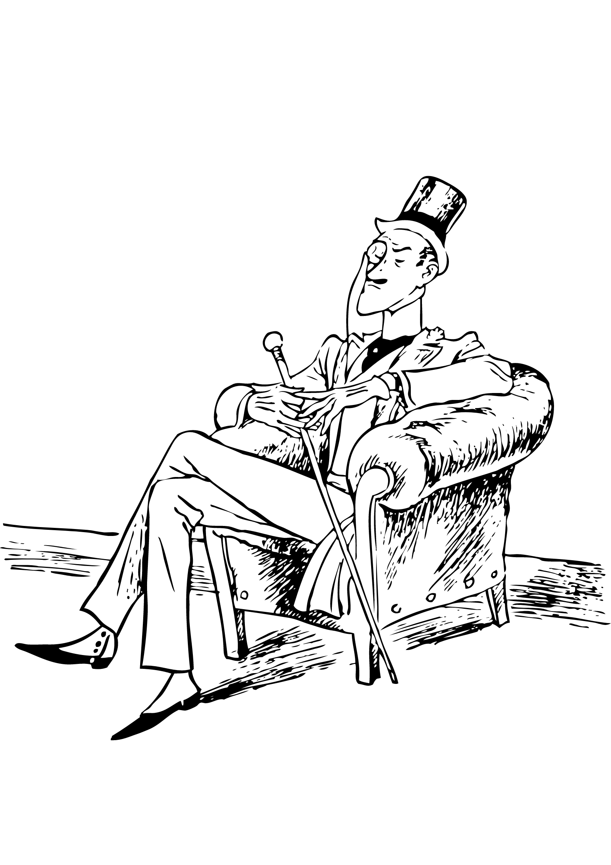
Action, 2nd point of view
“I'm looking for my head cook because I found out he has been stealing from me and he needs to be punished.”

Slide 13
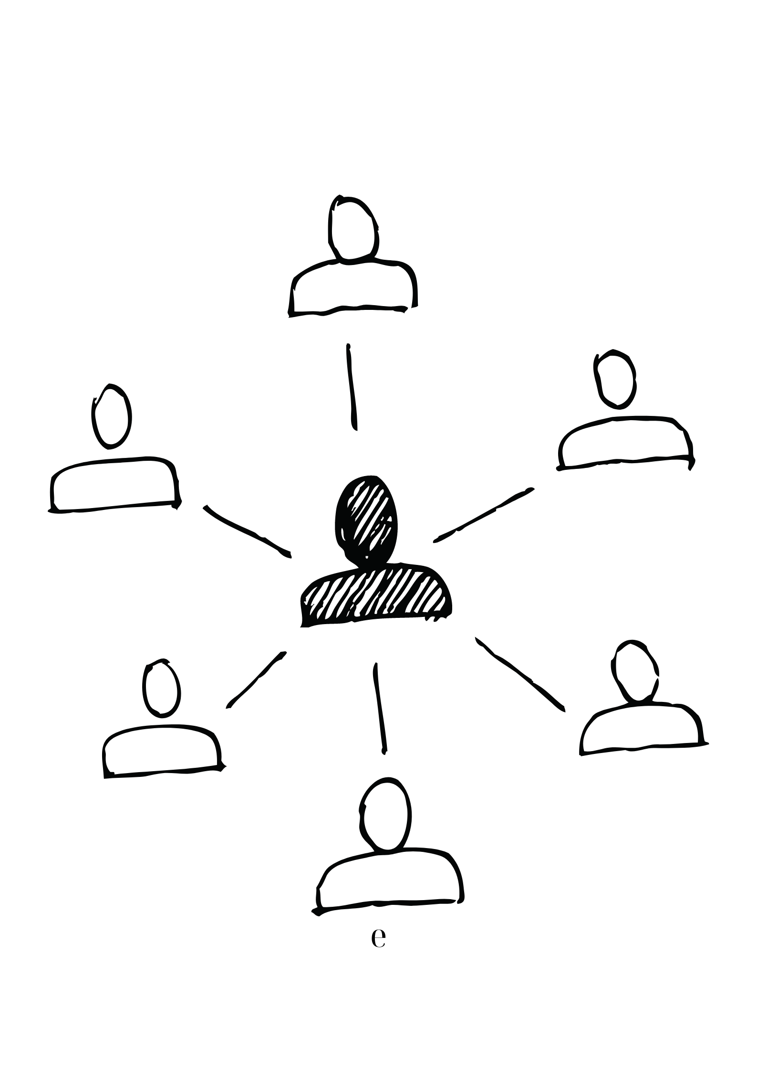
Assimilation of the 2nd point of view: activity A
The animator gives the participants a paper roll and colours. One member of the group lies down on the paper and the others will outline his body.
The animator instructs: “This outline is of Lord Nicholas. I want you to write on the inside Lord's thoughts and/or feelings about the situation he is in, and on the outside of the outline the thoughts others have about him.”

Slide 14
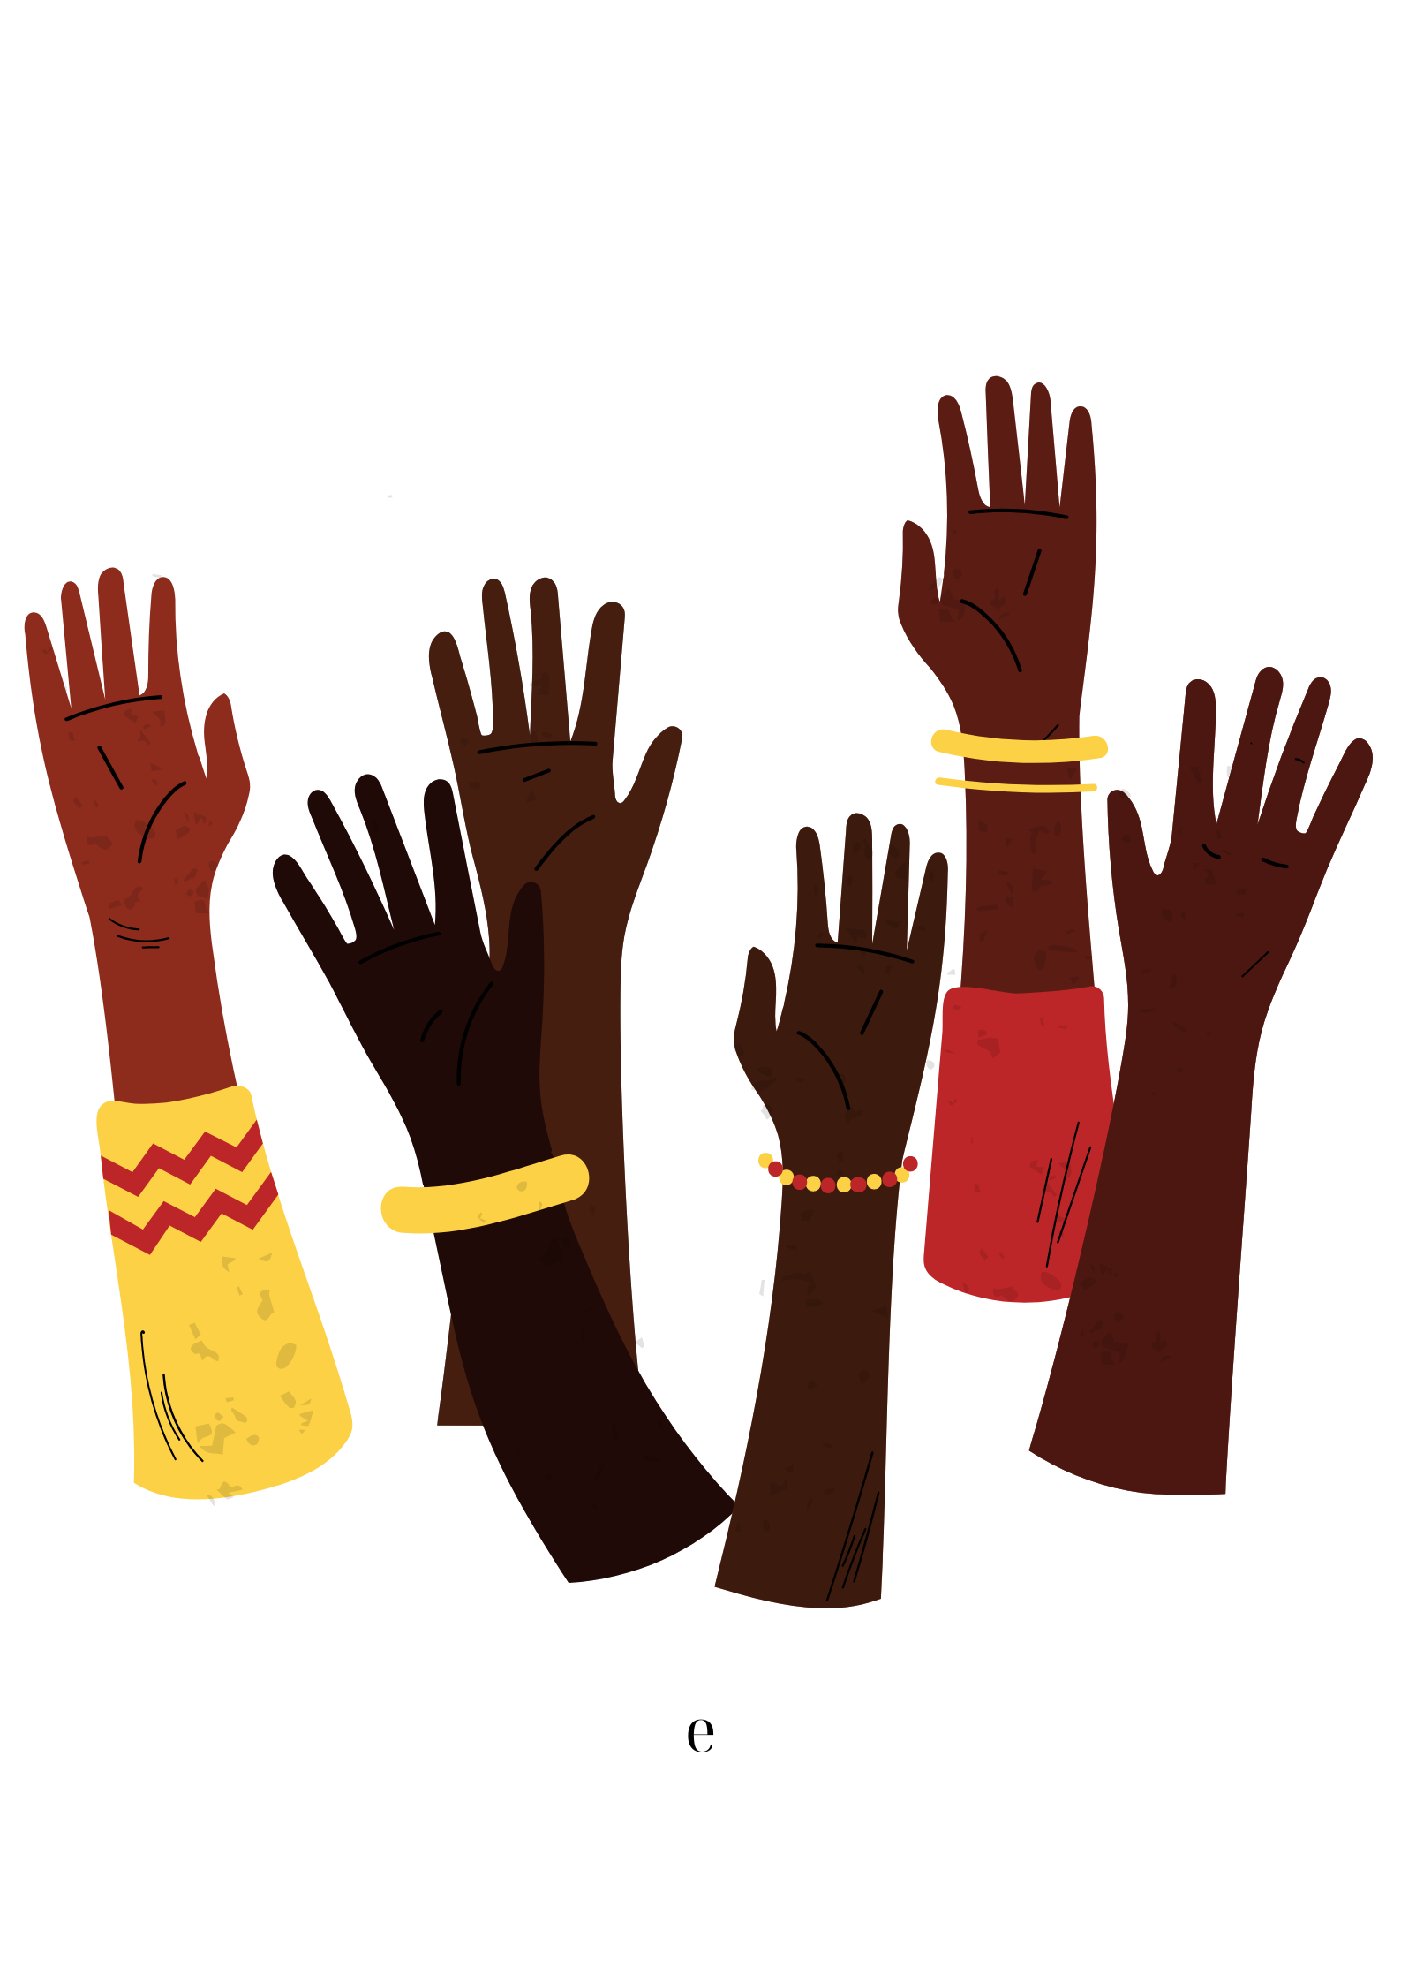
Assimilation of the 2nd point of view: Activity B-Forum Theatre
Just as the Lord was leaving the temple to return to the city, he met the head cook who was on his way to receive the final advice of the group.
The animator gives the instruction: “Everyone create a circle and watch the meeting between the Lord and the head cook Fotis (one member pretends to be the Lord and another pretends to be the head cook). The roles and symbols alternate. We must never forget that when the dialogue is interrupted, it must be continued exactly from the point of interruption.”

Slide 15
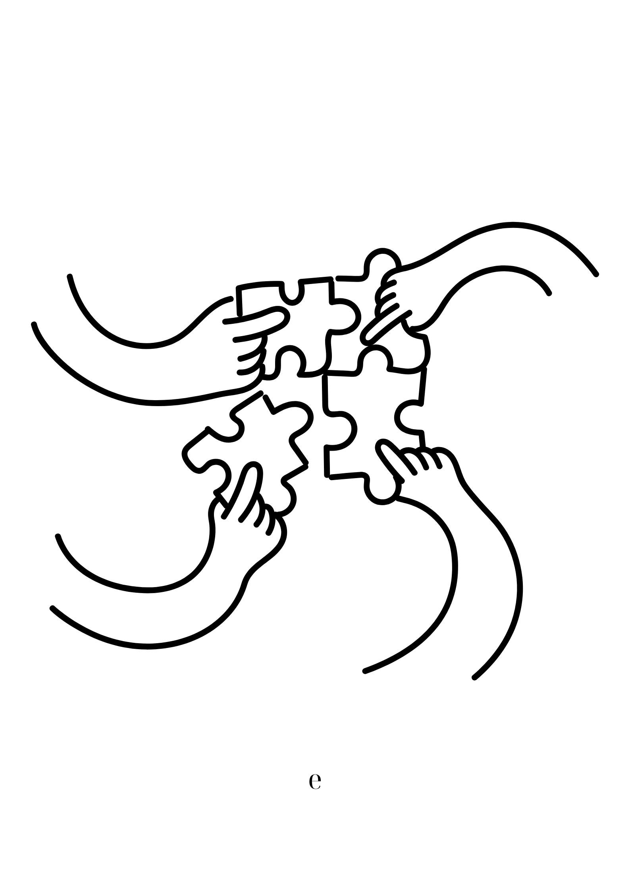
Action - announcement of decision
The animator gives the instruction: “Get in the temple.”
The head cook Fotis visits again the temple.
The group’s decision.

Slide 16
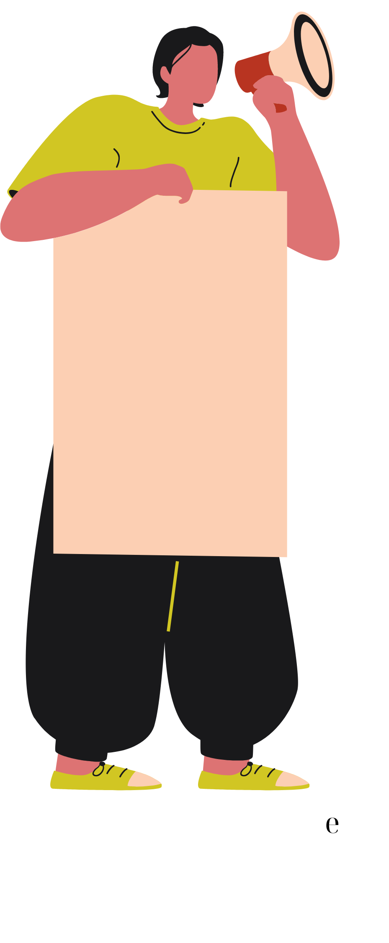
Reflection
Years later, on the day of the advice to the head cook Fotis, the city’s community had established an event, which was attended by many residents from the surrounding villages. The community residents, wanting to inform them about their own experience, created leaflets and posters to distribute to the residents of the surrounding areas.
The animator gives the instruction: “I now want you to create this poster using slogans and drawings.”

Slide 17
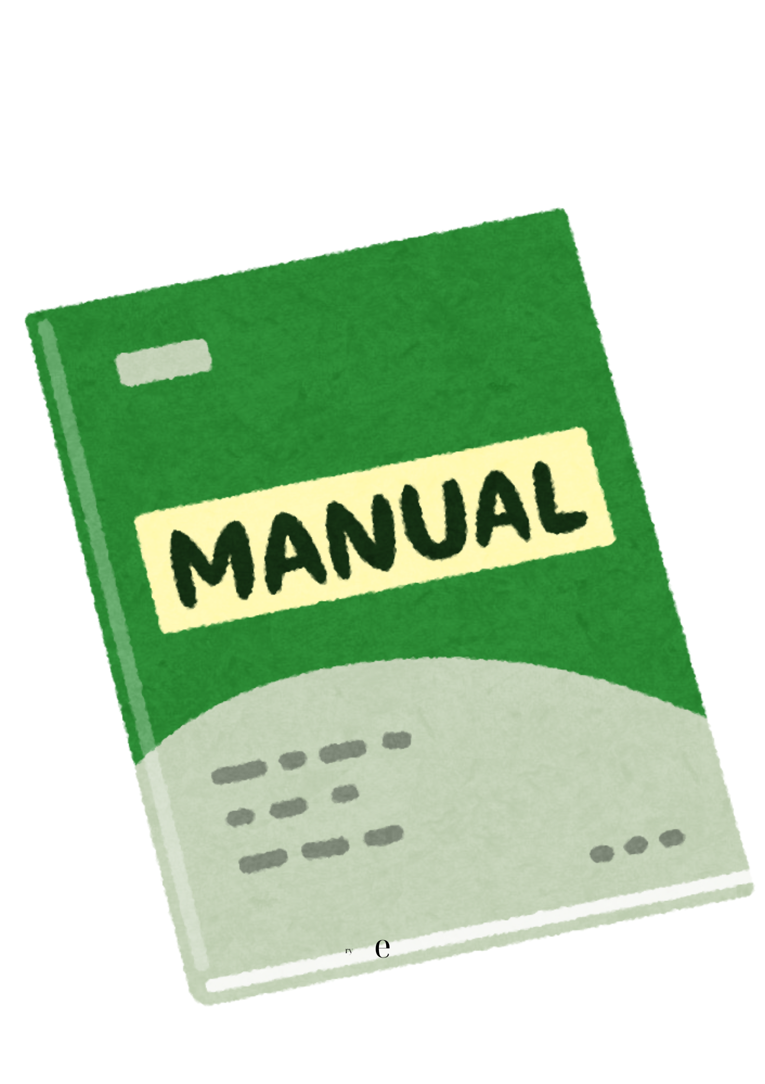
Instructions
In the temple area there must be room for all of you and there must be one entrance-exit through which you will strictly enter and exit.
Each time you are inside the temple you will be the members of the group. When you exit the temple, you also exit the role.
Every time someone is wearing the hooded coat, they are the head cook. Every time someone is holding the cane is the Lord.

Slide 18
Materials
Tape, paper sheets, paper roll, cardboard, colouring pencils, photos that depict fruits and vegetables.
Camera or mobile phone with camera.
Hooded overcoat, cane.

Slide 19
Thank you ☺

