Slide 2
The groups of 2nd semester undergraduates tried their hand at translating the Greek National Anthem lyrics into English
1. The Lavaro group | 2. The Aghia Lavra group | 3. The Exodus group
Ελένη Αγάθη Γεωργία Αναγνώστου Πέννυ Μιτσοπούλου Μαρία Σαββοπούλου Ευαγγελία Σαραντίνου Θεοδοσία-Δήμ. Ζαννίκου Φωτεινή Γιαννοπούλου | Αγγιολίνα Αντωνάτου Ιωάννα Βαμβακοπούλου Λέανδρος-Εμμανουήλ Καραϊσκάκης Δέσποινα Λουκά Νίκη-Ειρήνη Μαστοράκη Αγγελική Μπούντου | Μαριέττα Γκουντάνη Βαγγέλης Αργυρόπουλος Φανή Κουτσογιάννη Αλεξάνδρα Δρακουλάκη Σταυρίνα Αποστολοπούλου

Slide 3
The Evaluation Committee of the postgrads voted and competition winners were the ‘Aghia Lavra’ group (group 2, with 7/14 votes) for their potential to communicatively transfer meaning. Congratulations!

Slide 4
Competition polls Group 1 (the Lavaro group) received 2 votes and group 3 (the Exodus group) received 5 votes.
Aghia Lavra
7
Lavaro 2
Exodus 5
…
However, see below the evaluation of critics who voted for the ‘Lavaro’ and ‘Exodus’ groups!

Slide 5
While congratulating the winners and the evaluation committee for the effort they put into this,…
…we would like to present some of the evaluators’ views anonymously, on group 1 and group 3 production
for highlighting their appreciation of successful strategies in versions 1 and 3.
After all, translation is never a straightforward activity!

Slide 6
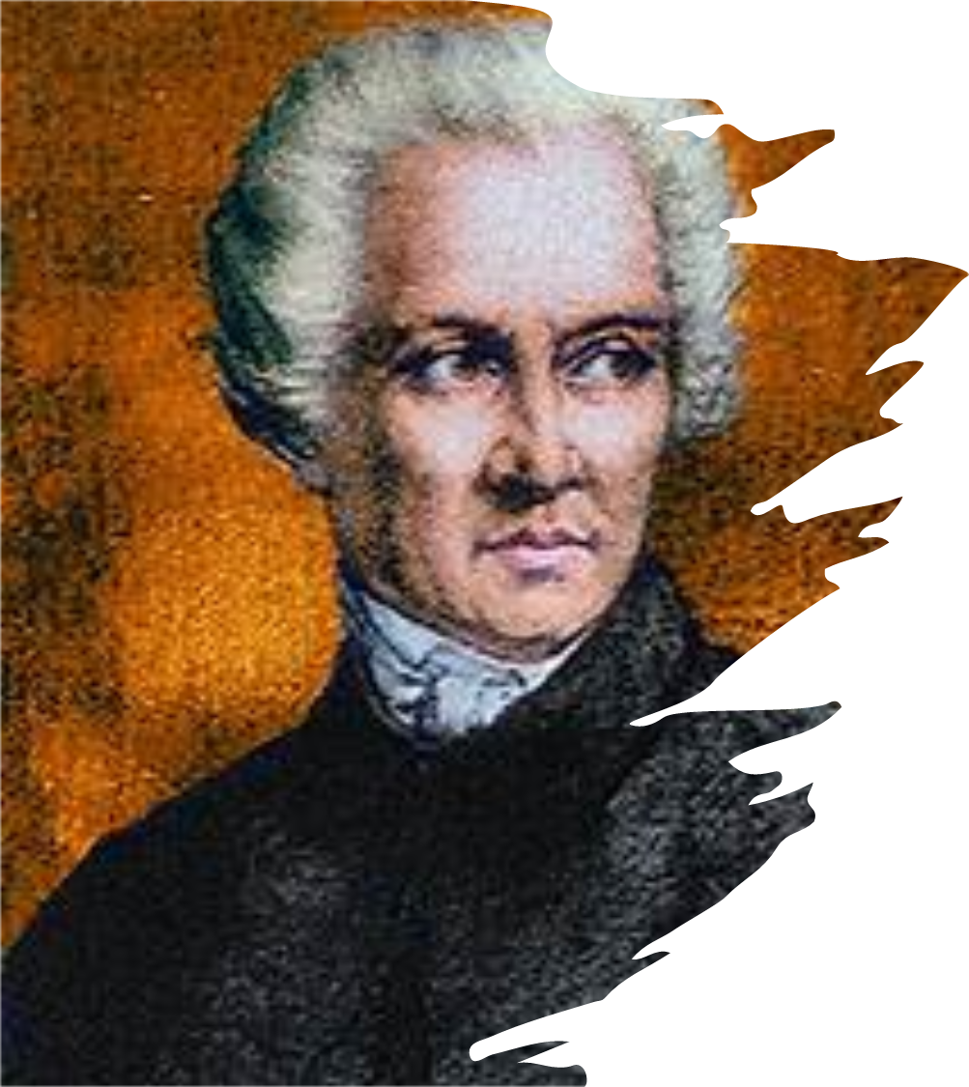
The Exodus group View 1
I vote in favour of the Έξοδος group, for their poetic and elegant wording, for the beautiful rhythms and melodies produced, and for the auditory and imaginary sensations evoked. Although it’s obviously not a word-for-word translation, the translators have grasped the essence of the original work and have successfully rendered its spirit with English of high calibre. There are indeed certain points where the translators have made their own modifications and emotional exaggerations, but from where I’m standing, this dose of creativity is permissive for poetry translation. Translators do have the right not only to put the author’s words into translation, but to put what they perceived into words. The Έξοδος group shows great understanding of the original work and acts as an active and visible agent in the translation process. Their interpretation gives the original work an extra gloss.

Slide 7
The Exodus group View 2
In my opinion the third translation is the one that could be prioritized. Students have managed to render the meanings of the Greek poem with much creativity and the outcome is a legible text. They retained the same rhyming pattern which is a very important feature. Lexical items suit the context of the poem and the old features such as thee and thy (missing from the other two translations) remind the reader of the fact that this poem was written long ago. The language is poetic and creative but at the same time close to the original and provokes emotions to readers.

Slide 8
The Exodus group View 3
The Exodus group offered the best option, not a word-by-word translation, but a literary and poetic performance. While reading the third version, a reader can see and feel the rhyme, order and melody of the lines, which is portrayed in the original poem. Moreover, it can be easily sung just as the Greek Anthem. I like the use of archaic types of pronouns such as thy, thou and thee which transfers the reader to past times... Despite the fact that the translators in the third version used a kind of free way of expression they remained faithful to the original text and didn’t lose the meaning. The two first translations are not so creative and poetic as the third one. Their language is simpler and the style of translation is more direct.

Slide 9
The Exodus group View 5
Κατά την άποψή μου η μετάφραση αυτή είναι καλύτερη από όλες. Με συνεπαίρνει η ποιητική χροιά που προσπαθεί να μιμηθεί το ελληνικό πρωτότυπο και είναι πολύ κοντά στο ύφος και το νόημα.

Slide 10
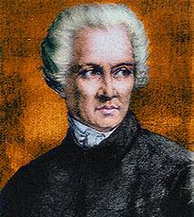
The Lavaro group View 1
I think the first translation by the Λάβαρο group conveys the meaning of the Greek National Anthem more accurately and concisely. The group seems to have dealt with Greek metaphorical expressions in a really creative way. Even though modern English is used, the target version does not lose the poetic aspect of the original.

Slide 11
The Lavaro group View 2
I chose this translation predominantly because upon reading it, it seemed familiar and very pleasant to my ears. More specifically, the translation has a nice flow and since the national anthem is meant to be sung in formal occasions and celebrations, I could easily “hear” the rhythm of this translation. The fact that the students retained the abab rhyming of the source text greatly contributes to this impression I got upon reading the poem.
The original translation by Charles Brinsley Sheridan is very lofty and evocative of the poetry of Lord Byron and Percy Bysshe Shelley, two poets who were indeed major inspirations for Solomos. However, I appreciate the fact that the students were not afraid to create a modern translation. It might seem like a bold choice, but I like the fact that they did not want to repeat the original translation or heavily rely on it.
I think that the students were able to retain both the epic and lyrical tone of the Greek original, without losing the romantic elements. After all, let’s not forget that Solomos’s intention was to write a poem commemorative of the battles of the Greek folk. Indeed, he wrote about extraordinary things achieved by everyday people who came together to fight for the common cause of freeing the Greek nation.

Slide 12
Congratulations to all!

