Slide 1



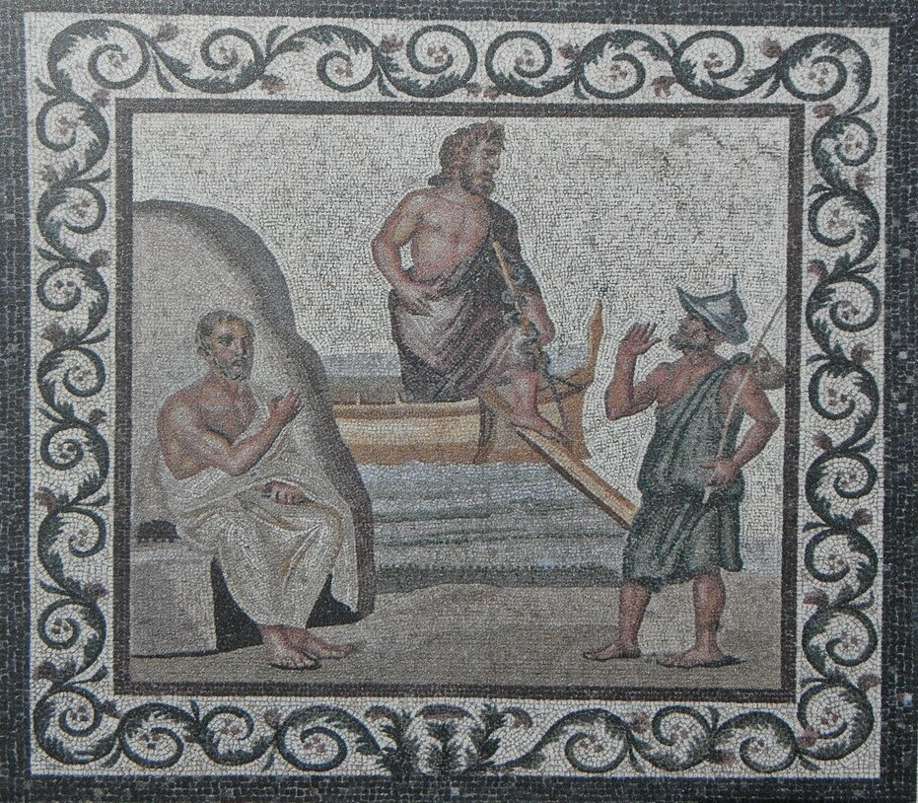
International Symposium
“Ancient Strategies of Medical Authority”
3rd March 2026, 10.00-14.30
Eastern Hall, Academy of Athens
Organised by
Athena Bazou, Petros Bouras-Vallianatos, and Sophia Xenophontos
Sponsored by the:
Research Centre for Greek and Latin Literature, Academy of Athens
Department of Philology and Department of History and Philosophy of Science, NKUA
Speakers
Jacques Jouanna (AIBL, Paris)
Athena Bazou ((NKUA, Athens)
Véronique Boudon-Millot (CNRS, Paris)
Petros Bouras-Vallianatos (NKUA, Athens)
Giulia Ecca (Università degli Studi “La Sapienza” di Roma)
Antonio Ricciardetto (CNRS, Paris)
Sophia Xenophontos (Academy of Athens)
Program: https://conferences.uoa.gr/e/symposium_medicine_2026

