Slide 1


Electromagnetic signatures of gradual magnetic dissipation in leptohadronic jets from supermassive black holes
S. Dimitrakoudis
In collaboration with: M. Petropoulou, D. Giannios, and S. I. Stathopoulos
Department of Physics,
National and Kapodistrian University of Athens
MuMeNTA Athens 2-3-2026

Slide 2
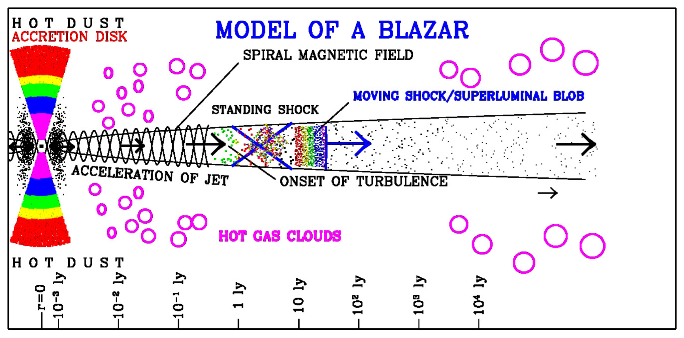
AGN jets: a multi-scale physics laboratory
Marscher (2009)
MuMeNTA Athens 2-3-2026

Slide 3
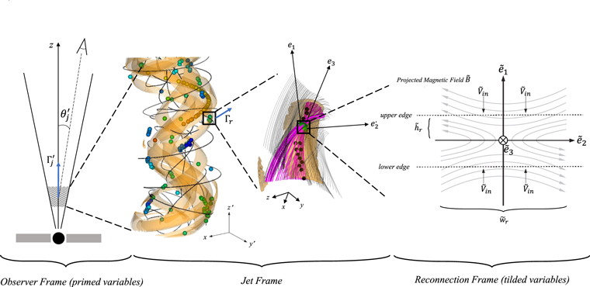
Local dissipation due to reconnection in the jet
Kadowaki et al. 2021
MuMeNTA Athens 2-3-2026

Slide 4
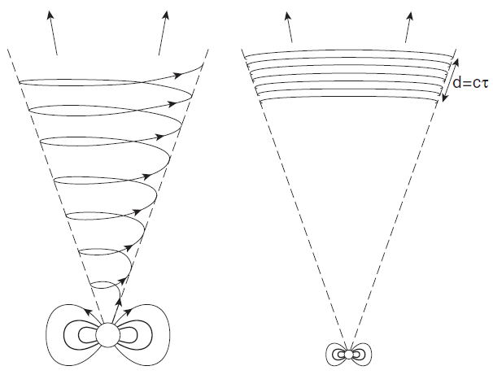
The “striped wind” model
outflow field becomes
“pancake” of toroidal flux
kink instability leads to
magnetic reconnection
Drenkhahn (2002)
Drenkhahn & Spruit+ (2002)
Giannios (2006)
Spruit+ (2001)
MuMeNTA Athens 2-3-2026

Slide 5
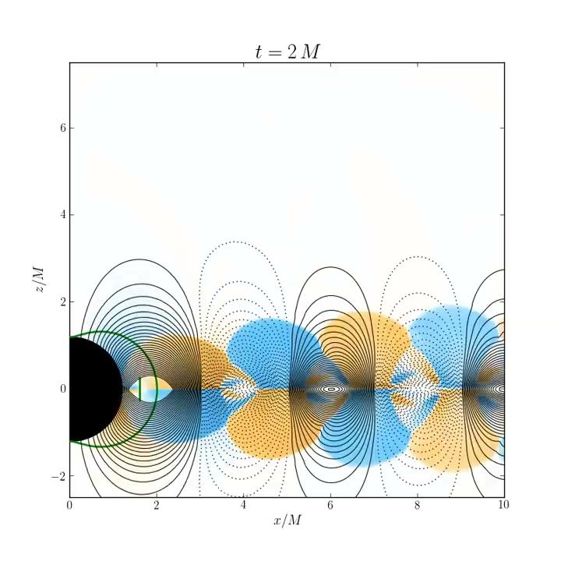
Gradual dissipation jet model
Gradual dissipation jet model
Parfrey+ (2016)
MuMeNTA Athens 2-3-2026

Slide 6
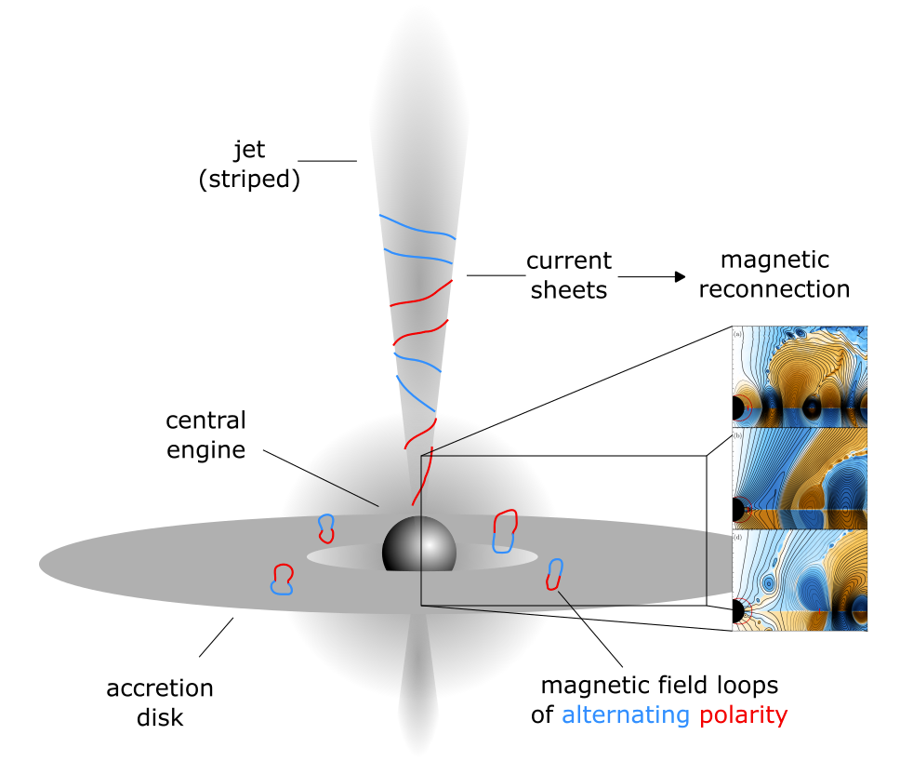
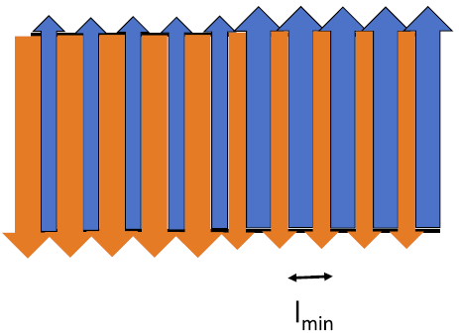

Gradual dissipation jet model
magnetorotational instability (MRI)
leads to
reconnection in the jet
which
dissipates energy
and
drives bulk flow and particle acceleration
Parfrey+ (2016)
Giannios & Uzdensky (2019)
MuMeNTA Athens 2-3-2026

Slide 7
Gradual dissipation jet model
Conserved quantities:
: jet power
Additional parameters:
z: distance along jet axis
: jet opening angle
s: electron power-law slope
α: power-law index of loop size distribution
θ_{obs}: viewing angle
MuMeNTA Athens 2-3-2026

Slide 8

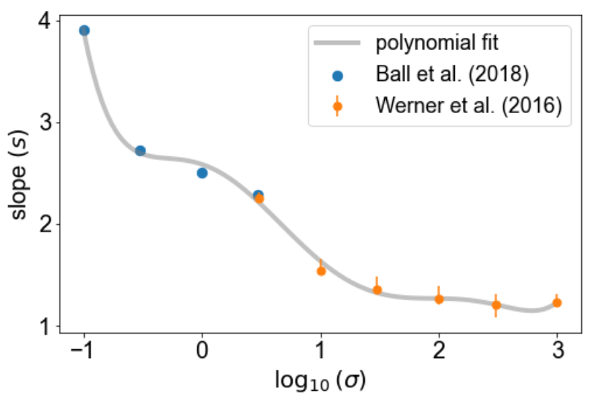




Gradual dissipation jet model
- slope is derived from σ (PIC simulations)
- σ is derived from:
where χ is derived from α and :
Soft
Hard
Giannios & Uzdensky (2019)
MuMeNTA Athens 2-3-2026

Slide 9




Gradual dissipation jet model
differential energy dissipation rate
injection power in comoving frame
MuMeNTA Athens 2-3-2026

Slide 10
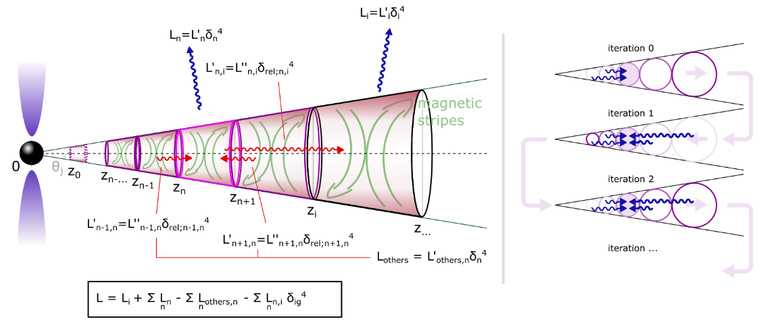
Our segmented jet model
MuMeNTA Athens 2-3-2026

Slide 11
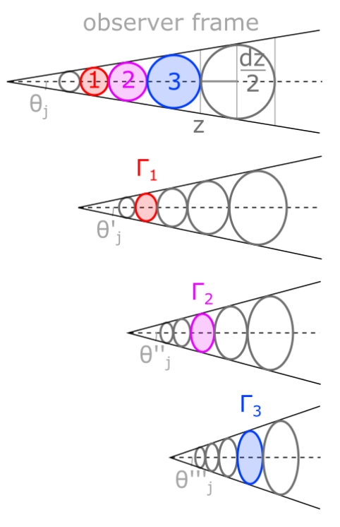
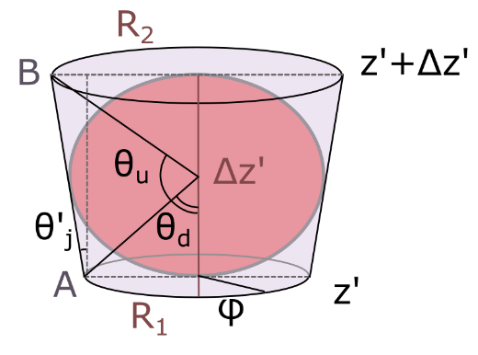
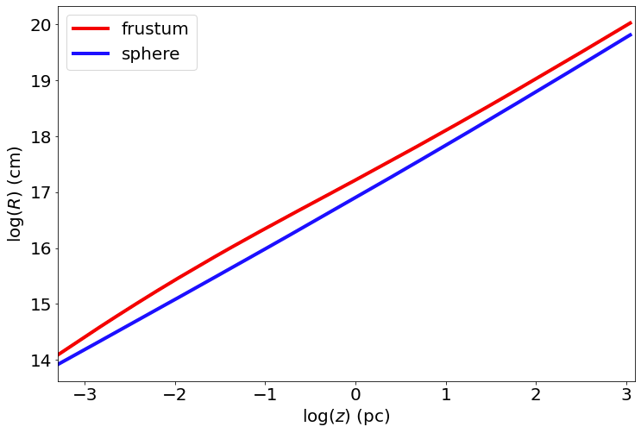
Segment shape
Average radius of frustum vs average radius of ellipsoid with distance (same volume or observer frame sphere)
MuMeNTA Athens 2-3-2026

Slide 12

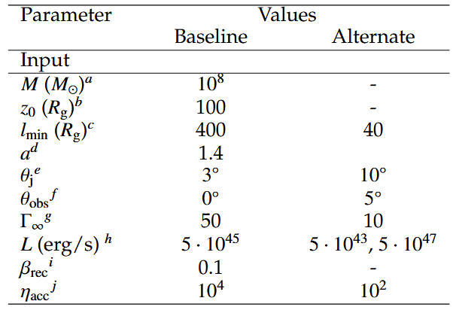
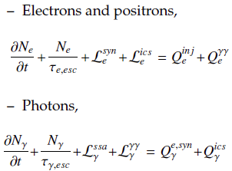

Setup
Open-source lepto-hadronic code in Python
List of parameters for following slides
Numerical density of particles computed in time and energy through partial differential equations
Stathopoulos+ (2023)
https://github.com/mariapetro/LeHaMoC
MuMeNTA Athens 2-3-2026

Slide 13
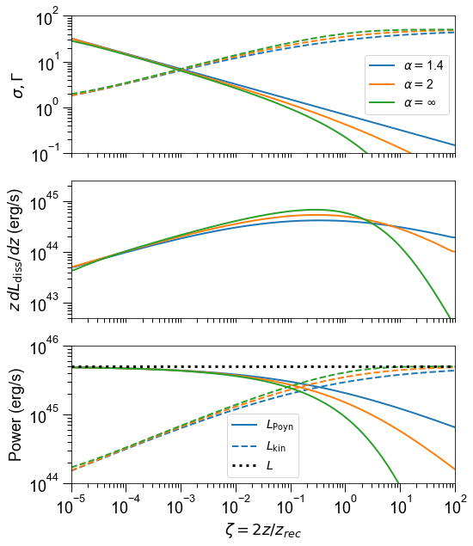
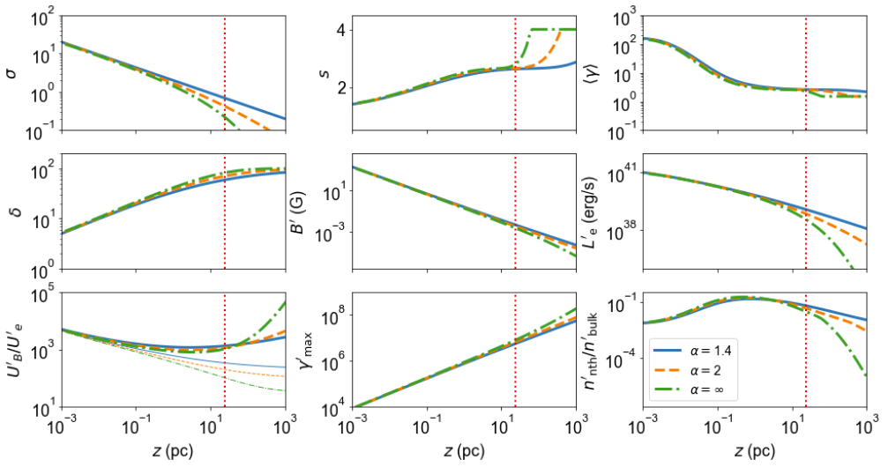
Selected scenarios
MuMeNTA Athens 2-3-2026

Slide 14
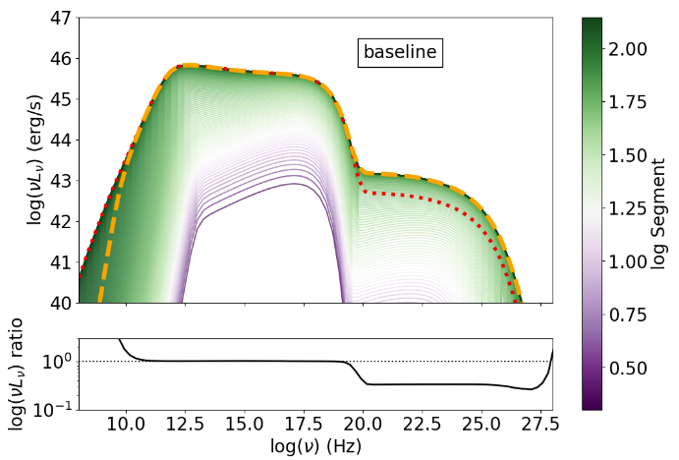
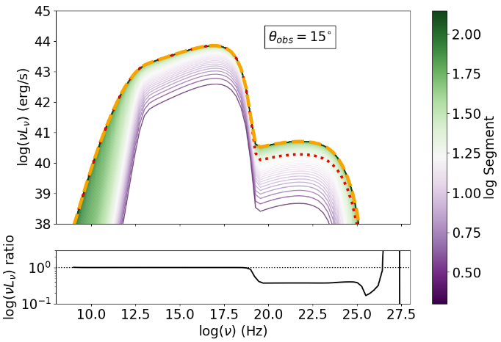
Selected scenarios
MuMeNTA Athens 2-3-2026

Slide 15
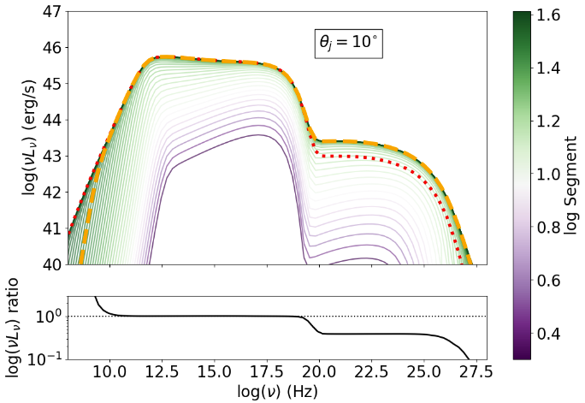
Selected scenarios
MuMeNTA Athens 2-3-2026

Slide 16
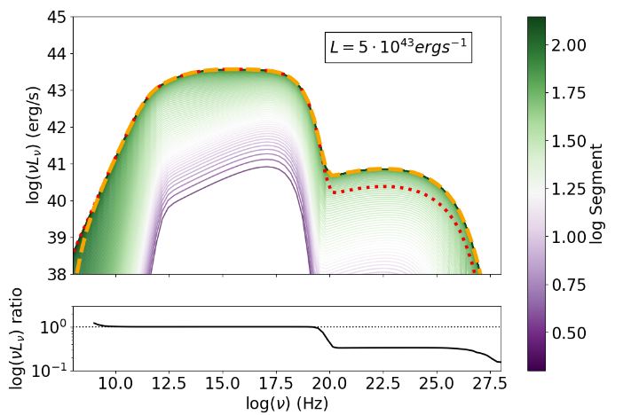
Selected scenarios
MuMeNTA Athens 2-3-2026

Slide 17
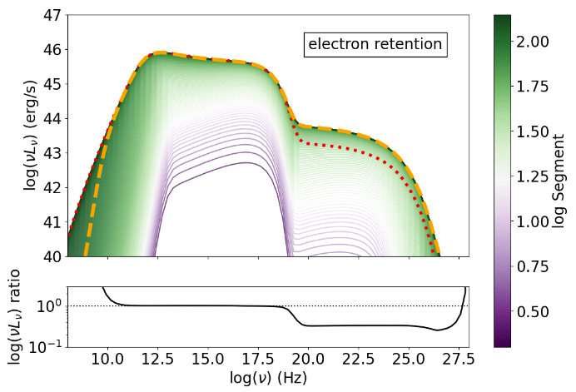
Selected scenarios
Electron retention: for segment at distance z, all electrons at steady state in previous segments down to z/2 are still in it
MuMeNTA Athens 2-3-2026

Slide 18
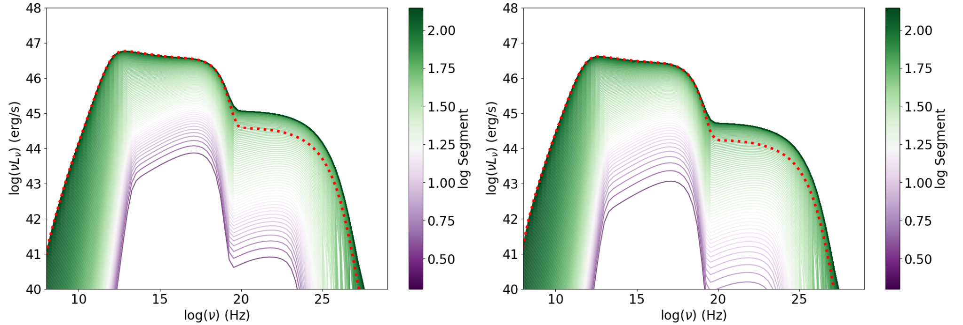

Selected scenarios
Electron retention: for segment at distance z, all electrons at steady state in all previous segments are still in it
Zhang & Giannios 2021
MuMeNTA Athens 2-3-2026

Slide 19
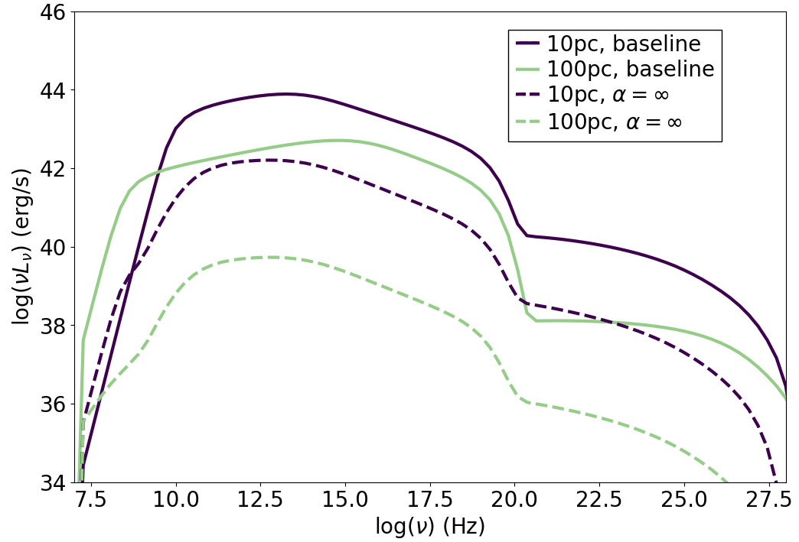
Large scale jet emission
Individual segments shown for two cases
MuMeNTA Athens 2-3-2026

Slide 20
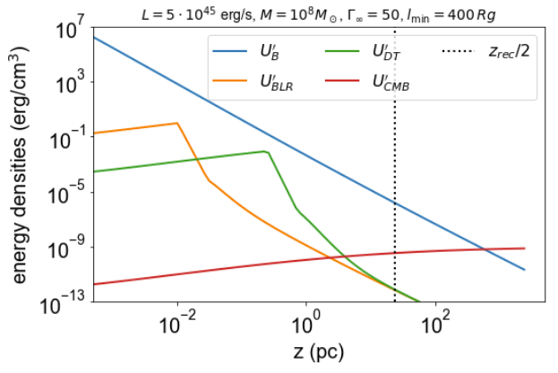
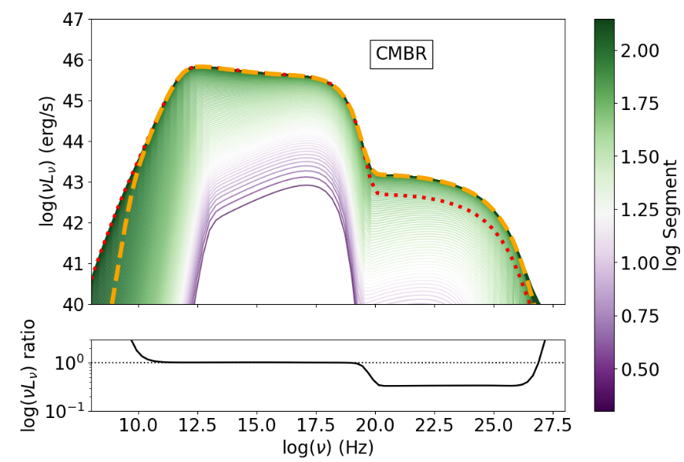
Selected scenarios
External photon field
MuMeNTA Athens 2-3-2026

Slide 21
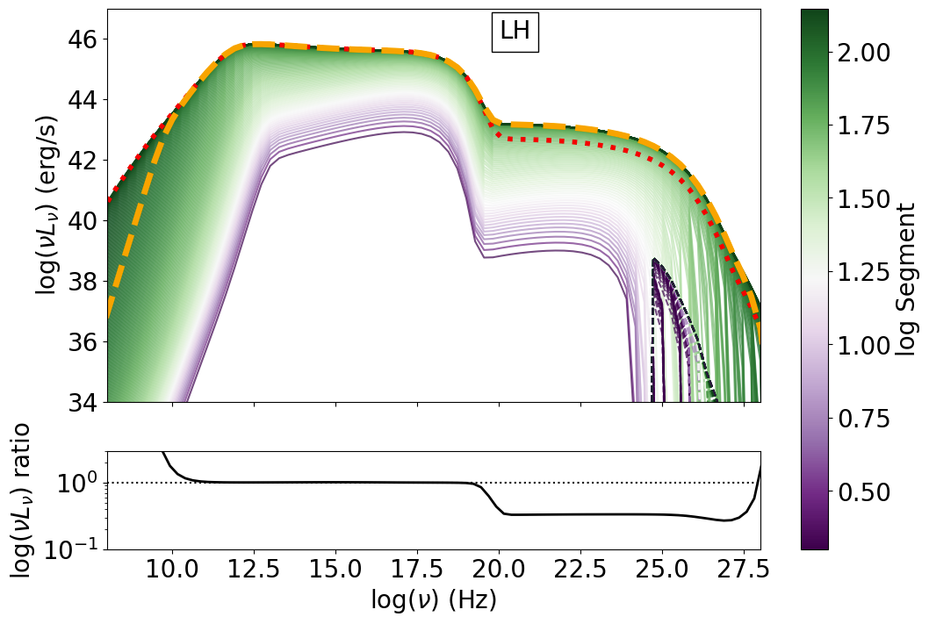
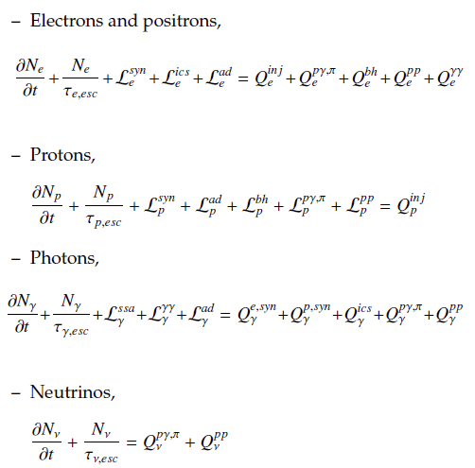
Selected scenarios
Leptohadronic scenario
neutrinos
MuMeNTA Athens 2-3-2026

Slide 22
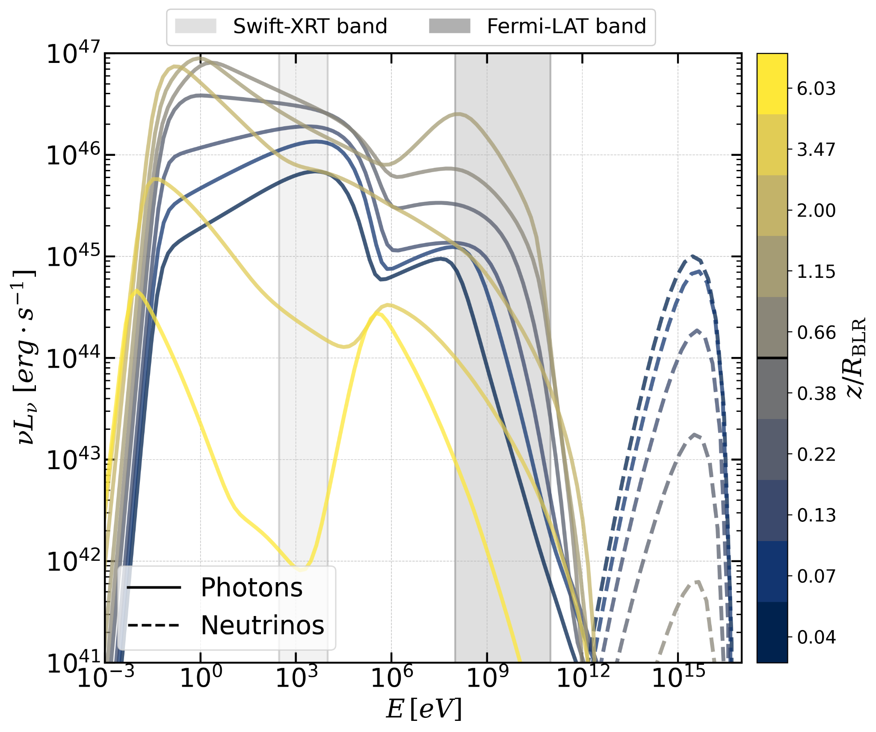
Comparison to another approach
distance
Stathopoulos & Petropoulou (2025)
MuMeNTA Athens 2-3-2026

Slide 23
Conclusions
We calculated, for the first time, blazar photon emission across the jet by taking into account photon spillage across different parts of the jet.
This exploration is performed in the physical framework of gradual magnetic dissipation for magnetically dominated jets.
Inter-segment photon spillage is important for the inverse Compton hump.
Neutrinos are only prominent in upstream segments.
SEDs have an almost universal shape, with a low Compton ratio.
The code (adjustable for other dissipation schemes) will soon be available on github
THANK YOU!
MuMeNTA Athens 2-3-2026

Slide 24
Backup slides
MuMeNTA Athens 2-3-2026

Slide 25
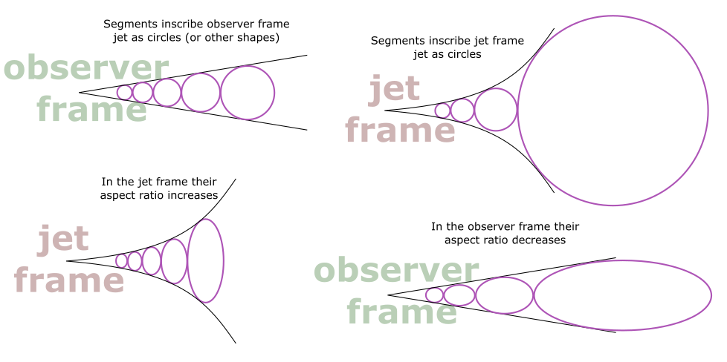
Segment geometry selection
MuMeNTA Athens 2-3-2026

Slide 26
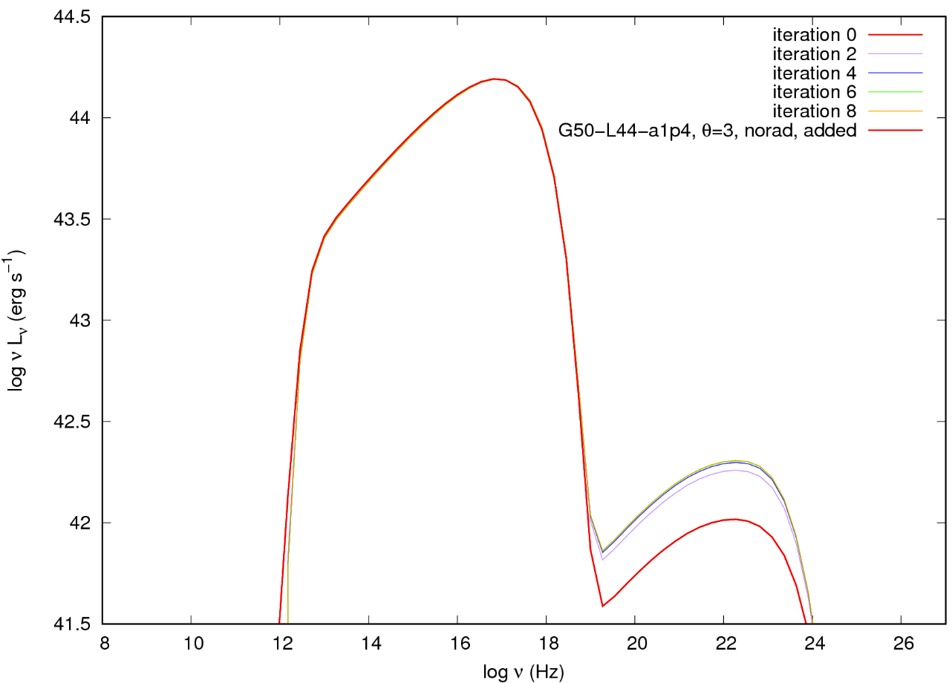
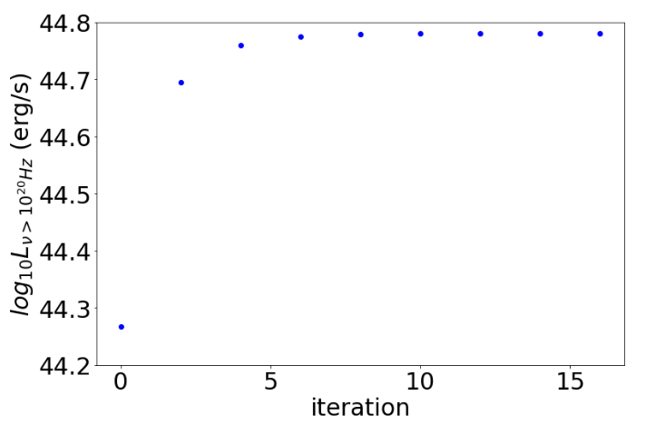
Technical details
Convergence over n iterations for ν > 10²⁰ Hz
1286 s (~21min) for 8 iterations of 21 segments
4783 s (~80 min) for 4 iterations of 131 segments
About 7 s per segment plus some initial calculation time
Execution time:
MuMeNTA Athens 2-3-2026

Slide 27
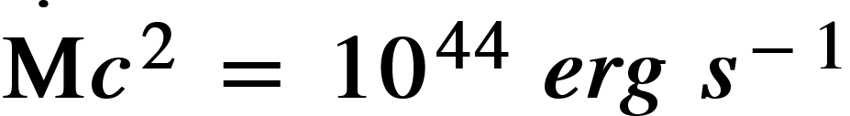
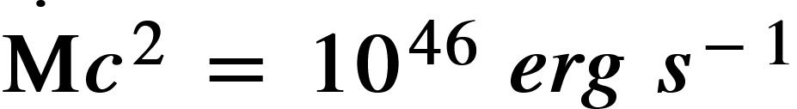
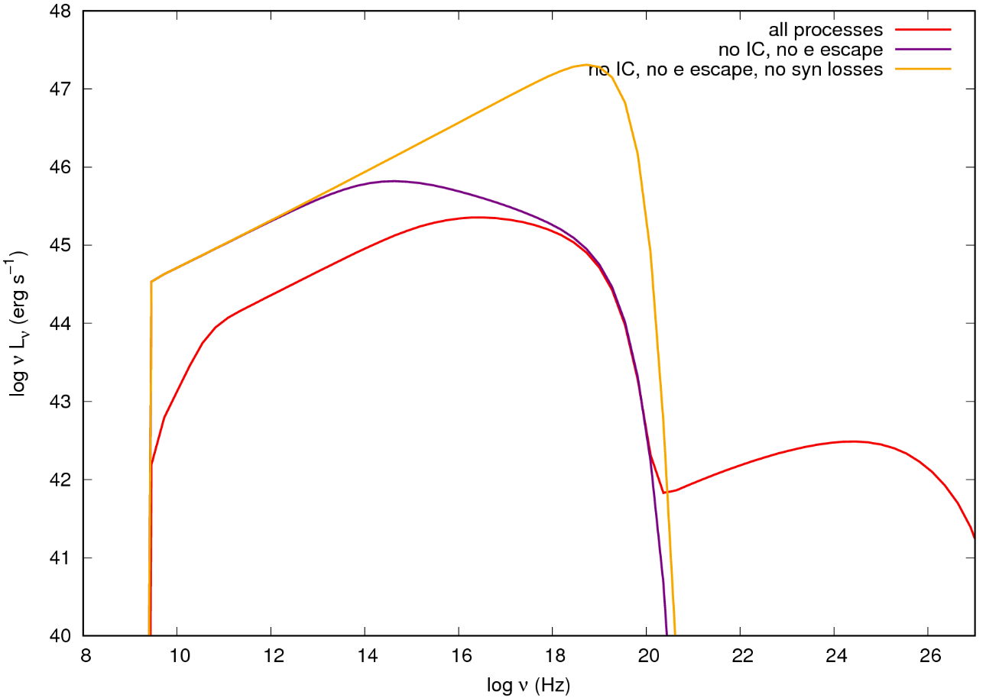
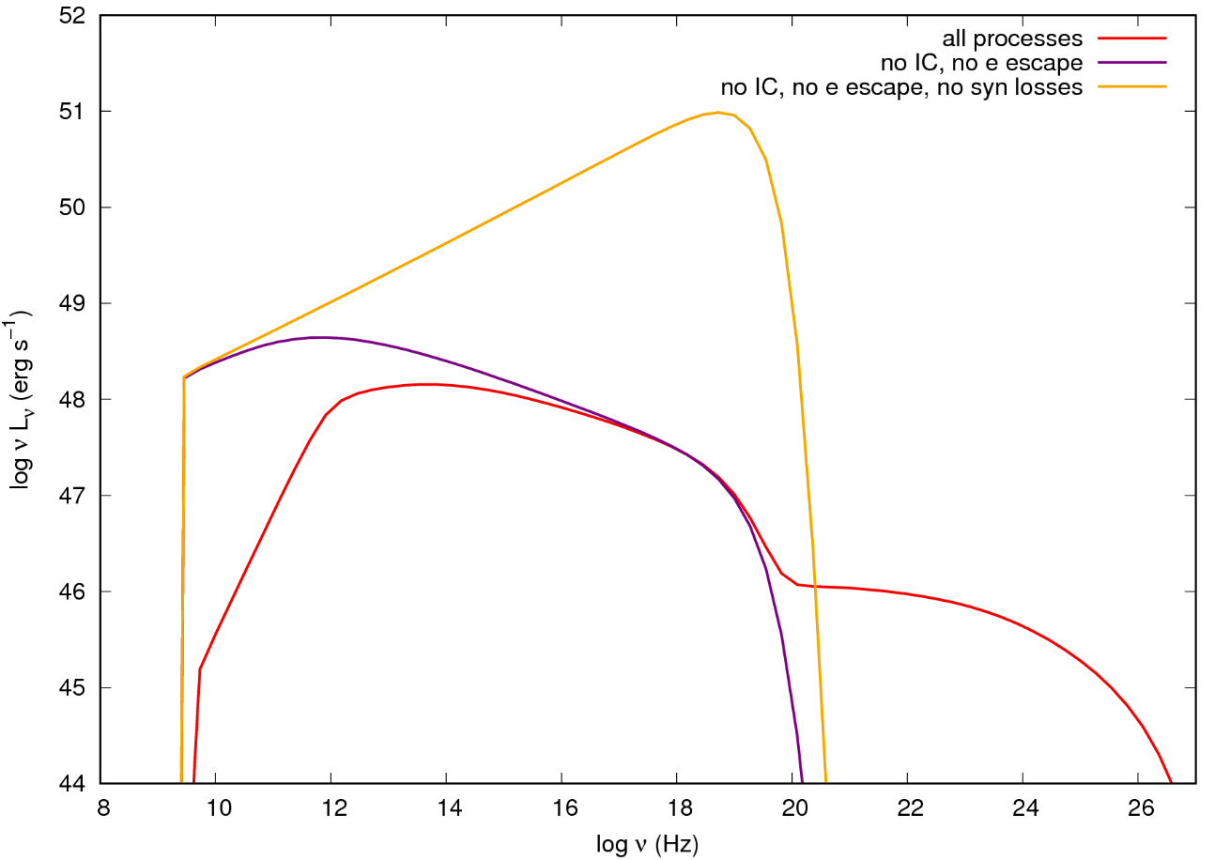
Spectral shape
MuMeNTA Athens 2-3-2026

