Slide 1

Pulsars with PINNs part 2: 3D
Ioannis Contopoulos
Research Center for Astronomy of the Academy of Athens
MuMeNTA, March 4, 2026

Slide 2
The steady-state Magnetosphere
Run a time-dependent FFE/MHD/PIC simulation starting from no rotation at t=0. Wait for 1 to 2 rotations to relax to the steady-state
(hyperbolic problem)
or
Solve directly for the steady-state
(elliptic problem)

Slide 3
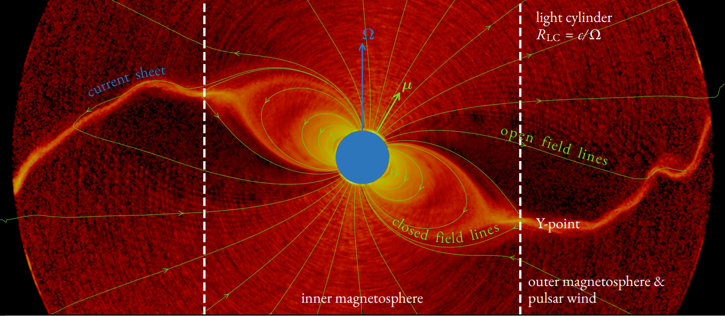
The steady-state Magnetosphere
Hakobyan, Philippov & Spitkovsky 2022

Slide 4
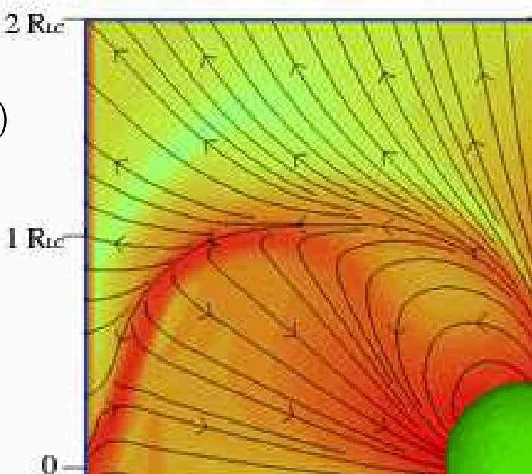
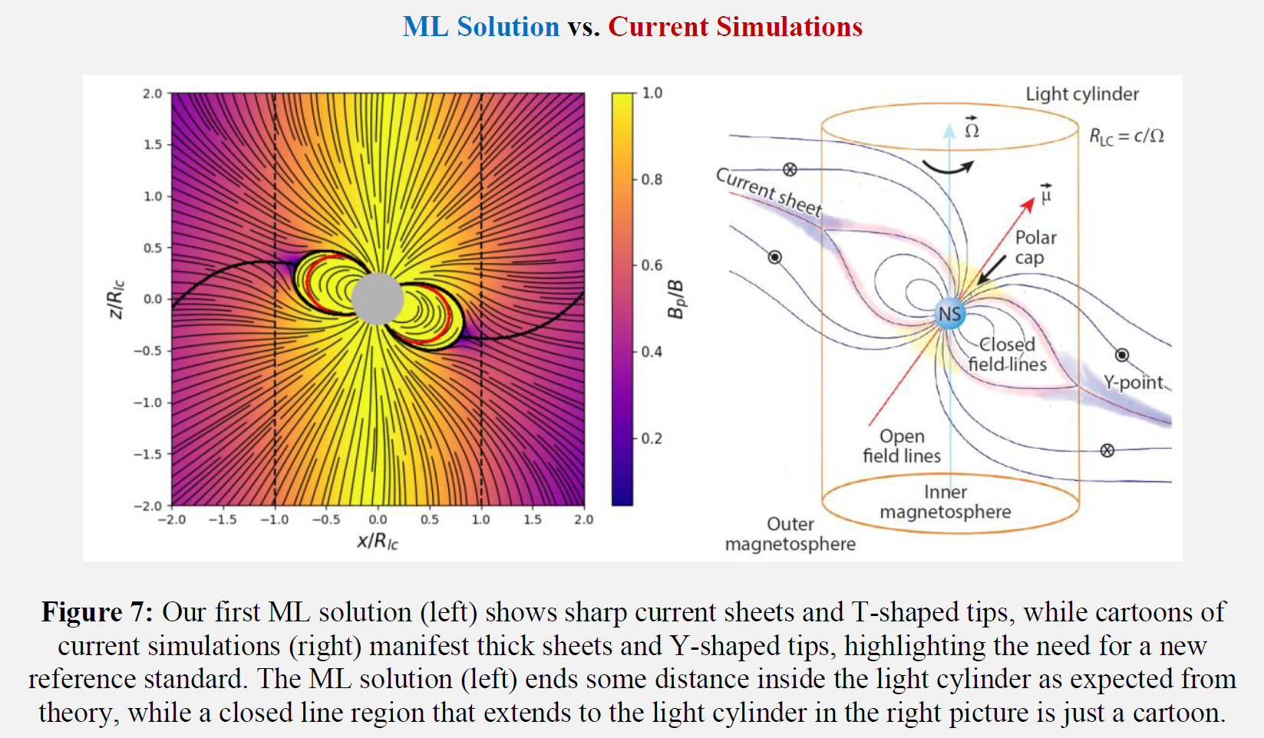
Issues
Numerical treatment of Current Sheets
Dimitropoulos et al. 2026
Spitkovsky 2006

Slide 5
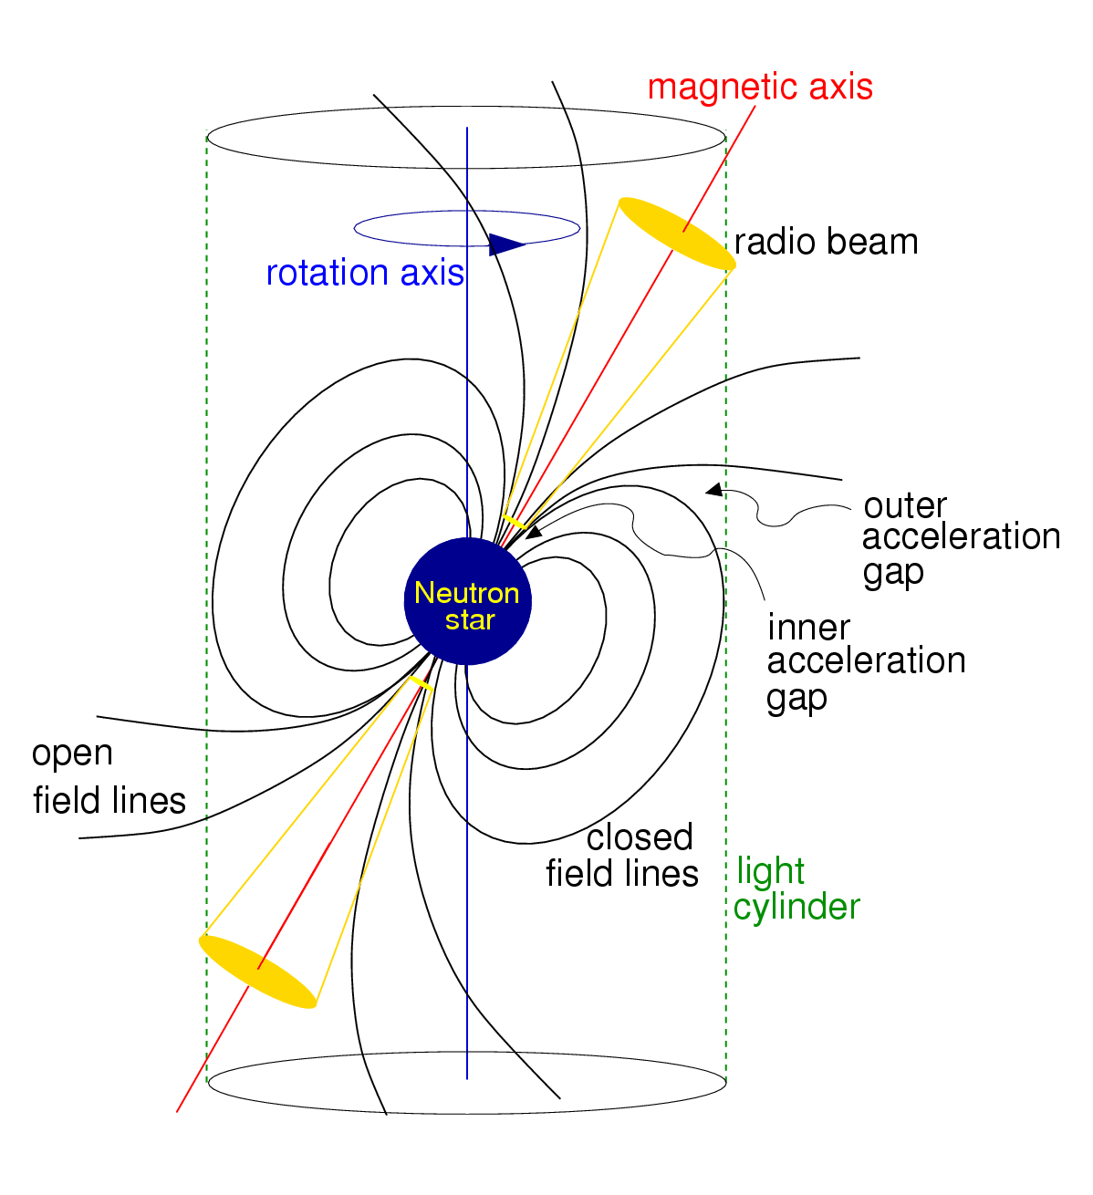
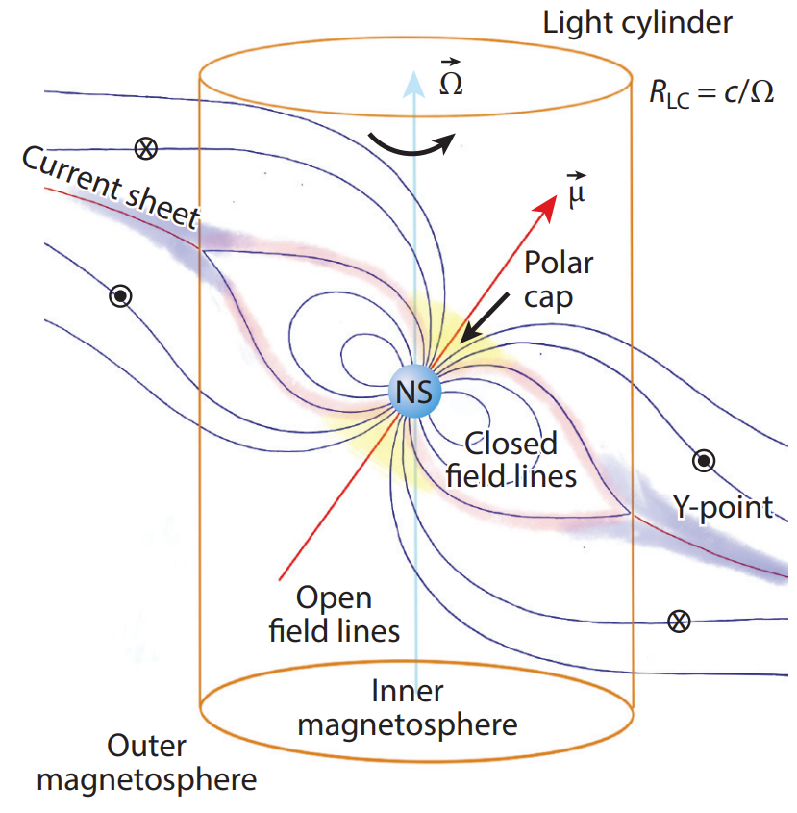
The steady-state Magnetosphere
Lorimer & Kramer 2005
“Handbook of pulsar astronomy”
Philippov & Kramer 2022
“Pulsar Magnetospheres and their Radiation”

Slide 6
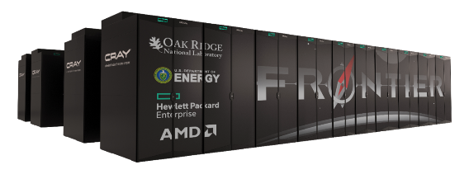
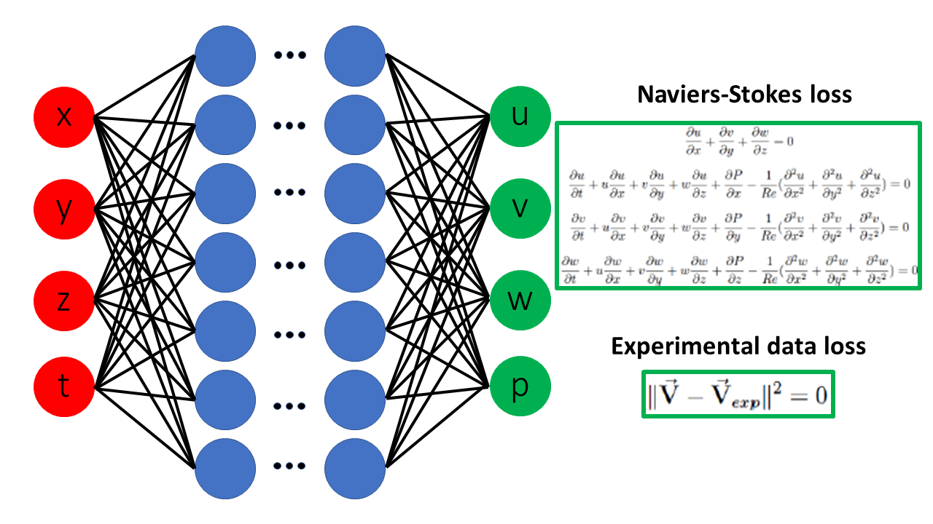

Εxascale Computing vs Neural Networks
B_{x}
B_{y}
B_{z}
The Pulsar physical Equations
Data: radio, X-ray/NICER, γ-ray
α
Petros Stefanou, Jorge Urban and Jose Pons 2023

Slide 7
Neural Networks vs current simulations
Dimitropoulos et al. 2024, 2026
Philippov & Kramer 2022

Slide 8
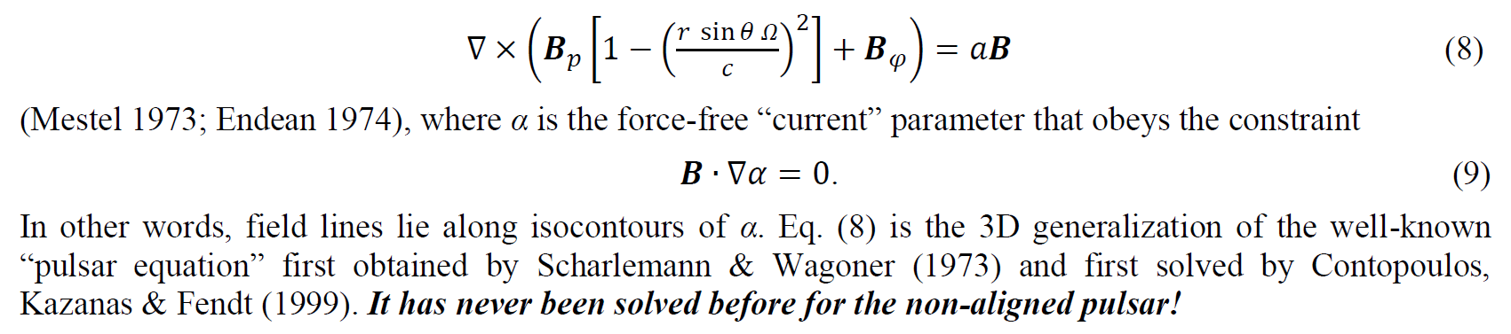
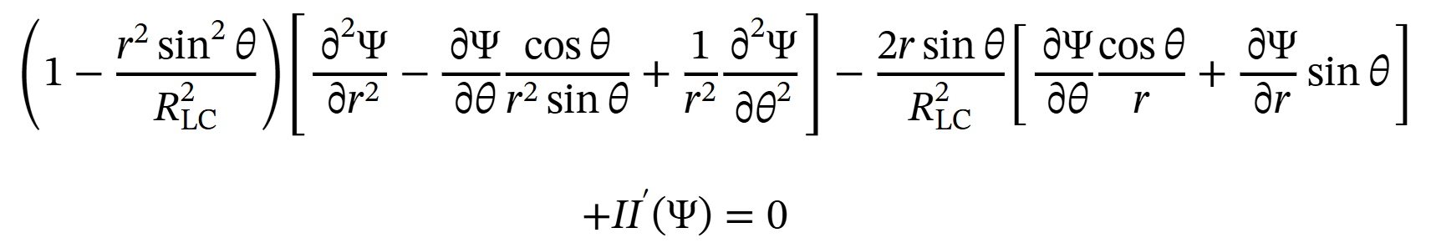
Methodology
Solve directly for the ideal force-free steady-state in the corotating frame
This is the generalization of the Pulsar Equation. It has never been solved before in 3D.
Λ
Λ

Slide 9
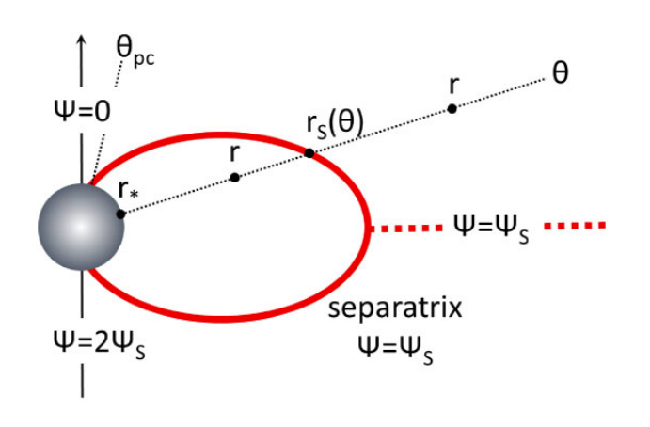
Methodology
θ_{pc},φ_{pc}
r_{S}(θ,φ)
θ,φ
Choose open lines (θ_{pc},φ_{pc})
Separate closed (IN) and open (OUT) regions
  Monopole OUT ➔equatorial CS disappears!
Solve IN, solve OUT (meshless with PINNs)
Check for pressure imbalance across separatrix
Adjust separatrix
➔Solution with pressure balance across separatrix
  Equatorial CS restored in the end

Slide 10
Physics Informed Neural Networks as Universal Function Approximators
B_{x}
The 3D Pulsar Equation
B_{y}
Boundary conditions
B_{z}
Data: radio, X-ray/NICER, γ-ray
α
Dimitropoulos et al. 2026

Slide 11
Physics Informed Neural Networks as Universal Function Approximators
B_{x}
The 2D Pulsar Equation
r
Ψ
θ
B_{y}
Ι
Boundary conditions
B_{z}
Data: radio, X-ray/NICER, γ-ray
α
Dimitropoulos, Contopoulos, Mpisketzis, Chaniadakis 2024
Stefanou, Urban, Pons 2023

Slide 12
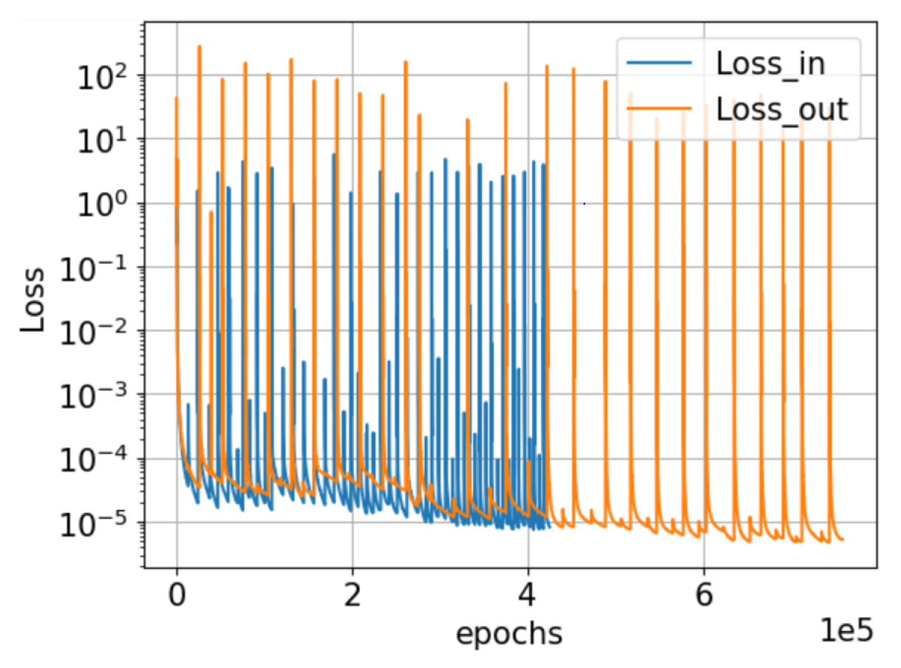
Dimitropoulos et al. 2026

Slide 13
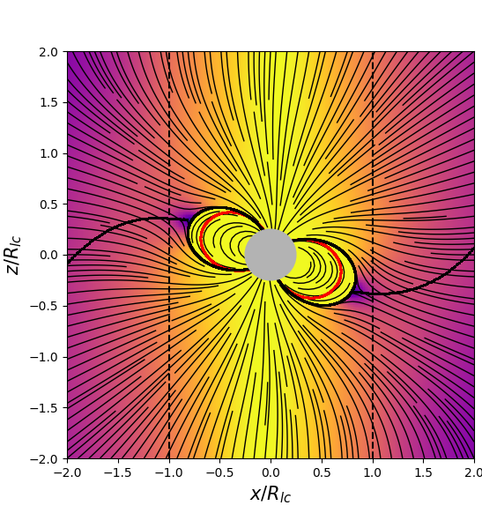
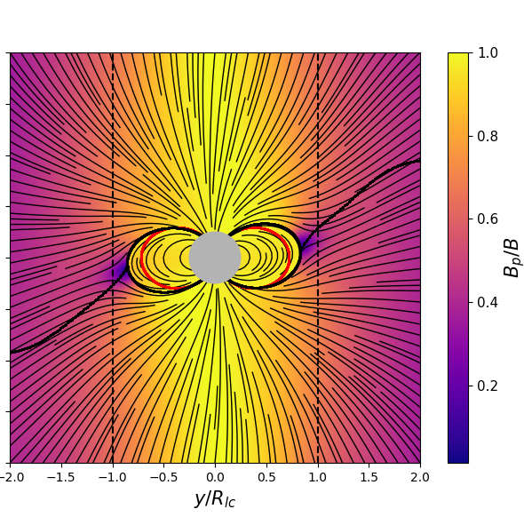
Inclination 20º, polar cap 36º
Dimitropoulos et al. 2026

Slide 14
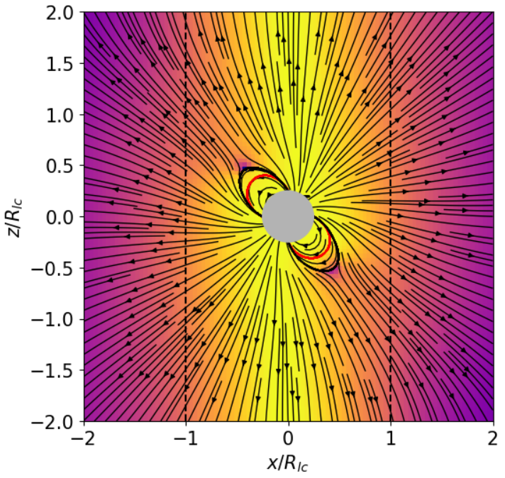
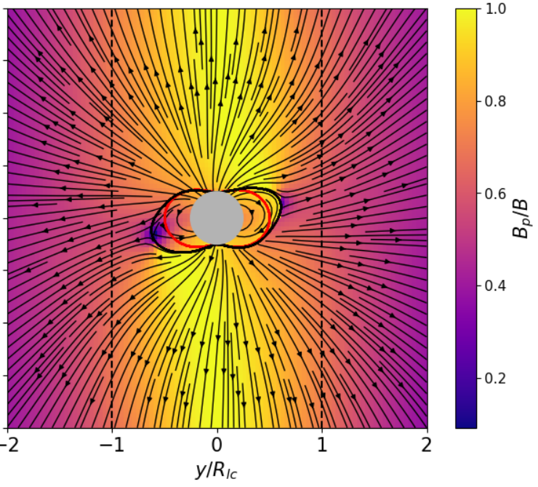
Inclination 45º, polar cap 45º
Dimitropoulos et al. 2026 (in preparation)

Slide 15
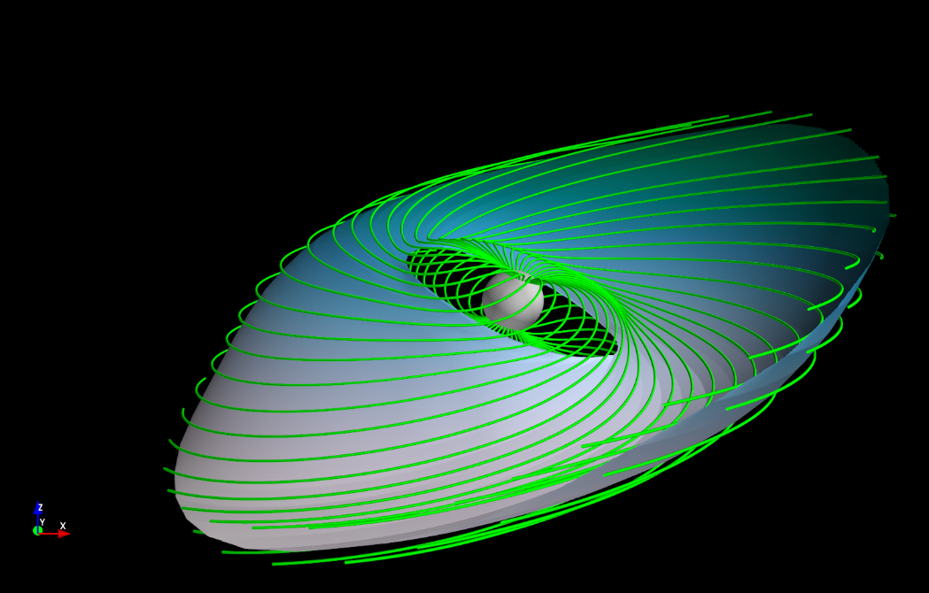
Dimitropoulos et al. 2026

Slide 16
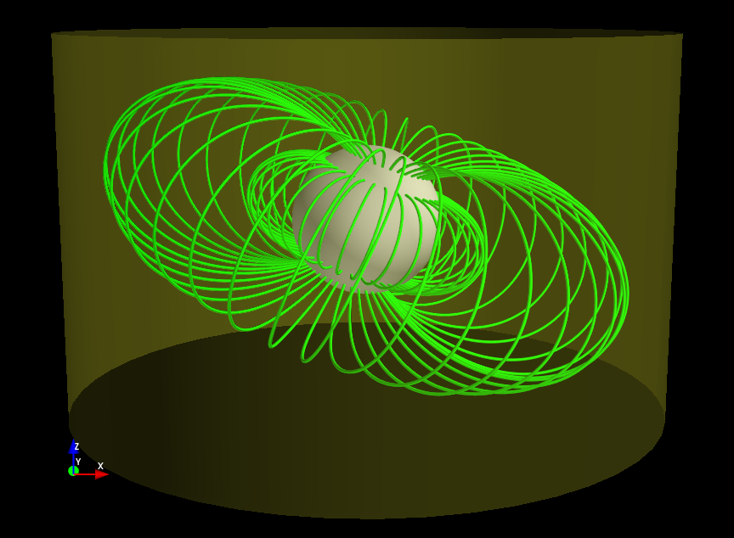
Dimitropoulos et al. 2026

Slide 17
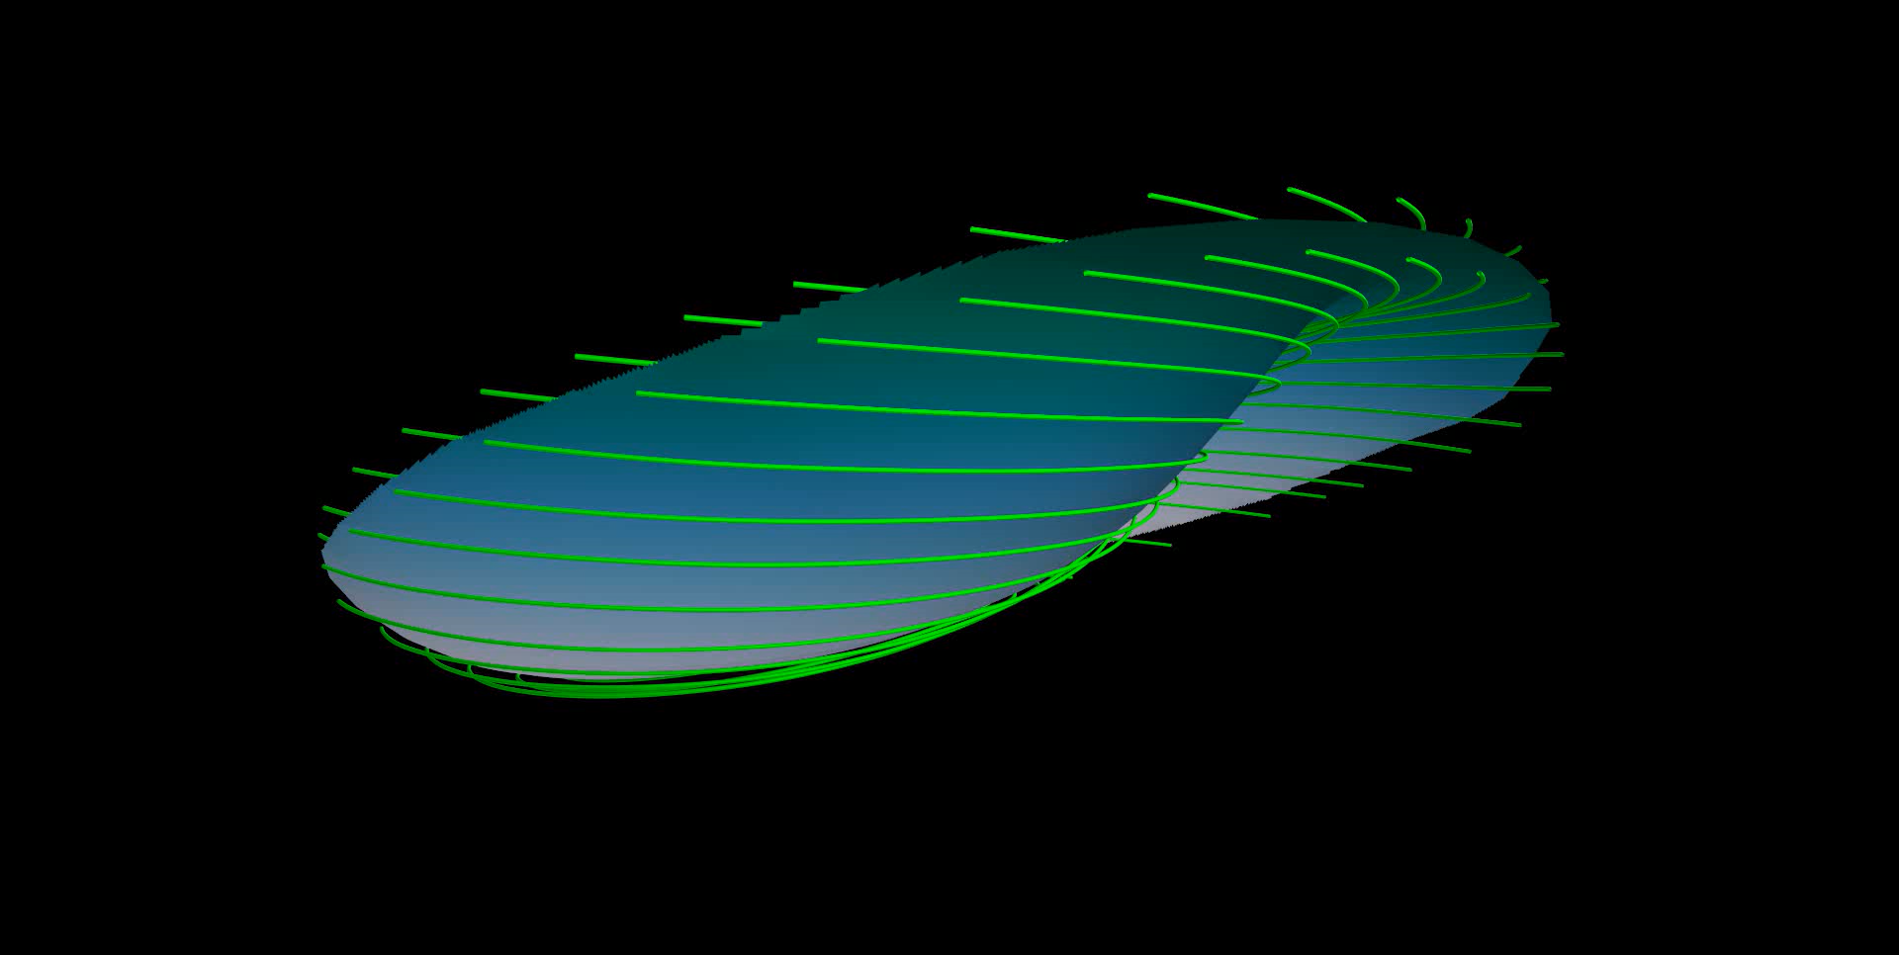
Dimitropoulos et al. 2026

Slide 18
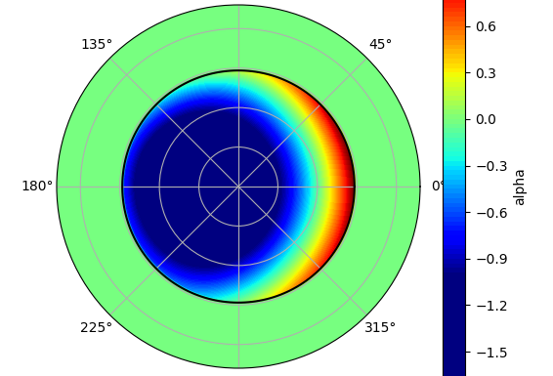
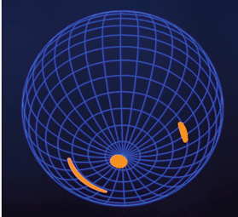
Electric current supply 20º
Dimitropoulos et al. 2026

Slide 19
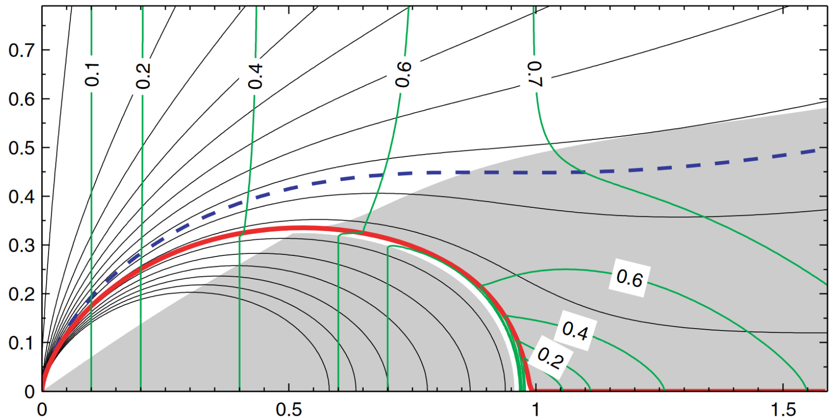
Electric current supply
e⁻
e⁻
e⁻
e⁻ e⁺
e⁻ e⁺
Timokhin 2006
Contopoulos 2019; Contopoulos & Stefanou 2019; Contopoulos, Petri & Stefanou 2019

Slide 20
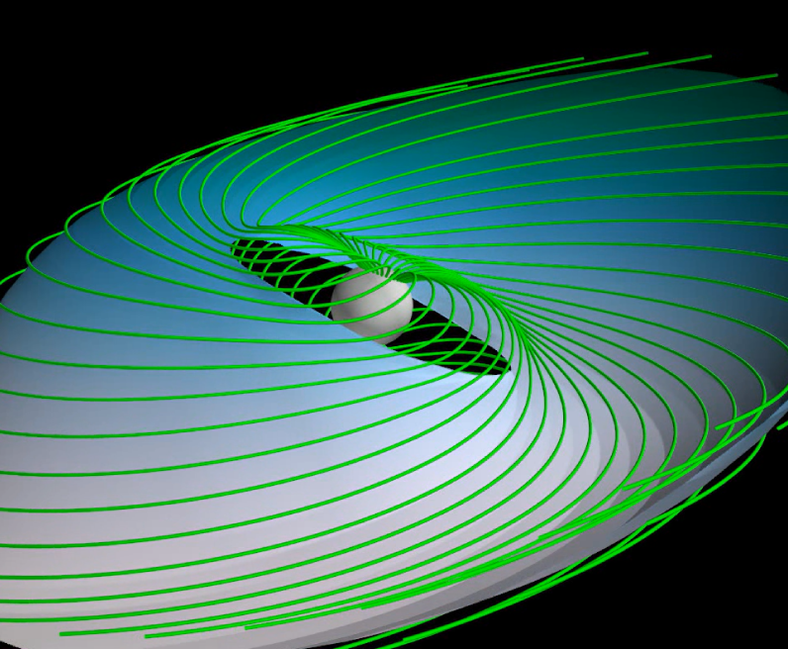
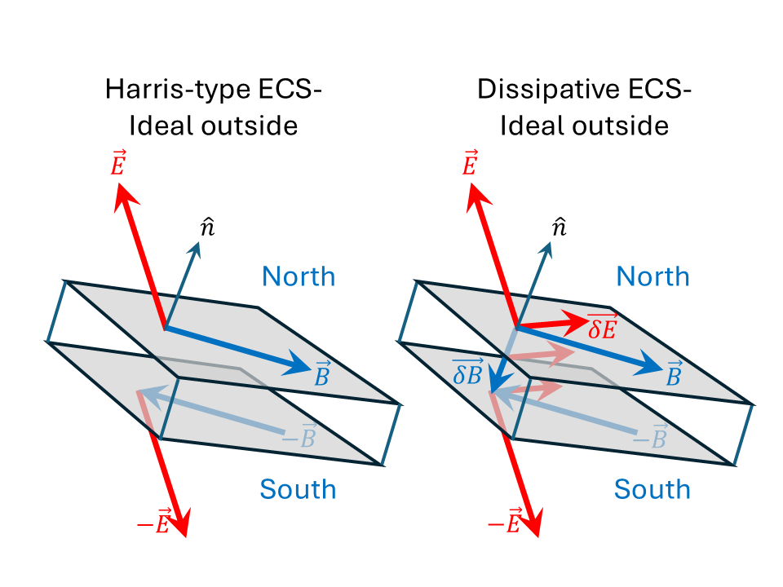
Radiation from the Equatorial CS

Slide 21
Contopoulos et al. 2026 (submitted)

Slide 22
Contopoulos et al. 2026 (submitted)

Slide 23
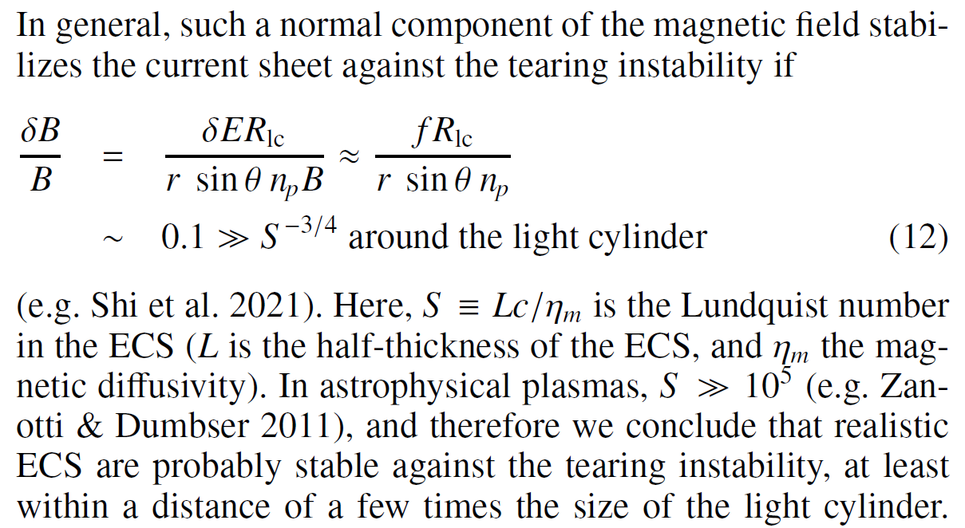
The Equatorial CS is stable!
Global PIC CSs are unstable: S ~ Lc/(δx 0.1c) = 10 L/δx ~ 10
Contopoulos et al. 2026 (submitted)

Slide 24
Radiation from the Equatorial CS
Reconnection at 0.1c
Radiation-reaction limit
with realistic magnetic fields
and realistic Lorentz factors
→ Curvature radiation 2 GeV γ-rays
→ Fundamental plane (Κalapotharakos et al. 2019)
→ Sky maps (light curves for various observation angles)

Slide 25
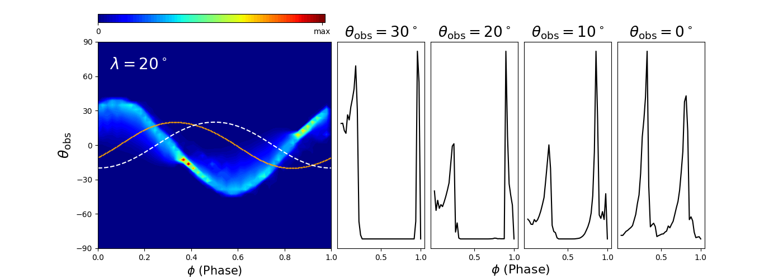
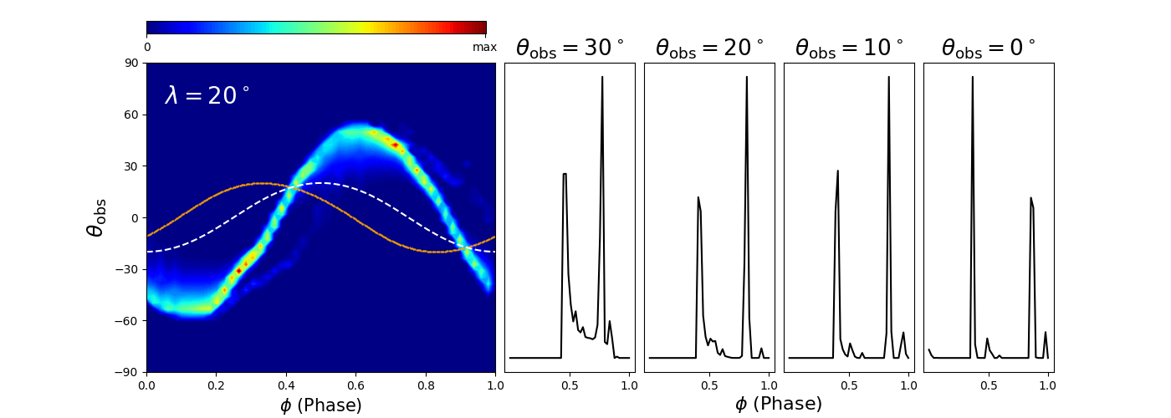
positrons
δΕ x δB/δE² + β δΕ
electrons
δΕ x δB/δE² - β δΕ
Contopoulos et al. 2026 (submitted)

Slide 26
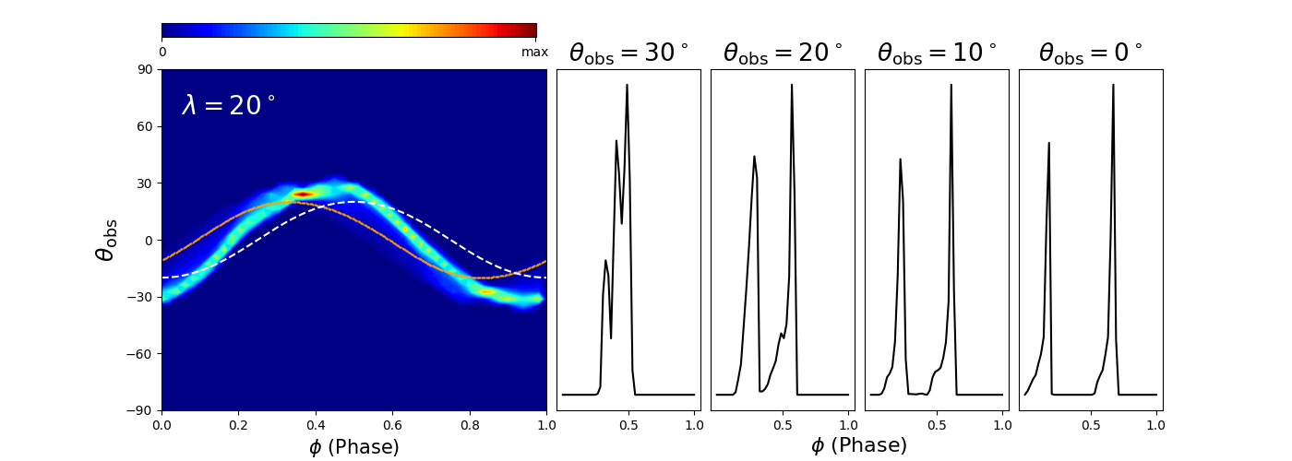
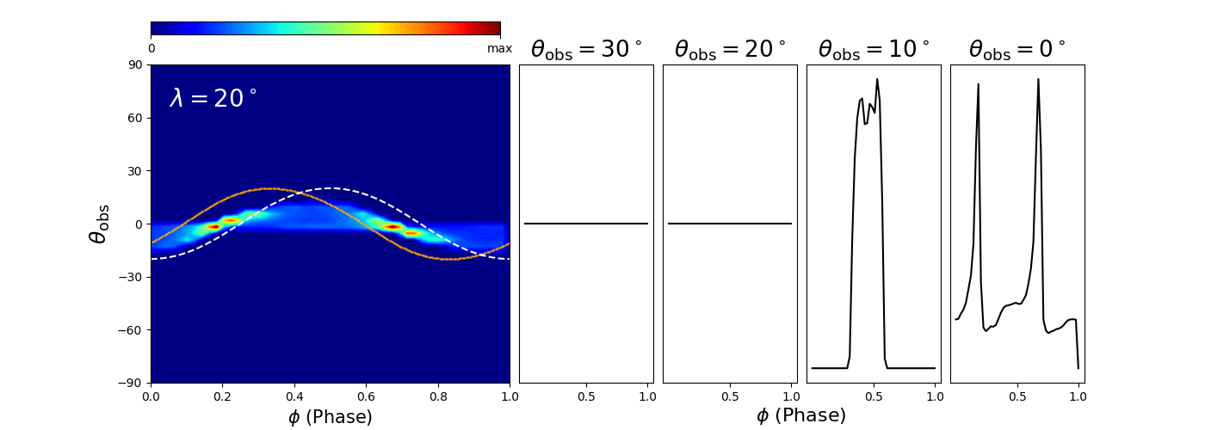
ΕxB/B² + β’B
ΕxB/B² ⁻ β’B
Contopoulos et al. 2026 (submitted)

Slide 27
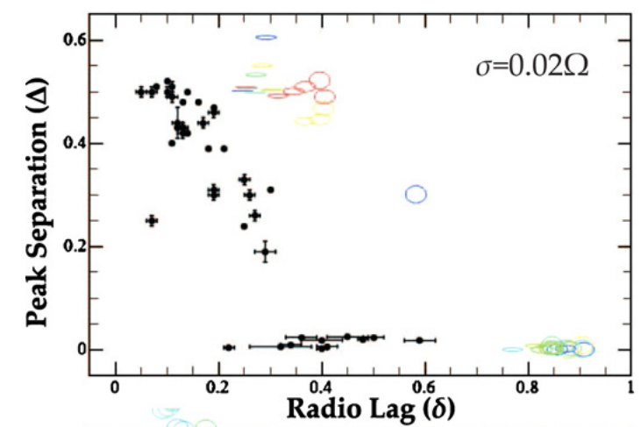
positrons
δ
Δ
δ
Δ
δΕ x δB/δE² + β δΕ
Contopoulos et al. 2026 (submitted)

Slide 28
positrons
δΕ x δB/δE² + β δΕ
Δ
δ
Contopoulos et al. 2026 (submitted)

Slide 29
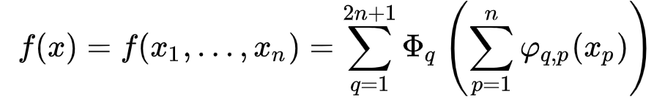
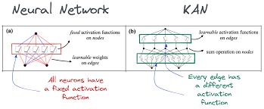
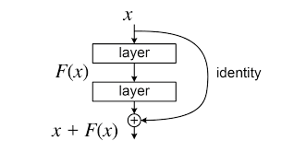
The NN field advances very fast!
Kolmogorov-Arnold Networks (KAN)
(KART)
Residual NNs
JAX

Slide 30
Thank you
for your attention

Slide 31
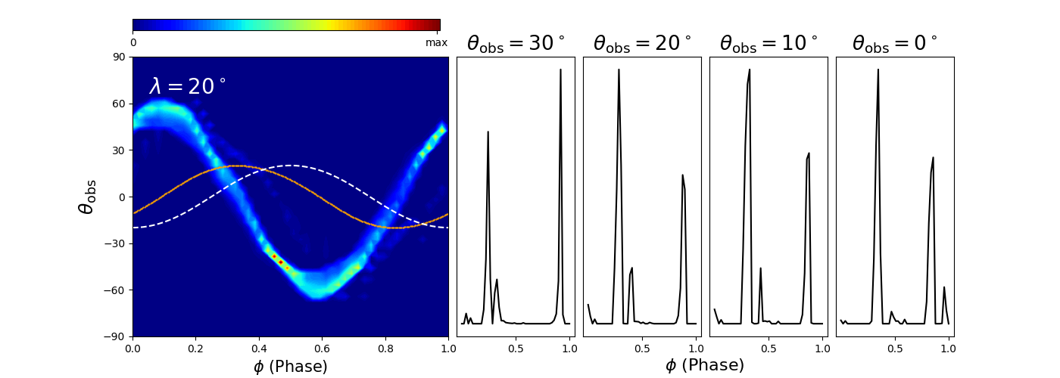
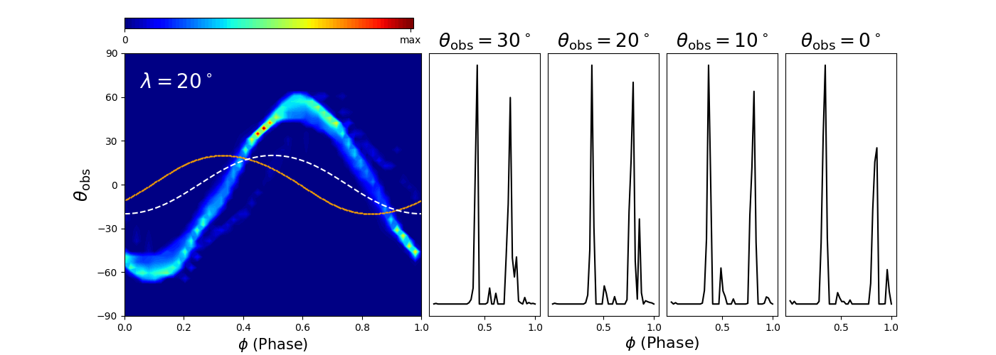
positrons
δΕ
electrons
electrons
-δΕ
Contopoulos et al. 2026 (submitted)

