Slide 1




From Spherical Cows to Asymmetric Dinosaurs
Astrophysical Jets and a New Approach to Modelling their Emissions
Christopher Everett
Garret Cotter
in collaboration with Marc Klinger-Plaisier

Slide 2
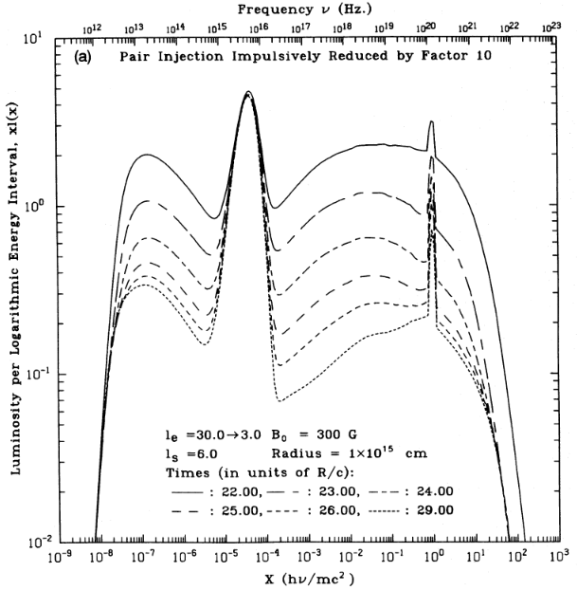
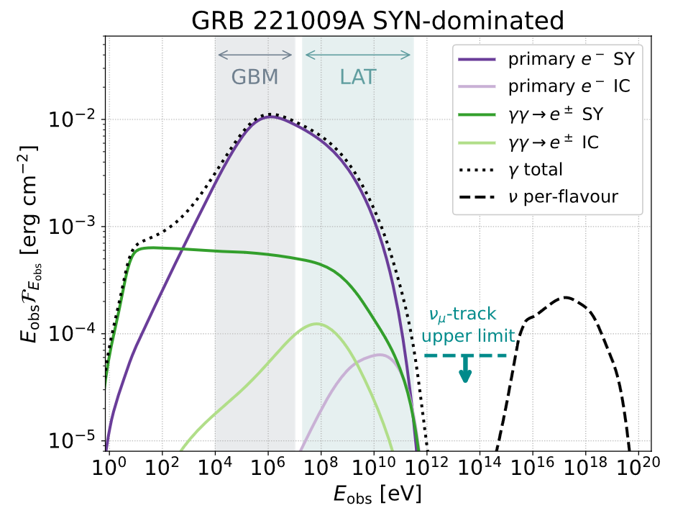
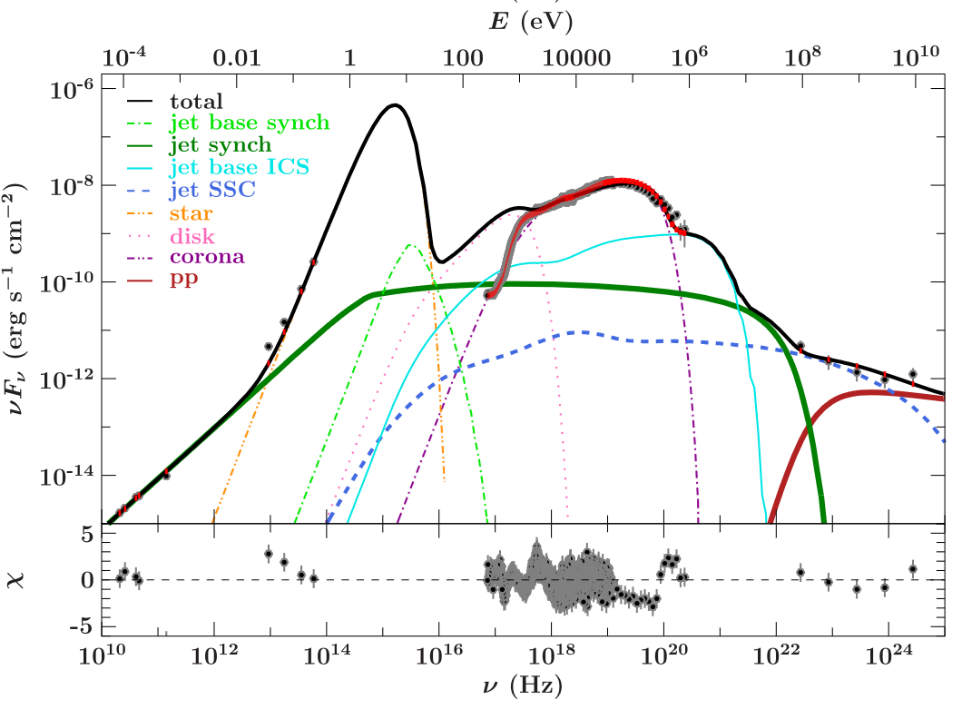
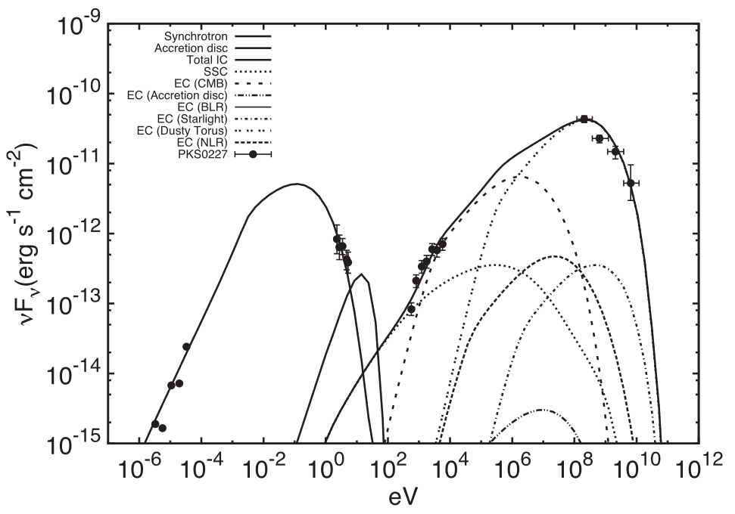
Coppi 1992
Klinger et al.
2024
Potter+Cotter
2013
Kantaz et al.
2021

Slide 3
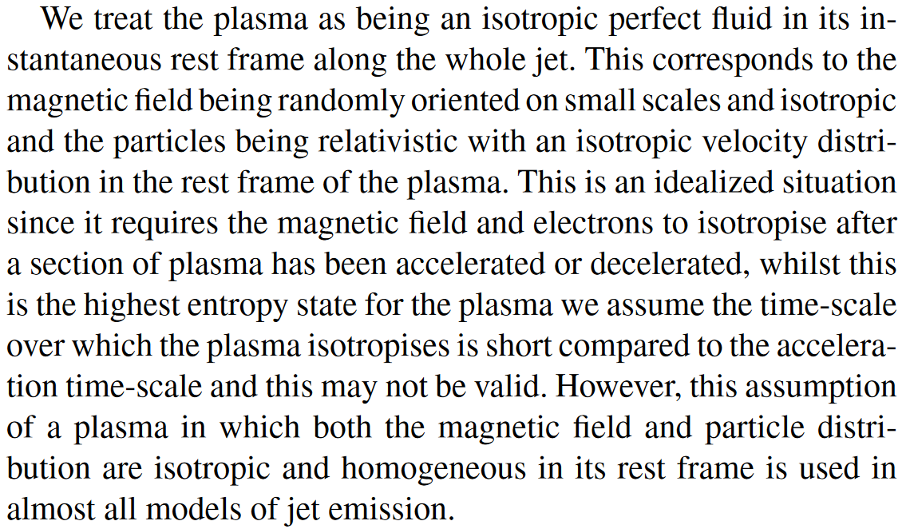
...
...
Potter+Cotter 2013

Slide 4
True
True
B
Parameter
A
Flux
A: Iso
B: NOT iso

Slide 5
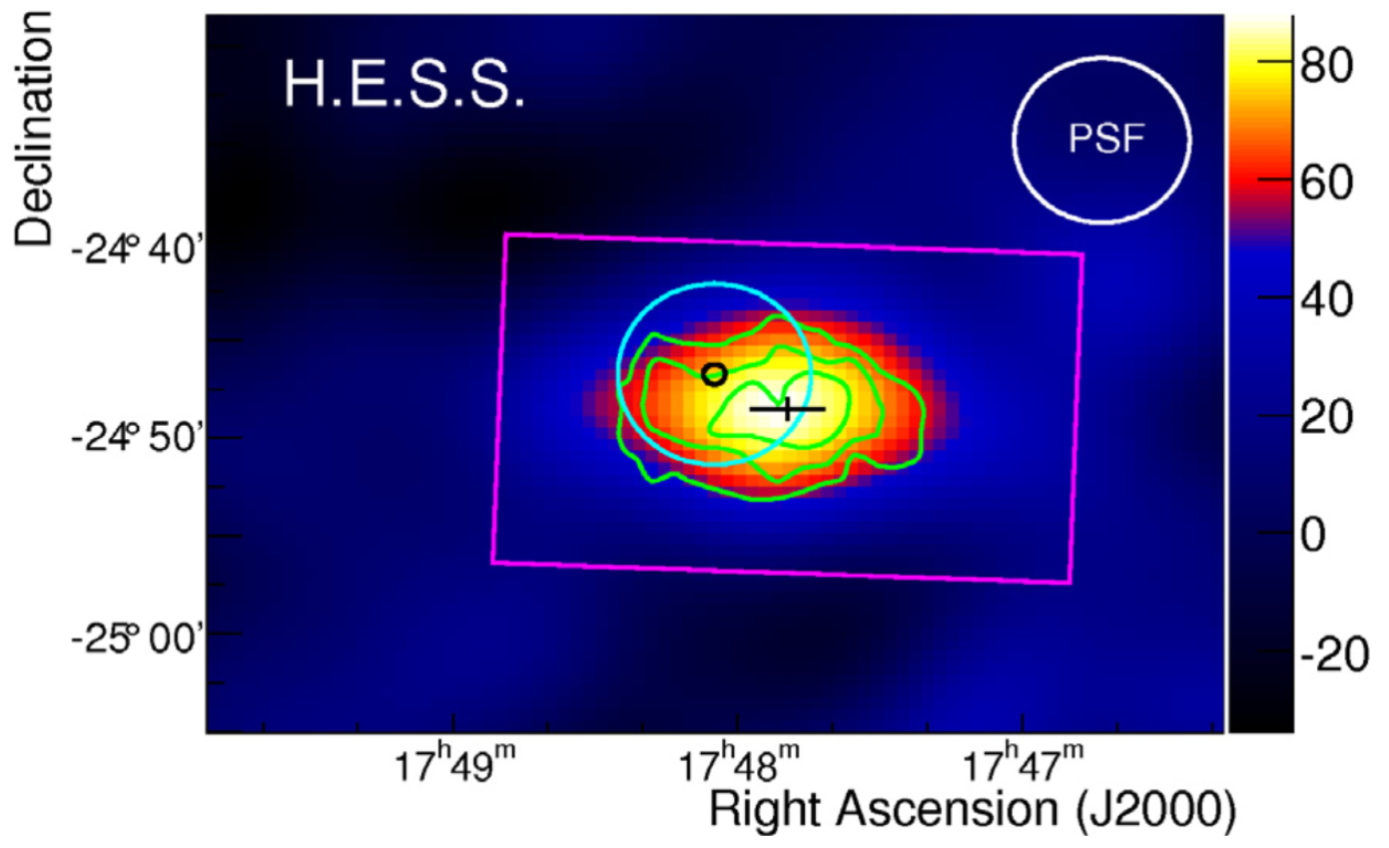
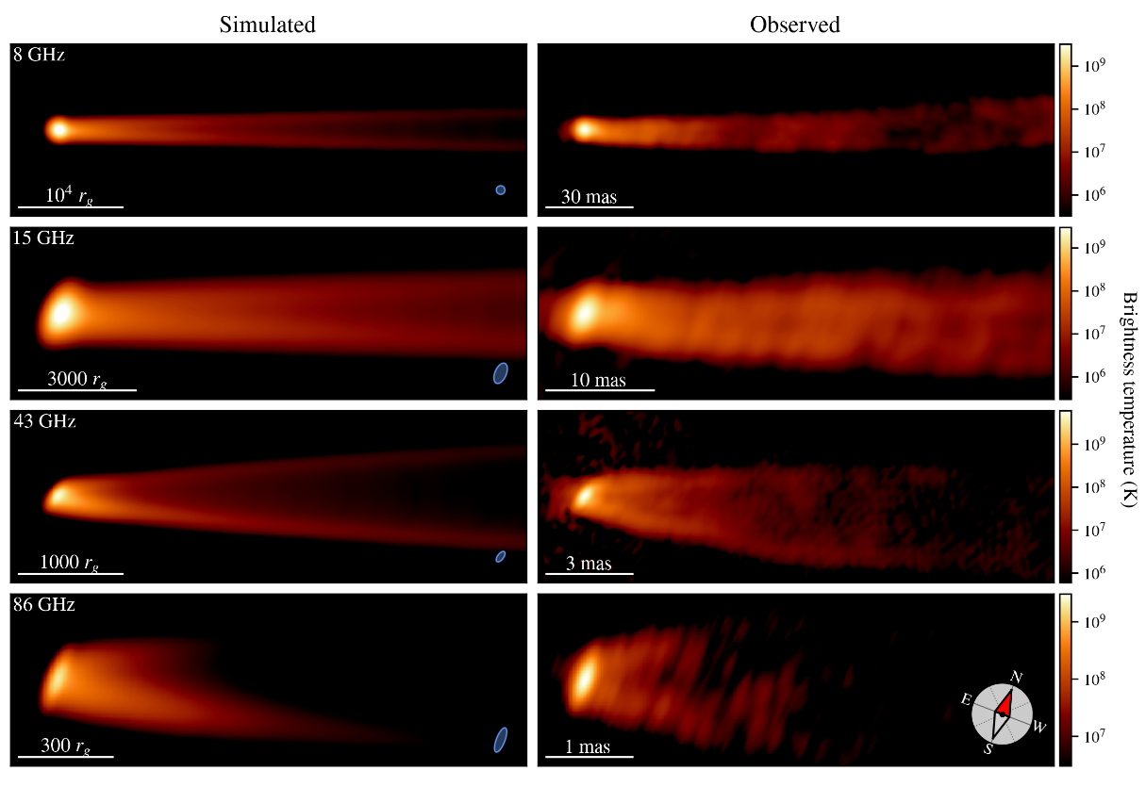
Tsunetoe et al. 2025
HESS Collaboration 2011
Krumholz et al. 2024

Slide 6
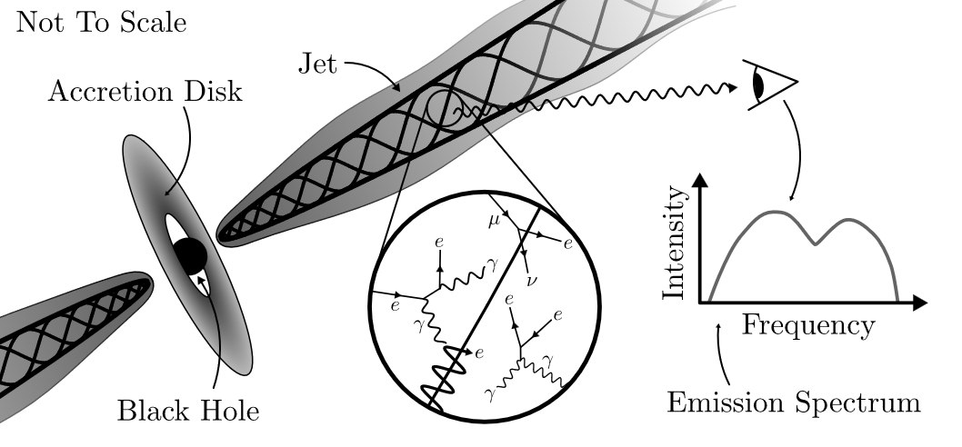
The goal:
AGN jet model, capturing both asymmetric small- scale interactions and large-scale structure

Slide 7

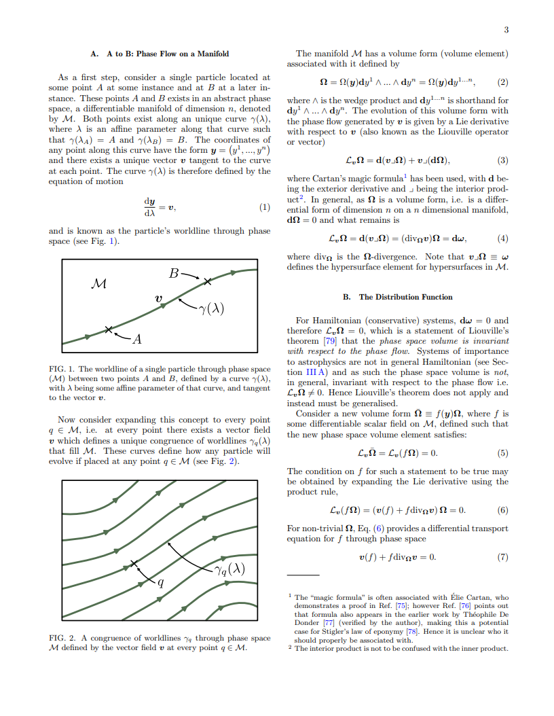
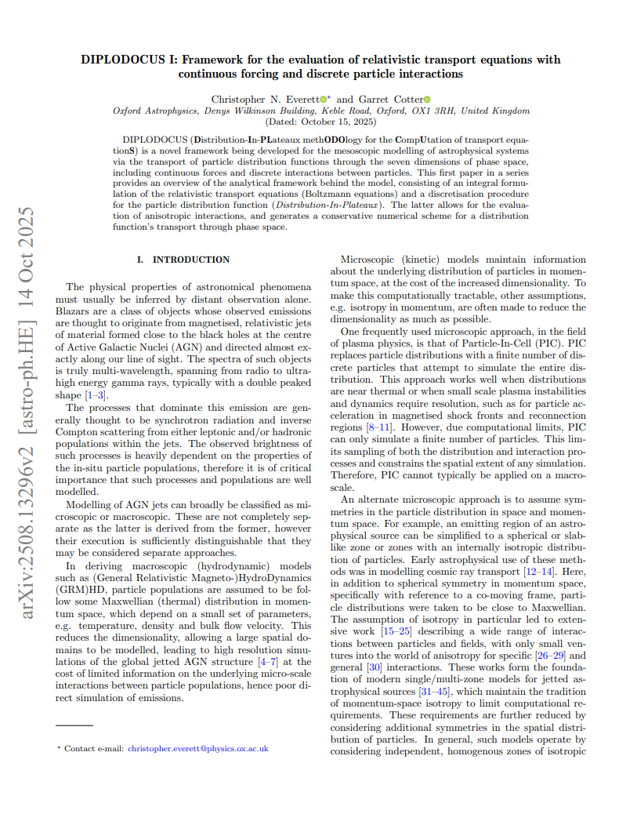
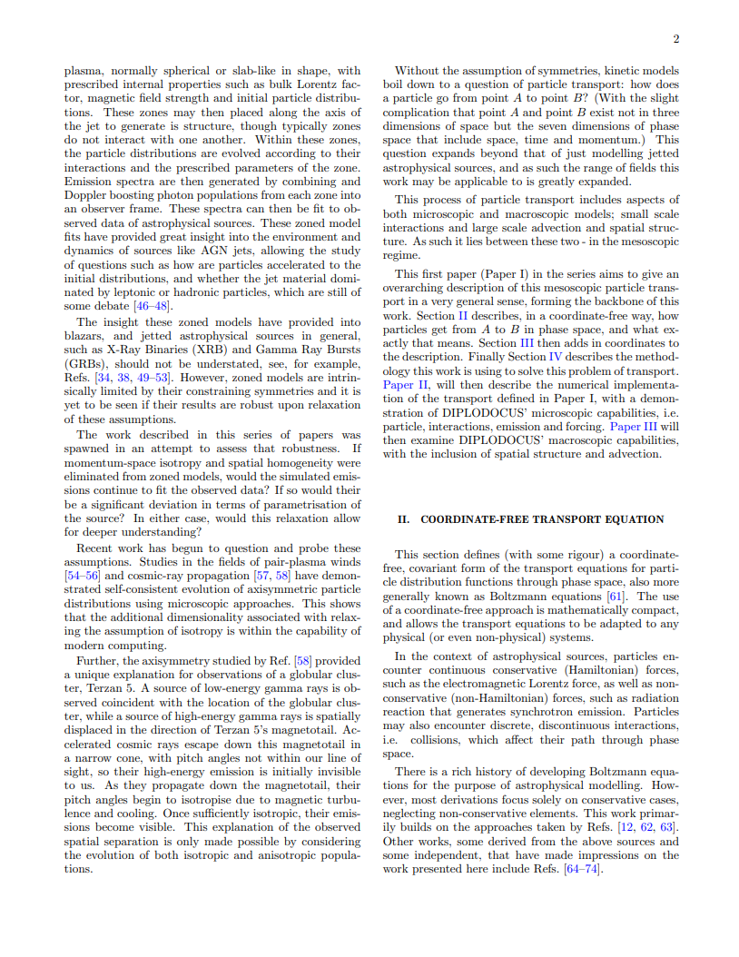

DIPLODOCUS
Distribution-In-Plateaux
methODOlogy for the CompUtation
of transport equationS
Anisotropic collisions
arbitrary forces
general spacetimes

Slide 8
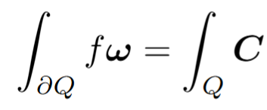
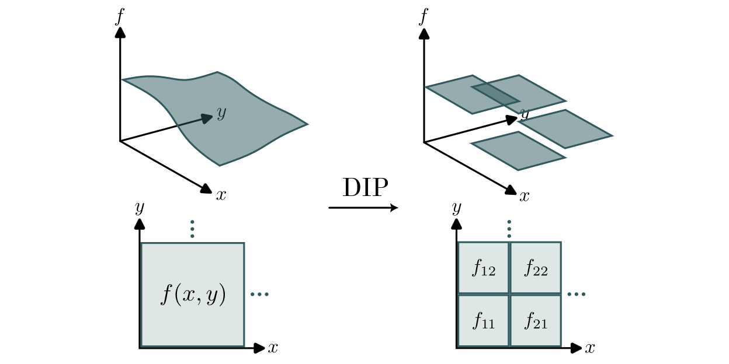
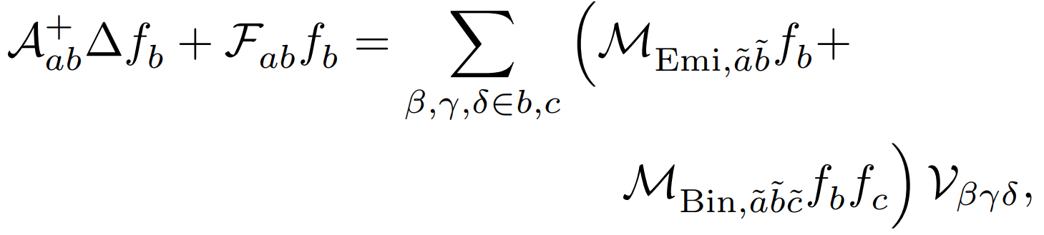

Distribution-in-Plateaux
DIP
Diplodocus.jl

Slide 9
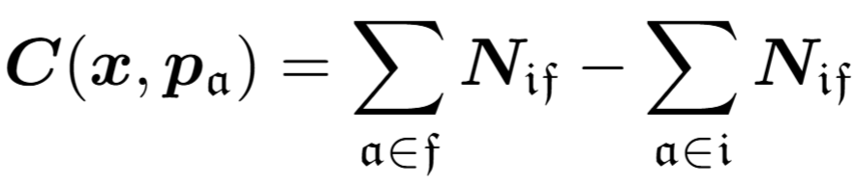
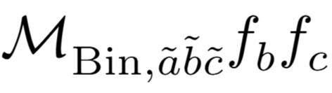
Horrible!
Probability of a collision
Density of particles able to collide
Integrate over each particle

Slide 10
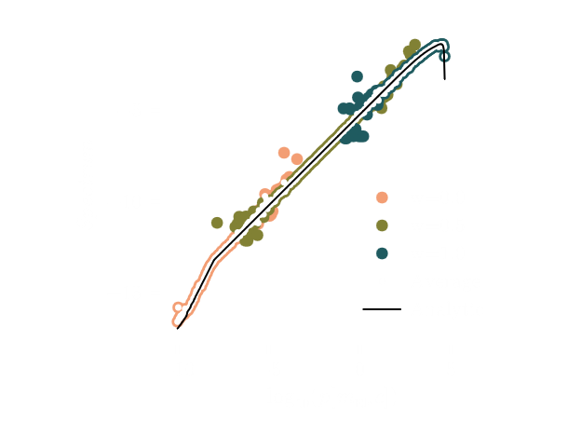
Novel MC Importance sampling:
no approximations or numerical
inversion of cross sections
Covers whole spectrum
Conserves particle number
and energy
Emission Rate [Arb. Units]
Based on the idea that Particles more likely scatter in the direction of the centre-of-momentum frame

Slide 11
Particle Interactions
Advection and
Structure
PIC
Zoned-Models
GRMHD
Force-Free
Diplodocus
Microscopic
Mesoscopic
Macroscopic

Slide 12
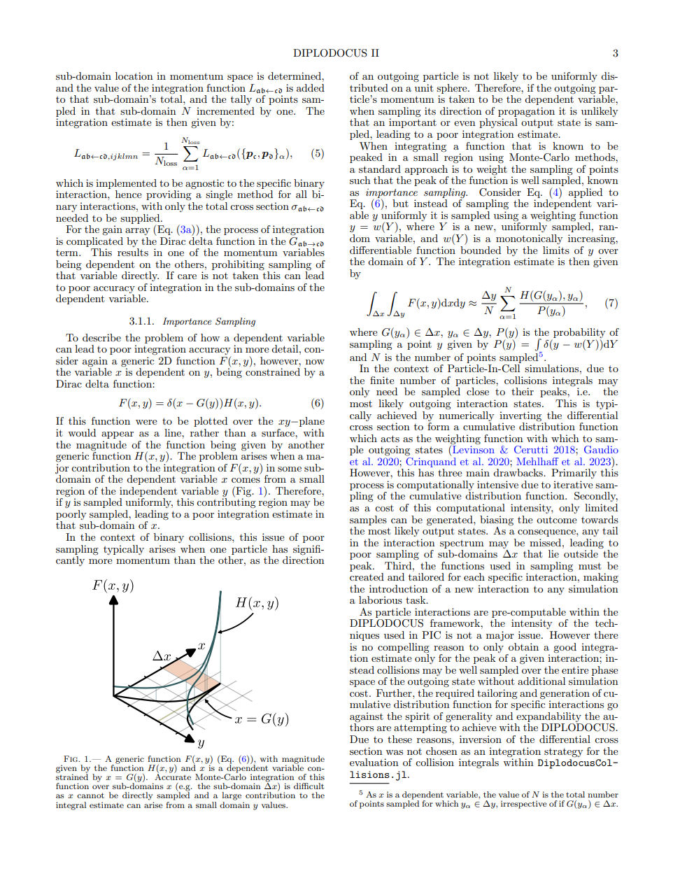
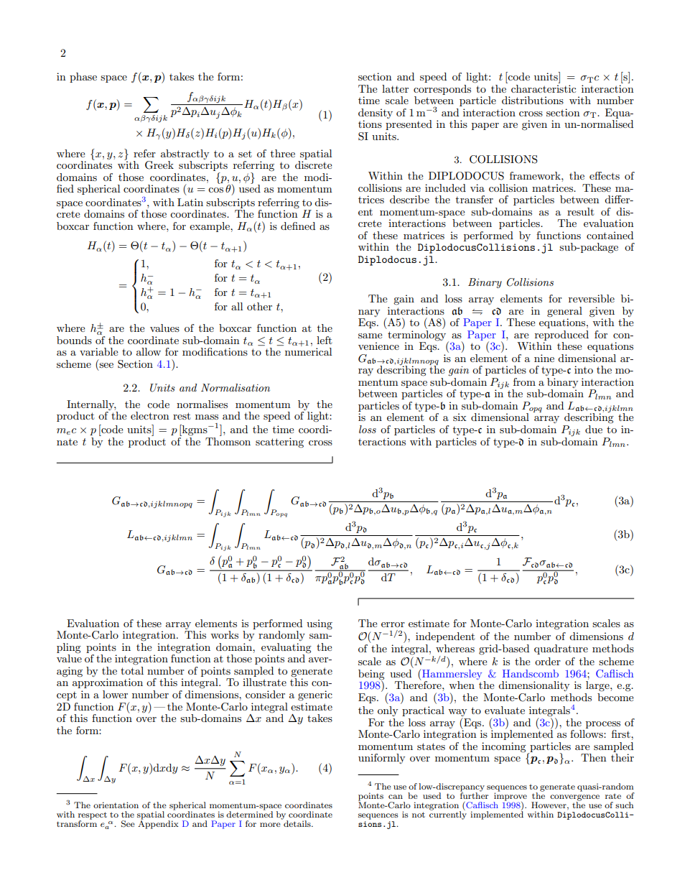
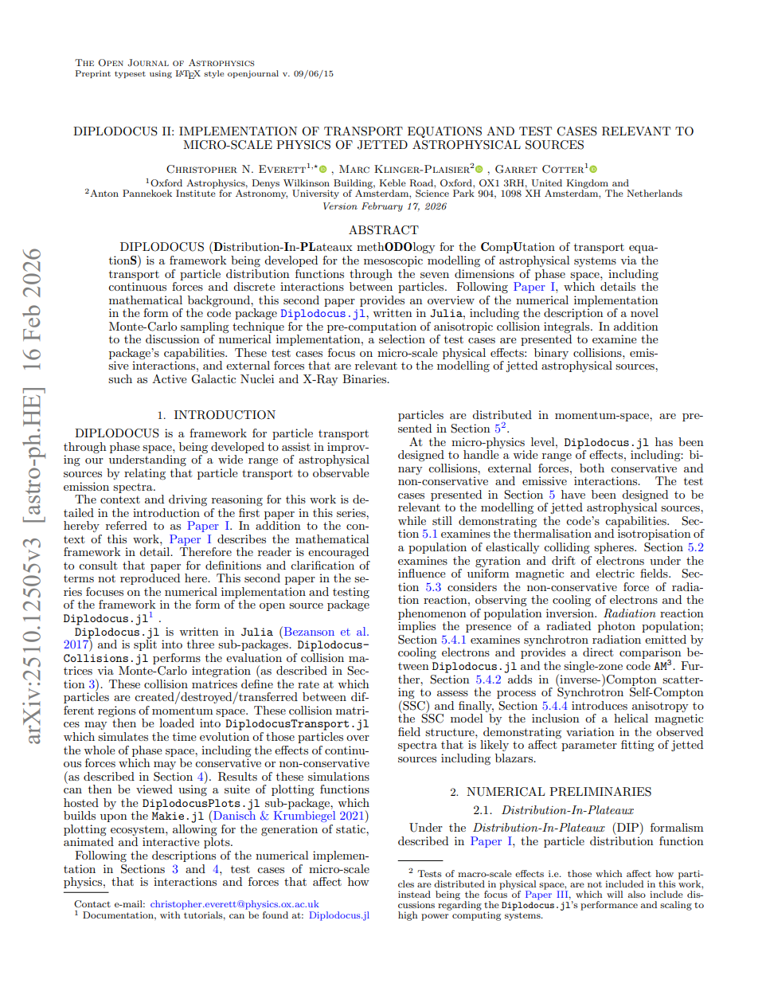

v0.1 - Micro
Anisotropic interactions
General forces
Arbitrary spacetimes
No spatial advection
4 out of 7 Dimensions
Runs on CPU
High memory load

Slide 13
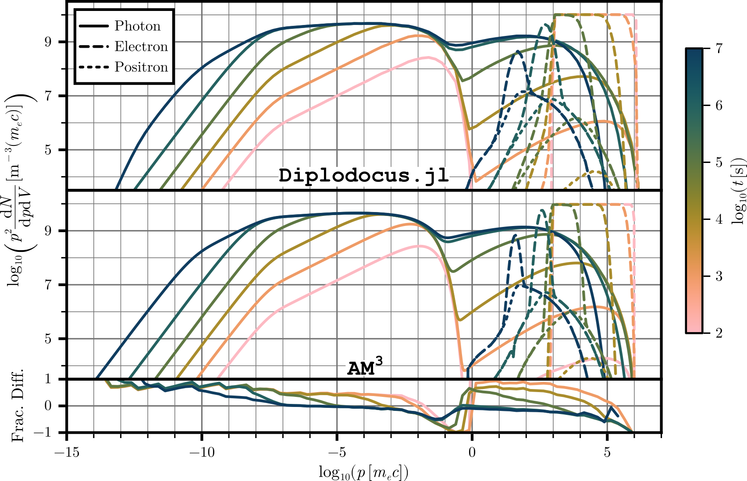
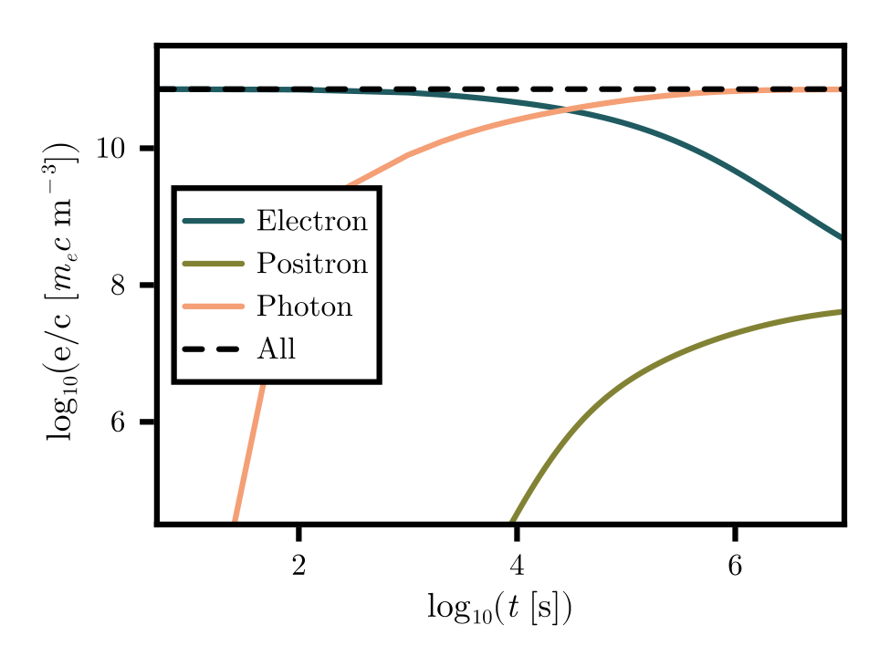


v0.1
SSC with Pair Production:
Spherical Zone
Initial power-law of electrons
$$J_{n},J_{n}^{′}$$
$$K_{1/3},K_{2/3}$$

Slide 14
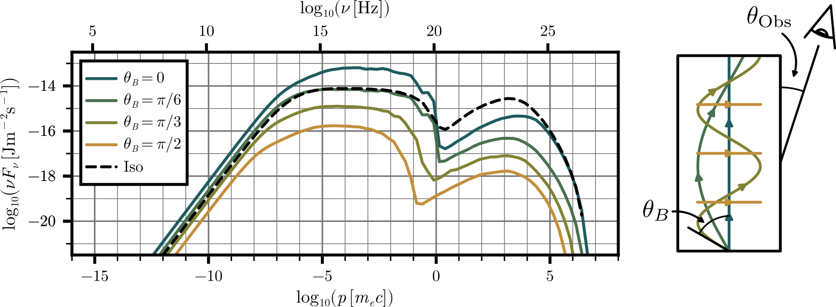
SSC with Helical Field:
Cylindrical Zone
Initial boosted power-law of electrons
Different B-Field pitch angles
v0.1
Magnetic field structure significantly affects observed spectrum

Slide 15
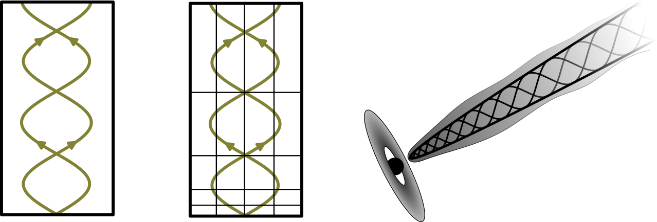

Asymmetric jet?
v0.1
Cylindrical
Single-Zone
$B=Const.$
$$θ_{B}≠Const.$$

Slide 16
v0.2 – Everything*
Anisotropic interactions
General forces
Arbitrary spacetimes
Full spatial advection
7 out of 7 dimensions
Runs on CPU and GPU**
Reduced memory load
*within reason
**Early testing indicate at least
10x speedup

Slide 17

Asymmetric jet?
v0.1
v0.2 Current
v0.2 In Dev.
Cylindrical
Single-Zone
$B=Const.$
$$θ_{B}≠Const.$$
Cylindrical
Multi-Zone
$B≠Const.$
$$θ_{B}≠Const.$$
“Real” Force-Free Geometry
e.g. BZ 1977,
Blandford 1976

Slide 18
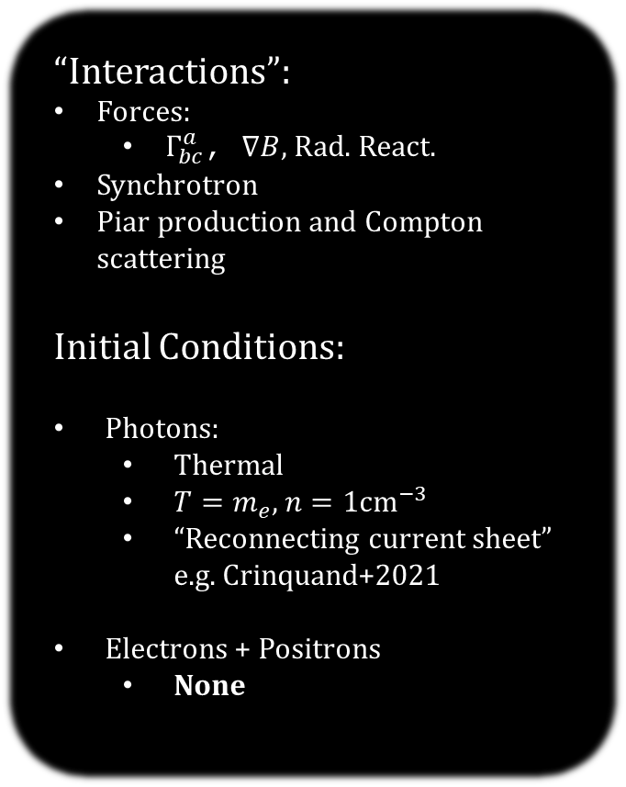
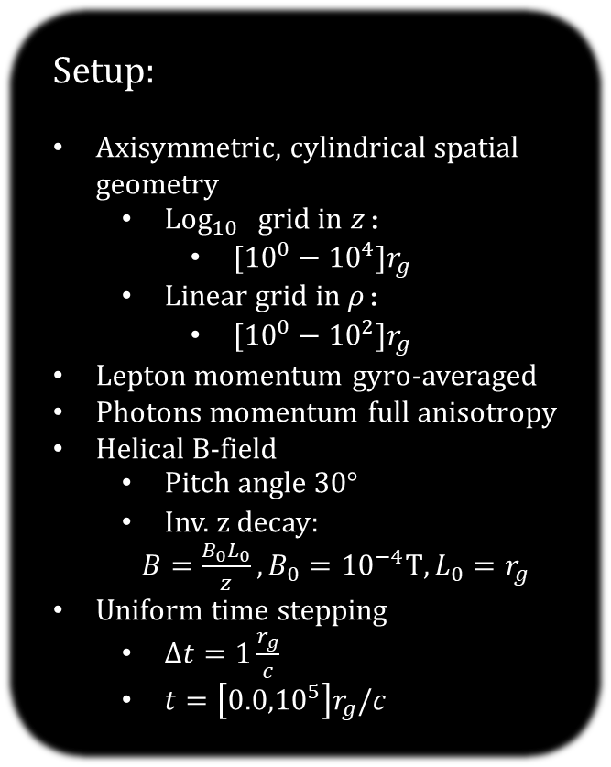
Setup:
Axisymmetric, cylindrical spatial geometry
  $Log_{10}$ grid in $z$:
    $[{10}^{0}−{10}^{4}]r_{g}$
  Linear grid in $ρ$:
    $[{10}^{0}−{10}^{2}]r_{g}$
Lepton momentum gyro-averaged
Photons momentum full anisotropy
Helical B-field
  Pitch angle $30°$
  Inv. z decay:
  $B=\frac{B_{0}L_{0}}{z}, B_{0}={10}^{−4}T, L_{0}=r_{g}$
Uniform time stepping
  $Δt=1\frac{r_{g}}{c}$
  $t=\left[{0.0,10}^{5}\right]r_{g}/c$
10⁴
“Interactions”:
Forces:
  $Γ_{bc}^{a}$, $∇B$, Rad. React.
Synchrotron
Piar production and Compton scattering
Initial Conditions:
Photons:
  Thermal
  $T=m_{e}$, $n=1cm^{−3}$
  “Reconnecting current sheet” e.g. Crinquand+2021
Electrons + Positrons
  None
10³
10²
10¹
10⁰
Photon inj.

Slide 19
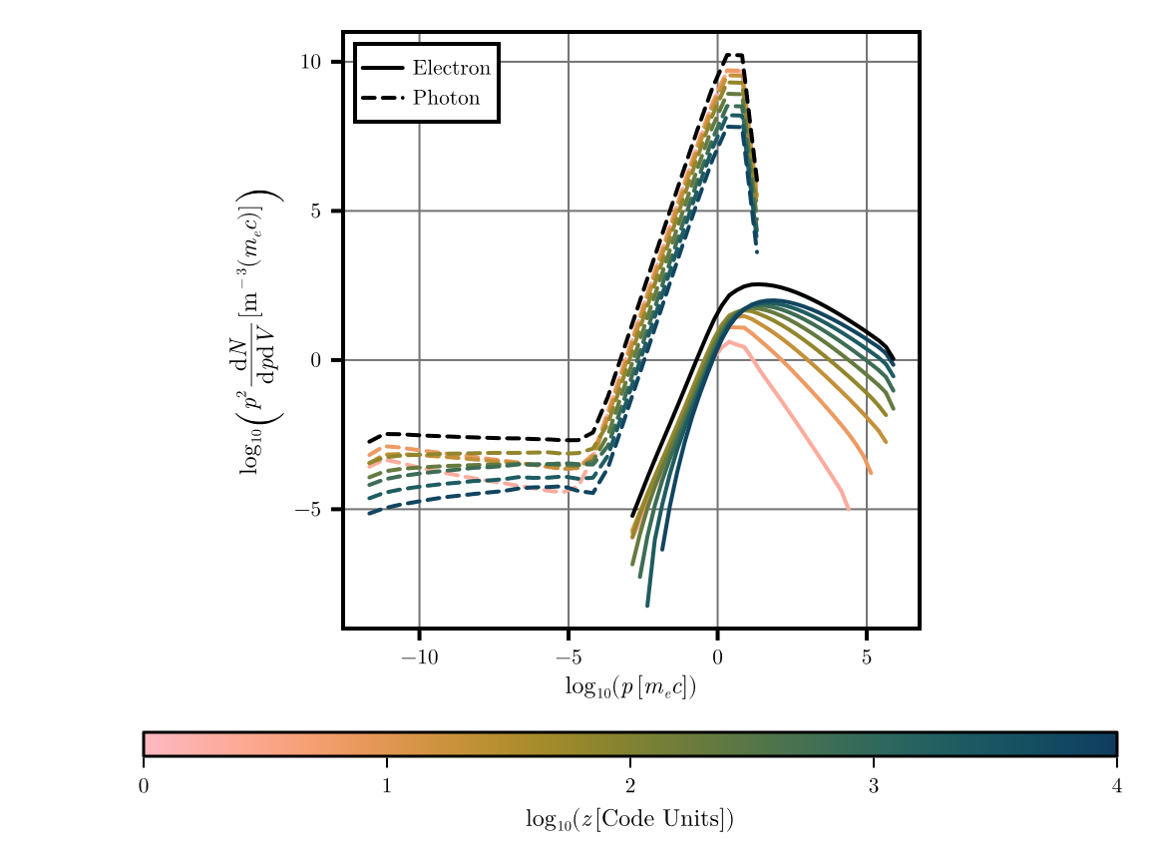
v0.2
Preliminary
Self-consistent generation of leptonic population
Flat photon spectrum close to “black hole”
2
2.5
3
Natural formation of a power-law lepton
distribution
Inverse-Compton sub-dominant: need to add background photon fields

Slide 20
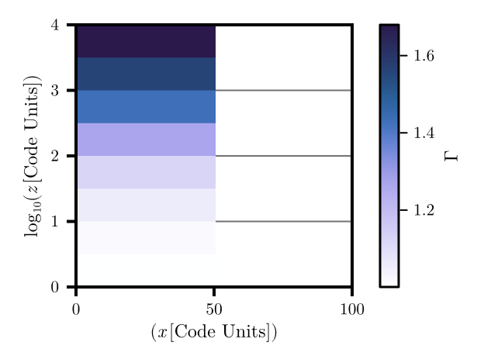
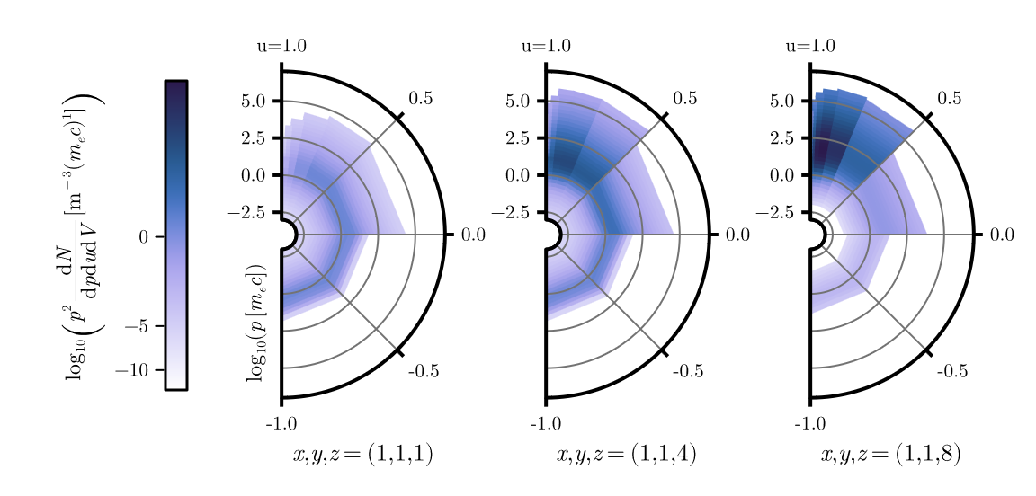




Local* bulk velocity increases down
“jet” due to $∇B$
This is not prescribed but arises naturally
*Local: direction with respect to B field
Preliminary
$$B$$
$$u=\cos{θ}$$
$$p$$

Slide 21
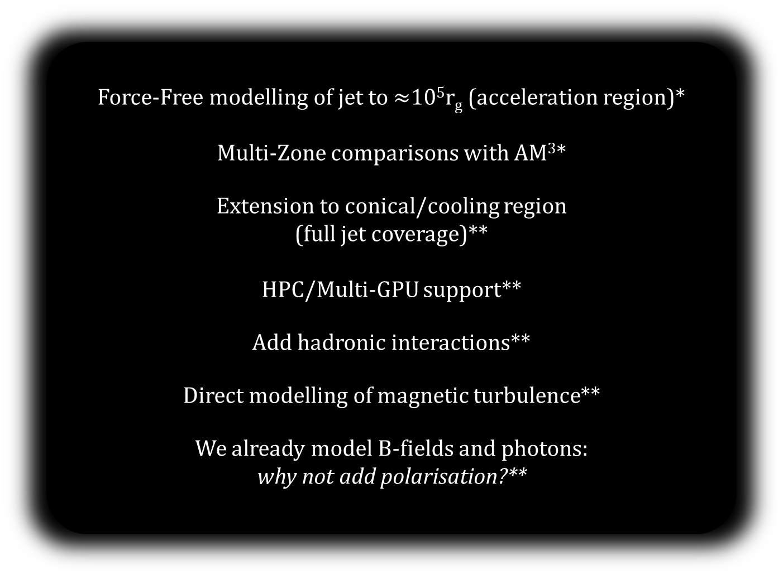
What’s next?
Force-Free modelling of jet to $≈$10⁵r_{g} (acceleration region)*
Multi-Zone comparisons with AM³*
Extension to conical/cooling region
(full jet coverage)**
HPC/Multi-GPU support**
Add hadronic interactions**
Direct modelling of magnetic turbulence**
We already model B-fields and photons:
why not add polarisation?**
*In Progress
**Funding dependent

Slide 22
If you want to use Diplodocus or collaborate on its development, please do get in contact
GitHub link:
v0.2 Release soonish
Paper III soonish
christopher.everett
@physics.ox.ac.uk
Thank you for listening
Notes:
Three papers are in prep. Covering the theory and code aspects of the framework, first of which should be on arxiv in the next few weeks.
The code is open source and once released, will be available on my GitHub along with extensive tutorials
Thank you for listening.

Slide 23
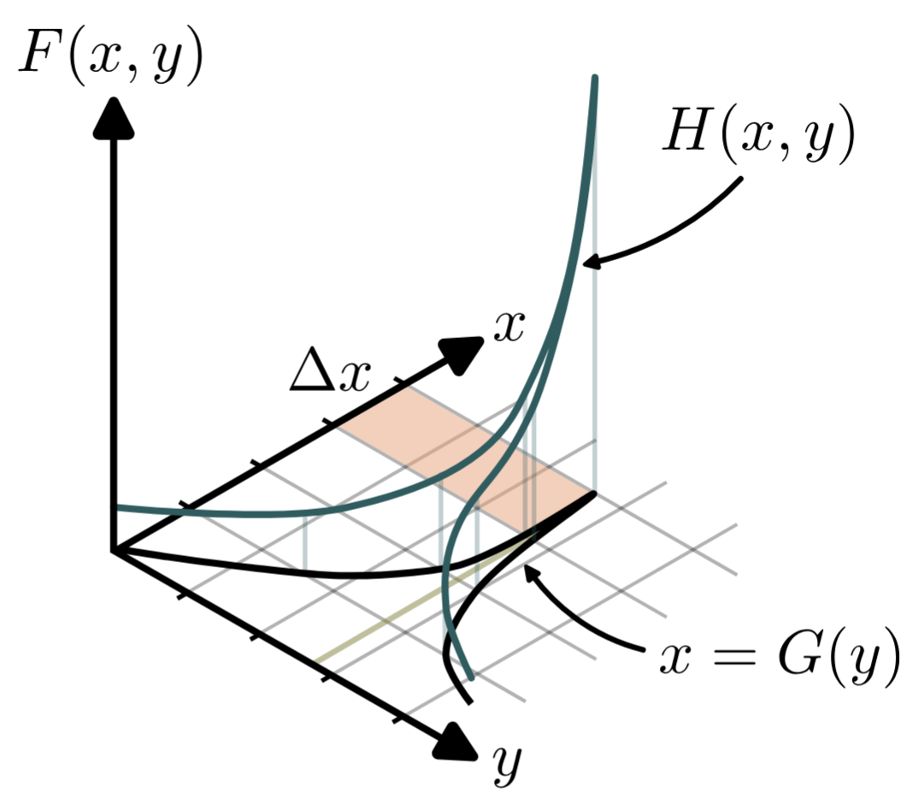
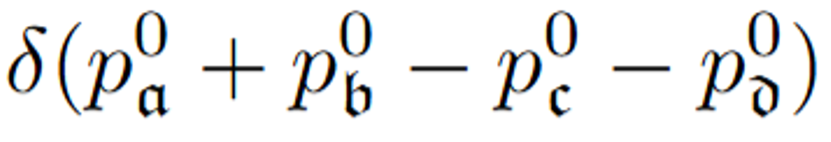
MC sampling of collision matrices is difficult

Slide 24
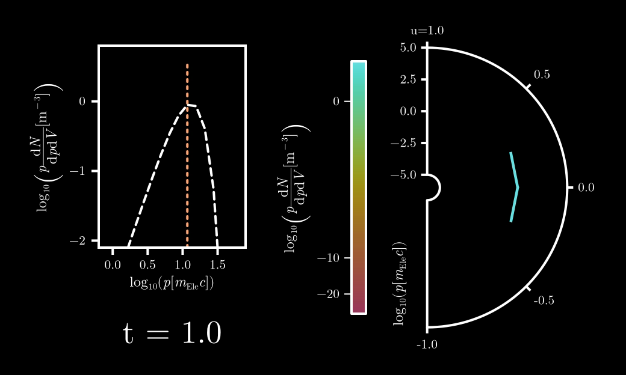
“Elastic Spheres”:
Initial non-thermal and anisotropic

Slide 25
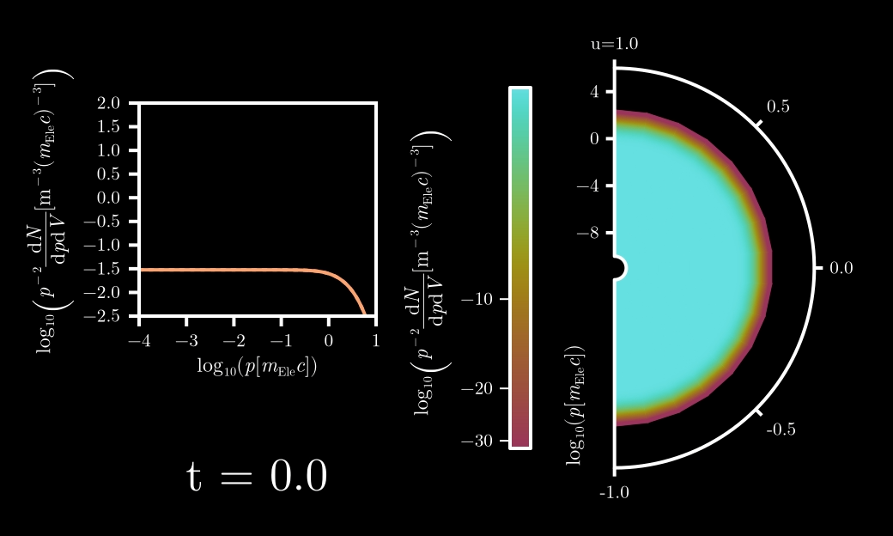


“Electron Cooling”:
Initial thermal and isotropic
$$τ_{Sync}≈const.$$
$$τ_{Sync}∝p^{−2}$$

Slide 26
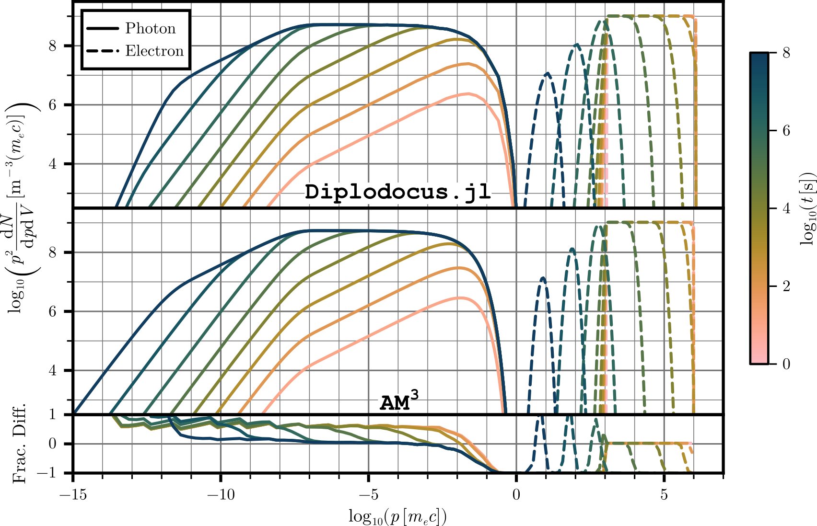
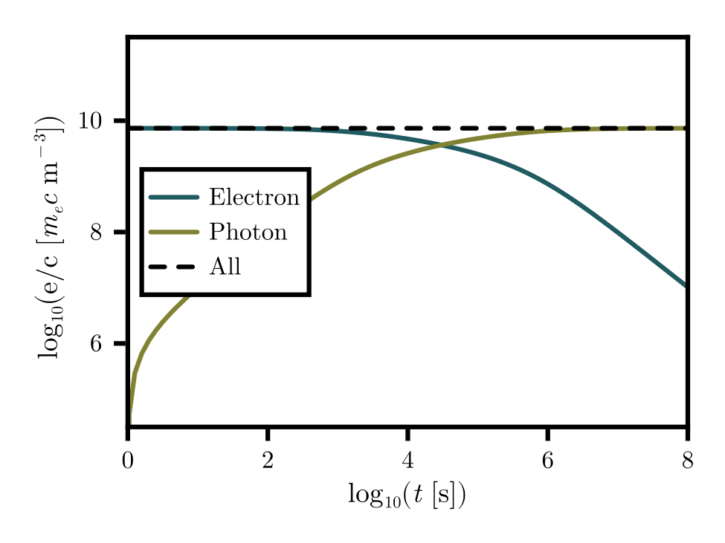
v0.1
Synchrotron:
Spherical Zone
Initial power-law of electrons

Slide 27
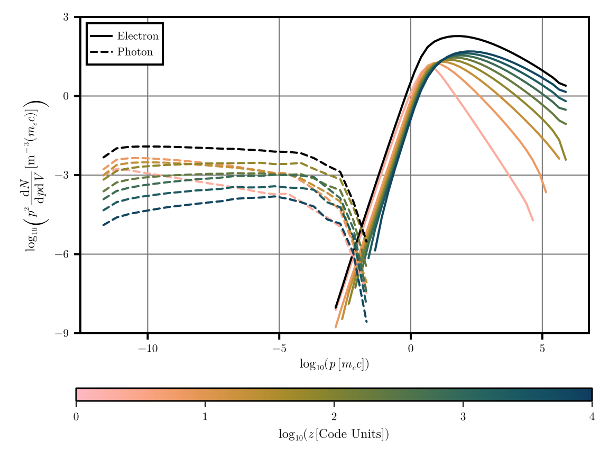
Run 1:
Sync. Only
v0.2
Natural formation of a power-law lepton
distribution
2
2.5
Flat frequency spectrum close to “black hole”
3

Slide 28
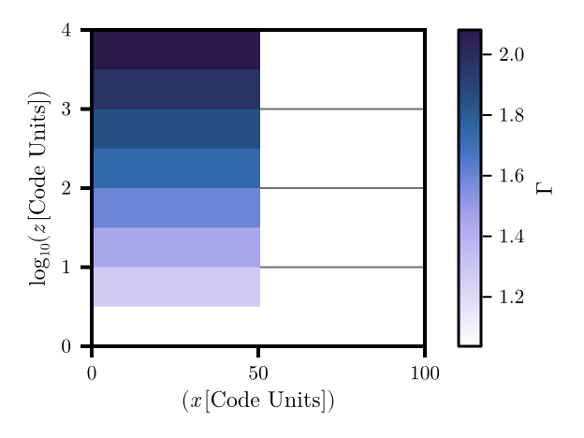
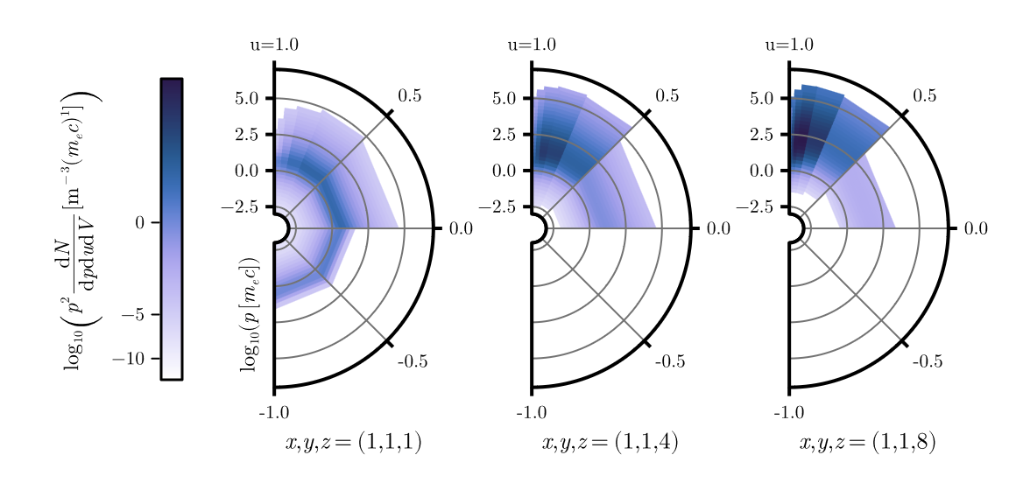
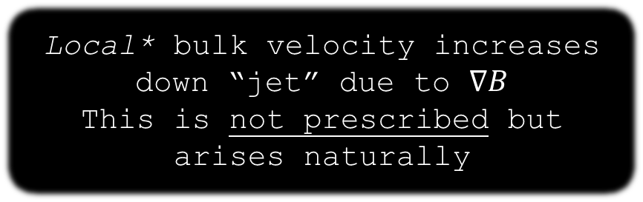
Local* bulk velocity increases down “jet” due to $∇B$
This is not prescribed but arises naturally
*Local: direction with respect to B field
$$B$$
$$u=\cos{θ}$$
$$p$$

Slide 29
Track 1:
Pictorial Representation
Track 2:
Maths (sorry)

Slide 30
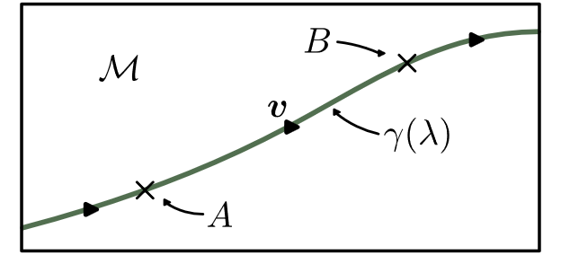
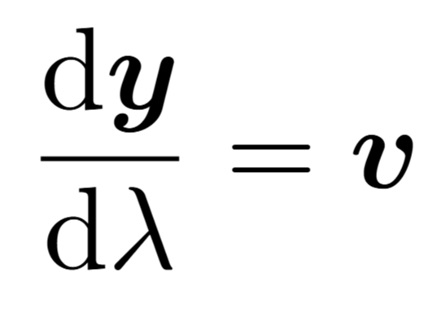
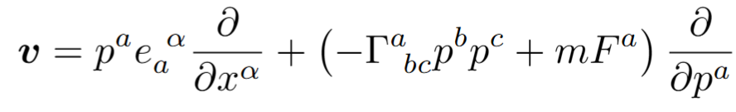

Slide 31
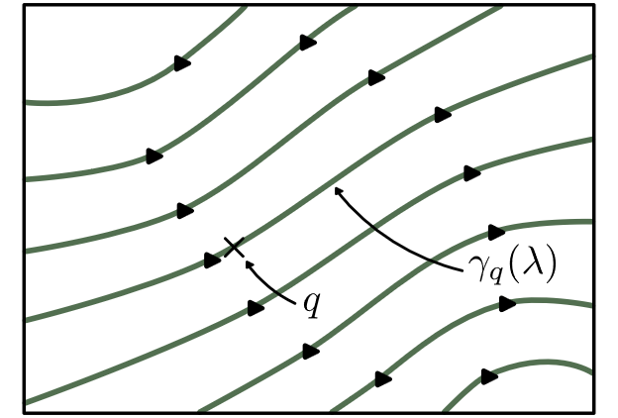
No Maths needed here

Slide 32
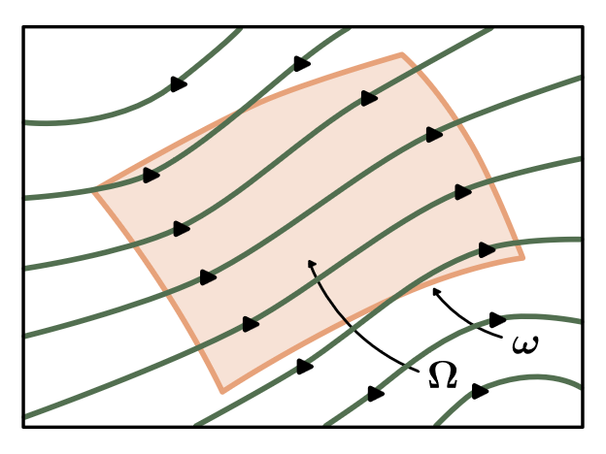
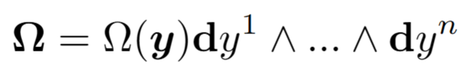
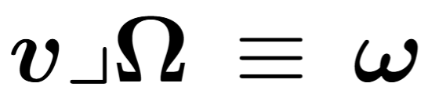

Slide 33
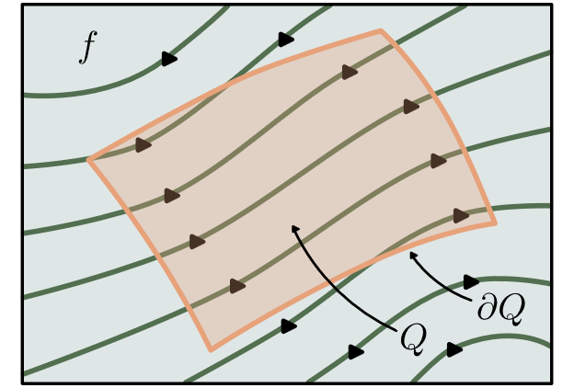


Slide 34


