Slide 1




Probing the Statistical Correlation of Optical Tidal Disruption Events with High Energy Neutrinos
Presenter: Dimitrios Alkinoos Langis
Supervisor: Dr. Ioannis Liodakis
Affiliations: Institute of Astrophysics FORTH, Physics Department University of Crete

Slide 2
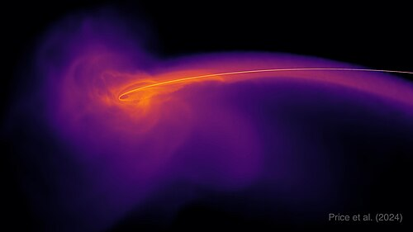
Introduction
Tidal disruption events (TDEs) → star disrupted by supermassive black hole
Price et al. 2024

Slide 3
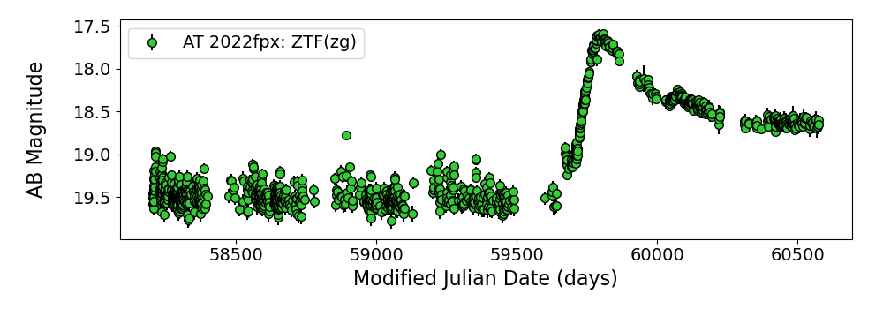
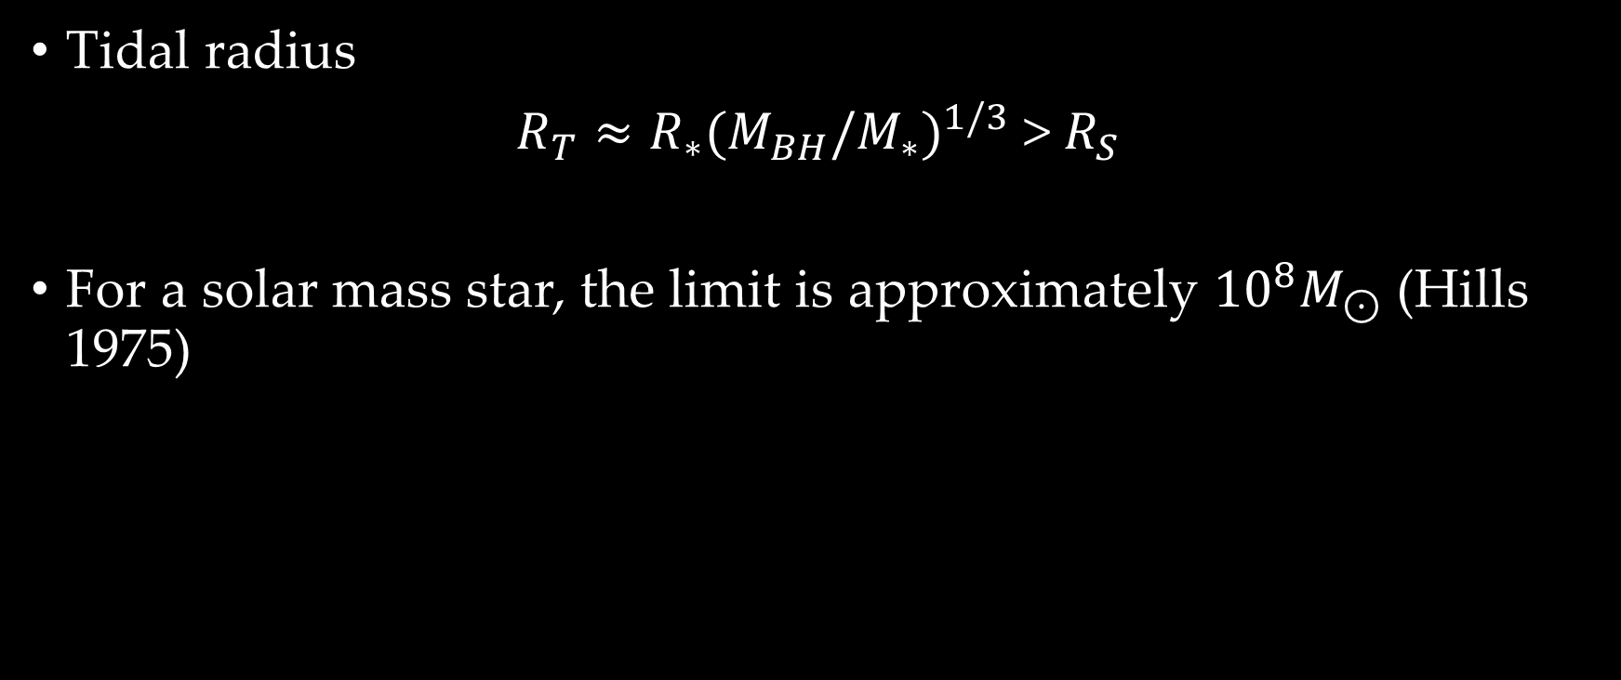
Introduction
Tidal radius
$R_{T}≈R_{∗}{(M_{BH}/M_{∗})}^{1/3}$ > $R_{S}$
For a solar mass star, the limit is approximately ${10}^{8}M_{⊙}$ (Hills 1975)

Slide 4
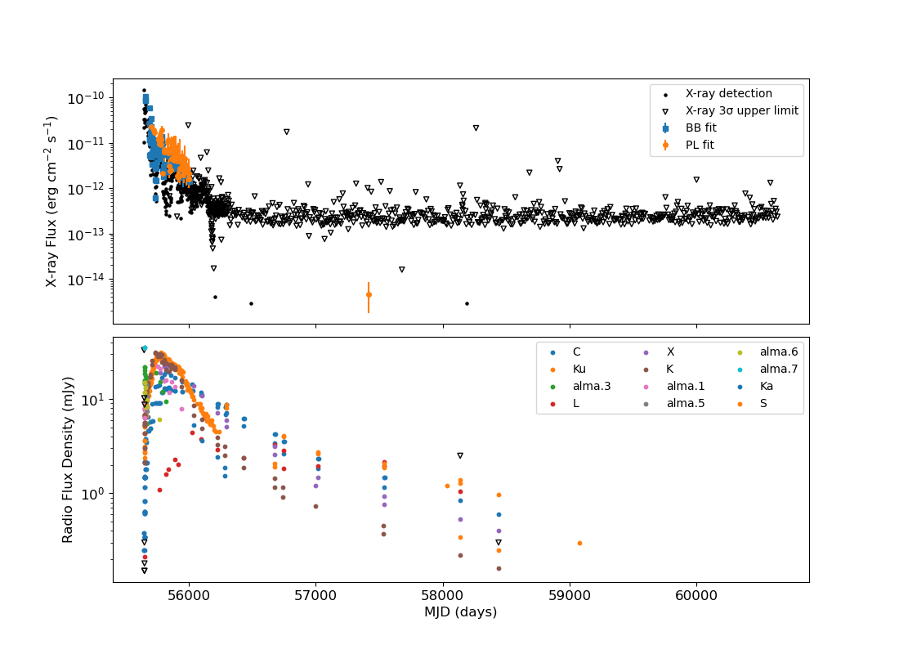
Introduction: Jetted TDEs
Swift J1644+57
Initial discovery →
Swift J1644+57 (e.g.
Bloom et al. 2011)
There are 4 proposed
jetted TDEs from the
literature

Slide 5
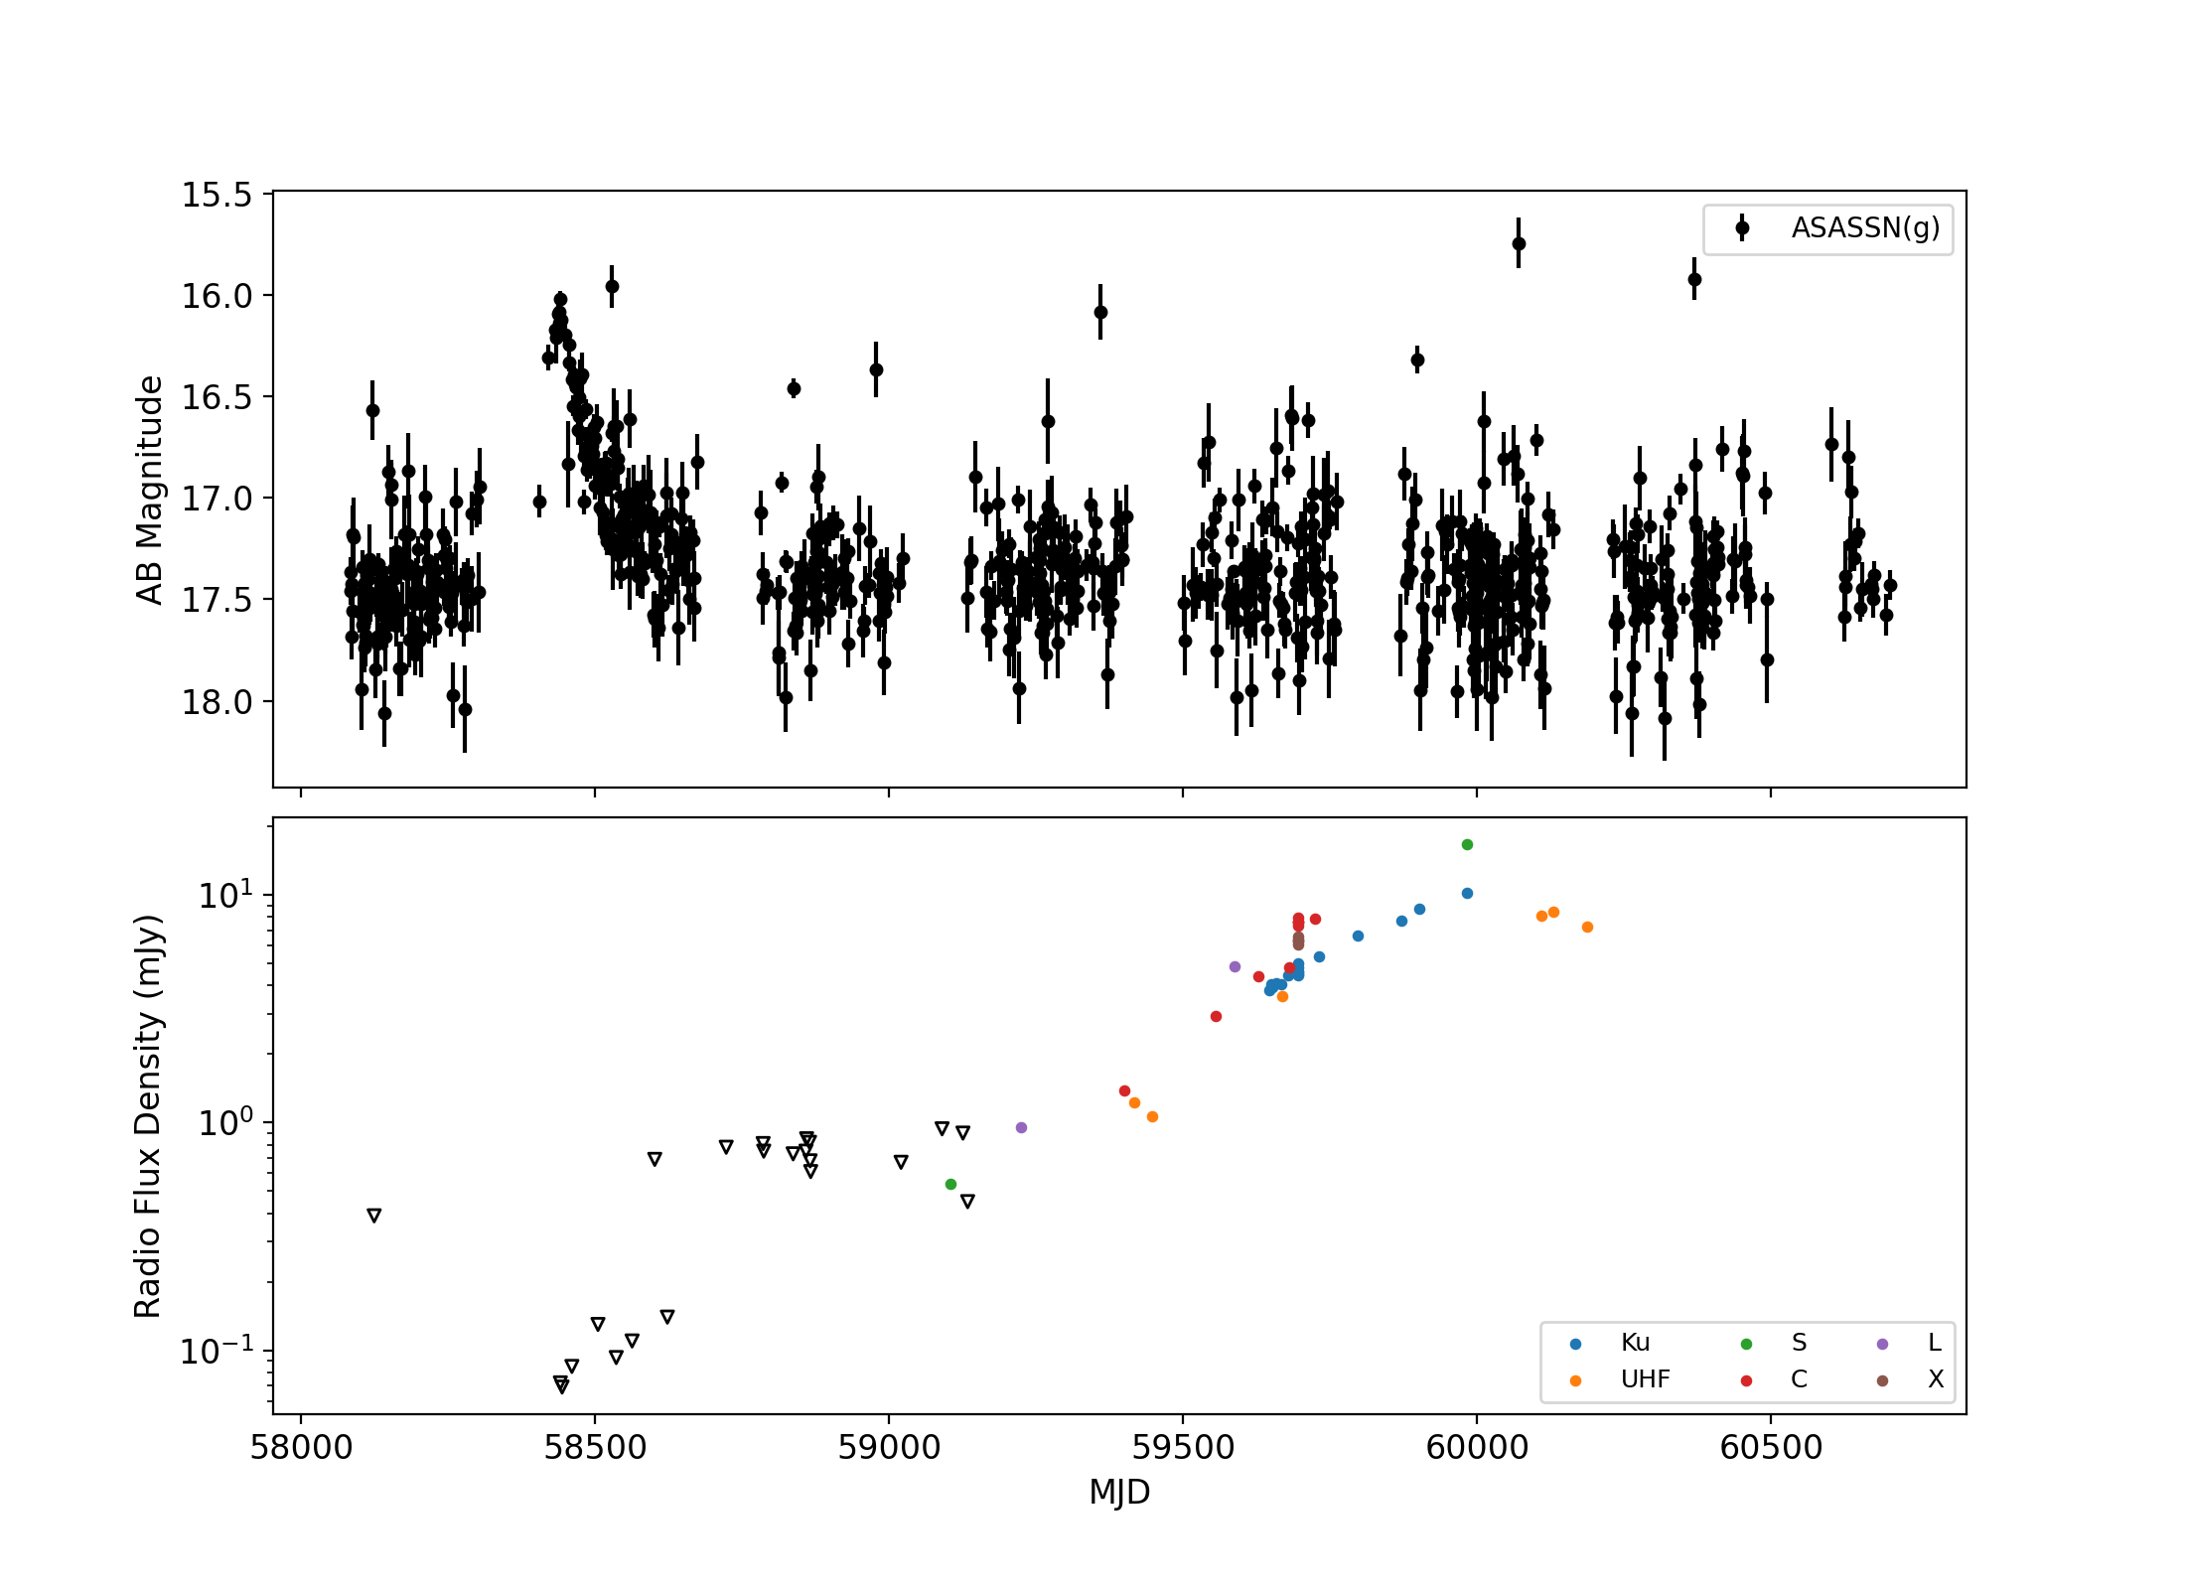
Introduction: Delayed Radio Emission
Jets or outflows?
Mechanism → mystery
For now ~15 TDEs have
been observed to have
delayed radio emission
AT2018hyz

Slide 6
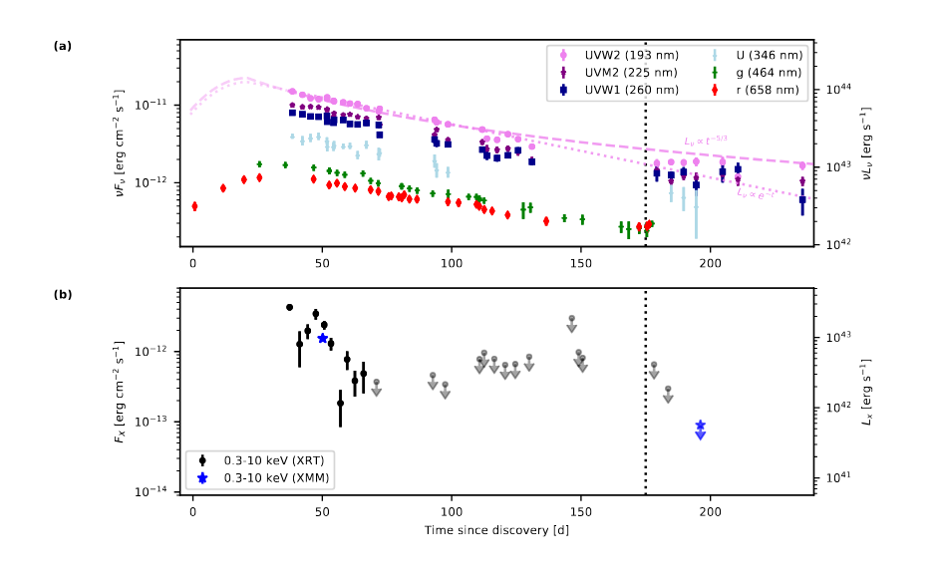
Introduction: TDEs and Neutrinos?
First TDE coincident with high-energy neutrino (Stein et al. 2021)
Stein et al. 2021

Slide 7
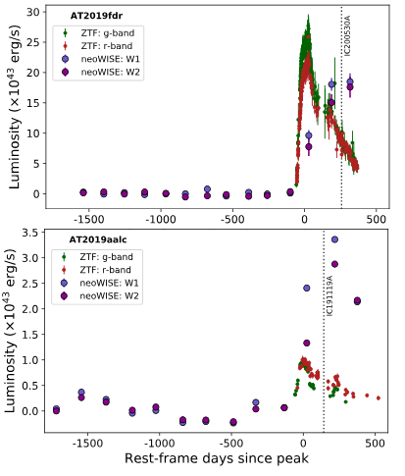
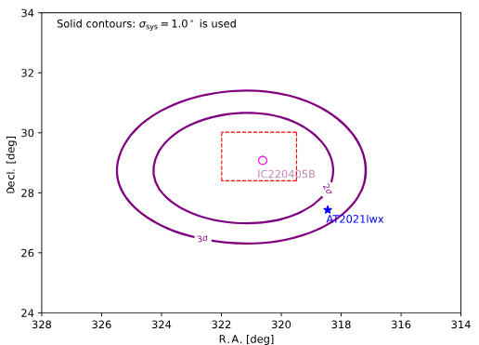
Later associations
van Velzen et al. 2024
AT2019fdr - IC200530A (Reusch et al. 2022)
AT2019aalc - IC191119A (van Velzen et al. 2024)
AT2021lwx - IC220405B (Yuan et al. 2024)
Yuan et al. 2024
Stein et al. 2021

Slide 8
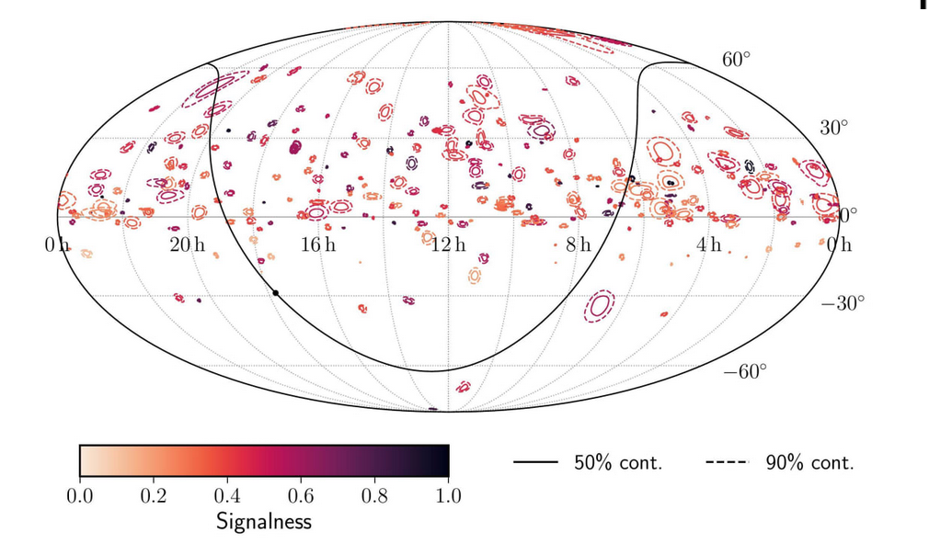
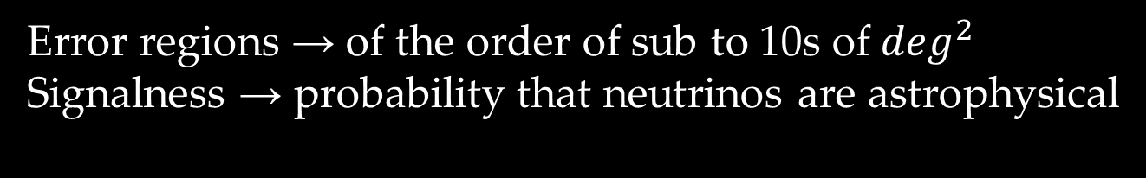
Neutrino observations
Error regions → of the order of sub to 10s of $\deg^{2}$
Signalness → probability that neutrinos are astrophysical
The IceCube collaboration

Slide 9
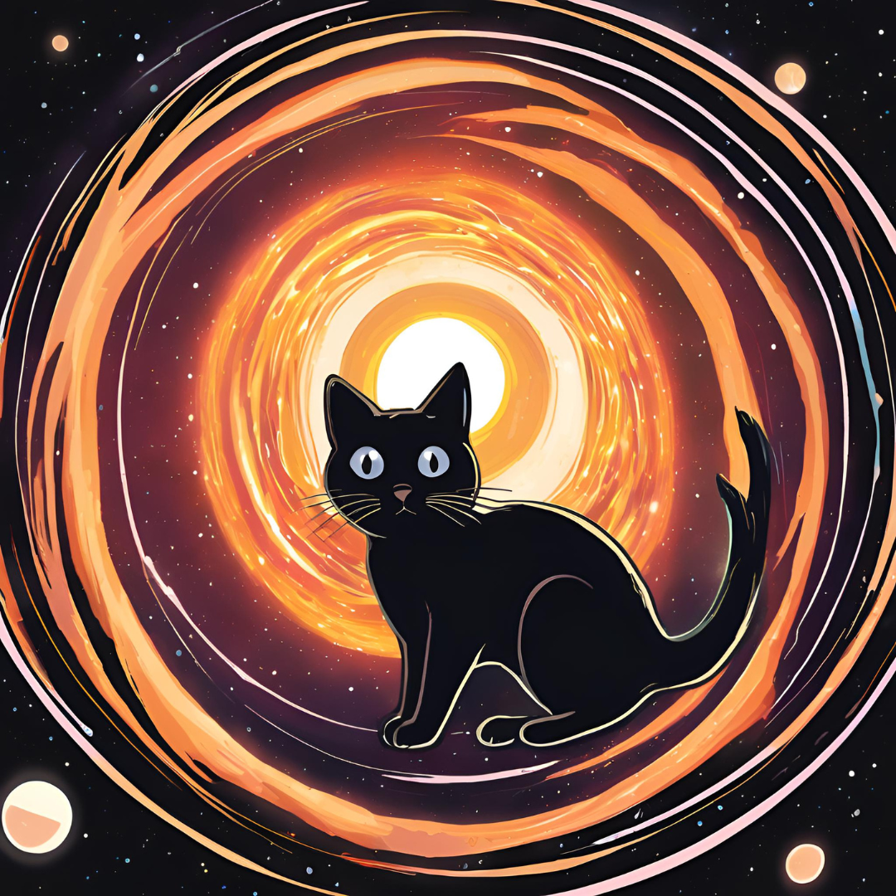
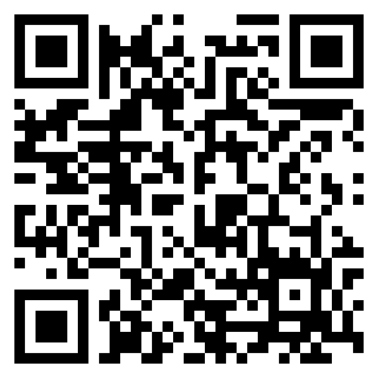

TDE Catalogue: TDECat
Confirmed TDEs → photometry + spectra from the time of the flare
Main sample: 134 TDEs, 131 confirmed optical TDEs and 3 jetted TDEs
Collected multi-wavelength (X-ray, UV, optical, IR) photometry and optical spectroscopy → TDECat GitHub repository

Slide 10


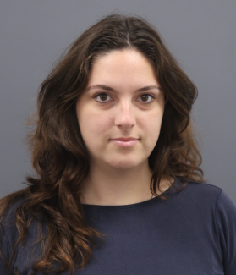

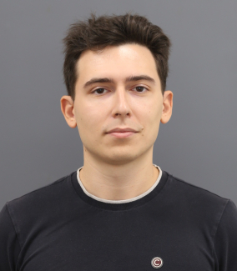
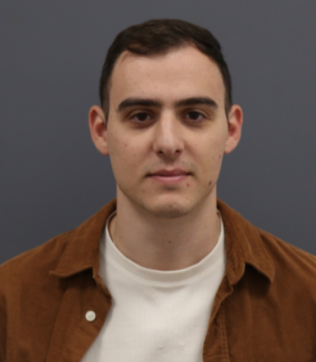
TDECat+
Cross correlation with high-energy neutrino events
Black hole mass estimation
Host galaxy morphology
Search for γ-ray emission

Slide 11
Samples
TDEs
TDECat → 108 flares between 55056 and 60232 MJD
Neutrinos
356 neutrino events → IceCat-1 neutrino track events (275 in total; Abbasi et al. 2023) + 73 neutrinos from updated IceCat-1 + 16 from Abbasi et al. 2022

Slide 12
Spatio-temporal method
Spatial association → cross-correlating TDE coordinates with neutrino sky error regions (typically a few deg²)
Temporal association → Activity index (AI) test statistic (TS), either 1 or 0, depending if neutrino arrives within the TDE flare duration
Weighting scheme → Raw and Weighted

Slide 13
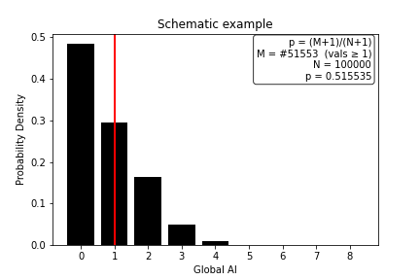
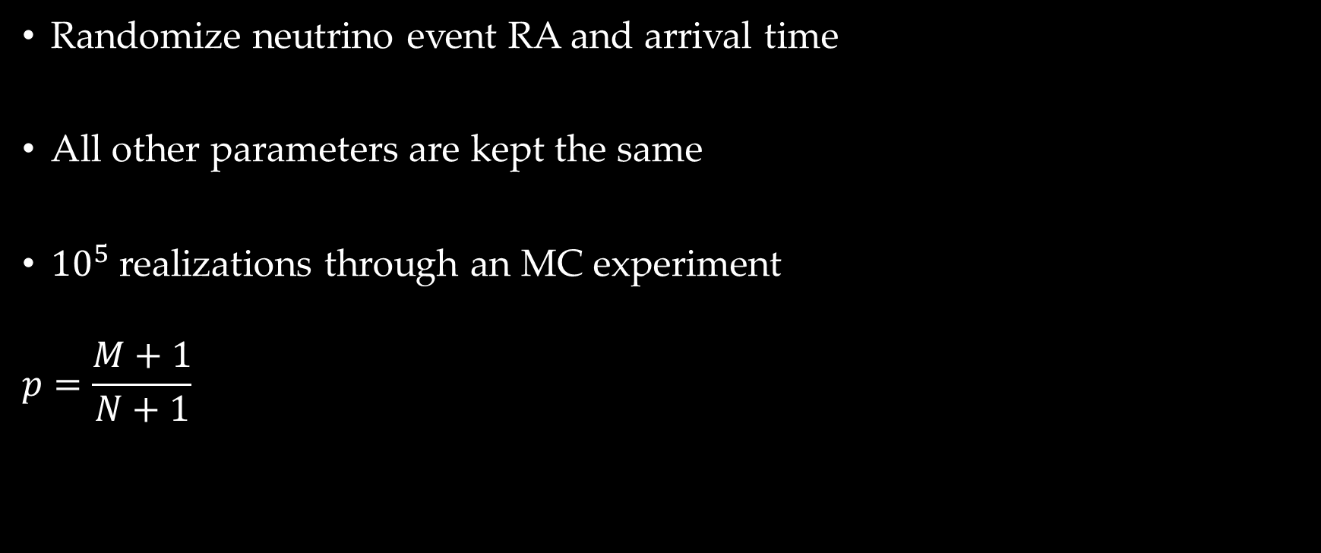
Null hypothesis TS distribution
Randomize neutrino event RA and arrival time
All other parameters are kept the same
${10}^{5}$ realizations through an MC experiment
$$p=\frac{M+1}{N+1}$$

Slide 14
In this work
Simulations
  Correlated
  Random
  Combined
Observations
  Sample
  Individual

Slide 15
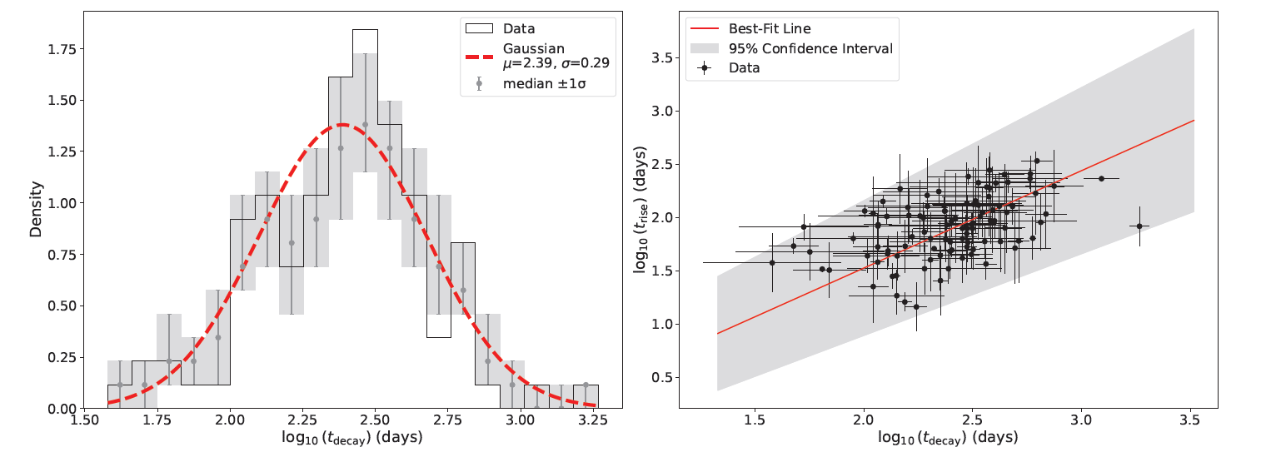
Simulations: Setup
Datasets → real neutrino data and mock TDE data
Timescales → Generated from Langis et al. 2025 (in press)
Correlated → forced spatiotemporal associations of neutrinos with TDEs
Random → random TDE mock TDE data

Slide 16
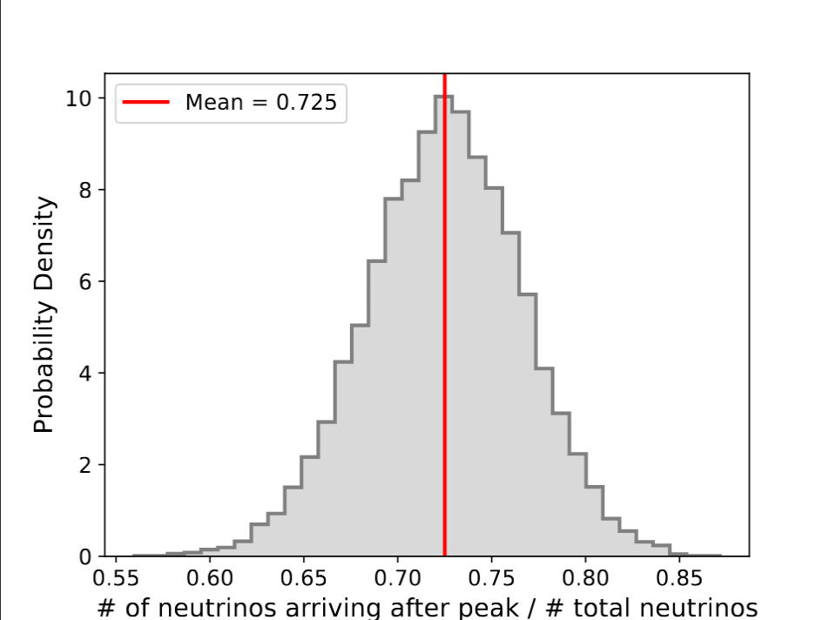
Correlated simulations: Results
Which ones are astrophysical ?
Signalness → draw x randomly from [0,1) and compare with the real signalness of the neutrino events, S
If S > x then the event is astrophysical

Slide 17
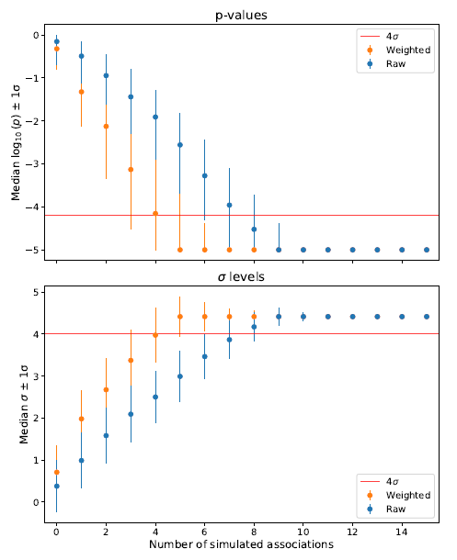
Required associations
Start from 108 associations and remove 1 association each time until the samples are random
Raw : 9 simulated associations for 4σ
Weighted : 6 simulated associations for 4σ

Slide 18
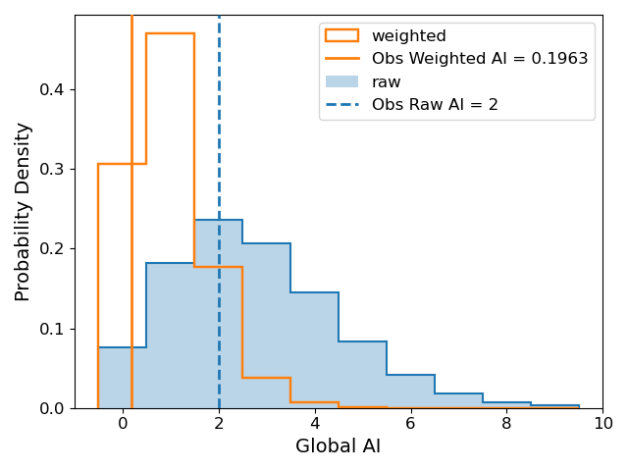
Observed: Statistical association?
Raw: global AI TS = 2 → p=0.51
Weighted: global AI TS = 0.196 → p=0.85

Slide 19
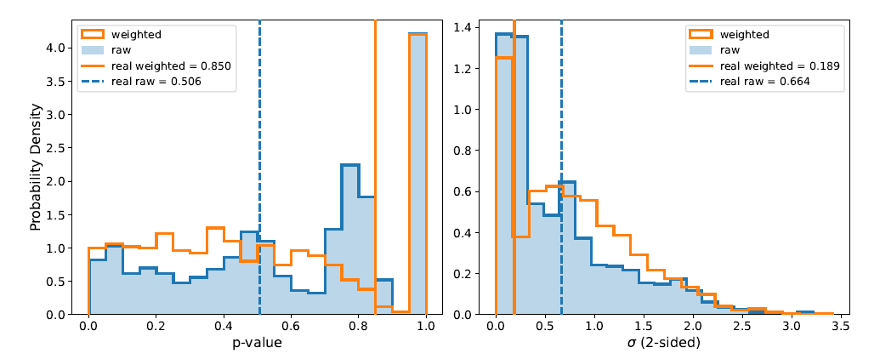
Random simulations: Results
1000 simulated random data sets → p-value for each one

Slide 20
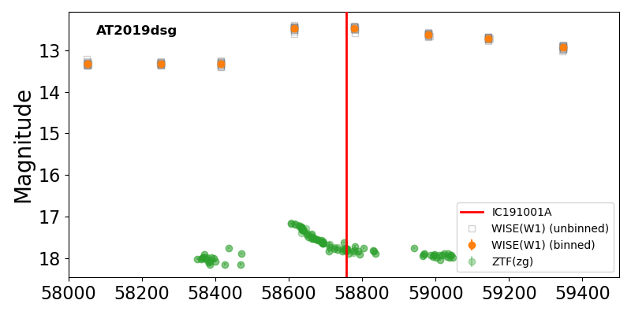
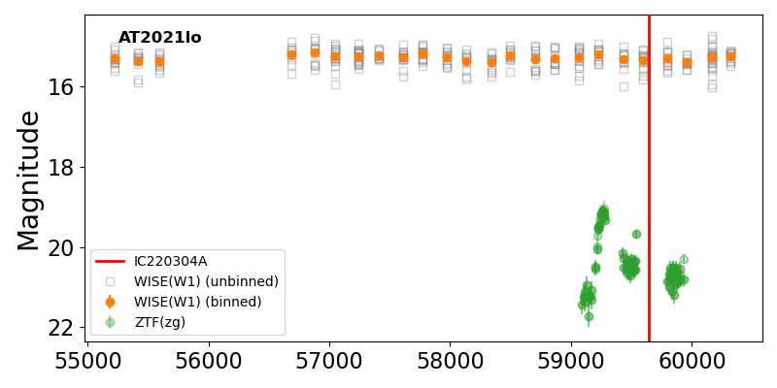
AT2019dsg/IC191001A
AT2021lo/IC220304A
“Neutrino 1”
“Neutrino 2”

Slide 21
AT2019dsg/IC191001A
AT2021lo/IC220304A
“Neutrino 1”
“Neutrino 2”
“Neutrino 2”
pp or pγ
Neutrinos and γ-rays

Slide 22
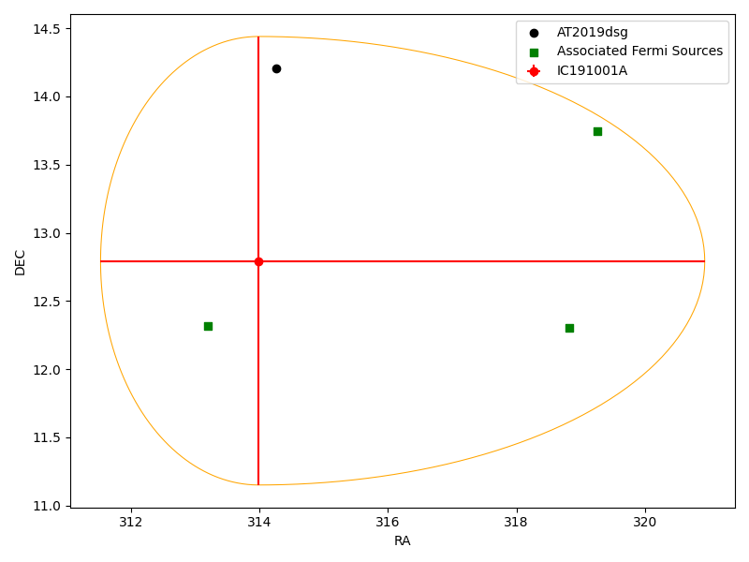
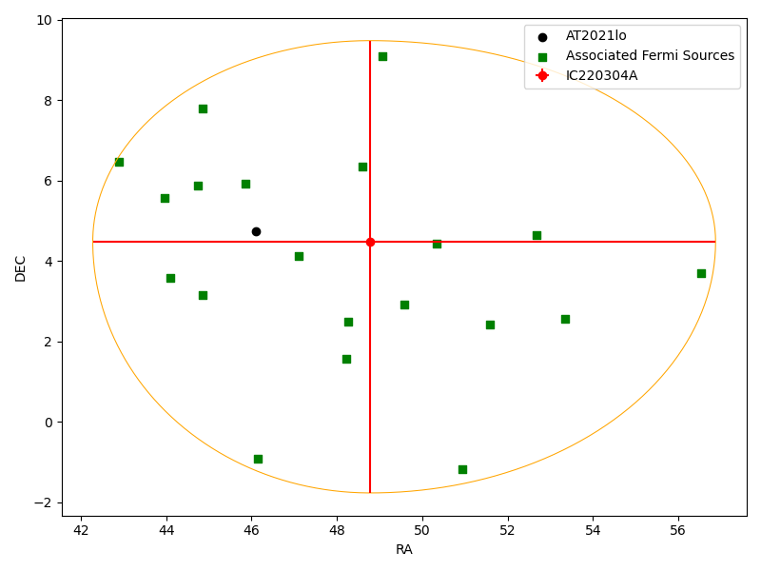
AT2019dsg/IC191001A
AT2021lo/IC220304A
“Neutrino 1”
“Neutrino 2”
3 gamma-ray sources inside the neutrino error region
20 gamma-ray sources inside the neutrino error region

Slide 23
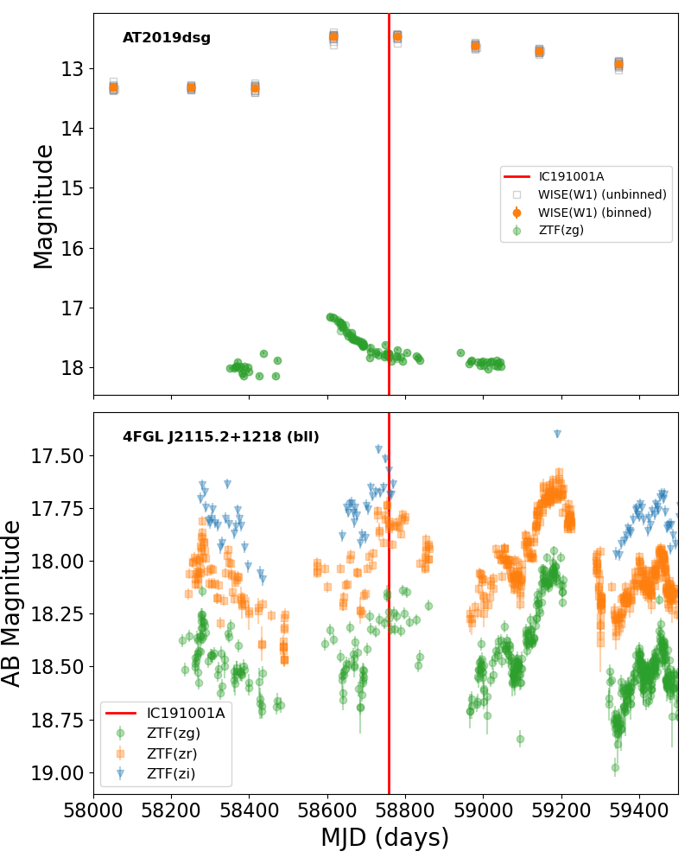
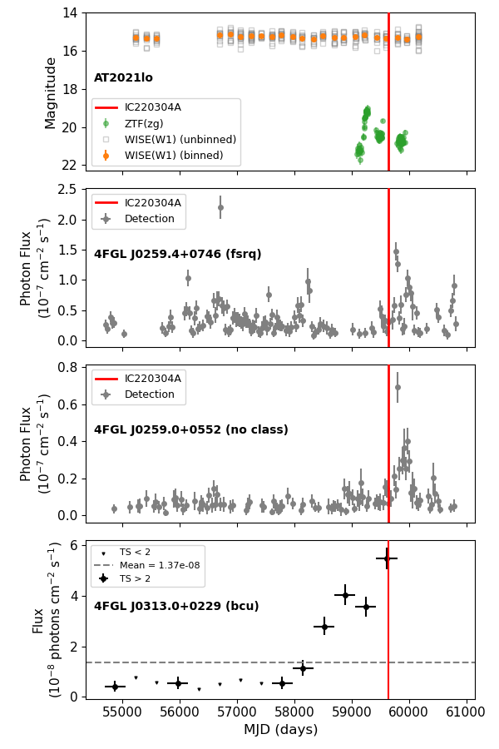
AT2019dsg/IC191001A
AT2021lo/IC220304A

Slide 24
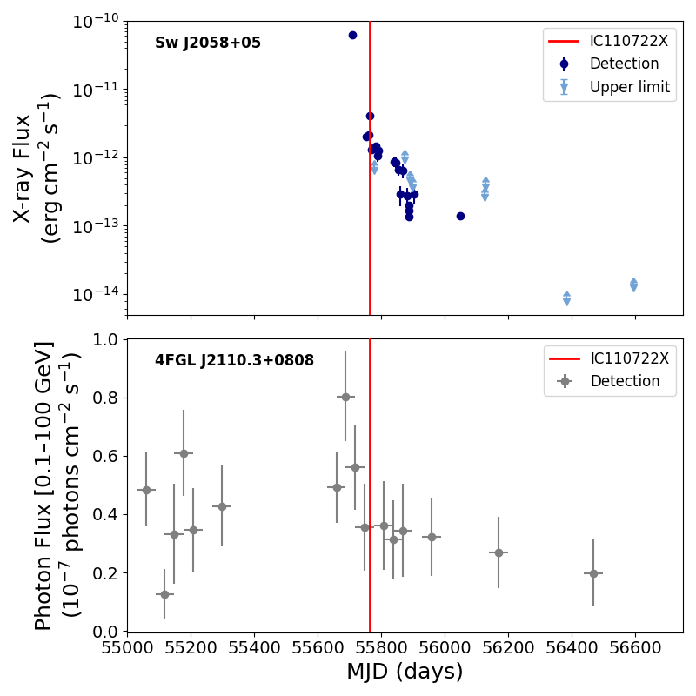
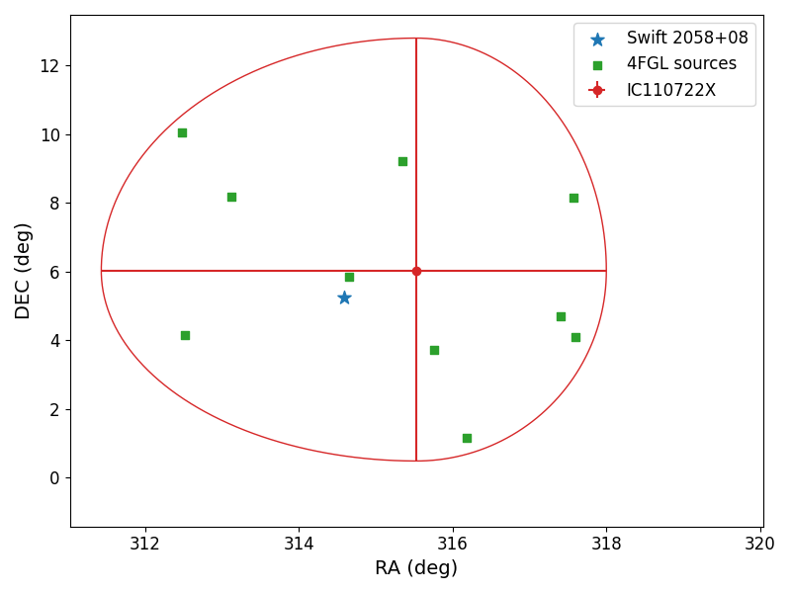
Jetted TDEs
Spatio-temporal association →
Swift J2058+05/IC110722X

Slide 25
Summary
No statistical correlation between neutrinos and TDEs so far
Required associations for 4σ → 9 or 6
Individual cases → spatiotemporally associated with neutrino events (AT2019dsg, AT2021lo, Swift J2058)
Future is bright: LSST + KM3NeT

Slide 26
Thank you for your attention!
D.A.L. was funded by the European Union ERC-2022-STG – BOOTES - 101076343

Slide 27
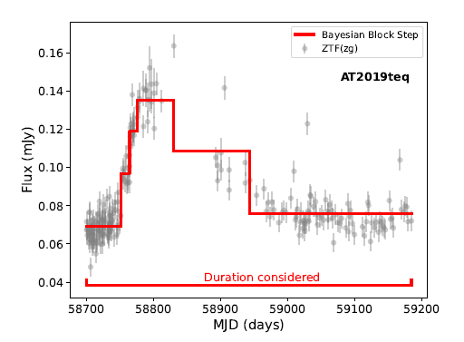
Backup: Duration of TDEs

Slide 28
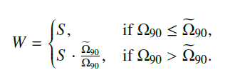

Backup: Weighted scheme
$$\tilde{Ω}=6.73 \deg^{2}$$

